Slide 1
Risk Management Analysis of the Royal Bank of Canada
by Sandy Chen, Alex Mak and Kyle Woo

Slide 2
Agenda
Economic and market analysis
Overview of RBC
Risk management environment
Risk management structure of RBC
Analysis of financial statements
Major risks of RBC
Hedging and derivative activities

Slide 3
Economic and Market Analysis
ROYAL BANK OF CANADA

Slide 4
Market Overview
Canadian banking industry includes
  22 domestic banks
  26 foreign bank subsidiaries
  22 full-service foreign bank branches
  7 foreign bank lending branches

Slide 5
Schedule Banks
Schedule I banks
  Domestically owned institutions authorized to take deposits
Schedule II banks
  Foreign owned institutions authorized to take deposits
Schedule III banks
  Foreign bank branches that may undertake banking business in Canada subject to restrictions
Notes:
RBC is schedule I bank

Slide 6
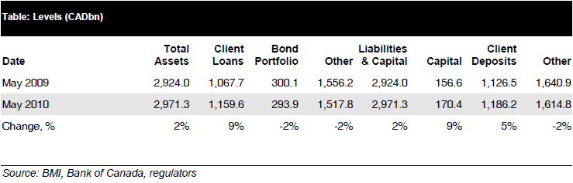
Industry Data

Slide 7
Overview
ROYAL BANK OF CANADA

Slide 8
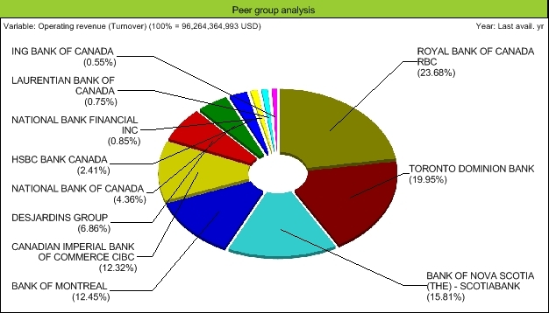
Market Share

Slide 9
Products
Canadian Banking
  Personal Financial Services
  Business Financial Services
  Cards and Payment Solutions
Wealth Management
  Canadian Wealth Management
  U.S. & International Wealth Management
  Global Asset Management

Slide 10
Products
Insurance
  Canadian Insurance
  U.S. Insurance
  International & Other Insurance
International Banking
  Banking
  RBC Dexia Investor Services (RBC Dexia IS)

Slide 11
Products
Capital Markets
  Capital Markets Sales and Trading
  Corporate and Investment Banking

Slide 12
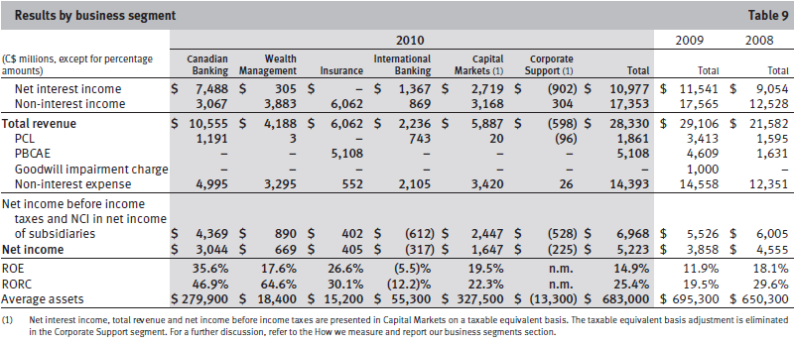
Results by Business Segment

Slide 13
Revenue and Cost

Slide 14
Vision and Goals
Vision
  Always earning the right to be clients’ first choice
Strategic goals
  In Canada, to be the undisputed leader in financial services
  Globally, to be a leading provider of capital markets and wealth management solutions
  In targeted markets, to be a leading provider of select financial services complementary to core strengths

Slide 15
Financial Objectives
Goals
  Diluted EPS growth of 7%+
  ROE of 16% – 20%
  Strong capital ratios
Outcome
  Dividend payout ratio targeted at 40% – 50%.

Slide 16
regulation
Basel Committee

Slide 17
BIS
The Bank for International Settlements (BIS)
A forum to promote discussion and policy analysis among central banks and within the international financial community
A centre for economic and monetary research
A prime counterparty for central banks in their financial transactions
Agent or trustee in connection with international financial operations
Notes:
is an international organisation which fosters international monetary and financial cooperation and serves as a bank for central banks.

Slide 18
Basel Committee
The Committee's members come from Argentina, Australia, Belgium, Brazil, Canada, China, France, Germany, Hong Kong SAR, India, Indonesia, Italy, Japan, Korea, Luxembourg, Mexico, the Netherlands, Russia, Saudi Arabia, Singapore, South Africa, Spain, Sweden, Switzerland, Turkey, the United Kingdom and the United States.
The present Chairman of the Committee is Mr Nout Wellink, President of the Netherlands Bank.

Slide 19
About the Basel Committee on Banking
The Basel Committee on Banking Supervision provides a forum for regular cooperation on banking supervisory matters.
“Objective is to enhance understanding of key supervisory issues and improve the quality of banking supervision on a international scale." based on regular cooperation among its participating members

Slide 20
Basel: Known standards
International standards on capital adequacy
Core Principles for Effective Banking Supervision
The Concordat on cross-border banking supervision

Slide 21
Basel: Main Expert Sub-Committees
The Committee's work is organized under four main sub-committees:
1. The Standards Implementation Group (SIG)
2. The Policy Development Group (PDG)
3. The Accounting Task Force (ATF)
4. The Basel Consultative Group (BCG)

Slide 22
Sub-committee(1): SIG
Established to share information and promote consistency in implementation of the Basel II Framework.
In January 2009, broadened to concentrate on implementation of Basel Committee guidance and standards
SIG has two subgroups that share information and discuss specific issues related to Basel II implementation.
Notes:
-It is chaired by Mr Jos¨¦ Mar¨ªa Rold¨¢n, Director General of Banking Regulation at the Bank of Spain.

Slide 23
SIG: 2 subgroups
I) The Validation Subgroup
Explores issues related to the validation of systems used to generate rating and parameters for internal rating-based approaches to credit risk
II) The Operational Risk Subgroup
Addresses issues related primarily to banks' implementation of advanced measurement approaches for operational risk
Notes:
1. used to generate the ratings and parameters that serve as inputs into the internal ratings-based approaches to credit risk.
The group is chaired by Mr Alvir Alberto Hoffmann, Deputy Governor at the Central Bank of Brazil.
2. Mr Mitsutoshi Adachi, Deputy Head at the Bank of Japan, chairs the group.

Slide 24
Sub-committee (2): PDG
Review and identify potential supervisory issues
Propose and develop policies that supports a sound banking system and high supervisory standards
Notes:
-the Policy Development Group (PDG) is to support the Committee by identifying and reviewing emerging supervisory issues and proposing and developing policies that promote a sound banking system and high supervisory standards.
-The group is chaired by Mr Stefan Walter, Secretary General of the Basel Committee.

Slide 25
7 working groups reporting to PDG
Contacts and assess banks current and new risk management practices and measures
Exchange information and engage in research projects on supervisory and financial stability issue with academic and institution economist
Addresses exposures arising from trading activities and appropriate capital treatment of event risk in the trading book.
Risk Management and Modeling Group
Research Task Force
Trading Book Group
Working Group on Liquidity
Definition of Capital Subgroup
the Cross-border Bank Resolution Group
Basel II Capital Monitoring Group
Sept, 2008: Issued Principles for Sound Liquidity Risk Management and Supervision.
-Forum for info exchange on national approaches to liquidity risk regulation &supervision
Explores trends in eligible capital instruments by reviewing issues related to the quality, consistency and transparency of capital with focus on Tier 1 capital
Compare national policies, legal frameworks and the allocation of responsibilities for resolution of banks with significant cross-border operations.
Monitor and report capital requirements to ensure that banks maintain a solid capital base throughout the economic cycle.
Notes:
-TBG: issues relating texposuio the application of Basel II to certain exposures arising from trading activities
the Working Group on Liquidity:
-Serves as a forum for information exchange on national approaches to liquidity risk regulation and supervision.
Principles for Sound Liquidity Risk Management and Supervision, the global standards for liquidity risk management and supervision. The Working Group is also examining the scope for additional steps to promote more robust and internationally consistent liquidity approaches for cross-border banks.
-Def of capital sub-group: Explores emerging trends in eligible capital instruments in member jurisdictions by reviewing issues related to the quality, consistency and transparency of capital with a particular focus on Tier 1 capital.
*a Basel II Capital Monitoring Group,
-In the course of implementation of Basel II, national supervisors are monitoring capital requirements to ensure that banks in their jurisdiction maintain a solid capital base throughout the economic cycle.
-The Basel Committee has established a Basel II Capital Monitoring Group that will from time to time share national experiences in monitoring capital requirements.
*the Cross-border Bank Resolution Group.
-compare the national policies, legal frameworks and the allocation of responsibilities for the resolution of banks with significant cross-border operations.

Slide 26
Sub-committee (3): ATF
Ensure that international accounting and auditing standards and practices promote sound risk management at financial institutions, support market discipline through transparency, and reinforce the safety and soundness of the banking system.
Developed reporting guidance and takes active role in the development of international accounting and auditing standards.

Slide 27
3 working groups report to the ATF:
Conceptual Framework Issues Subgroup
Monitors and responds to the conceptual accounting framework project of the International Accounting Standards Board (IASB) and the Financial Accounting Standards Board in the United States.
Financial Instruments Practices Subgroup
Assesses implementation of international accounting standards related to financial instruments, and the links between accounting practices in this area and prudential supervision.
Audit Subgroup
Promotes reliable financial information by exploring key audit issues from a banking supervision perspective.
Responds to international audit standards-setting proposals, other issuances of the International Auditing and Assurance Standards Board and the International Ethics Standards Board for Accountants, and audit quality issues.

Slide 28
Sub-committee (4): BCG
Provides a forum for deepening the Committee's engagement with supervisors around the world on banking supervisory issues.
Communicate supervisory matter with non-member countries on new Committee initiatives
Coordinate with other standard setters includes:
  the Joint Forum and the Coordination Group.
  The Joint Forum was established in 1996 to address issues common to the banking, securities and insurance sectors, including the regulation of financial conglomerates.
  The Coordination Group is a senior group of supervisory standard setters comprising the Chairmen and Secretaries General of the Committee, the International Organization of Securities Commissions (IOSCO) and the International Association of Insurance Supervisors (IAIS), as well as the Joint Forum Chairman and Secretariat.
  The Coordination Group meets twice annually to exchange views on the priorities and key issues of interest to supervisory standard setters. The position of chairman and the secretariat function for the Coordination Group rotate among the memb-er representatives of the three standard setters every two years.
Notes:
Facilitates broad supervisory dialogue with non-member countries on new Committee initiatives early in the process by gathering senior representatives from various countries, international institutions and regional groups of banking supervisors that are not members of the Committee.
-The BCG is chaired by Mr Karl Cordewener, Deputy Secretary General of the Basel Committee.
Formal channels for coordinating with supervisors of non-bank financial institutions include the Joint Forum, for which the Basel Committee Secretariat provides the secretariat function, and the Coordination Group. The Joint Forum was established in 1996 to address issues common to the banking, securities and insurance sectors, including the regulation of financial conglomerates. The Coordination Group is a senior group of supervisory standard setters comprising the Chairmen and Secretaries General of the Committee, the International Organization of Securities Commissions (IOSCO) and the International Association of Insurance Supervisors (IAIS), as well as the Joint Forum Chairman and Secretariat. The Coordination Group meets twice annually to exchange views on the priorities and key issues of interest to supervisory standard setters. The position of chairman and the secretariat function for the Coordination Group rotate among the memb-er representatives of the three standard setters every two years.

Slide 29
BASEL II
Replace BASEL I (1988)
the concept and rationale of the three pillars (minimum capital requirements, supervisory review, and market discipline) approach

Slide 30
THE FIRST PILLAR: Minimum Capital Requirements
Credit Risk
  Standardised Approach
    Weighted Risk
    External credit assessment institution (ECAI)
  Internal Ratings-based Approach

Slide 31
THE FIRST PILLAR: Minimum Capital Requirements (Con’t)
Operational Risk
  Operational risk is defined as the risk of loss resulting from inadequate or failed internal processes, people and systems or from external events. (Basel II, paragraph 644.)
  Three approaches:
    the Basic Indicator Approach
    the Standardised Approach
    Advanced Measurement

Slide 32
THE FIRST PILLAR: Minimum Capital Requirements (Con’t)
Market Risk
  Market risk is defined as the risk of losses in on and off-balance-sheet positions arising from movements in market prices. The risks subject to this requirement are (BASEL II, paragraph 683(i):
    The risks pertaining to interest rate related instruments and equities in the trading book;
    Foreign exchange risk and commodities risk throughout the bank.

Slide 33
THE FIRST PILLAR: Minimum Capital Requirements (Con’t)
Market Risk valuation:
  Standardised method
  Internal Model Approach

Slide 34
THE SECOND PILLAR: Supervisory Review
Principle 1: Banks should have a process for assessing their overall capital adequacy in relation to their risk profile and a strategy for maintaining their capital levels.
Principle 2: Supervisors should review and evaluate banks’ internal capital adequacy assessments and strategies, as well as their ability to monitor and ensure their compliance with regulatory capital ratios. Supervisors should take appropriate supervisory action if they are not satisfied with the result of this process.
Principle 3: Supervisors should expect banks to operate above the minimum regulatory capital ratios and should have the ability to require banks to hold capital in excess of the minimum.
Principle 4: Supervisors should seek to intervene at an early stage to prevent capital from falling below the minimum levels required to support the risk characteristics of a particular bank and should require rapid remedial action if capital is not maintained or restored.

Slide 35
THE SECOND PILLAR: Supervisory Review
Supervisors must take care to carry out their obligations in a transparent and accountable manner (Basel II, paragraph 779)

Slide 36
THE THIRD PILLAR: Market Discipline
Basel II, 824. For each separate risk area (e.g. credit, market, operational, banking book interest rate risk, equity) banks must describe their risk management objectives and policies, including:
  strategies and processes;
  the structure and organisation of the relevant risk management function;
  the scope and nature of risk reporting and/or measurement systems;
  policies for hedging and/or mitigating risk and strategies and processes for monitoring the continuing effectiveness of hedges/mitigants.

Slide 37
BASEL III
G20
To address the market failures revealed by the crisis, the Committee is introducing a number of fundamental reforms to the international regulatory framework. The reforms strengthen bank-level, or microprudential, regulation, which will help raise the resilience of individual banking institutions to periods of stress (BASEL III, paragraph 4)

Slide 38
BASEL III (con’t)
Key objectives (BASEL III)
1.dampen any excess cyclicality of the minimum capital requirement;
2.promote more forward looking provisions;
3.conserve capital to build buffers at individual banks and the banking sector that can be used in stress; and
4.achieve the broader macro-prudential goal of protecting the banking sector from periods of excess credit growth.

Slide 39
BASEL III (con’t)
Changes to Basel II are as follows:
  Higher Tier 1 capital requirements
  Requirement of increased banking transparency
  Higher capital requirements
    Derivatives
      Encourage Central Counterparties (CCP)
    Repo
    Security Financing Activities

Slide 40
BASEL III (con’t)
Changes to Basel II are as follows:
  Capital Charge for potential mark-to-market losses
    Only covered default in BASEL II
  Leverage Ratio

Slide 41
MACRO-RISK
What are the major risks faced by firms in the industry?

Slide 42
Risk Assessment
HIGH
MID-HIGH
MID-HIGH
LOW-MED
MID-HIGH
Notes:
4 major interconnected source of risk comes from:
{High}sovereign debt concerns in several countries:
{mid-High} Financial fragility associated with the weak global economic recovery
{Higher} Global imbalances has risen in the 4th quarter of 2010
{High}Main domestic risk is the rising financial position of Canadian households, which in turn is weak against adverse events
{Moderate}Potential for risk-taking behavior due to the low interest rates in major advanced economies

Slide 43
High sovereign debt concerns
Canada can be affected by European financial situation due to financial and economic linkages between Europeans banks and Canadian banks
  "Cross-border spill over": peripheral debt problems may affect and weaken borderline European banks
  Market concern: sovereign debt in countries with severe fiscal strains rise concerns of default risks thus affecting all banks involved in the debt which may affect the Global bank funding markets as institutional investors become less willing to lend to each other
Notes:
Spillover from debt problems may affect

Slide 44
High sovereign debt concerns

Slide 45
High sovereign debt concerns
Notes:
14.34 % in Europe
53.92% in US
31.73% inn other countries

Slide 46
High sovereign debt concerns
General Indication: Escalation to generalized retrenchment:
Affect prices of risky assets (include equity, currencies, commodities)
General Result
Relative status of Canadian financial banking industry
Slower global economic growth, potential risk that fiscal strains can affect others due to general loss of confidence in market
Increase risk aversion results in increased spread and narrower options for borrowers and financial institutions
Potential risk to the global sovereign debt is high and has risen since June 2010
Notes:
Indications:
Escalation to generalized retrenchment: affect prices of risky assets (include equity, currencies, commodities), increase risk aversion result in increased spread and narrower options for borrowers and financial institutions
RESULT:
slower global economic growth, potential risk that fiscal strains can affect others due to general loss of confidence in market
Relative status of Canadian financial banking industry:
Potential risk to the global sovereign debt is high and has risen since June 2010

Slide 47
Financial fragility associated with the weak global economic recovery
Recovery is slower than expected; weak macroeconomic environment raises concern of investors
Result:
Delay of the improvement in the international financial sector and the pace of structural adjustments.

Slide 48
Global imbalances
Global imbalances has risen in the 4th quarter of 2010
Notes:
"Such large imbalances cannot persist indefinitely; the more they grow, the greater the magnitude of the future adjustment required to resolve them.”

Slide 49
Global imbalances
Disorderly resolution—characterized by a sharp adjustment in exchange rates and risk premiums for a wide range of assets—Major stress lay on financial institutions, particularly those with imperfectly hedged cross-border exposures and funding strategies. Investors with exposures to cross-border carry trades could also experience losses arising from sharp fluctuations in exchange rates."
Resolution: US and other deficit counties need to increase domestic savings and countries with emerging economies need to adjust internal source of growth to become less dependent on external demand
No actual steps being implemented
Notes:
"Such large imbalances cannot persist indefinitely; the more they grow, the greater the magnitude of the future adjustment required to resolve them.”

Slide 50
Low interest rates in major advanced economies
Potential for risk-taking behavior due to the low interest rates in major advanced economies
Indications of global investors increasing investment in riskier assets for higher return:
  The record issuance of high-yield debt securities in US
  Rebound of capital flows into emerging-market economies
  Increase popularity of commodity exchange-traded funds
Result:
Excessive credit creation and increase risk-taking behaviors as investors seek higher returns, leading to the underpricing of risk and unsustainable increases in asset prices
Notes:
Experience suggests that a long period of very low interest rates may be associated with excessive credit creation and undue risk-taking as investors seek higher returns, leading to the underpricing of risk and unsustainable increases in asset prices
The influence of sustained low interest rates in major advanced economies on risk-taking behaviour is a powerful dynamic that bears watching. While the Bank judges that the risk of this environment jeopardizing financial stability in Canada in the near term is moderate, careful monitoring of risk-taking is essential so that any resulting buildup of financial imbalances can be identified early.

Slide 51
Rising financial position of Canadian households
The risk is that a shock to economic conditions could be transmitted to the broader financial system through a deterioration in the credit quality of loans to households.
This would prompt a tightening of credit conditions that could trigger a mutually reinforcing deterioration of real activity and financial stability.
Notes:
The risk is that a shock to economic conditions could be transmitted to the broader financial system through a deterioration in the credit quality of loans to households. This would prompt a tightening of credit conditions that could trigger a mutually reinforcing deterioration of real activity and financial stability.

Slide 52
Current Condition for Canadian banking sector
Capital position strengthened
Profitability remains strong compared to historical standard
Enjoy access to domestic and global capital market for funding
Profitability and capital adequacy
  Risk-weighted capital ratio increased since June 2010
  Average return-on-equity ratio of 13.6 %
  Rise in return is boosted by recovered profit increase from banks' core retail and commercial lending business leading to decrease in loan loss
  Total loan loss has receded 1% of loans in second quarter of 2010
  0.5 % in the third quarter of 2010
  Potential risk by US residential and commercial real estate loans held by some Canadian banks

Slide 53
Current Condition for Canadian banking sector
Notes:
Tier 1 capital is the core measure of a bank's financial strength from a regulator's point of view. It is composed of core capital,^{[1]} which consists primarily of common stock and disclosed reserves (or retained earnings),^{[2]} but may also include non-redeemable non-cumulative preferred stock.

Slide 54
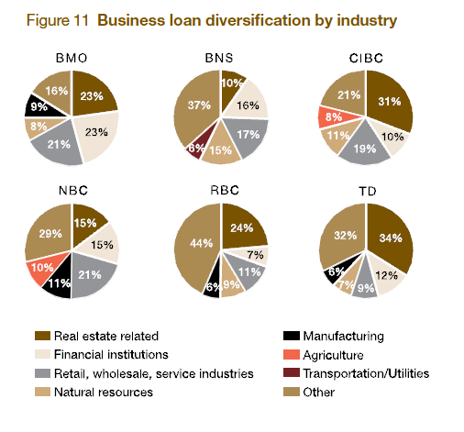
Current Condition for Canadian banking sector

Slide 55
Prospects
Supervision (BCBS) will strengthen the entire financial system by:
  Use countercyclical capital buffer: increase the capital available to absorb losses
    latest addition to the new capital framework.
    An instrument policy-makers can use to respond to the build-up of system-wide imbalances.
Notes:
(requires that capital be built up in
favourable financial conditions but allows it to be drawn
down to absorb losses under conditions of stress)
-is a system-wide overlay to the traditional microprudential
orientation of bank capital rules

Slide 56
Risk Management Structure
ROYAL BANK OF CANADA

Slide 57
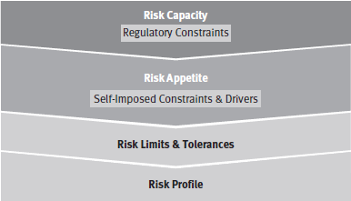
Risk Appetite
Risk appetite framework
  Define risk capacity
  Establish and confirm risk appetite to self-imposed constraints and drivers
  Translate risk appetite into
  risk limits and tolerances
  Measure and evaluate risk
  profile against risk limits
  and tolerances
Notes:
1. Define our Risk Capacity by identifying regulatory constraints
that restrict our ability to accept risk.
2. Establish and regularly confirm our Risk Appetite, defined by
Self-Imposed Constraints and Drivers in which we have chosen
to limit or otherwise influence the amount of risk undertaken.
They include:
• maintaining an “AA” rating or better,
• ensuring capital adequacy by maintaining capital ratios in
excess of rating agency and regulatory thresholds,
• maintaining low exposure to “stress events”,
• maintaining stability of earnings,
• ensuring sound management of liquidity and funding risk,
• maintaining a generally acceptable regulatory risk and
compliance control environment, and
• maintaining a Risk Profile that is no riskier than that of our
average peer.
3. Translate our Risk Appetite into Risk Limits and Tolerances that
guide businesses in their risk taking activities.
4. Regularly measure and evaluate our Risk Profile against Risk
Limits and Tolerances ensuring appropriate action is taken in
advance of Risk Profile surpassing Risk Appetite.
We apply our Risk Appetite Framework at an enterprise-wide level, as
well as at the business segment, Corporate Support, and line of
business levels. Risk Appetite is integrated into our business
strategies and our planning process.

Slide 58
Risk Management Principal
Effective balancing of risk and reward
Shared responsibility for risk management
Business decisions are based on an understanding of risk
Avoid activities that are not consistent with core values, code of conduct or policies
Proper focus on clients to reduce risks
Use of judgment and common sense
Notes:
1. Effective balancing of risk and reward by aligning risk appetite
with business strategy, diversifying risk, pricing appropriately for
risk, mitigating risk through preventive and detective controls
and transferring risk to third parties.
2. Shared responsibility for risk management as business
segments are responsible for active management of their risks,
with direction and oversight provided by Group Risk
Management and other corporate support groups.
3. Business decisions are based on an understanding of risk as we
perform rigorous assessment of risks in relationships, products,
transactions and other business activities.
4. Avoid activities that are not consistent with our Values, Code of
Conduct or Policies, which contributes to the protection of our
reputation.
5. Proper focus on clients reduces our risks by knowing our clients
and ensuring that the services we provide are suitable for and
understood by our clients.
6. Use of judgment and common sense in order to manage risk
throughout the organization.

Slide 59
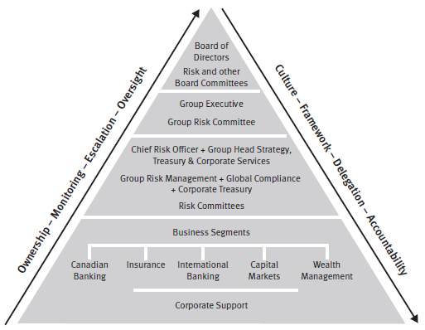
Risk Governance
Notes:
The Board of Directors provides oversight and carries out its risk
management mandate primarily through its Risk and other Board
Committees, consisting of the Audit Committee, Corporate Governance
and Public Policy Committee (CG&PPC) and Human Resources
Committee. The Group Executive (GE) is responsible for our strategy
and its execution by establishing the “tone at the top”. GE’s risk
oversight role is executed primarily through the mandate of the Group
Risk Committee (GRC). GRC, with the assistance of its supporting Risk
Committees, is the senior management risk committee responsible
for ensuring that our overall risk profile is consistent with strategic
objectives and there are ongoing, appropriate and effective risk
management processes. In addition, our risk governance structure is
supported by:
• The Chief Risk Officer (CRO) and Group Risk Management (GRM)
which have overall responsibility for the promotion of our risk
culture; and maintain our enterprise-wide program for
identifying, measuring, controlling and reporting the significant
risks that face the organization;
• The Chief Compliance Officer and Global Compliance which are
responsible for our compliance policies and processes designed
to mitigate and manage regulatory risk;
• Corporate Treasury which manages and oversees our capital
position, structural interest rate risk and liquidity and funding
risks; and
• The business segments which are responsible for specific risks,
alignment of business strategies with risk appetite, and identification,
control and management of their risks.

Slide 60
Risk Measurement
Qualitative and quantitative measurement
  Expected loss
  Unexpected loss and economic capital
  Sensitivity analysis and stress testing
  Model validation
Notes:
Expected loss
Expected loss represents losses that are statistically expected to
occur in the normal course of business in a given period of time.
Unexpected loss and economic capital
Unexpected loss is a statistical estimate of the amount by which
actual losses can exceed expected loss over a specified time horizon,
measured at a specified level of confidence. We hold economic
capital to offset these unexpected losses, should they occur. For
further information, refer to the Capital management section.
Sensitivity analysis and stress testing
Sensitivity analysis and stress testing are risk measurement
techniques that help us ensure that risks we take remain within our
risk appetite and our level of capital remains adequate.
Sensitivity analysis involves varying a single factor (e.g., a model
input or specific assumption) to assess the impact on various risk
measures.
Stress testing generally involves consideration of the simultaneous
movements in a number of risk factors. It is used to measure
the potential impacts on the organization of Credit, Market, Liquidity
and Funding and Operational risks under adverse conditions. Stress
testing plays an important role in supporting overall capital
management and adequacy assessment processes. Our enterprisewide
stress testing program utilizes stress scenarios featuring a range
of severities based on possible adverse market and economic events.
These stress scenarios are evaluated across the organization, and
results are integrated to develop an enterprise-wide view of the
impacts on our financial results and capital requirements. This
program uses macroeconomic projections that are then transformed
into stress impacts on various types of risk across the organization.
Macroeconomic scenarios evaluated this year include mild recession,
prolonged recession, real estate weakness, crisis in China, and
sovereign debt crisis. Our evaluations indicate that the resulting
capital and financial impacts of these stress scenarios are within our
ability to manage.
Model validation
We use models to measure and manage different types of risk. We
employ a holistic process whereby a model, its inputs and outputs are
reviewed. This includes the data used, the logic and theoretical
underpinnings of the model, the processing component, the interpretation
of the output and the strategic use of the model results. Our
model validation process is designed to ensure that all underlying
model risk factors are identified and successfully mitigated. To ensure
robustness of our measurement techniques, model validation is
carried out by our risk professionals independent of those responsible
for the development and use of the models and assumptions. In
cases where independent validation is not internally possible (e.g.,
exceptionally specialized models) outside experts are hired to
validate the model. Validation activities, results and conclusions are
also reviewed by Internal Audit Services on a regular basis.

Slide 61
Risk Control
Risk review and approval processes
Authorities and limits
Reporting
Notes:
Risk review and approval processes
Risk review and approval processes are established by GRM based on
the nature, size, and complexity of risk involved. In general, the risk
review and approval process involves a formal review and approval by
an individual, group or committee that is independent from the
originator. The approval responsibilities are governed by delegated
authorities based on the following categories: transactions, structured
credit, projects and initiatives, and new products and services.
Authorities and limits
The Risk Committee of the Board of Directors delegates Credit,
Market, and Insurance risk authorities to the President and Chief
Executive Officer and CRO. These delegated authorities allow these
officers to approve single name, geographic (country and region) and
industry sector exposures within defined parameters, establish
underwriting and inventory limits for trading and investment banking
activities and set market risk tolerances.
Reporting
Enterprise level risk monitoring and reporting are critical components
of our enterprise risk management program and support the ability of
senior management and the Board of Directors to effectively perform
their risk management and oversight responsibilities. On a quarterly
basis, the Enterprise Risk Report which includes a range of risks
facing the organization along with analysis of related issues and
trends is provided to senior management and the Board of Directors.
This report includes a comprehensive review of our risk profile relative
to our risk appetite and the identification of emerging risks. In
addition to regular risk monitoring, ad-hoc risk reporting is provided
to senior management and the Board of Directors as warranted for
new or emerging risk issues or significant changes in our level of risk.

Slide 62
Analysis of Financial Statements
ROYAL BANK OF CANADA

Slide 63
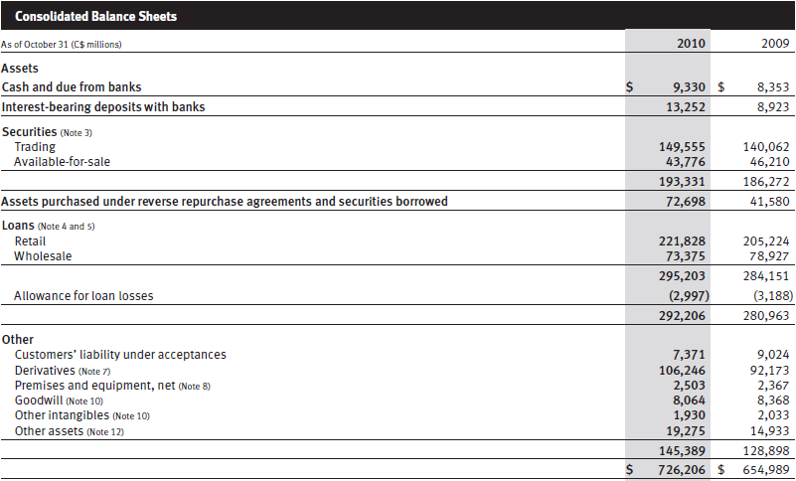
Consolidated Balance Sheets

Slide 64
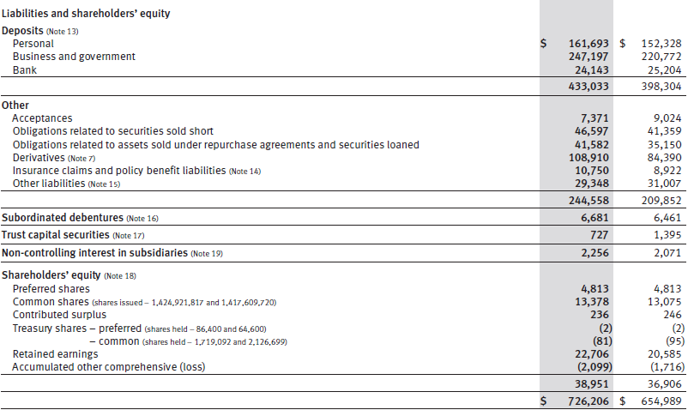
Consolidated Balance Sheets

Slide 65
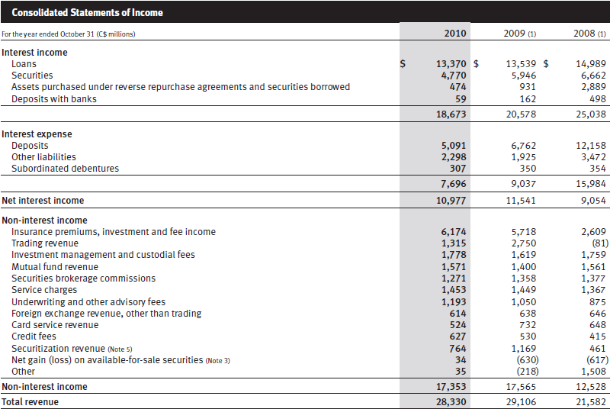
Consolidated Income Statements

Slide 66
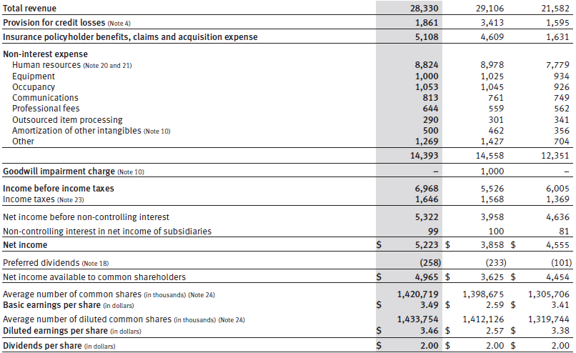
Consolidated Income Statements

Slide 67
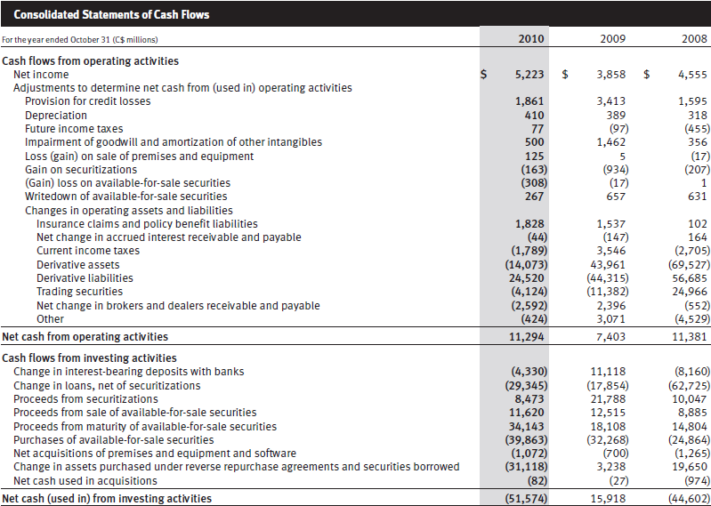
Consolidated Cash Flow Statements

Slide 68
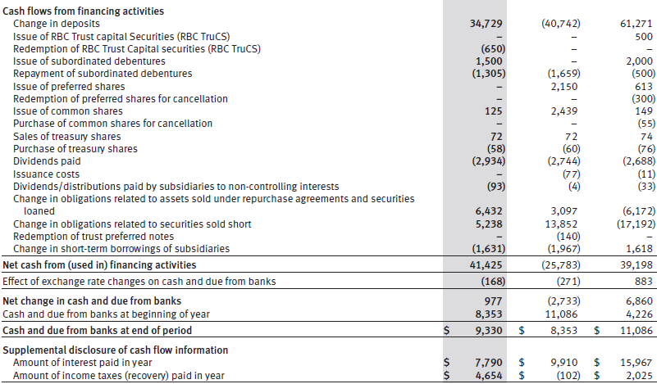
Consolidated Cash Flow Statements

Slide 69
MAJOR RISKS OF RBC
ROYAL BANK OF CANADA

Slide 70
Major Risks
Credit risk
Market risk
Liquidity and funding risk
Other risks

Slide 71
Credit Risk
The risk of loss associated with an obligor’s inability or unwillingness to fulfill its contractual obligations
May arise directly from the risk of default of a primary obligor (e.g. issuer, debtor, counterparty, borrower or policyholder), or indirectly from a secondary obligor (e.g. guarantor, reinsurer)

Slide 72
Key Parameters for Credit Risk
Probability of default (PD): An estimated percentage that represents the likelihood of default within a one-year period of an obligor for a specific rating grade or for a particular pool of exposures
Exposure at default (EAD): An amount expected to be owed by an obligor at the time of default
Loss given default (LGD): An estimated percentage of EAD that is not expected to be recovered during the collections and recoveries process

Slide 73
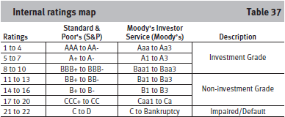
Wholesale Credit Portfolio
Assign a borrower risk rating (BRR)
Each credit facility is assigned an LGD rate
EAD is estimated based on the current exposure
Notes:
First, each obligor is assigned a borrower risk rating (BRR),
reflecting an assessment of the credit quality of the obligor. Each
BRR has a PD assigned to it. The BRR differentiates the riskiness of
obligors and represents our evaluation of the obligor’s ability and
willingness to meet its contractual obligations despite adverse or
stressed business conditions, troughs in the business cycle,
economic downturns or unexpected events that may occur. The
assignment of BRRs is based on the evaluation of obligors’ business
risk and financial risk based on fundamental credit analysis
supplemented by quantitative models.
Second, each credit facility is assigned an LGD rate. LGD rates are
largely driven by factors such as seniority of debt, collateral security,
product type, and the industry in which the obligor operates and
market environment.
EAD is estimated based on the current exposure to the obligor
and the possible future changes of that exposure driven by factors
such as credit quality of the obligor and type of credit commitment.

Slide 74
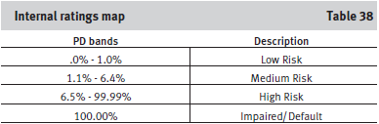
Retail Credit Portfolio
Acquisition scoring for new clients
Behavioural scoring for existing clients
Pooled basis assessment for overall portfolio management
Notes:
Acquisition scoring models, which are used for underwriting
purposes, utilize established statistical methods of analyzing new
applicant characteristics and past performance to estimate future
credit performance. In model development, sources of data are used
and include information obtained from the client such as
employment status, data from our internal systems such as loan
information and information from external sources such as credit
bureaus.
Behavioural scoring is used in the ongoing management of retail
clients with whom we have an established relationship. It utilizes
statistical techniques that capture past performance to predict future
behaviour and incorporate information, such as cash flow and
borrowing trends, as well as the extent of our relationship with the
client. The behavioural risk score is dynamic and is generally updated
on a monthly basis to continually re-evaluate the risk. Characteristics
used in behavioural scoring models are based on information from
existing accounts and lending products for each client, and from
information obtained from external sources, such as credit bureaus.
For overall portfolio management, retail exposures are assessed
on a pooled basis, with each pool consisting of exposures with
similar homogeneous characteristics. We believe pooling allows for
more precise, accurate and consistent estimates of default and loss
characteristics at the pool level.
Criteria used to pool exposures for risk quantification include
behavioural score, product type (mortgage, credit cards, lines of
credit and instalment loans), collateral type (chattel, liquid assets
and real estate), the length of time that the account has been on our
books, and the delinquency status (performing, delinquent and
default) of the exposure. Regular monitoring and periodic adjustments
and alignments are conducted to ensure that this process
provides for a meaningful differentiation of risk. Migration between
the pools is considered when assessing credit quality.
The pools are also assessed based on PD, EAD and LGD which
consider borrower and transaction characteristics, including
behavioural credit score, product type and delinquency status. The
LGD is estimated based on transaction specific factors, including
product, loan to value and collateral types. Our risk ratings are
reviewed and updated on a regular basis.

Slide 75
Credit Risk Mitigation
Structuring of transactions
Collateral
Credit derivatives
Notes:
Structuring of transactions
• Includes the use of guarantees, security, seniority and
covenants. Product-specific guidelines set out appropriate
product structuring as well as client and guarantor criteria.
The third-party guarantors that we deal with are primarily
sovereign-sponsored agencies.
Collateral
• We often require obligors to pledge collateral as security
when we advance credit. The extent of risk mitigation
provided by collateral depends on the amount, type and
quality of the collateral taken.
Credit derivatives
• Used as a tool to mitigate industry sector concentration and
single-name exposure. The counterparties that we transact
with are typically investment-grade banks and broker/
dealers. As with other derivatives, we use collateral and
master netting agreements for managing counterparty credit
risk and these contracts are subject to the same credit
approval, limit and monitoring standards used for managing
credit risk.

Slide 76
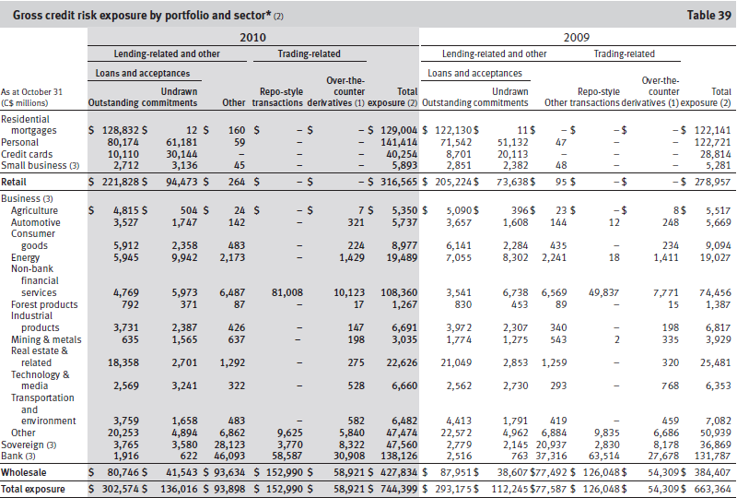
Gross Credit Risk Exposure
Notes:
2010 vs. 2009
Total gross credit risk exposure increased $81 billion, or 12%, from a
year ago, reflecting increases in both retail and wholesale portfolios.
Retail exposure increased $38 billion, or 14%, primarily driven
by the implementation of updated risk parameters for undrawn
commitments and the realignment of the retail risk rating system
reflecting recent credit experience. Retail exposure also increased as
a result of solid volume growth in Canadian home equity and personal
lending products. The use of guarantees and collateral represents an
integral part of our credit risk mitigation in the retail portfolio. Insured
mortgages accounted for 20% of our residential mortgage portfolio in
2010 as compared to 24% in 2009. Secured personal lending
represented 56% of personal loans outstanding in 2010 as compared
to 54% in 2009.
Wholesale exposure increased $43 billion, or 11%, mainly
reflecting increases in most exposure types. Repo-style transactions
increased $27 billion, primarily in non-bank financial services, due to
higher market activity from the European Government Bond business
and increased volume for our primary dealer activities, partially offset
by the impact of the stronger Canadian dollar. Other exposure
increased $16 billion in bank and sovereign, largely due to higher
guarantees and securities exposures. Loans and acceptances
decreased $7 billion, mainly in the business portfolio across most
sectors largely due to a strategic reduction in our U.S. loan portfolio,
maturity and repayments and the impact of the stronger Canadian
dollar. Most of the decrease in business exposure was in real estate
and related, mining and metals, energy and other services within the
other category. The decrease was partially offset by increases in nonbank
financial services and sovereign. The loan utilization rate
remained stable at 42%.

Slide 77
Loans and Acceptance Credit Risk
Notes:
2010 vs. 2009
Loans and acceptances increased by $9 billion, or 3%, from the prior
year, mainly reflecting strong retail growth in Canada, partially offset
by decreases in our wholesale portfolio.
Solid retail growth of $17 billion was driven by volume growth in
Canadian personal lending and residential mortgages.
Wholesale loans and acceptances decreased by $7 billion
mainly due to the same reasons discussed in the gross credit risk
exposure section.

Slide 78
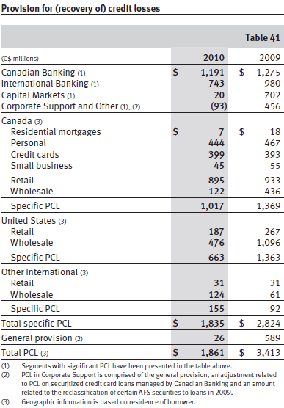
Provision for Credit Losses
Notes:
2010 vs. 2009
Total PCL of $1.9 billion decreased $1.6 billion from a year ago,
mainly reflecting decreased specific PCL of $1.0 billion. We incurred a
general provision of $26 million in the current year, as compared to
$589 million in 2009.
Specific PCL in Canadian Banking decreased by $84 million, or
7%, largely due to lower provisions in our business lending, personal
and small business portfolios reflecting improved economic
conditions. Lower personal lending provisions were driven by lower
loss rates in our fixed and variable, and unsecured loans.
Specific PCL in International Banking decreased $237 million, or
24%, primarily reflecting declines in our provision in U.S. banking
primarily due to our residential builder finance portfolio, AFS
securities reclassified to loans, lot loans and the impact of the
stronger Canadian dollar. These factors were partially offset by higher
provisions in our commercial portfolios in the Caribbean. Although
asset quality has stabilized compared to prior year, PCL remained
elevated, reflecting continued weakness in residential and
commercial property values.
Specific PCL in Capital Markets decreased $682 million,
primarily reflecting a number of provisions in our U.S. and Canadian
portfolios in the prior period and recoveries of a few large accounts in
the current period. This was offset by provisions in the current year
mainly in the U.S. in our real estate and related, and technology and
media sectors.
We incurred a lower general provision in the current year
reflecting improved credit quality in our commercial U.S. banking and
Canadian retail portfolios.

Slide 79
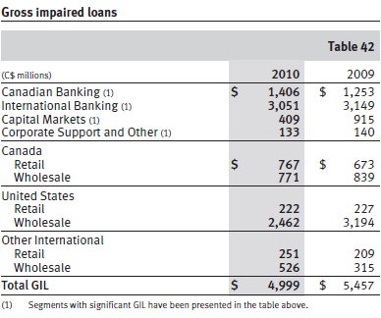
Gross Impaired Loans
Notes:
2010 vs. 2009
Total gross impaired loans (GIL) decreased by $458 million, or 8%
from a year ago.
GIL in Canadian Banking increased $153 million, or 12% mainly
reflecting higher impaired loans in our residential mortgages and
commercial portfolios.
GIL in International Banking decreased $98 million, or 3%,
mainly reflecting reductions in our residential builder finance portfolio
from higher write-offs and foreclosures, and declines in certain
impaired AFS securities reclassified to loans. These factors were
partially offset by higher impaired loans in our U.S. commercial
portfolio. Both our Caribbean wholesale and retail portfolios
remained under pressure from the slow economic recovery and
continued weakness in commercial real estate asset values.
GIL in Capital Markets decreased $506 million, or 55%, mainly
due to lower new impaired loans in our non-bank financial services,
and other portfolios primarily in the U.S.
GIL in Corporate Support and Other decreased slightly by
$7 million.

Slide 80
Market Risk
The risk of loss that may arise from changes in market factors such as interest rates, foreign exchange rates, equity or commodity prices, and credit spreads
Exposed to market risk in trading activity and asset/liability management activities

Slide 81
Trading Market Risk
Interest rate risk
Credit specific risk
Foreign exchange rate risk
Equity risk
Commodities risk
Market liquidity risk
Notes:
Trading market risks associated with securities and related
derivatives trading activities are a result of market-making, proprietary,
and sales and arbitrage activities in the interest rate, credit,
foreign exchange, equity, and commodities markets. Trading market
risk reflects the potential adverse impact on our earnings and
economic value and is comprised of the following components:
• Interest rate risk arises from the changes in interest rates and is
composed of directional risk, yield curve risk, basis risk and
option risk. Interest rate risk also captures credit spread risk
arising from the changes in issuer spreads.
• Credit specific risk arises from the change in the
creditworthiness and default of issuers of our holdings in fixed
income products.
• Foreign exchange rate risk arises from the change in currency
rates and precious metals price movements and volatilities. In
our proprietary positions, we are exposed to the spot, forward
and derivative markets.
• Equity risk arises from the movements in individual equity
prices or movements in the level of stock market indices.
• Commodities risk arises from commodities price movements
and volatilities.
• Market illiquidity risk arises from the inability to liquidate our
positions or acquire hedges to neutralize our trading positions.

Slide 82
Risk Measurement
Value at risk (VaR)
Sensitivity analysis
Stress testing
Notes:
Value-at-Risk
VaR is a statistical technique that measures the worst-case loss
expected over a one-day period within a 99% confidence level.
Larger losses are possible, but with low probability.
Sensitivity analysis is used to measure the impact of small changes in
individual risk factors such as interest rates and foreign exchange
rates and is designed to isolate and quantify exposure to the
underlying risk.
In order to address more extreme market events, stress testing is
used to measure and alert senior management to our exposure to
potential political, economic or other disruptive events.

Slide 83
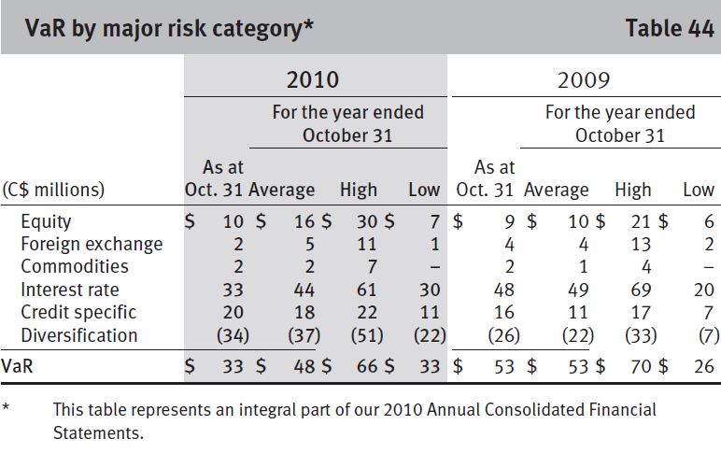
VaR
Notes:
2010 vs. 2009
Average VaR of $48 million for the year was down $5 million
compared to a year ago. This was largely due to the impact of the
stronger Canadian dollar on foreign-denominated portfolios and an
increase in diversification from 29% to 44%. These factors were
partially offset by the increases in Credit Specific and Equity VaR. The
increase in Credit Specific VaR is attributed to the Credit Specific VaR
model incorporating higher probabilities of credit events. The
increase in Equity VaR was largely driven by a combination of
business activity and market volatility.

Slide 84
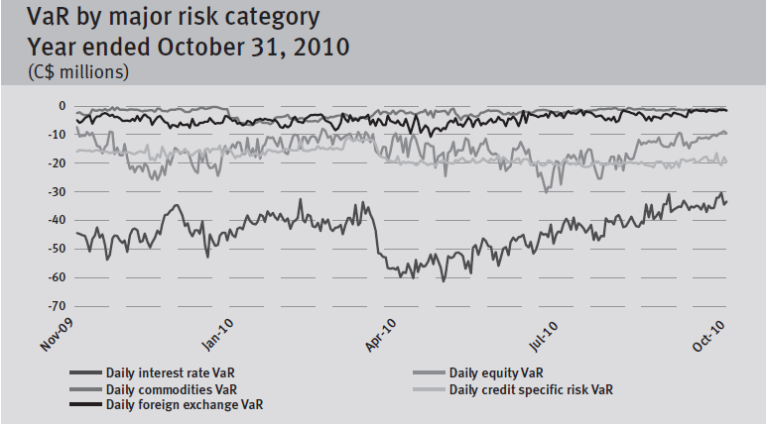
VaR

Slide 85
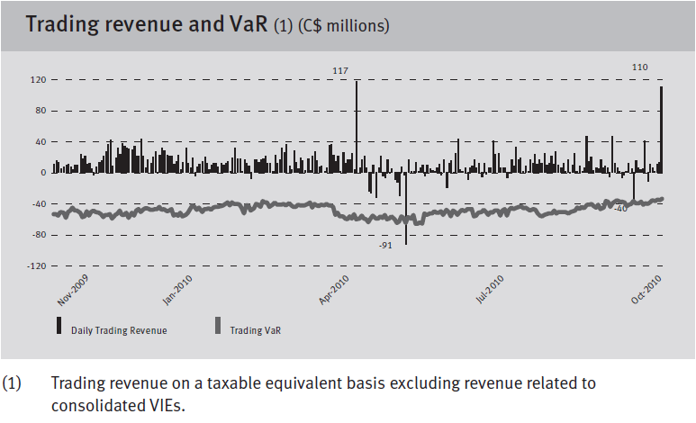
VaR

Slide 86
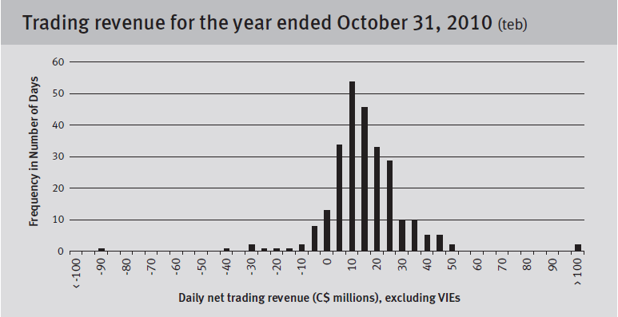
VaR
Notes:
2010 vs. 2009
During the year, we experienced 30 days of net trading losses
compared to 13 days in 2009. Two of the losses in 2010 exceeded
VaR. The volatility in daily trading revenue during the second and
third quarters reflected the increased volatility in the market driven by
the European sovereign debt crisis. The largest loss occurred on
May 31, 2010, totalling $91 million, exceeding the VaR for that day.
This loss as well as two large profit days on April 30, 2010 and
October 29, 2010, were primarily due to a month-end credit valuation
adjustment on a certain MBIA exposure.

Slide 87
Non-trading Market Risk (Asset/Liability Management)
Deposit taking and lending expose to market risk, of which interest rate risk is the largest component
Goal is to manage the interest rate risk of the non-trading balance sheet to a target level

Slide 88
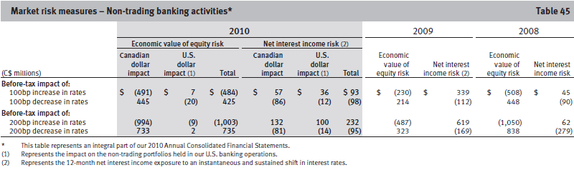
Risk Control
Notes:
Our risk position is measured
daily, weekly or monthly based on the size and complexity of the
portfolio. Measurement of risk is based on rates charged to clients as
well as funds transfer pricing rates. Key rate analysis is one of the
tools utilized for risk management. It provides us with an assessment
of the sensitivity of the exposure of our economic value of equity to
instantaneous changes in individual points on the yield curve. The
economic value of equity is equal to the net present value of our
assets, liabilities and off-balance sheet instruments.
As part of our monitoring process, the effectiveness of our
interest rate risk mitigation activity is assessed on value and earnings
bases, and model assumptions are validated against actual client
behaviour.
The Asset Liability Committee (ALCO) provides oversight over
non-trading market risk policies, limits, and operating standards.
Interest rate risk reports are reviewed regularly by ALCO, GRC and the
Board of Directors. The structural interest rate risk policy defines the
management standards and acceptable limits within which risks to
net interest income over a 12-month horizon, and the economic value
of equity, are to be contained. These ranges are based on immediate
and sustained ±100 basis points (bps) parallel shifts of the yield
curve. The limit for net interest income risk is 3% of projected net
interest income, and for economic value of equity risk, the limit is
3.75% of shareholder’s equity. Interest rate risk limits are reviewed
and approved annually by the Board of Directors.
The following table provides the potential before-tax impact of
an immediate and sustained 100 basis point and 200 basis point
increase or decrease in interest rates on net interest income and
economic value of equity of our non-trading portfolio, assuming that
no further hedging is undertaken. These measures are based upon
assumptions made by senior management and validated by empirical
research. All interest rate risk measures are based upon interest rate
exposures at a specific time and continuously change as a result of
business activities and our risk management actions. Over the course
of 2010, our interest rate risk exposure was well within our target
level.

Slide 89
Non-trading Foreign Exchange Rate Risk
Potential adverse impact on earnings and economic value due to changes in foreign currency rates
Also exposed to foreign exchange rate risk arising from investments in foreign operations
Reduce risks by hedging
Notes:
Foreign exchange rate risk is the potential adverse impact on earnings
and economic value due to changes in foreign currency rates. Our
revenue, expenses and income denominated in currencies other than
the Canadian dollar are subject to fluctuations as a result of changes
in the value of the average Canadian dollar relative to the average
value of those currencies. Our most significant exposure is to the U.S.
dollar due to our level of operations in the U.S., and other activities
conducted in U.S. dollars. We are also exposed to the British pound
and the Euro due to our activities conducted internationally in these
currencies. A strengthening or weakening of the Canadian dollar
compared to the U.S. dollar, British pound and the Euro could reduce
or increase, as applicable, the translated value of our foreign currency
denominated revenue, expenses and earnings and could have a
significant effect on the results of our operations. We are also
exposed to foreign exchange rate risk arising from our investments in
foreign operations. For un-hedged equity investments, when the
Canadian dollar appreciates against other currencies, the unrealized
translation losses on net foreign investments decreases our
shareholders’ equity through the cumulative translation account and
decreases the translated value of the RWA of the foreign currencydenominated
operations. The reverse is true when the Canadian
dollar depreciates against other currencies. Consequently, we
consider these impacts in selecting an appropriate level of our
investments in foreign operations to be hedged.

Slide 90
Liquidity and funding risk
Risk that the bank may be unable to generate or obtain sufficient cash or its equivalent in time
RBC uses: residential mortgage, commercial mortgage and credit card receivable-backed securitization programs as alternative sources of funding and for liquidity and asset/liability management purposes
Notes:
can cost-effective manner to meet its commitments as they come due.

Slide 91
Liquidity and funding risk
RBC’s Goals:
• An balance between the level of risk and cost of its mitigation
• Broad funding access through retaining and promoting a reliable base of client deposits, accessing diversified sources of wholesale funding
• A comprehensive enterprise-wide liquidity contingency plan supported by unencumbered marketable securities that provide assured access to cash in a crisis
• Appropriate and transparent liquidity transfer pricing and cost allocation
Notes:
A contingency plan is a plan devised for a specific situation when things could go wrong. Contingency plans are often devised by governments or businesses who want to be prepared for anything that could happen.

Slide 92
Liquidity and funding risk measurement
Structural (longer-term) liquidity risk: Uses cash capital and identify mismatches in effective maturity btw all assets and liabilities
Tactical (shorter-term) liquidity risk: Apply net cash flow limits in CAD and foreign currencies for key short-term time horizons and assign a risk-adjusted limit to our aggregate pledging exposure
Contingency liquidity risk management: assesses the impact of and intended responses to sudden stressful events

Slide 93
Liquidity and funding risk control
Delegation and liquidity management framework are approved annually
Liquidity status and position monitored on a regular basis
Shared management and oversight of funding activities and status
Analyze ability to lend or borrow funds between:
Branches→ Subsidiaries→ convert btw currencies
Notes:
Risk governance and control
The Board of Directors approves delegation of liquidity risk approval
authorities annually to senior management. The Audit Committee and
the Conduct Review and Risk Policy Committee of the Board annually
approve the liquidity management framework and are responsible for
its oversight. The Board of Directors and these committees also
review, on a regular basis, reporting on RBC’s enterprise-wide
liquidity position and status. Group Risk Committee (GRC) and ALCO
share management oversight responsibility and review all liquidity
documents prepared for the Board of Directors or its committees.
ALCO annually approves the liquidity management framework’s key
supporting documents and provides strategic direction and primary
management oversight to Corporate Treasury, other functions and
business platforms in the area of liquidity risk management. To
maximize funding and operational efficiencies, we monitor and
manage our liquidity position on a consolidated basis and for key
units and consider market, legal, regulatory, tax, operational and any
other applicable restrictions. This includes analyzing our ability to
lend or borrow funds between branches, branches and subsidiaries,
and subsidiaries, and converting funds between currencies.
Policies
Our principal liquidity policies define risk tolerance parameters. They
authorize senior management committees or Corporate Treasury to
approve more detailed policies and limits that govern management,
measurement and reporting requirements for specific businesses and
products.
Authorities and limits
Limits for our structural liquidity risk positions are approved at least
annually and measured and monitored, monthly or quarterly. Net
cash flow limits are approved at least annually. Depending on the
materiality of each reporting entity, net cash flow limits are monitored
daily or weekly by major currency, branches, subsidiaries and
geographic locations. Any potential exceptions to established limits
are reported immediately to Corporate Treasury, which provides or
arranges for approval after reviewing a remedial action plan.
The liquidity factors for cash flow assets and liabilities under
varying conditions are reviewed periodically by Corporate Treasury in
concert with GRM and the business segments to determine if they
remain valid or changes to assumptions and limits are required.
Through this process, we ensure that a close link is maintained
between the management of liquidity and funding risk, market
liquidity risk and credit risk, including GRM approval of credit lines
between entities. In response to our experience during the volatile
markets of the past two years, we have modified the liquidity
treatment of certain asset classes to reflect our expectations that
market liquidity for these products will remain impaired for some
time. Where required, limits have been reduced in consideration of
the results of updated stress tests. During the fiscal year, OSFI
introduced a regulatory enterprise liquidity metric, which we formally
report to OSFI on a monthly basis and monitor intra-month.

Slide 94
Liquidity & Funding strategy
Cost-effective funding by:
  Diversified pool of deposits (personal to commercial and institutional segment, currency, structure and maturity) evaluated against relative issuance costs, help expand wholesale funding flexibility and minimize funding concentration and dependency and generally reduces financing costs
  Operate long-term debt issuance in Canada, US, Europe, Australia and Japan
  Maintain competitive credit ratings
Notes:
1)(pg 49) Deposit profile
The principal source of reliable funding while certain commercial and institutional client
groups also maintain relational balances with low volatility profiles.
Taken together, these clients represent a highly stable supply of core
deposits in most conceivable environments as they typically are less
responsive to market developments than transactional lenders and
investors due to the impact of deposit insurance and extensive and,
at times, exclusive relationships with us. Core deposits, consisting of
our own statistically derived estimates of the highly stable portions of
all of our relational personal, commercial and institutional balances
(demand, notice and fixed-term) together with wholesale funds
maturing beyond one year were unchanged during the year at 63% of
our total deposits.

Slide 95
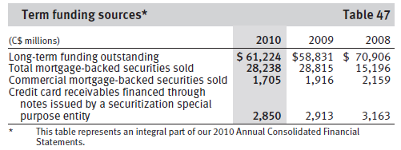
Liquidity and funding strategy: deposit source
Notes:
During 2010, we continued to expand our long-term funding base by
selectively issuing, either directly or through our subsidiaries,
$21.5 billion of senior deposit notes in various currencies and
markets. Total long-term funding outstanding increased by
$3.2 billion. Outstanding senior debt containing ratings triggers,
which would accelerate repayment, constitutes a very small
proportion of our overall outstanding debt of $62 billion.
Other liquidity and funding sources
We use residential mortgage, commercial mortgage and credit card
receivable-backed securitization programs as alternative sources of
funding and for liquidity and asset/liability management purposes.
We hold retained interests in our residential mortgage and credit card
securitization programs. Our total outstanding mortgage backed
securities sold decreased year over year by $577 million. Our credit
card receivables, which are financed through notes issued by a
securitization special purpose entity, decreased year over year by
$63 million. For further details, refer to the Off-balance sheet
arrangements section and Note 5 to our 2010 Annual Consolidated
Financial Statements.

Slide 96
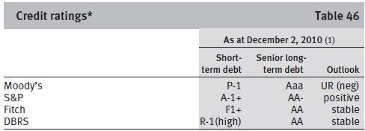
Liquidity and funding strategy: credit rating
Aa1
Notes:
attracted to the growth potential of capital markets businesses, but these businesses can expose bank bondholders to hidden tail risks
RBC has announced a strategic target to maintain 25 to 30 per cent of earnings contributions from capital markets operations
Credit ratings
Our ability to access unsecured funding markets and to engage in
certain collateralized business activities on a cost-effective basis is
primarily dependent upon maintaining competitive credit ratings. Our
credit ratings are largely determined by the quality of our earnings,
the adequacy of our capital and the effectiveness of our risk
management programs. There can be no assurance that our credit
ratings and rating outlooks will not be lowered or that rating agencies
will not issue adverse commentaries about us, potentially resulting in
adverse consequences for our funding capacity or access to capital
markets. A lowering of our credit ratings may also affect our ability,
and the cost, to enter into normal course derivative or hedging
transactions and may require us to post additional collateral under
certain contracts. However, we estimate, based on periodic reviews of
ratings triggers embedded in our existing businesses and of our
funding capacity sensitivity, that a minor downgrade would not
materially influence our liability composition, funding access,
collateral usage and associated costs. For a discussion on the
potential impact of a downgrade on certain derivative instruments,
see Note 31, Reconciliation of the application of Canadian and United
States generally accepted accounting principles – Fair value of
derivatives by major types of products.
On September 14, 2010 we were placed on review for possible
downgrade by Moody’s. During its review Moody’s will focus on
gaining a better understanding of our capital markets business and
our growth plans for the business. Moody’s is expected to announce
the results of its review in mid-December 2010.
The following table presents our major credit ratings and outlook
as at December 2, 2010:

Slide 97
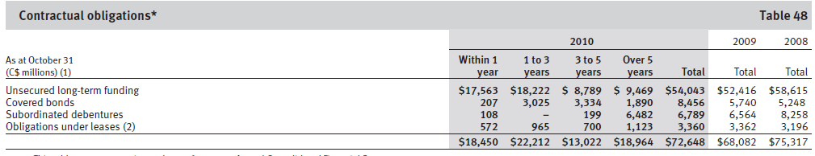
Liquidity and funding limitation: Contractual obligations
Notes:
Contractual obligations
In the normal course of business, we enter into contracts that give
rise to commitments of future minimum payments that affect our
liquidity. Depending on the nature of these commitments, the
obligation may be recorded on- or off-balance sheet. The following
table provides a summary of our future contractual funding
commitments.

Slide 98
Other risks
Strategic risk
Regulatory and legal risk
Reputation risk
Insurance risk

Slide 99
Strategic risk
Risk of making inappropriate strategic choices or not able to to successfully implement selected strategies, related plans and decisions which in turn may affect financial performance
Ex: failure to retain clients, integrate key employees from strategic acquisitions/joint ventures
Notes:
For example, failure to successfully integrate and retain
clients and key employees from our strategic acquisitions or joint ventures may adversely affect our financial performance.

Slide 100
Management of Strategic risk
Oversight of strategic risk is the responsibility of the heads of the business segments: the Enterprise Strategy Office, Group Executive, and the Board of Directors.
Management supported by the Enterprise Strategy Group through the use of an enterprise strategy framework that synthesizes business portfolio strategies with the enterprise vision.

Slide 101
Regulatory and legal risk
Risk of negative impact to business activities, earnings or capital, regulatory relationships or reputation due to failure to comply with or adapt to current and changing regulations, law, industry codes or rules, regulatory expectations, or ethical standards
Ex: change in entry barrier increase cost of compliance, judicial or regulatory judgment or decision resulting in fines will damage reputation which in turn impact earnings negatively
Any litigation have possible adverse effect that give rise to significant reputational damage, which in turn could impact future business prospects.
Notes:
for example by lowering barriers to entry in
the businesses in which we operate or increasing our costs of
compliance. Further, there is no assurance that we always will be or
will be deemed to be in compliance with laws, regulations or
regulatory policies. Accordingly, it is possible that we could receive a
judicial or regulatory judgment or decision that results in fines,
damages, and other costs or injunctions or loss of licenses or
registrations that would damage our reputation and negatively impact
on our earnings. In addition, we are subject to litigation arising in the
ordinary course of our business and the adverse resolution of any
litigation could have a material adverse effect on our results or could
give rise to significant reputational damage, which in turn could
impact our future business prospects.

Slide 102
Regulatory and legal risk management
Implemented Enterprise Compliance Management (ECM) framework that is consistent with regulatory guidance from OSFI and other regulators.
Designed to promote the proactive, risk-based management of compliance and regulatory risk.
Applies to all businesses and operations, legal entities and employees globally, and confirms the shared accountability of all employees for ensuring we maintain robust and effective regulatory risk and compliance controls.

Slide 103
Reputation risk
the risk that an activity undertaken by an organization or its representatives will affect its image in the community or lower public confidence in it, resulting loss of business, legal action or increased regulatory oversight.
Operational failures and non-compliance with laws and regulations can have a significant reputational impact

Slide 104
Reputation risk Management
Operate with integrity at all times in order to sustain a strong and positive reputation.
All our employees, including senior management to all members of the Board of Directors are responsible to protect reputation

Slide 105
Insurance risk
Exposure to potential financial loss from payments that are different than anticipated
(e.g. number, amount or timing) under an insurance policy or reinsurance treaty.
Primarily associated with respect to mortality, morbidity, longevity, claim frequency, claim severity, policyholder behaviour, and expense.

Slide 106
Insurance risk
1. Claims risk represents the risk that the actual severity, frequency or timing of claims differs from the levels assumed in pricing calculations or reserves.
  Types of claims risk include mortality risk, longevity risk, morbidity risk, home and auto risk, and travel risk.

Slide 107
Insurance risk
2. Policyholder Behaviour Risk (Lapse Risk)
The risk that the actual behaviour of policyholders relating to premium payments, policy withdrawals or loans, policy lapses, surrenders, and the exercise of other policy options differ from the behaviour assumed in pricing calculations or reserves.
Notes:
lapse risk
measure of the sensitivity of the insurance company's liability to changing policy surrender distributions.

Slide 108
Insurance risk Management
-Establishment of risk approval authorities
and limits, independent risk oversight and approval by GRM-Insurance and risk mitigation, which include: identifying, assessing and managing insurance risk through a risk review and approval process

Slide 109
RISK MANAGEMENT STRATEGIES
ROYAL BANK OF CANADA

Slide 110
Derivative Instruments
Financial derivatives
  Forwards and futures
  Swaps
  Options
  Credit derivatives
Non-financial derivatives
  Precious metal
  Commodities
Notes:
Forwards and futures
Forward contracts are effectively tailor-made agreements that are
transacted between counterparties in the over-the-counter market,
whereas futures are standardized contracts with respect to amounts
and settlement dates, and are traded on regular futures exchanges.
Examples of forwards and futures are described below:
Interest rate forwards (forward rate agreements) and futures are
contractual obligations to buy or sell an interest-rate sensitive
financial instrument on a predetermined future date at a specified
price.
Foreign exchange forwards and futures are contractual
obligations to exchange one currency for another at a specified price
for settlement at a predetermined future date.
Equity forwards and futures are contractual obligations to buy or
sell at a fixed value (the contracted price) of an equity index, a basket
of stocks or a single stock at a predetermined future date.
Swaps
Swaps are over-the-counter contracts in which two counterparties
exchange a series of cash flows based on agreed upon rates to a
notional amount. The various swap agreements that we enter into are
as follows:
Interest rate swaps are agreements where two counterparties
exchange a series of payments based on different interest rates
applied to a notional amount in a single currency. Cross currency
swaps involve the exchange of payments in one currency for the
receipt of payments in another currency. Cross currency interest rate
swaps may involve the exchange of both interest and principal
amounts in two different currencies.
Equity swaps are contracts in which one counterparty agrees to
pay or receive from the other cash flows based on changes in the
value of an equity index, a basket of stocks or a single stock.
Options
Options are contractual agreements under which the seller (writer)
grants the purchaser the right, but not the obligation, either to buy
(call option) or sell (put option), a security, exchange rate, interest
rate, or other financial instrument or commodity at a predetermined
price, at or by a specified future date. The seller (writer) of an option
can also settle the contract by paying the cash settlement value of the
purchaser’s right. The seller (writer) receives a premium from the
purchaser for this right. The various option agreements that we enter
into include interest rate options, foreign currency options, equity
options and index options.
Credit derivatives
Credit derivatives are over-the-counter contracts that transfer credit
risk related to an underlying financial instrument (referenced asset)
from one counterparty to another. Examples of credit derivatives
include credit default swaps, credit default baskets and total return
swaps.
Credit default swaps provide protection against the decline in
value of the referenced asset as a result of specified credit events
such as default or bankruptcy. It is similar in structure to an option
whereby the purchaser pays a premium to the seller of the credit
default swap in return for payment contingent on a credit event
affecting the referenced asset.
Credit default baskets are similar to credit default swaps except
that the underlying referenced financial instrument is a group of
assets instead of a single asset.
Total return swaps are contracts where one counterparty agrees
to pay or receive from the other cash flows based on changes in the
value of the referenced asset.

Slide 111
Derivative Instruments
Trading purposes
  Sales
  Trading
Non-trading purposes (hedging)
  Interest rate swaps
  Cross currency swaps
  Foreign exchange forward contracts
  Credit derivatives
Notes:
We also use derivatives for purposes other than trading, primarily for
hedging, in conjunction with the management of interest rate, credit,
equity and foreign exchange risk related to our funding, lending,
investment activities and asset/liability management.
Interest rate swaps are used to manage our exposure to interest
rate risk by modifying the repricing or maturity characteristics of
existing and/or anticipated assets and liabilities, including funding
and investment activities. Purchased interest rate options are used to
hedge redeemable deposits and other options embedded in
consumer products. We manage our exposure to foreign currency risk
with cross currency swaps and foreign exchange forward contracts.
We predominantly use credit derivatives to manage our credit
exposures. We mitigate industry sector concentrations and singlename
exposures related to our credit portfolio by purchasing credit
derivatives to transfer credit risk to third parties.
Certain derivatives and cash instruments are specifically
designated and qualify for hedge accounting. We apply hedge
accounting to minimize volatility in earnings caused by changes in
interest rates or foreign exchange rates. Interest rate and currency
fluctuations will either cause assets and liabilities to appreciate or
depreciate in market value or cause variability in anticipated cash
flows. When a hedging instrument functions effectively, gains, losses,
revenue and expenses of the hedging instrument will offset the gains,
losses, revenue and expenses of the hedged item. We largely assess
and measure the effectiveness of a derivative that is designated as a
hedging instrument based on the change in its fair value. When cash
instruments are designated as hedges of currency risks, only changes
in their value due to currency risk are included in the assessment and
measurement of hedge effectiveness. We applied hedge accounting
to anticipated transactions and firm commitments during the year.

Slide 112
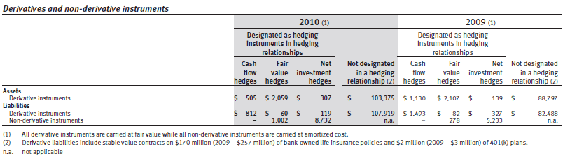
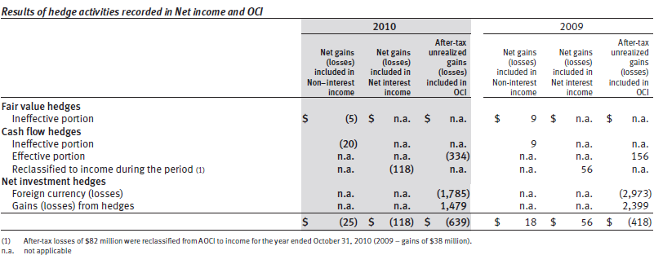
Results of Hedging Activities

Slide 113

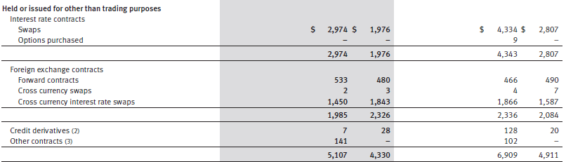
Fair Value of Derivatives for Hedging Purposes

Slide 114
Derivative-related Credit Risk
Generated by the potential for the counterparty to default on its contractual obligations
Represented by the positive fair value of the instrument
Normally a small fraction of the contract’s notional amount

Slide 115
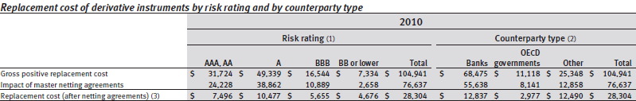
Derivative-related Credit Risk
How to reduce derivative-related credit risk?
  Collateral
  Mark-to-market
  Master netting agreement
Notes:
Netting is a technique that can reduce credit exposure from
derivatives and is generally facilitated through the use of master
netting agreements. A master netting agreement provides for a single
net settlement of all financial instruments covered by the agreement
in the event of default. However, credit risk is reduced only to the
extent that our financial obligations to the same counterparty can be
set off against obligations of the counterparty to us. We maximize the
use of master netting agreements to reduce derivative-related credit
exposure. Our overall exposure to credit risk that is reduced through
master netting agreements may change substantially following the
reporting date as the exposure is affected by each transaction subject
to the agreement as well as by changes in underlying market rates.
Measurement of our credit exposure arising out of derivative transactions
is reduced to reflect the effects of netting in cases where the
enforceability of that netting is supported by appropriate legal
analysis as documented in our trading credit risk policies.
The use of collateral is another significant credit mitigation
technique for managing derivative-related counterparty credit risk.
Mark-to-market provisions in our agreements with some counterparties,
typically in the form of a Credit Support Annex, provide us
with the right to request that the counterparty pay down or collateralize
the current market value of its derivatives positions when the
value passes a specified threshold amount.

Slide 116
Thank you for your attention
Any questions?

