Slide 1
Risk Management - Mining Industry
By: Hartanto Salim
Allen Yeung
Desiree Lee

Slide 2
Agenda
Mining Industry Overview
BHP-Billiton
Newmont
Teck

Slide 3
Industry Characteristics
Capital intensive
Sensitive to business cycles
Revenues driven by fluctuations in commodity prices and exchange rates
Costs associated with exploration, licensing, mine construction, rehabilitation and clean up
Operating expenses
Maintenance costs
Fuel costs
Energy costs
Labour costs

Slide 4
Industry Characteristics
Environmental concerns
Noise pollution
Acid mine drainage
Changes in local water balance
Soil erosion
Disruption of animal life
Stringent environmental regulations

Slide 5
Mining Terminology
Mineral Resource
Inferred Mineral Resource
Indicated Mineral Resource
Measured Mineral Resource
Mineral Reserve
Probable Mineral Reserve
Proven Mineral Reserve
Geological Confidence
Economically Mineable
Notes:
A Qualified personal is an engineer or geoscientist with 5 years experience in the mineral exploration processes.
Mineral Resource: amount of mineral
Indicated resources are simply economic mineral occurrences that have been sampled (from locations such as outcrops, trenches, pits and drillholes) to a point where an estimate has been made, at a reasonable level of confidence, of their contained metal, grade, tonnage, shape, densities, physical characteristics
Measured resources are indicated resources that have undergone enough further sampling that a ‘qualified person' has declared them to be an acceptable estimate, at a high degree of confidence, of the grade, tonnage, shape, densities, physical characteristics and mineral content of the mineral occurrence.
Conduct feasibility analysis
Mineral Reserve: Mineable portion of Mineral Resource given feasibility
A Mineral Reserve is the economically mineable part of a Measured or Indicated Mineral Resource demonstrated by at least a Preliminary Feasibility Study. This Study must include adequate information on mining, processing, metallurgical, economic and other relevant factors that demonstrate, at the time of reporting, that economic extraction can be justified. A Mineral Reserve includes diluting materials and allowances for losses that may occur when the material is mined.

Slide 6
Mining Process
1. Prospecting to locate ore body
2. Deposit evaluation or pre-feasibility activities
- Mathematically estimate the extent and grade of the deposit
- Evaluate the economically recoverable portion of the deposit
4. Mine planning and feasibility study to evaluate the total project
-Mining methods, infrastructure required, location of facilities, impact assessment of facilities
5. Mine construction and operation
6. Mine closure
- Reclamation to make a previous mine suitable for future use.

Slide 7
Coal
World’s most abundant and widely distributed fossil fuel
Used for:
Power generation (Thermal Coal)
Steel production (Metallurgical or Coking Coal)
Cement manufacturing
As a liquid fuel
Quality Ranking:
High-rank coals are high in carbon and therefore heat value, and have low moisture content.
Low-rank coals have low carbon content but high in hydrogen and oxygen content.

Slide 8
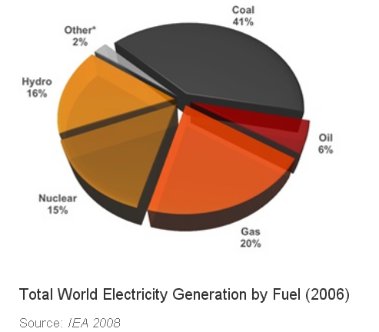

Slide 9
Coal Consumption
Worldwide consumption in 2009
Around 5.9 billion tonnes of hard coal
Around 909 million tonnes of brown coal
Top five coal users are China, USA, India, Japan and South Africa
Accounts for 82% of total global coal usage

Slide 10
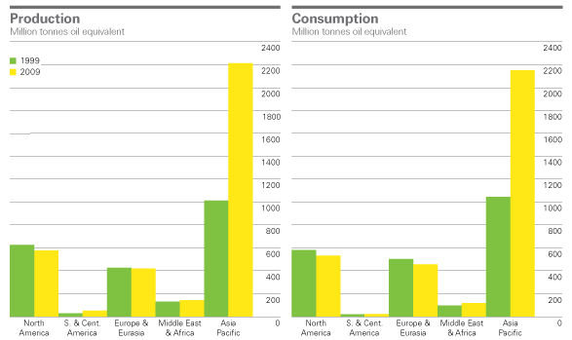
Global Consumption and Production

Slide 11
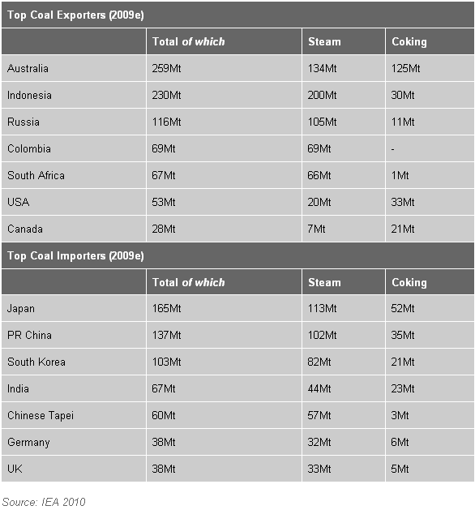
Coal Trade

Slide 12
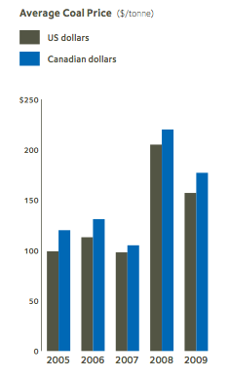
Price Chart (Metallurgical Coal)

Slide 13
Copper
Excellent conductor of electricity mostly used in electrical wiring and electronics
Resistant to corrosion, high thermal conductivity, durable and flexible
Extensively used in construction industry for piping, plumbing and ventilation
Energy-efficient and infinitely recyclable
Traded on established international exchanges
New York Mercantile Exchange (COMEX)
London Metals Exchange (LME)
Shanghai Futures Exchange (SHFE)

Slide 14
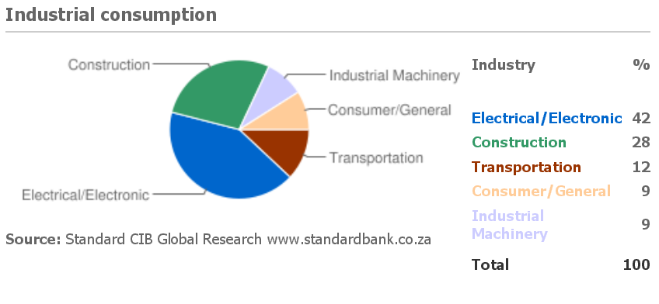
Copper Usage

Slide 15
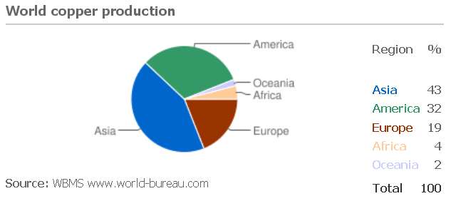
Copper Production

Slide 16
Copper Demand
Driven by global industrial activity levels
In 2009, global copper consumption exceeded 18 million tonnes but down 1.3% from 2008
North America: Demand down 9%
Germany: Demand down 12%
France: Demand down 9%
China: Demand up 42%

Slide 17
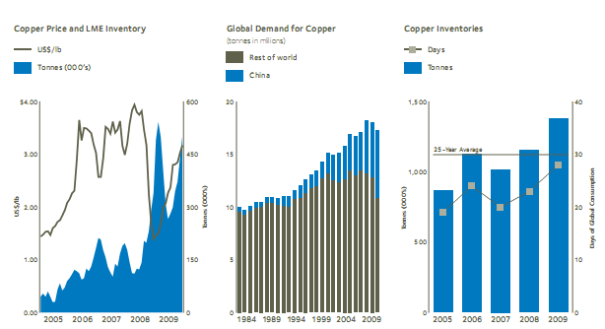
Copper Demand

Slide 18
Zinc
4th most common metal in use (behind iron, aluminum and copper)
24th most abundant element in Earth’s crust
Commonly mined as a co-product with standard lead
Largest exploitable deposits located in Australia, Asia and U.S.

Slide 19
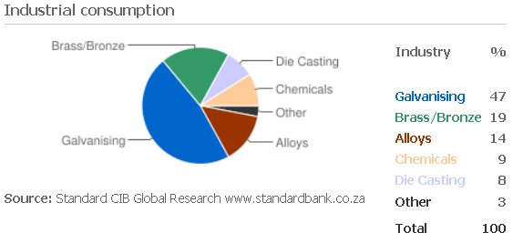
Zinc Usage
Notes:
Mainly used as a protective coating to prevent underlying metal from corrosion (galvanizing)

Slide 20
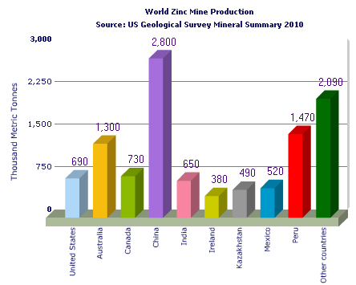
Zinc Production

Slide 21
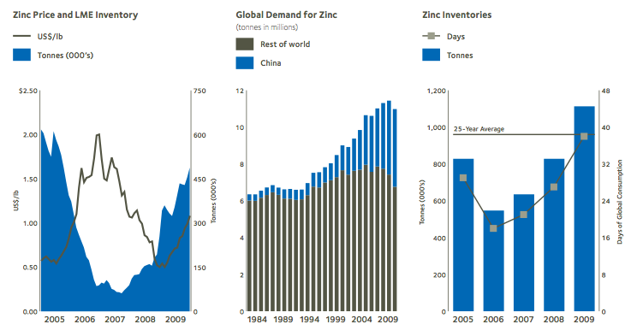
Zinc Demand

Slide 22


Slide 23
BHP company overview
World largest diversified natural resource company
Listed in Australian Securities Exchange, London Stock Exchange, Johannesburg Stock exchange and BHP plc ADR trade in New York stock exchange
Market cap: 165.6 Billion USD
BHP operates 9 businesses: petroleum, aluminum, base metals (copper, silver, lead, zinc, uranium), diamonds, stainless steel materials, iron ore, manganese, metallurgical coal, energy coal

Slide 24
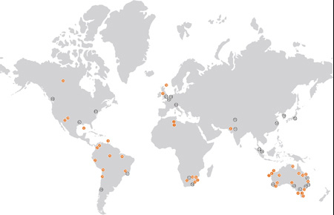
BHP company overview

Slide 25
Risk Factors
Fluctuation in commodity price and macro economic factors
the policy is sell the goods at prevailing market prices
Maintain credit rating “A” as part of strategy
Exchange rate fluctuation
Sales are dominated in USD
Costs in Australian dollar, USD, South African rand, Chilean peso, and Brazilian Real
Do not believe that hedging provides long term shareholder value
Special circumstances hedge subject to limit by board

Slide 26
Risk Factors Continued
Interest Rate Risk
Policy: U.S. Floating interest rate basis
Uses interest rate swaps, cross currency interest rate swap to convert floating rate into fixed rate
Counterparty Default Risk
Failure to discover new resource/ maintain and develop new operations
Uncertainty in estimating resources
Reduction in Chinese demand
56% of iron demand, 36% copper demand, 35% nickel demand, 39% aluminum demand comes from china

Slide 27
Risk Factors Continued
Legal / political risks in some countries
Mineral Resource Rent Tax in Australia
Operational Risk
Exposed to increased litigation, compliance cost, unforeseen environmental rehabilitation cost.
Natural and operational catastrophe: Risk management maintains self-insurance for property damage and business interruption risk exposure
Third party claim may exceed insurance policy that’s in place

Slide 28
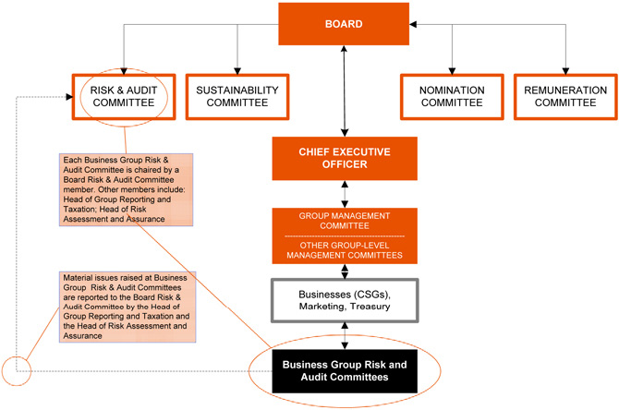
Corporate Governance

Slide 29
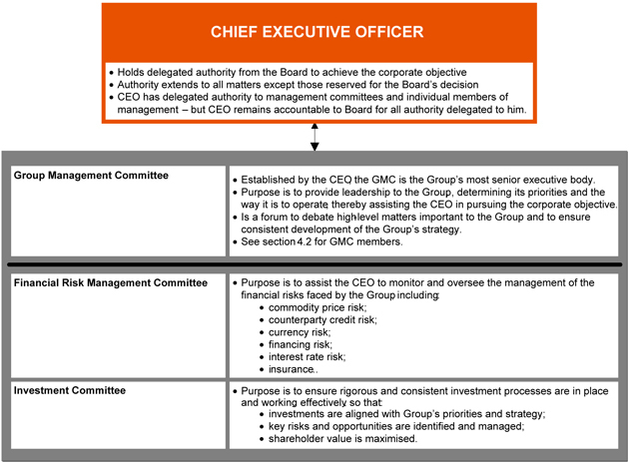
Corporate Governance continued

Slide 30
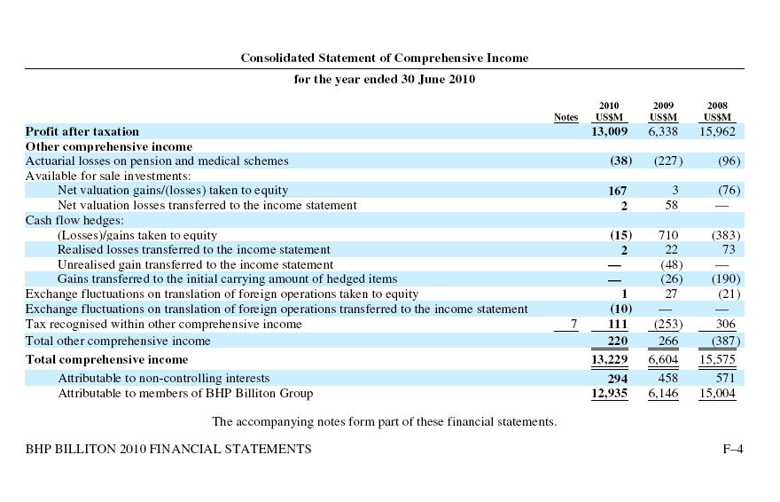

Slide 31
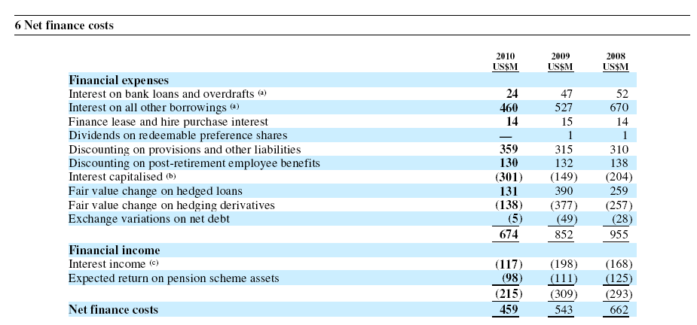
Note 1
Cash flow hedges: Fair value of derivatives designated and qualify for as cash flow hedges in hedging reserves

Slide 32
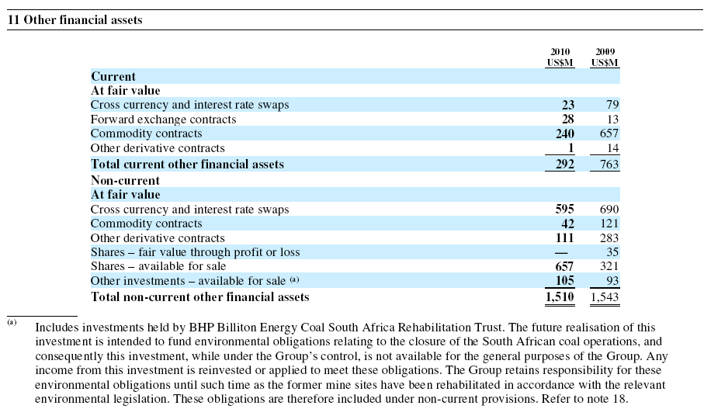
Other Financial assets

Slide 33
Risk management
Financial risk management strategy uses cash flow at risk (CFaR) method, which is defined as worst expected loss to projected business plan cash flow over one year horizon under normal market circumstances at a confidence level of 95%
Risk mitigation activity: hedging revenues with financial instrument to mitigate risk; Assess CFaR against board approved limits
Economic hedging of commodity sales, cost and debt
Align total group exposure to index target
measuring and reporting exposure in customer commodity contracts and issue debt instruments

Slide 34
Risk Management continued
Strategic financial transaction
Opportunistic transaction of over/under valued valuation may be executed with financial instrument
Proprietary trading
Undertake trading activities of approved commodity derivatives
Interest rate risk
Managed as part of portfolio management strategy within the CFaR limit

Slide 35
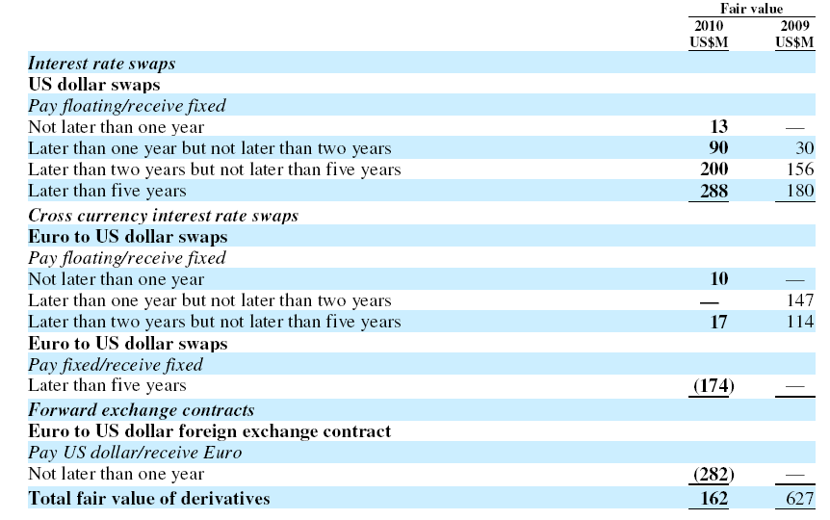
Swaps

Slide 36
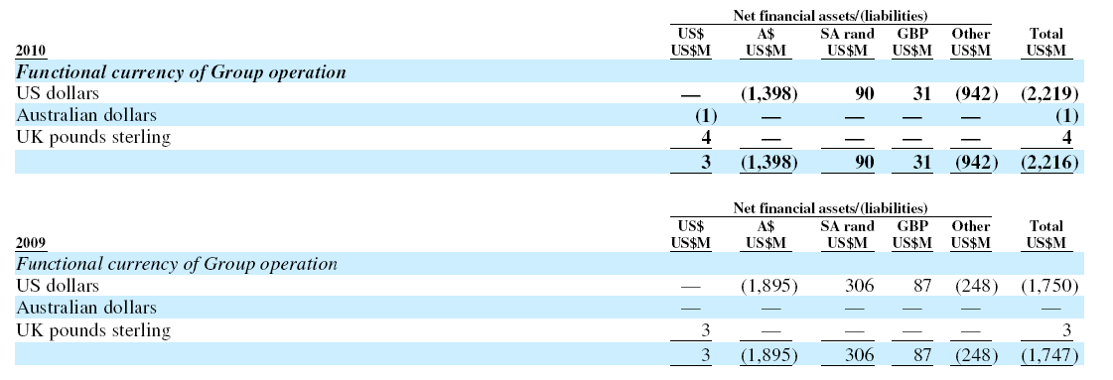
Currency Risk
Currency risks due to financial asset/liabilities in currency other than functional currency of operation

Slide 37
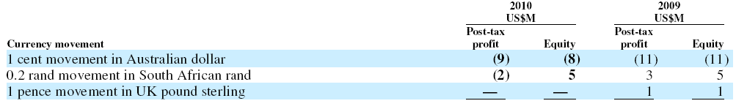
Currency Risk Continued

Slide 38
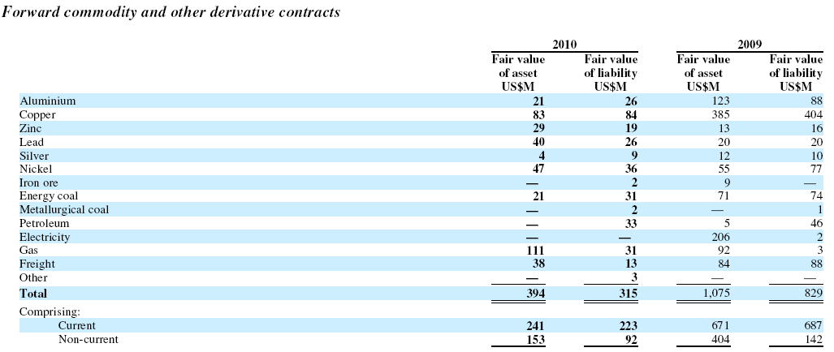
Commodity Price Risk
Contracts for sale, physical delivery are executed on pricing basis to meet a relevant index target

Slide 39
Liquidity risk
Uses highly liquid derivative market only
Moody investor guide rated A-1 for group’s long term rating (Short term rating P-1)
S&P Rating of A+ (Short term rating A-1)
No default on loan payable

Slide 40
Credit risk
Manage credit risk by group-wide procedures covering approval for credit approvals, granting, and renewal of counterparty limits and daily monitoring of the limit.
No significant concentration of credit risk

Slide 41

Notes:
Now lets look at Newmont Mining Corporation

Slide 42
Company Profile
Incorporated in 1921
Primarily a gold producer (83% of net revenue), also engages in some copper production
Owns 91.8 million equity ounces of proven and probable gold reserves, 9.1 billion equity ounces of copper reserves
Listed on NYSE, Australian and Toronto stock exchanges (NYSE & ASX: NEM; TSX: NMC)
Only gold company included in the S&P 500 Index and Fortune 500
Market Capitalization: 30.12 B USD

Slide 43
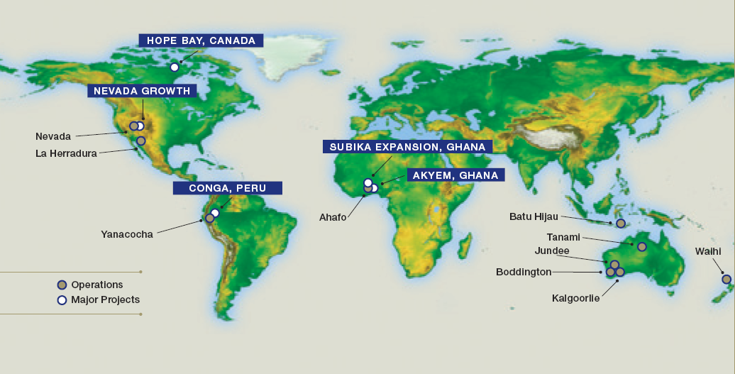
Newmont Operations and Major Projects
Have operations in US, Canada, Australia, Peru, Indonesia, Ghana, New Zealand and Mexico

Slide 44
Financial Highlights
In 2009:
Revenues of $7.7 billion
Equity gold sales of 5.3 million ounces
Equity copper sales of 226 million pounds
Net cash from continuing operations of $2.9 billion

Slide 45
Hedging Philosophy
Follows the strategy of not hedging gold and copper sales to provide shareholders with leverage to changes in gold and copper prices
Uses derivatives to manage risk associated with:
Commodity input costs
Interest rates
Foreign currencies

Slide 46
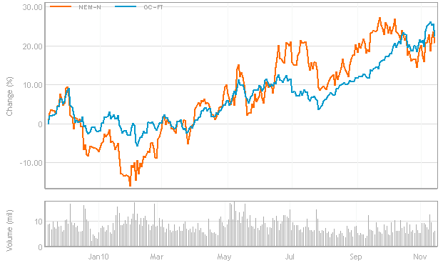
Stock Price vs. Gold Price

Slide 47
Risk Exposures
Mineral Exploration and Mining Hazards
Environmental Risks
Reserve Estimates
Licenses and Permits
Notes:
Natural resource companies are required to close their operations and rehabilitate the lands that they mine in accordance with a variety of environmental laws and regulations. Any underestimated or unanticipated rehabilitation costs could materially affect asset values, earnings and cash flows.

Slide 48
Risk Exposures
Commodity Price Risk
Foreign Exchange Risk
Interest Rate Risk
Derivative Instrument Risk
- Credit risk
- Market liquidity risk
- Mark-to-market risk
Notes:
Mark to market risk mitigated by establishing trading agreements with counterparties under which we are not
required to post any collateral or make any margin calls on our derivatives

Slide 49
Commodity Price Risk
Newmont’s revenues, net income and cash flow is highly dependent on the price of gold and copper
Metal prices fluctuate due to factors which include:
Gold sales or leasing by government and central banks
Forward sales by producers;
Demand for jewellery, industrial and investment purposes
Speculative trading
The relative strength of U.S dollars to other currencies
Global production and cost levels
Availability of cheaper substitutes

Slide 50
Derivatives for Commodity Price Risk
Gold mining companies mainly use:
Forward contracts
Spot deferred contract
Put and call option
Gold lease rate swaps
Most prefer to use forward contracts as its hedging instruments since this allows producers to not consider their sales contracts as derivative instruments as long as they are considered to be normal sales
Gold mining firms can record the proceeds under this contract as revenue and can be held off balance sheet until maturity

Slide 51
Foreign Exchange Risk
Gold and copper sold based primarily on the U.S. dollar price, but operating expenses are incurred in local currencies
Appreciation of local currencies against U.S. dollar increases costs of production in U.S. dollar terms at mines located outside of U.S.
The currency that primarily impacts Newmont’s results of operations is the Australian dollar
Newmont enters into fixed forward contracts to hedge up to:
80% of IDR, 85% of A$ and 75% of NZ$ denominated operating expenditures

Slide 52
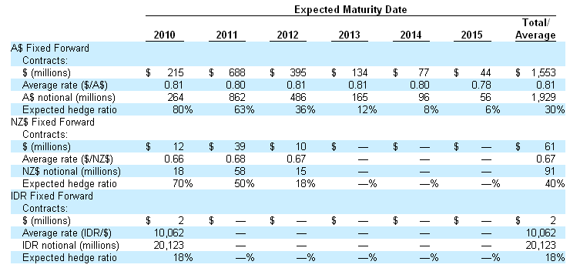
Foreign Currency Derivatives
At Sept. 30, 2010, Newmont had the following foreign currency contracts outstanding:

Slide 53
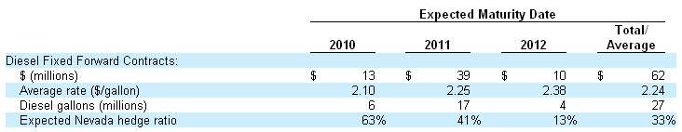
Diesel Fixed Forward Contracts
Newmont hedges up to 66% of its operating cost exposure related to diesel consumed at its Nevada operations to reduce the variability in realized diesel prices
At Sept. 30, 2010, Newmont had the following diesel derivative contracts outstanding:

Slide 54
Interest Rate Risk
Interest rate swap contracts to hedge against the interest rate risk exposure from bonds, notes, debentures, and other debts
At December 31, 2009, Newmont had fixed to floating swap contracts to hedge against its 8.625% senior notes due 2011
Receives fixed-rate interest payments at 8.63% and pays floating rate interest amounts based on periodic LIBOR settings plus a spread, ranging from 2.60% to 7.63%
The purpose is for providing balance to Newmont’s targeted mix of fixed and floating rate debt

Slide 55
Price-Capped Sales Contracts
In September 2001, Newmont entered into transactions that closed out certain call options through replacement with a series of forward sales contracts requiring physical delivery of the same quantity of gold over slightly extended future periods
Under the terms of the contracts, Newmont will realize the lower of the spot price on the delivery date or the capped price ranging from $381 to $392 per ounce
In June 2007, Newmont paid $578 to settle the 1.85 million ounce price- capped forward sales contracts, reporting a $531 pre-tax loss on the early settlement after a $47 reversal of previously recognized deferred revenue in 2007

Slide 56
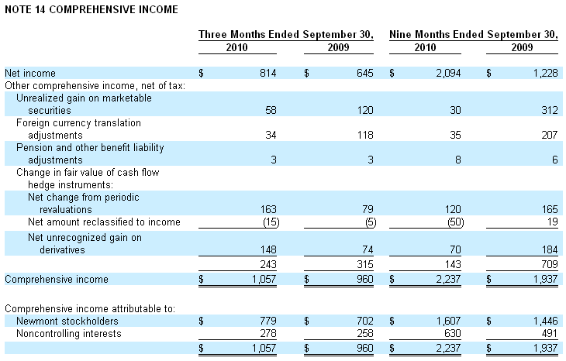

Slide 57
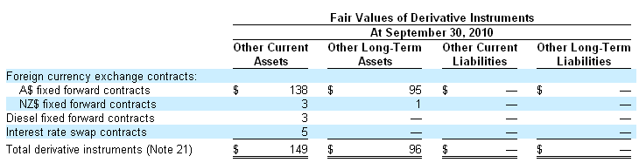
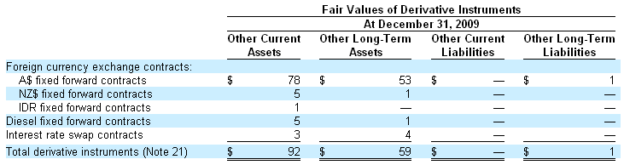
Derivative Instrument Fair Values
Newmont had the following derivative instruments designated as hedges with fair values at Sept. 30, 2010 and Dec. 31, 2009
Notes:
Here is a table on the rough break-down of derivative instruments outstanding, which include fixed forward contracts on foreign currency, fixed forward contract on diesel, and interest rate swap contracts

Slide 58


Notes:
About teck: operations profits/revenues, risk exposures, financial instruments (?)
credit risk
derivatives and hedges
sensitivity analysis (should be on fs)
dervatives?
BS?
IS
CFS

Slide 59
About Teck
Canada’s largest diversified mining, mineral processing and metallurgical company
Focus on copper, metallurgical coal, zinc and energy
2009 experienced record revenue of 2.5B

Slide 60
Area of Operations

Slide 61
Q3 2010 Report
Notes:
Info results for 3 months ended sept 30, 2010
From Q3 2010 report
Compared to 3rd quarter last year, 2.5B vs 2.1B
Copper revenues similar- higher copper prices offset by 18% redcution in sales volume
Coal: increased from higher coal prices, slighty lower sales prices
Zinc: higher zinc/lead prices and higher sales volumes
-effect of weaker US dollar partly offset impact of higher commodity prices in other business units
Copper: prices rose in 3rdQ => pre tax positive pricing adjustments; price of copper averaged US 3.29$ per pound,24% higher than in same period last year -higher price was primarily offset bu lower sales volumes and effect of weaker USD; copper sales volumes 18% lower than last year due to lower production
COAL: increase from last year in same period due to higher coal prices, partially offset by effect of weaker USD and higher unit cost of product sold. Coal prices averaged $200 USD per tonne compared to 137$USD per tonne in same period last year. Lower production due to congestion and coal loading problems at one of their coal factories. They were also affected by higher strip ratios and higher diesal prices, increasing the unit cost of product sold from 54$ to 62$ comapredto same quarter in last year
ZINC: zinc prices rose; affecting pre tax positive pricing adjustments, and and increasing operating profit

Slide 62
Q3 2010 Report

Slide 63
Quarterly Earnings and Cash Flow

Slide 64
Teck’s Risk Exposures
Foreign exchange risk
Interest rate risk
Commodity price risk
Credit risk
Liquidity risk
Risks associated with capital markets
Use of derivatives managed by Hedging Committee and Board of Directors
Notes:
2009 Annual Report: their activites expose them to financial risks including foreign exchange risk, interest rate risk, cmmodity price risk, credit risk, liquidity risk, and other risks associated with capital markets.
From time to time, they may use foreign exchange forward contracts, commodity price contracts and interest rate swaps to manage exposure to fluctuations to foreign exchange ,metal prices and interest rates.
They do not havea practice of trading derivatives; their use of derivatives based on established practices and parameters , subject to oversight of Hedging Committee and BOD (COULDN’T FIND ORG CHART!)

Slide 65
Risk Factors
Teck faces inherent risks in mining and metals business.
Environment
Industrial acidents
Geological formations
Notes:
Have a section that addresses all potential risk factors and how they are managed. http://www.teck.com/Generic.aspx?PAGE=Investors+Pages%2fPublic+Filings&portalName=tc
1) . Environmental hazards, industrial accidents, geological formations, metallurgical difficultings, ground control problems/flooding.

Slide 66
Risk Factors
Fluctuations in market price of base metals, speciality metals and metallurgical coal may significantly adversely affect results of operations
Cyclical prices
Teck’s policy on hedging
Makes exception in certain circumstances
Notes:
2) prices are cyclical and subject to substantial fluctuations in price; general policy is NOT TO hedge changes in prices of mineral production; sometimes undertake hedging programs in specific circumstances, with intention to reduce risk of commodity’s market price while optimizing upside participation to maintain adequate CFs and profitability to contribute to LT viability of business.

Slide 67
Sensitivity Analysis:
Notes:
2) prices are cyclical and subject to substantial fluctuations in price; general policy is NOT TO hedge changes in prices of mineral production; sometimes undertake hedging programs in specific circumstances, with intention to reduce risk of commodity’s market price while optimizing upside participation to maintain adequate CFs and profitability to contribute to LT viability of business.

Slide 68
Risk Factors
Commodity Price Risk:
Notes:
2) prices are cyclical and subject to substantial fluctuations in price; general policy is NOT TO hedge changes in prices of mineral production; sometimes undertake hedging programs in specific circumstances, with intention to reduce risk of commodity’s market price while optimizing upside participation to maintain adequate CFs and profitability to contribute to LT viability of business.

Slide 69
Risk Factors
Volatility in commodity markets/financial markets may adversely affect ability to operate, as well as their financial condition
Inability to obtain equity
Notes:
3) Recent global fianncial conditions/commodity markets have been volatile, access to financing has been negatively affected. This can affect ability to obtain equity or financing on acceptable terms,
-hard to plan operations

Slide 70
Risk Factors
Liquidity Risk:
Teck’s liquidity risk arises from general and capital financing needs. The following chart illustrates contractual undiscounted cash flow requirements from liabilities as at December 31, 2009, and is taken from the 2009 Annual Report.

Slide 71
Risk Factors
Teck may be adversely affected by currency fluctuations
Enter into limited foreign exchange contracts time to time
Contracts expose Teck to risk of default
Notes:
Opearting results and CFs affected by changes in CDn $ exchange rate relative to currencies of other companeis
Movements in exchange rate can impact results of operating costs incurred
To reduce exposure to currency fluctuations, enter limited foreign exchange contracts from “time to time”, but they don’t eliminate the potential that fluectionats may have an adverse effect on them.
-those contracts may expose Teck to risk of default by conterparties

Slide 72
Risk Factors
Interest rate changes may adversely affect Teck
Interest rate swaps
As at December 31, 2009, with other variables unchanged, a 1% change in the LIBOR rate would have a $36 million effect (2008 - $75 million) on net earnings. There would be no effect on other comprehensive income.
Notes:
Exposure to changes in interest rates result from investing and borrowing to manage luqidity and capital requirements
-They have incurred indebtedness that bears interet at fixed and floating rates, and have entered into interst rate swap agreements to effectively convert some fixed rate exposure to floating rate exposure.
-2009- arises from cash and cash equivalents, floating rate debt and interest rate swaps. Policy is generally to borrow at fixed rates to match duration of long lived assets. However, floating rate funding may be used,
-London Interbank Offered Rate : world's most widely used benchmark for short-term interest rates. It's important because it is the rate at which the world's most preferred borrowers are able to borrow money. It is also the rate upon which rates for less preferred borrowers are based.

Slide 73
Other Risks
Insurance may not provide adequate coverage
Subject to potential labour unrest/other labour disturbances as a result of failure of negotiations
May not be able to hire enough skilled employees to support operations
Ability to acquire properties may be affected by competition from other mining companies
Competition in product markets
May face restricted access to markets in futures (trade barriers or policies on tariffs)
Depletion of mineral reserves may not be offset by future discoveries or acquisitions of mineral reserves
Risks associated with issuenace and renewal of environmental permits
Changes in environmental, health and safety laws may have adverse effect on operations
Teck is highly dependent on third parties for provision of trasportation services (due to geographical locations of mining properties,i.e rail and port services)
Aboriginal title claims and rights to consultation and accomodation may affect existing operations as well as development projects and future acquisitions
Operations in foreign juristictions face added risks and uncertainties due to different economic, cultural and political environments

Slide 74
Effect of Derivative Instruments on Statement of Earnings and Comprehensive Income in 2009:

Slide 75
Accounting for Financial Instruments:
Notes:
Commodity Price Risk:subject to price risk from fluctuations in market prices of commodities produced –they use contracts to manage this exposure

Slide 76
Financial Instruments and Derivatives
Notes:
This shows after tax effect of financial instruments on net earnings :
Most significant of which are marketabale securities, forward sales contracts, prepayment rights on senior debt notes, and settlements receivable and payable.
From time to time will engage in simple derivative transactions like forward swaps and optinos to manage exposure to changes in market prices.

Slide 78
Thank You

