Slide 1

Risk Management – Oil & Gas
Angelin Liu, Jin Yan, Parry Pasricha
November 10, 2010

Slide 2
Industry Overview
2 major sectors
Upstream – applies to the operation of exploration, drilling, hydrocarbon production, and transmission via truck, rail or ship or pipe line to the refinery intake valve
Downstream – includes all work done at the refinery, distillation, cracking, reforming , blending storage, mixing and shipping

Slide 3
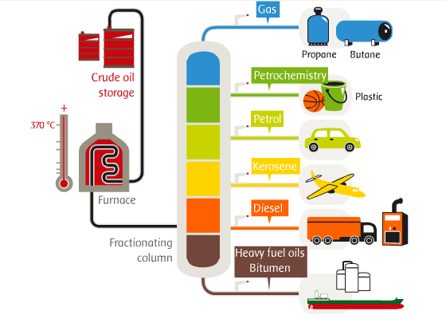
Industry Overview
Energy products

Slide 4
Top World Oil Net Exporters, 2008
Source: U.S. Energy Information Administration (2010)

Slide 5
Historical Crude Oil Spot & Futures Prices
Source: U.S. Energy Information Administration (2010)

Slide 6
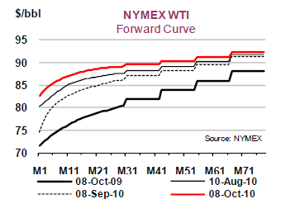

Slide 7
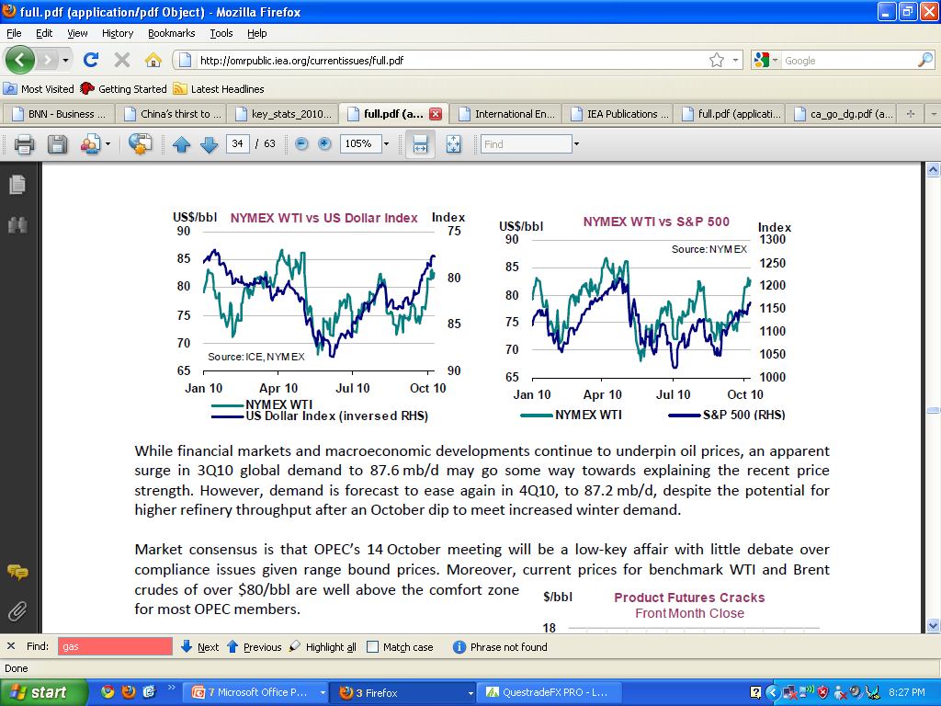

Slide 8
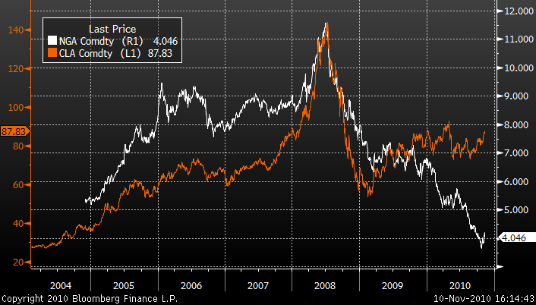
Crude Oil vs. Natural Gas Prices

Slide 9
O&G Risk Management Tools
Price collar hedge
Interest rate swap
Cross-currency swap
Forward rate agreement

Slide 10
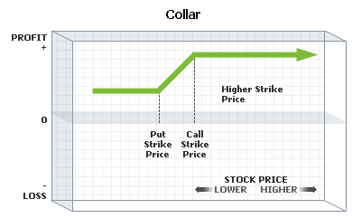
Collar Hedge
Price collar constructed by holding shares, purchasing a protective put and writing a covered call on the stock
Limits transaction costs and downside risk

Slide 11
Swaps
Interest rate swap
An agreement between two counterparties to exchange cash flows (Fixed vs. Float) in the same currency
Cross-currency swap
An agreement between two counterparties to exchange cash flows (Float vs. Float) in different currencies

Slide 12
Forward Rate Agreement (FRA)
Forward contract that determines the rate of interest, to be paid, or received, on an obligation beginning at some future start date

Slide 13
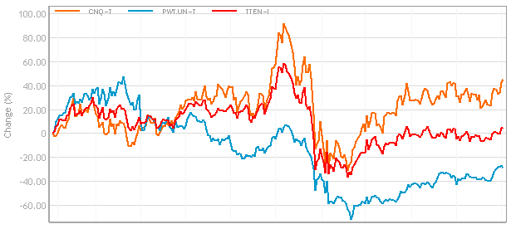
Relative Share Price Performance

Slide 14
Penn West Energy Trust (TSE: PWE)

Slide 15
Company Profile
Market Capitalization $10 Billion
Long Term Debt(2) $2.5 Billion
Production averaged 164,087 boe per day and was weighted 60 percent to liquids and 40 percent to natural gas
Cap X 2010: $0.9 – $1.0 billion
Forecast 2011 Production 172,000 – 177,000 boe/d
Cap X 2011: $1.0 – $1.2 billion
#1 Producer of Light & Medium oil in Western Canada
Notes:
Penn West Energy is one of the largest conventional oil and natural gas producers in North America. With proved plus probable reserves of approximately 687 million boe, Penn West has a reserve life index of 11.1 years. Penn West operates a significant portfolio of opportunities with a dominant position in light oil in Canada. Based in Calgary, Alberta, Penn West operates throughout the Western Canadian Sedimentary Basin on a land base encompassing approximately 7 million acres.

Slide 16
Q3 Report
Funds flow in the third quarter was $267 million compared to $349 million in the third quarter of 2009. The decline was primarily due to lower realized risk management gains.
Net loss was $25 million compared to a net income of $7 million in the third quarter of 2009. The decrease in net income in 2010 was mainly due to lower realized risk management gains and unrealized foreign exchange gains.
Netback was $23.13 per boe compared to $25.91 per boe in the third quarter of 2009. The decline was primarily due to lower realized risk management gains.

Slide 17
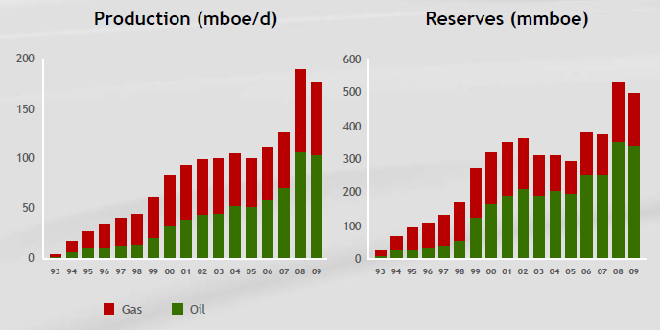
Oil & Gas

Slide 18
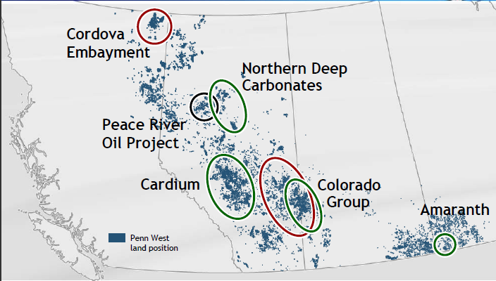
Operational Exposure

Slide 19
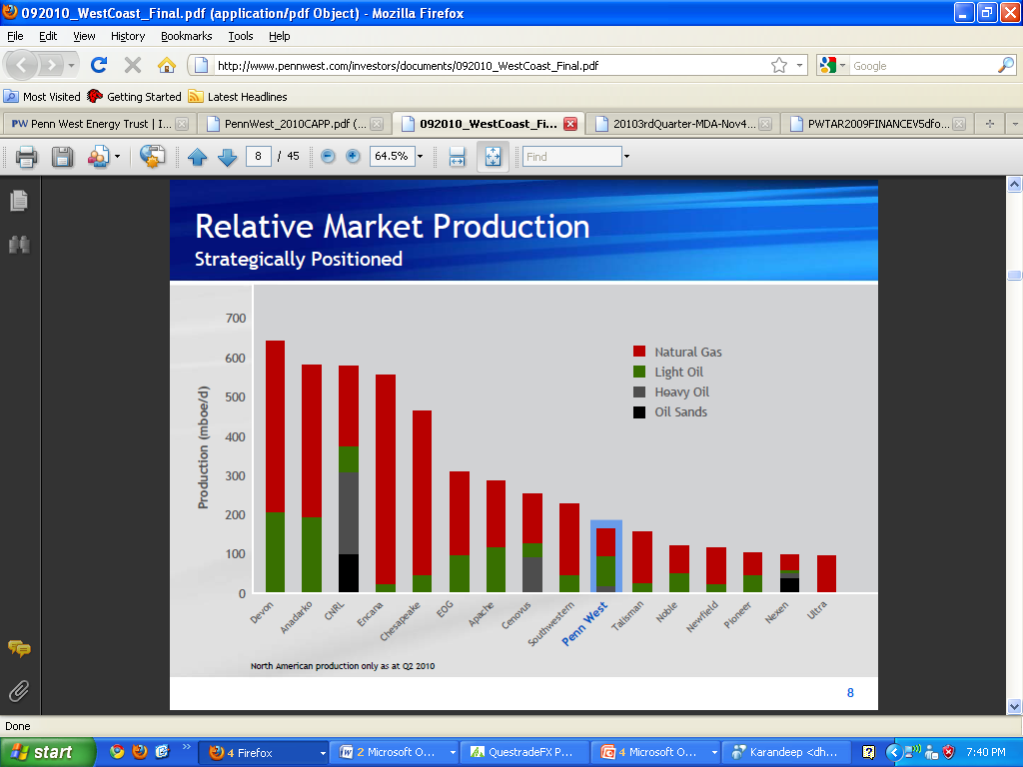

Slide 20
Strategy
• Capital budget of approximately $800 million necessary to maintain current production levels
• Focus funds to increase pace of development in key play areas – anticipate $200 to $400 million for organic growth
• Timing for conversion at year-end 2010
• Set dividend with objective to remain within funds flow for sustaining capital, growth capital and dividend
• Guidance for 2011 has been set at $1.0 - $1.2 billion capital and average daily production of 172,000 – 177,000

Slide 21

Management
William E. Andrew, (CEO) since 2005
Former President until 1995-2008
On the Board of Directors
Bill is a Professional Engineer with 35 years of oil and natural gas industry experience, including 18 years with Penn West.
Former Board of Governers at CAPP
Senior positions at Gulf Canada, Shell Canada, Canadian Occidental Petroleum, Ocelot Industries and Opinac Exploration.
Bill joined Penn West in 1992 as founding member of the team that led the company from a small cap to one of Canada’s largest senior oil and natural gas exploration and production companies.
Education
Engineering Diploma (UPEI)
BEng (UNS)

Slide 22

Management
Murray R. Nunns
President & COO (2008)
Previously on the Board of Directors
Professional Geologist with 30 years of growth oriented oil and natural gas experience
Brings to Penn West a long history of consistent success as an exploration and operational executive.
From 1993 to 2002, Murray held a Senior Vice President of Exploration and Development and Chief Operating Officer.
Education
Engineering Diploma (UPEI)

Slide 23

Management
Todd Takeyasu
Senior Vice President & CFO
25 years of oil and natural gas industry and public accounting experience.
He has been with Penn West since 1994 in various positions including
Financial Controller, Treasurer from 2001 to 2005 and Vice President, Finance until 2006
Education
BBA (University of Lethbridge)
CA

Slide 24
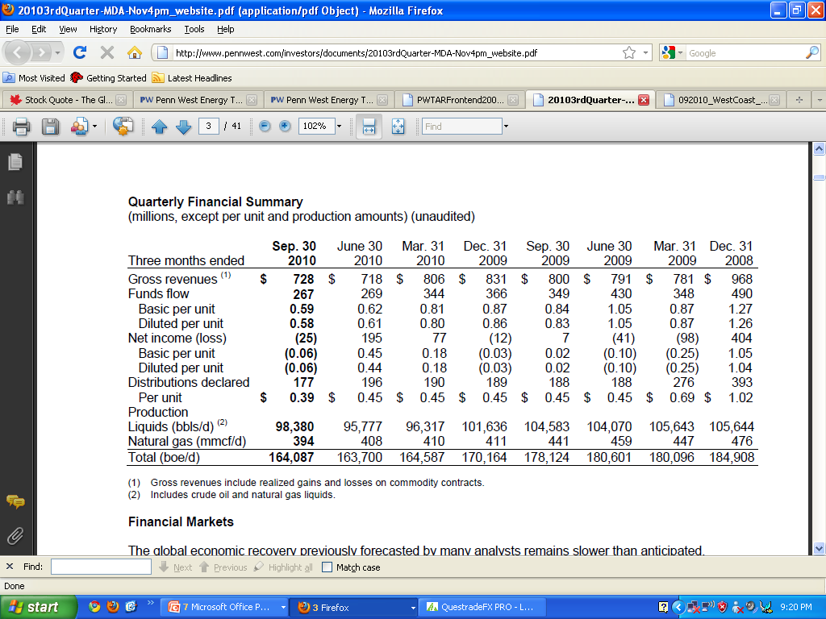

Slide 25
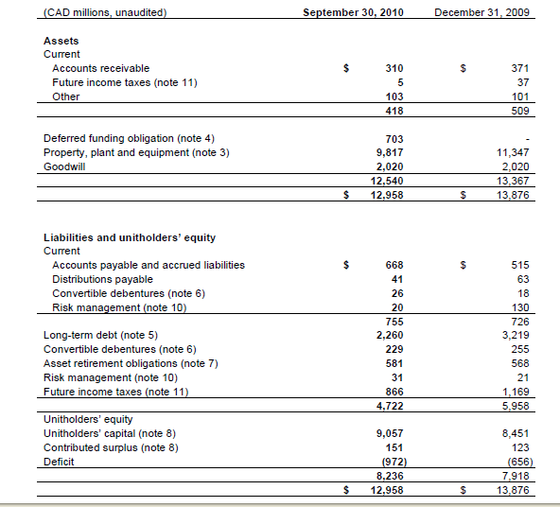

Slide 26
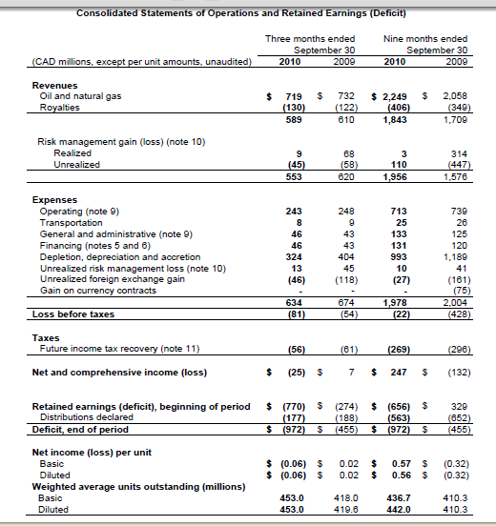

Slide 27
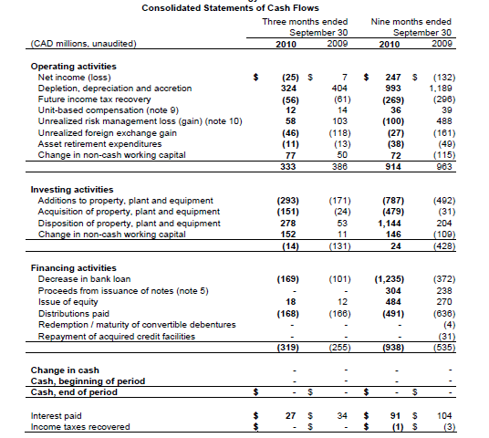

Slide 28
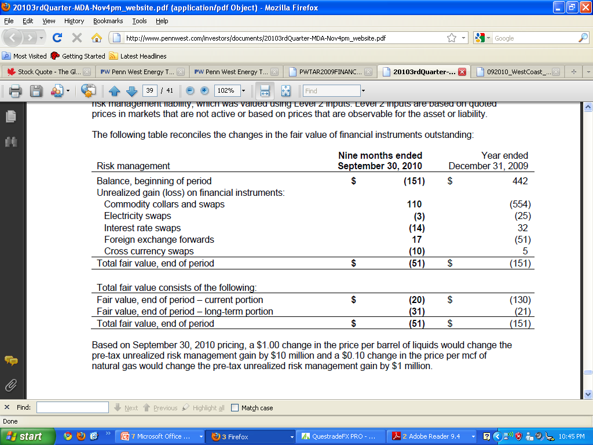

Slide 29
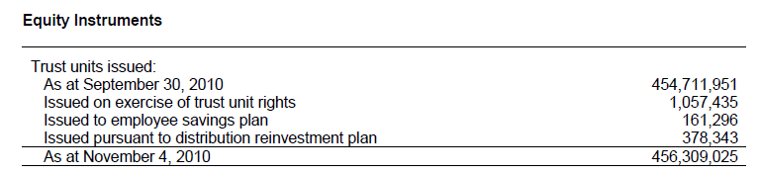

Slide 30
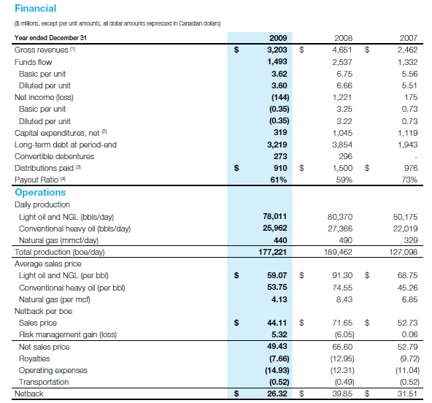

Slide 31
Business Risks
Commodity Price Risk
Foreign Currency Rate Risk
Credit Risk
Interest Rate Risk
Liquidity Risk
Environmental & Climate Change Risk

Slide 32
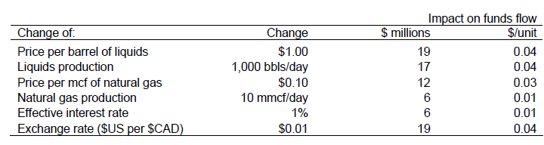
Sensitivity Analysis

Slide 33
Commodity Price Risk
Manage these risks through the use of swaps, collars or other financial instruments up to a maximum of 50 percent of forecast sales volumes, net of royalties, for the balance of any current year plus one additional year forward and up to a maximum of 25 percent for one additional year thereafter.

Slide 34
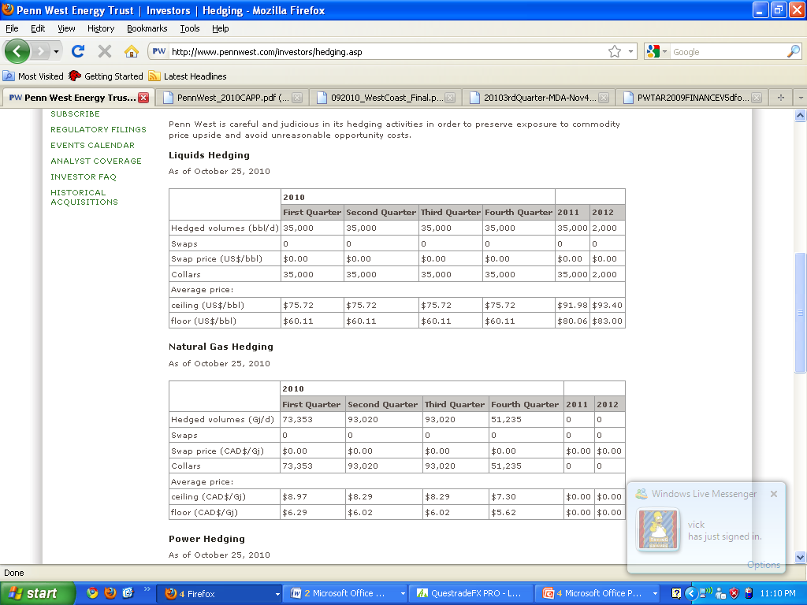
Current Hedges

Slide 35
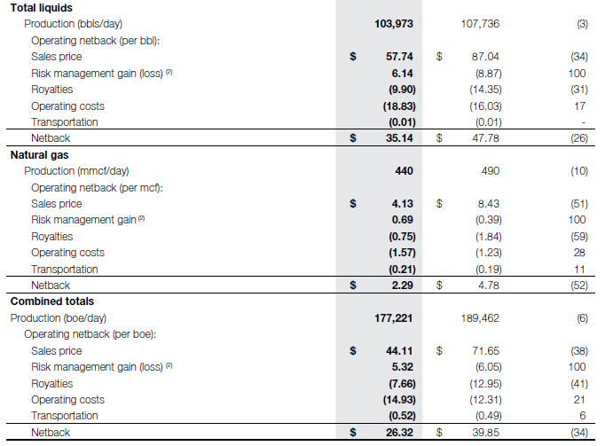
Profitability vs. Oil Price
2009 2008 % Change

Slide 36
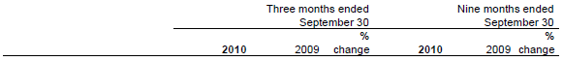
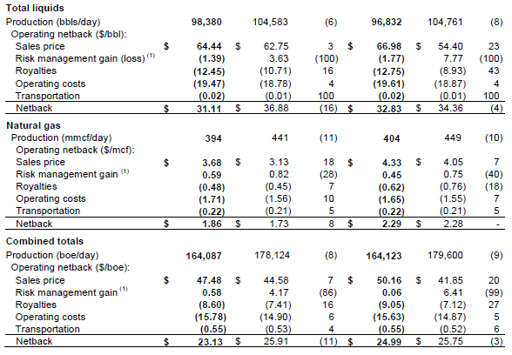
Profitability vs. Oil Price

Slide 37
Foreign Exchange Risk
Prices received for crude oil are referenced to or denominated directly in US dollars, thus our realized oil prices are impacted by Canadian dollar to US dollar exchange rates. A portion of our debt capital is denominated in US dollars, thus the principal and interest payments in Canadian dollars are also impacted by exchange rates.

Slide 38
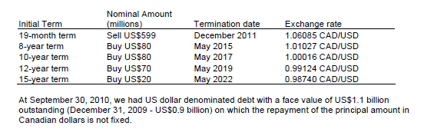
Foreign Exchange Forwards

Slide 39
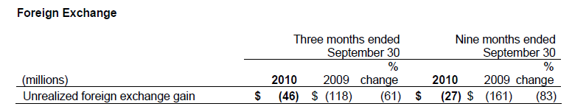

Slide 40
Credit Risk
Credit risk is the risk of loss if purchasers or counterparties do not fulfill their contractual obligations
For oil and natural gas sales and financial derivatives, we follow a counterparty risk procedure whereby each counterparty is reviewed on a regular basis for the purpose of assigning a credit limit and is requested to provide security if deemed necessary.
For financial derivatives, we normally transact with counterparties who are members of our banking syndicate or other counterparties that have investment grade bond ratings.

Slide 41
Interest Rate Risk
We currently maintain a portion of our debt capital in floating-rate bank facilities which results in exposure to fluctuations in short-term interest rates which remain at lower levels than longer-term rates.
From time to time, we may increase the certainty of our future interest rates by entering fixed interest rate debt instruments or by using financial instruments to swap floating interest rates for fixed rates or to collar interest rates.

Slide 42
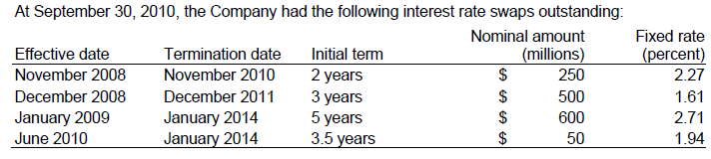
Interest Rate Swaps
As at September 30, 2010, we had a total of $1.6 billion of fixed interest rate debt instruments and $0.3 billion of convertible debentures outstanding. On the fixed interest rate debt, as at September 30, 2010, the average remaining term was 7.2 years (2009 – 7.9 years) with an average interest rate of 6.34 percent (2009 – 6.54 percent).

Slide 43
Liquidity Risk
Liquidity risk is the risk that we will be unable to meet our financial liabilities as they come due.
Management utilizes short and long-term financial and capital forecasting programs to ensure credit facilities are sufficient relative to forecast debt levels, distribution and capital program levels are appropriate, and that financial covenants will be met.
In the short term, liquidity is managed through daily cash management activities, short-term financing strategies and the use of collars and other financial instruments to increase the predictability of cash flow from operating activities.

Slide 44
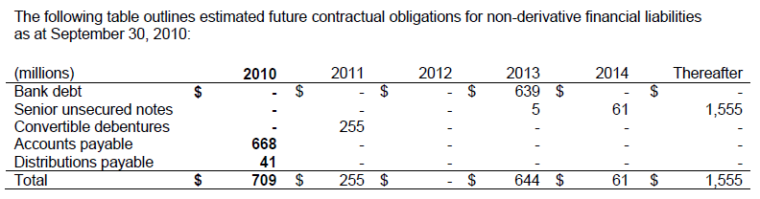
Current Obligations

Slide 45
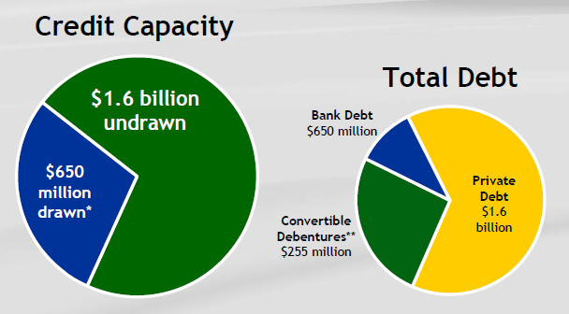
Liquidity

Slide 46
Environmental & Climate Change Risk
The oil and gas industry has a number of environmental risks and hazards and is subject to regulation by all levels of government. Environmental legislation includes, but is not limited to, operational controls, site restoration requirements and restrictions on emissions of various substances produced in association with oil and natural gas operations.

Slide 47
Canadian Natural Resources (TSE: CNQ)

Slide 48
Corporate Profile
One of the largest natural gas and crude oil producers in the world
Targets cost effective alternatives for project development and growth
Low-cost, diversified operations in North America, the North Sea (UK), and offshore West Africa

Slide 49
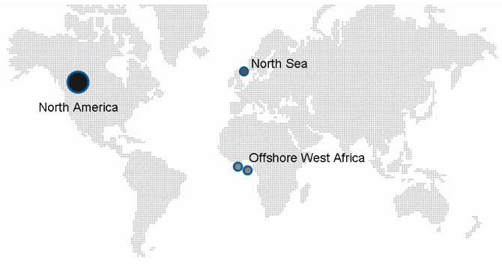
Areas of Operation

Slide 50
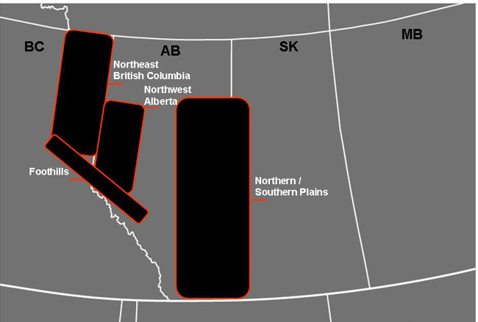
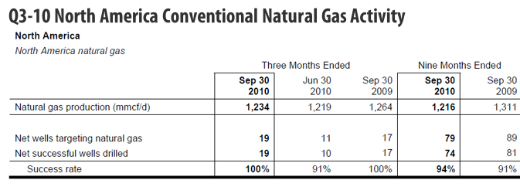
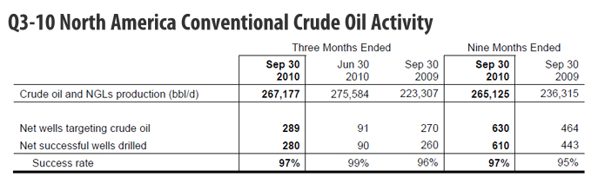
Areas of Operation

Slide 51
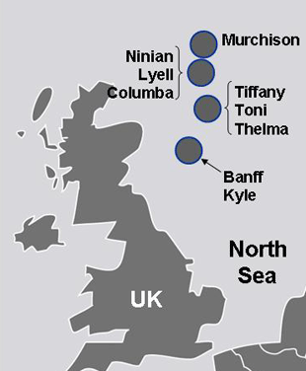
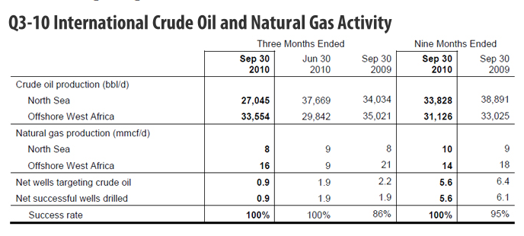
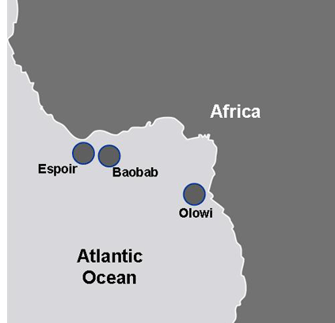
Areas of Operation

Slide 52
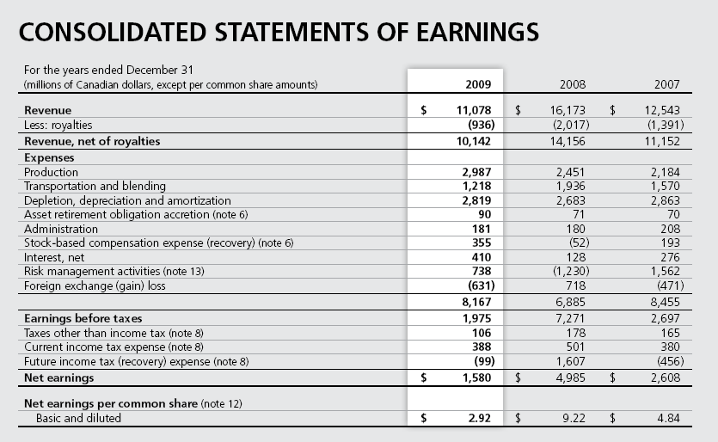
Financial Statements

Slide 53
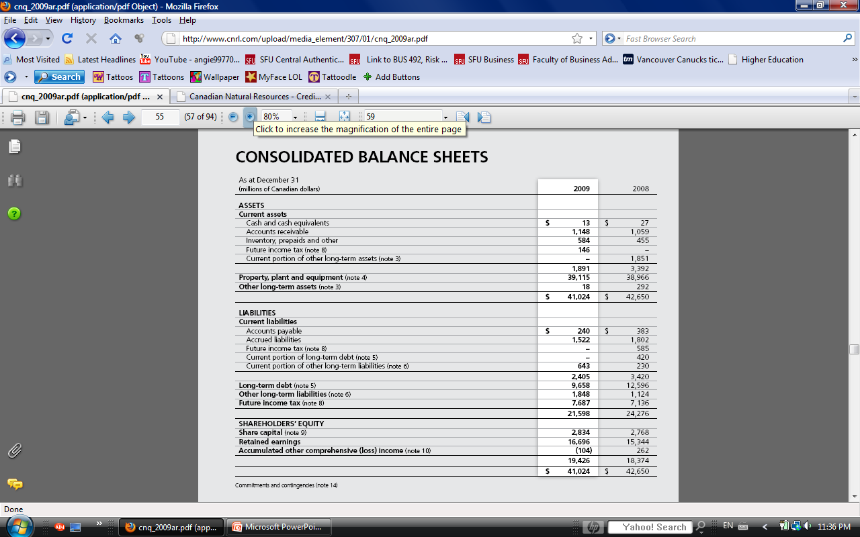
Financial Statements

Slide 54
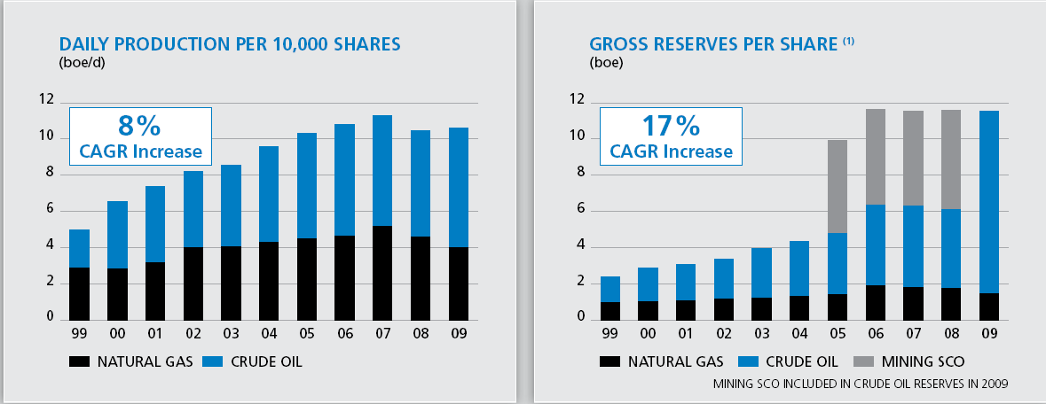
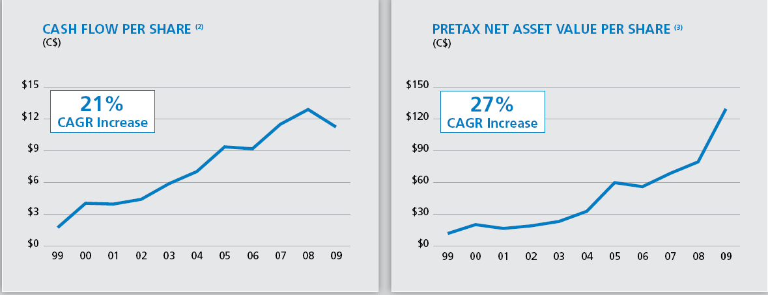
Financial Highlights

Slide 55
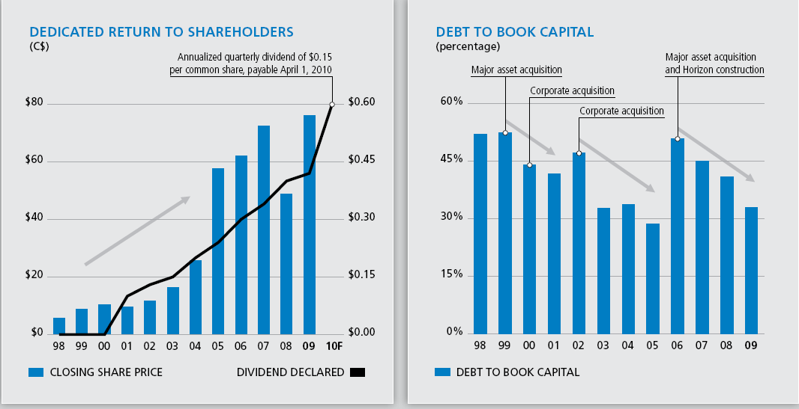
Financial Highlights

Slide 56
Business Approach
Low cost producer
Focus on exploitation
Strategic acquisitions
Maintain flexibility and control allocation of capital
Strive for a balanced asset portfolio
Maintain a strong balance sheet and investment grade debt rating
Hedging Principle
To use derivatives to minimize price, interest rate, and foreign exchange risk
Not for speculative purpose
Rely on external, observable market inputs
i.e. quoted commodity price, volatility, interest rate curves, fx rates

Slide 57
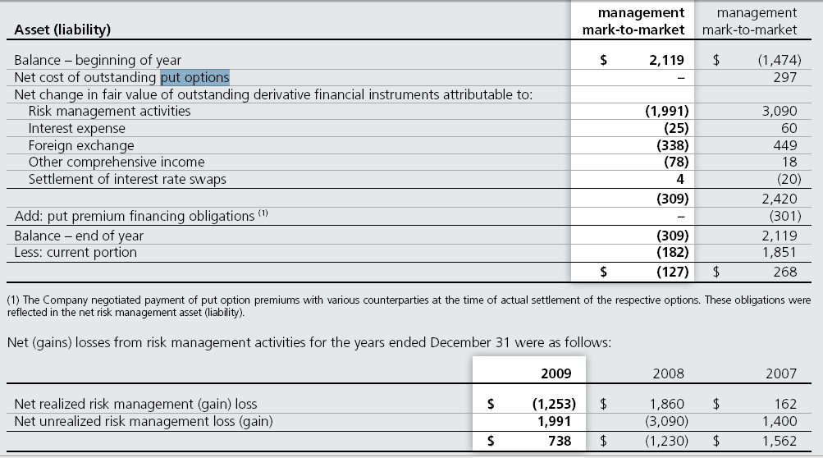
Risks Management Overview
Commodity Price
Interest Rate
Foreign Exchange Rate

Slide 58
Commodity Price Risk
Production sold based on USD benchmark price
WTI and Brent indices for crude oil
NYMEX for natural gas
There is an overall decrease in WTI pricing in 2009
Worldwide financial economic events
Partially offset by strong Asian demand
Company anticipates continued volatility results from:
Unpredictable nature of supply and demand
Geopolitical events
Global economy

Slide 59
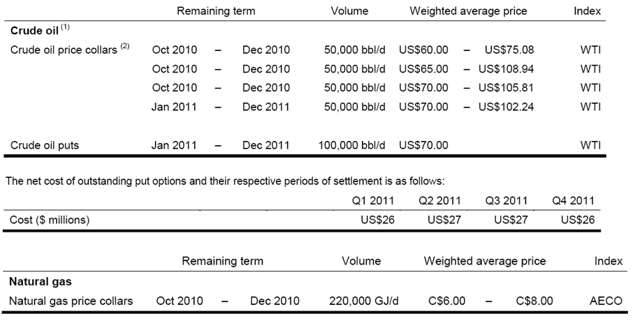
Commodity Price Risk

Slide 60
Currency Risk
Operating results affected by fluctuations in the exchange rates between CAD, US, and UK sterling
Majority revenue based on US dollar
Strong CAD= decrease in revenue
US dollar denominated long term debt
Working capital
Operations in North Sea (UK)

Slide 61
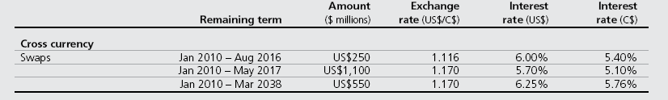
Currency Risk
Cross-currency swap outstanding year-end 2009:
Foreign currency forward
US$1,062 million contracts outstanding, with terms of approximately 30 days or less

Slide 62
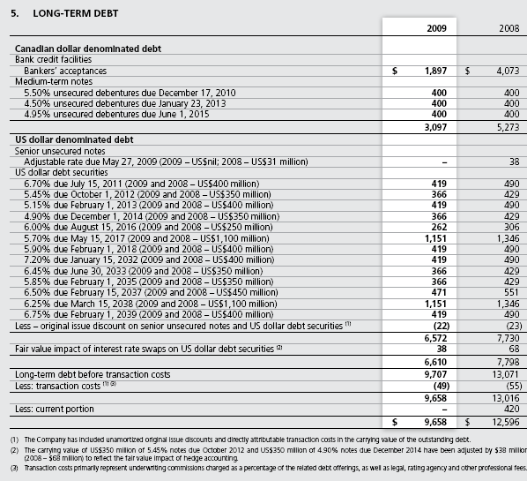
Interest Rate Risk
Company is exposed to:
Interest rate price risk on its fixed rate long-term debt
Interest rate cash flow risk on its floating rate long-term debt

Slide 63
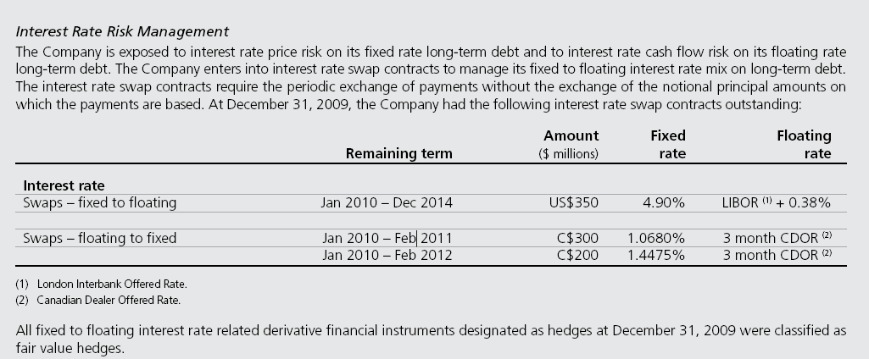
Interest Rate Risk
Notes:
P.66

Slide 64
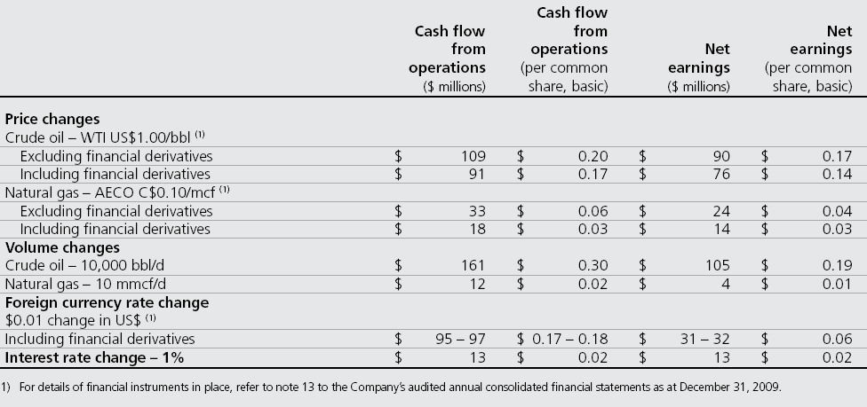
Sensitivity Analysis

Slide 65
Additional Information
“…we find that there is generally no difference in firm values between firms that hedge and firms that do not hedge.”
Commodity risk exposure can be easily identified and hedged by individual investors
Source: Jin and Jorion (2004), Journal of Finance
“By examining the impact of hedging on relationships between stock returns and oil/gas price changes, we find that stock returns indeed respond to these price changes in nonlinear ways and stock returns do not fall as oil and gas prices are falling.”
Source: Dan, Gu, and Xu

