Slide 1
Royal Bank of Canada
Presented by
Li Yao 301094849
Winny Li 301048633
Bus 492
Short Term Risk Management

Slide 2
Agenda
Industry Overview
Basel Committee
Risk Management--RBC
Types of Risks--RBC

Slide 3
Industry Overview
22 domestic banks
24 foreign bank subsidiaries
Over 15 foreign bank branches
Over 8,000 bank branches
Around 17,000 ATMs

Slide 4
Industry Overview
The Bank Act of 1991 divides banks operating in Canada in three schedules
  Schedule I banks allowed to accept deposits that are not a subsidiary of a foreign bank. Eg. RBC, TD banks, Scotiabank, CIBC, and BMO.
  Schedule II banks are a subsidiary of a foreign bank allowed to accept deposits in Canada. Eg. Citibank Canada, AMEX Bank of Canada, and ING Bank of Canada
  Schedule III banks are foreign banks which can do banking business in Canada. Eg. Bank of America, Deutsche Bank AG and Credit Suisse.

Slide 5
Industry Overview
“Big Five” Canadian banks
  RBC- Royal Bank of Canada
  TD- Toronto Dominion Bank Financial Group
  Scotiabank
  CIBC- Canadian Imperial Bank of Commerce
  Bank of Montreal
Notes:
http://www.bankingcanada.net/
RBC is the biggest, TD is the second biggest, and Scotiabank is the third

Slide 6
Industry Overview
Canadian Banks | Market Cap. | Assets
RBC | $77,685 million | $654,989 million
TD Financial Groups | $52,972 million | $557,219 million
Scotiabank | $46,379 million | $496,516 million
CIBC | $23,807 million | $335,944 million
BMO | $27,600 million | $388,458 million

Slide 7
Basel Committee
Its objective is to enhance understanding of key supervisory issues and improve the quality of banking supervision worldwide.
Created by the central bank Governors of the Group Ten nations in 1974 and meets four times a year at the Bank for International Settlements (BIS) in Basel Switzerland
  Current Basel members from 27 countries and regions
Notes:
Group Ten-Belgium, Canada, France, Germany, Italy, Japan, Netherlands, Sweden, Switzerland, the UK, the US
The Committee's members come from Argentina, Australia, Belgium, Brazil, Canada, China, France, Germany, Hong Kong SAR, India, Indonesia, Italy, Japan, Korea, Luxembourg, Mexico, the Netherlands, Russia, Saudi Arabia, Singapore, South Africa, Spain, Sweden, Switzerland, Turkey, the United Kingdom and the United States

Slide 8
Basel Committee
Work is organized under four main sub-committees
  The Standards Implementation Group
  The Policy Development Group
  The Accounting Task Force
  The Basel Consultative Group

Slide 9
  SIG
The Standards Implementation Group was originally established to share information and promote consistency in implementation of the Basel II Framework.
In Jan 2009, its mandate was broadened to concentrate on implementation of Basel Committee guidance and standards more generally.

Slide 10
PDG
The primary objective of the Policy Development Group is to support the committee by identifying and reviewing emerging supervisory issues and, where appropriate, proposing and developing policies that promotes a sound banking system and high supervisory standards.

Slide 11
PDG
7 subgroups
  Risk Management and Modelling Group- monitor latest advances in risk measurement and management
  the Research Task Force- acts as a research economists from member institutions to exchange information and research
  the Working Group on Liquidity- information exchange on national approaches to liquidity risk regulation and supervision

Slide 12
PDG
  the Definition of Capital Subgroup- explores emerging trends in eligible capital instruments in member jurisdictions
  a Basel II Capital Monitoring Group- ensure that banks in their jurisdiction maintain a solid capital base throughout the economic cycle
  the Trading Book Group- addresses issues relating to the application of Basel II to certain exposures arising from trading activities.
  and the Cross-border Bank Resolution Group- is comparing the national policies, legal frameworks and the allocation of responsibilities for the resolution of banks with significant cross-border operations.

Slide 13
ATF
The Accounting Task Force works to help ensure that international accounting and auditing standards and practices promote sound risk management at financial institutions, support market discipline through transparency, and reinforce the safety and soundness of the banking system.
Three working groups: the Conceptual Framework Issues Subgroup, the Financial Instruments Practices Subgroup, and the Audit Subgroup.

Slide 14
BCG
The Basel Consultative Group provides a forum for deepening the Committee’s engagement with supervisors around the world on banking supervisory issues.

Slide 15
Basel I
A set of minimal capital requirements for banks, as known as 1988 Basel Accord
Enforced by law in the Group Ten countries in 1992
Basel I is risk insensitive and can easily be circumvented by regulatory arbitrage

Slide 16
Basel II
Basel II was initially published in June 2004
The purpose is to create an international standard that banking regulators can use when creating regulations about how much capital banks need to put aside to guard against the types of financial and operational risks banks face

Slide 17
Basel II
Aims at
  ensuring that capital allocation is more risk sensitive
  separating operational risk from credit risk, and quantifying both
  attempting to align economic and regulatory capital more closely to reduce the scope for regulatory arbitrage

Slide 18
Basel II
Basel II uses a “three pillars” concept, whereas Basel I dealt with only parts of each three pillars
“three pillars”
  Minimum capital requirements
  Supervisory review
  Market discipline

Slide 19
The First Pillar
The first pillar
  Deals with maintenance of regulatory capital calculated three major components of risk that a bank faces: credit risk, market risk, and operational risk
  Credit risk component can be calculated in three different ways of varying degree of sophistication
    Standardized approach
    Foundation Internal Rating-Based Approach (IRB)
    Advanced IRB

Slide 20
The First Pillar
Three different approaches for operational risk
  Basic indicator approach (BIA)
  Standardized approach (TSA)
  Internal measurement approach
    an advanced form of advanced measurement approach (AMA)
  For market risk, the preferred approach is VaR

Slide 21
The Second Pillar
The second pillar deals with regulatory response to the first pillar, giving regulators much improved “tools” over those available to them under Basel I.
It also provides a framework for dealing with all the other risks, such as systemic risk, pension risk, concentration risk, reputational risk, liquidity risk and legal risk.

Slide 22
The Third Pillar
It leverages the ability of market discipline to motivate prudent management by enhancing the degree of transparency in banks’ public reporting to shareholders and customers
It presents a set of disclosure requirements that should improve market participants’ ability to assess banks’ capital structures, risk exposures, risk management processes.

Slide 23
Basel III
At September 12, 2010 meeting, Basel committee announced a substantial strengthening of existing capital requirements
These capital reforms, together with the introduction of a global liquidity standard, deliver on the core of the global financial reform agenda and will be presented to the Seoul G20 Leaders summit in November

Slide 24
Package of Reforms
Will increase the minimum common equity requirement from 2% to 4.5%
Banks will be required to hold a capital conservation buffer of 2.5% to withstand future periods of stress bringing the total common equity requirements to 7%
The reinforces the stronger definition of capital agreed by Governors and Heads of Supervision in July and the higher capital requirements for trading, derivative and securitisation activities to be introduced at the end of 2011

Slide 25
Capital Requirements
The minimum requirement for common equity will be raised from 2% to 4.5%
  Will be phased in by Jan 1, 2015
The purpose is to ensure that banks maintain a buffer of capital that can be used to absorb losses during periods of financial and economic stress
It will reinforce the objective of sound supervision and bank

Slide 26
Transition Arrangement
National implementation by member countries will begin on Jan 1, 2013
Member countries must translate the rules into national laws and regulations before Jan 1, 2013
  3.5% common equity/Risk-Weighted Assets (RWAs)
  4.5% Tier 1 capital/RWAs, and
  8.0% total capital/RWAs

Slide 27
Transition Arrangement
On Jan 1, 2014, banks will have to meet a 4% minimum common equity requirement and a Tier requirement of 5.5%
On Jan 1, 2015, banks will have to meet a 4.5% common equity and the 6% Tire 1 requirements

Slide 28
Transition Arrangement
By Jan 1, 2018, the regulatory adjustments would be fully deducted from common equity
  Amounts above the aggregate 15% limit for investments in financial institutions, mortgage rights, and deferred tax assets from timing differences
Deduction schedule: 20% on Jan 1, 2014 and increase an additional 20% for each subsequent year

Slide 29
Transition Arrangement
The capital conservation buffer will be phased in between Jan 1, 2016 and year end 2018
It will begin at 0.625% of RWAs on Jan 1 2016 and increase each subsequent year by an additional 0.625% to reach its final level of 2.5%

Slide 30
Royal Bank of Canada
RBC (RY on TSX and NYSE)
Operation in Canada, the US, and 53 other countries
Largest bank in Canada
80,000 full-time and part-time employees
More than 18 million clients in Canada

Slide 31
Royal Bank of Canada
Schedule I bank- accepting deposits that are not a subsidiary of a foreign bank
Services provided on a global basis
  Personal and commercial banking
  Wealth management services
  Insurance
  Corporate and investment banking
  Transaction processing services

Slide 32
Risk Environment
Global economy remained in recession and the pace of economic decline slowed largely reflecting stabilizing financial market and economic conditions
Credit risk has increased
Global capital markets remained under pressure and exhibited significant volatility
Notes:
The global economy remained in recession early in 2009. However, during the latter part of 2009, the pace of economic decline slowed largely reflecting stabilizing financial market and economic
conditions. Credit risk has increased while credit quality deteriorated from the prior year consistent with the global economic cycle. The extent of credit deterioration throughout 2010 will be driven by economic conditions and will continue to impact our consolidated results as credit losses generally come off the peak one year after the trough of the economic cycle.
Global capital markets remained under pressure and exhibited significant volatility during early 2009. The total market environment related net losses continued into 2009 at a similar pace to the end of 2008, though moderating in the latter part of the year, as global capital markets improved and volatility moderated due to increasing signs of stabilization in capital markets. However, there is still significant risk as the sustainability of this trend remains uncertain.

Slide 33
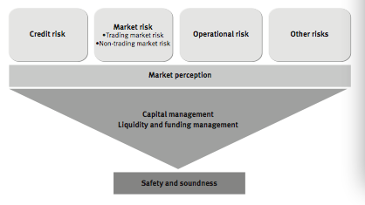
Risk Exposure

Slide 34
Risk Exposure

Slide 35
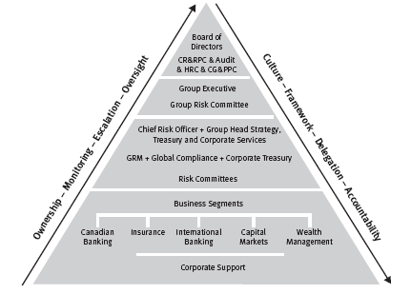
Risk Governance

Slide 36
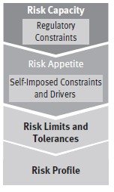
Risk Appetite
Define Risk Capacity by
    Identifying regulatory constrains that restrict the ability to accept risk
Establish and regularly confirm the Risk Appetite
  Chosen to limit or influence the amount of
    risk undertaken

Slide 37
Risk Appetite
Maintaining an “AA” rating or better
Ensuring capital adequacy
Maintaining low exposure to “stress events”
Maintaining stability of earnings
Ensuring sound management of liquidity and funding risk
Meeting regulatory requirements and expectations
Maintaining a Risk Profile that is no riskier than that of the average peer

Slide 38
Risk Appetite
Translate the Risk Appetite into Risk Limits and Tolerances
  Guide business in the risk taking activities
Regularly measure and evaluate the Risk Profile
  Against Risk Limits and Tolerances
  Ensuring appropriate action is taken in advance
  of Risk profile surpassing Risk Appetite
Notes:
This Risk Appetite Framework is consistent with current industry best practices and regulatory expectations. Going forward, it will be adapted and applied at the business segment, line of business and legal entity levels. It will evolve as regulators and markets continue to focus on management’s review and discussion of Risk Appetite.

Slide 39
Risk Management Principles
1. Effective balancing of risk and reward by aligning risk appetite
2. Shared responsibility for risk management
3. Business decisions are based on an understanding of risk
4. Avoid activities that are not consistent with our Values, Code of Conduct or Policies
5. Proper focus on clients reduces our risks
6. Use of judgment and common sense
Notes:
1. Effective balancing of risk and reward by aligning risk appetite
with business strategy, diversifying risk, pricing appropriately for risk, mitigating risk through preventive and detective controls and transferring risk to third parties.
2. Shared responsibility for risk management as business
segments are responsible for active management of their risks, with direction and oversight provided by Group Risk Management and other corporate support groups.
3. Business decisions are based on an understanding of risk as
we perform rigorous assessment of risks in relationships, products, transactions and other business activities.
4. Avoid activities that are not consistent with our Values, Code of Conduct or Policies, which contributes to the protection of
our reputation.
5. Proper focus on clients reduces our risks by knowing our clients and ensuring that the services we provide are suitable
for and understood by our clients.
6. Use of judgment and common sense in order to manage risk throughout the organization.

Slide 40
Risk Control
Level 1: Enterprise Risk Management Framework
Level 2: Risk-Specific Frameworks
Level 3: Enterprise Risk Policies
Level 4: “Multi-risk” Enterprise Risk Policies
Level 5: Business Segments Specific Policies & Procedures.
Notes:
Level 1: Enterprise Risk Management Framework is the foundation
for all matters related to risk management within the organization.
Level 2: Risk-Specific Frameworks elaborate on each specific risk
type and the mechanisms for identifying, measuring, monitoring and
reporting of risks, key policies and responsibilities.
Level 3: Enterprise Risk Policies articulate minimum requirements
within which businesses and employees must operate.
Level 4: “Multi-risk” Enterprise Risk Policies govern activities such
as product risk review and approval, stress testing, risk approval
authorities and model risk management.
Level 5: Business Segments Specific Policies & Procedures are
established to manage the risks that are unique to their operations.

Slide 41
Credit Risk
Credit risk is the risk of loss associated with a counterparty’s inability or unwillingness to fulfill its payment obligations and also includes counterparty credit risk in our trading operations.
  direct credit risk: eg. issuer, debtor, borrower or policyholder
  indirect credit risk: eg. guarantor, reinsurance

Slide 42
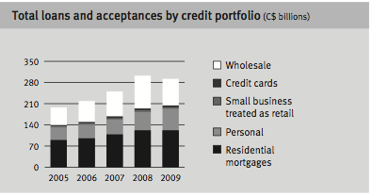
Credit Risk

Slide 43
Credit Risk Management
Ensuring that credit quality is not compromised for growth
Diversifying credit risks in transactions, relationships and portfolios
Using our credit risk rating and scoring systems, policies and tools
Pricing appropriately for the credit risk taken

Slide 44
Credit Risk Management
Applying consistent credit risk exposure measurements
Mitigating credit risk through preventive and detective controls
Transferring credit risk to third parties where appropriate through approved credit risk mitigation techniques, including hedging activities and insurance coverage

Slide 45
Credit Risk Measurements
Using Advanced Internal Ratings Based (AIRB) approach under Basel II
The key parameters used to measure expected loss are
  Probability of Default (PD)
  Loss Given Default (LGD)
  Exposure At Default (EAD)

Slide 46
Key Parameters
PD is an estimated percentage that represents the probability those obligors within a specific rating grade or for a particular pool of exposures will default within a one-year period
LGD is an estimated percentage of EAD that is expected to be lost in the event of default of an obligor
EAD is an estimated dollar value of the expected gross exposure of a facility upon default of the obligor before specific provisions or partial write-offs

Slide 47
Wholesale Credit Portfolio
The wholesale credit risk rating system is designed to measure and identify the risk inherent in our lending credit activities along two dimensions
  Each obligor is assigned a borrower risk rating (BRR), which has a PD assigned to, and it is an estimate of the probability that an obligor with a certain BRR will default within one-year time horizon [obligor level]
  RBC estimates EAD based on the outstanding portion and an estimated amount of the undrawn portion that is expected to be drawn at the time of default [credit facilities under that obligor]

Slide 48
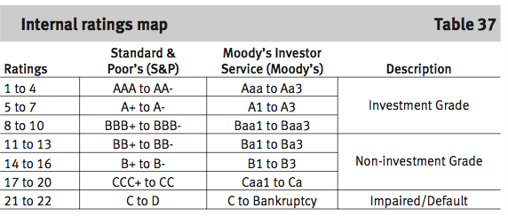
Internal Rating Map

Slide 49
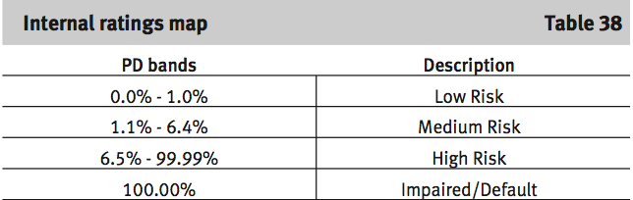
Internal Rating Map

Slide 50
Retail Credit Portfolio
Credit scoring is the primary risk rating system for assessing obligor and transaction risk for retail exposures
Credit scoring is employed in the acquisition of new clients (acquisition scoring) and management of existing clients (behavioral scoring)
  Acquisition scoring is used for underwriting purposes
  Behavioral scoring is used in the ongoing management of retail existed clients

Slide 51
Portfolio Management
Retail exposures are assessed on a pooled basis, with each pool consisting of exposures with similar homogeneous characteristics
The pools are assessed based on PD, EAD and LGD which considers borrower and transaction characteristics, including behavioural credit score, product type, and delinquency status

Slide 52
Credit Risk Control
Credit Risk Assessment
  Mandatory use of credit risk rating and scoring system
  Consistent credit risk assessment criteria
  Standard content requirements in credit application documents

Slide 53
Credit Risk Control
Credit Risk Mitigation
  Structuring of transactions-guarantees, security, seniority and convenants
  Collateral-require obligors to pledge collateral
  Credit derivatives- used as a tool to mitigate industry sector concentration and single-name exposure

Slide 54
Credit Risk Control
Credit Risk Approval
  Proposals for new and amended credit products and services are comprehensively reviewed and approved under a risk assessment framework and for those with significant risk implications
Credit Portfolio Management
  Ensure portfolios are well diversified
  Reduce concentration risk
  Credit limits are established
Notes:
single- name limits (notional and economic capital), underwriting risk limits, geographic (country and region) limits, industry sector limits (notional and economic capital), and product and portfolio limits

Slide 55
Credit Risk Control
Credit Risk Administration
  Portfolio management
  Collateral management
  Management of delinquency and default
  Credit risk data management

Slide 56
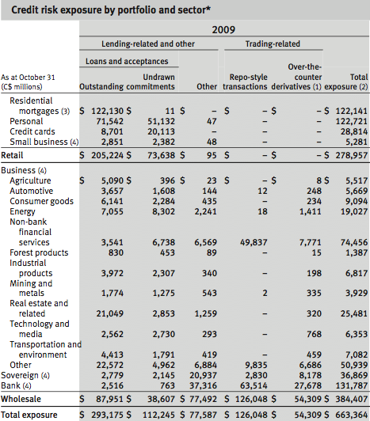
Credit Risk Exposure

Slide 57
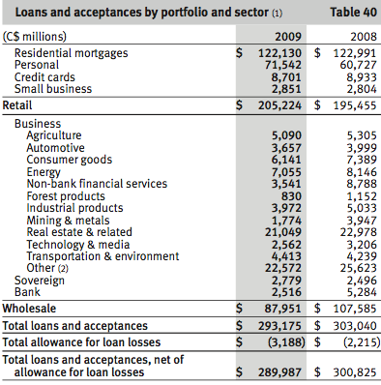
Loans and Exceptances

Slide 58
Provision for Credit Loss
The provision for credit losses is charged to income by an amount necessary to bring the allowance for credit losses to a level determined appropriate by management
Beginning in 2006, specific provision began to increase an continued into 2009
  Largely reflecting the impact of deterioration in the US housing market

Slide 59
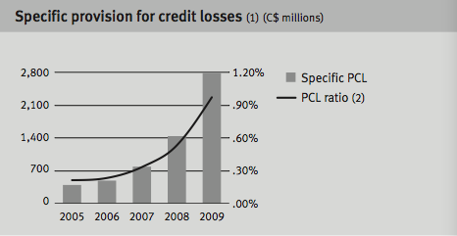
Specific Provisions

Slide 60
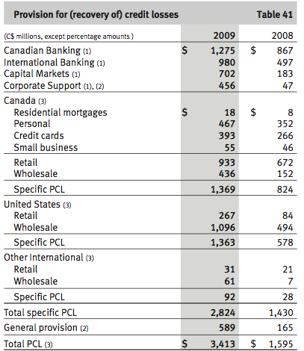
Provision for Credit Loss

Slide 61
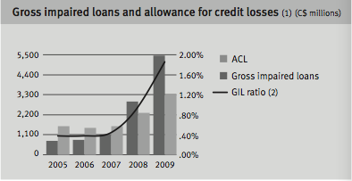
Gross Impaired Loss

Slide 62
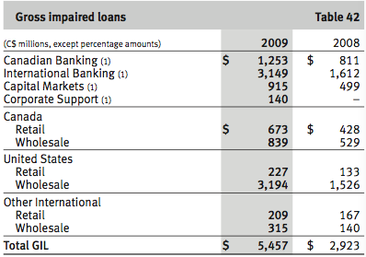
Gross Impaired Loss

Slide 63
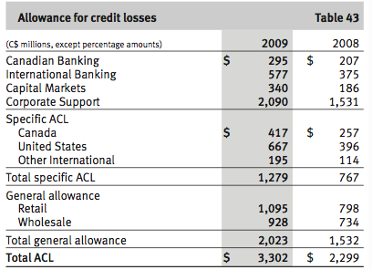
Allowance for Credit Losses

Slide 64
Market Risk
Market Risk is the risk of loss that may arise from changes in market factors such as
  Interest Rates
  Foreign Exchange Rates
  Equity or Commodity Prices
  Credit Spreads
Notes:
RBC is exposed to market risk in their trading activity and their asset/liability management activities. The level to which RBC is exposed varies depending on market conditions, expectations of future price and yield movements and the composition of their trading portfolio.

Slide 65
Market Risk - Trading
Risk associated with securities and related derivatives trading activities are a result of :
  Market-making
  Proprietary
  Sales and arbitrage activities in the
    Interest rate
    Foreign exchange
    Equity
    Commodities
    Credit markets

Slide 66
Market Risk-Trading
Risk Measurement Tools
  VaR – measures that worst-case loss expected over a one-day period within a 99% confidence level
  Sensitivity analysis – measure the impact of small changes in individual risk factors
    Designed to isolate and quantify exposure to the underlying risk
  Stress Testing – measure and alert senior management to our exposure to potential political, economic or other disruptive events.

Slide 67
Market Risk-Trading
Validation
Daily back-testing serves to compare hypothetical profit or loss against the VAR to monitor the statistical validity of 99% confidence level of the daily VAR measure.
VAR models and market risk factors are independently reviewed on a periodic basis to further ensure accuracy and reliability.

Slide 68
Market Risk-Trading
Risk Control
  Market risk management framework is designed to ensure the risks are appropriately diversified on a global basis
  Limit approval authorities
  Establish market risk policies and limits and developing
  Vet and maintain the various quantitative techniques and systems
  Limit on measures such as notional size, term and overall risk

Slide 69
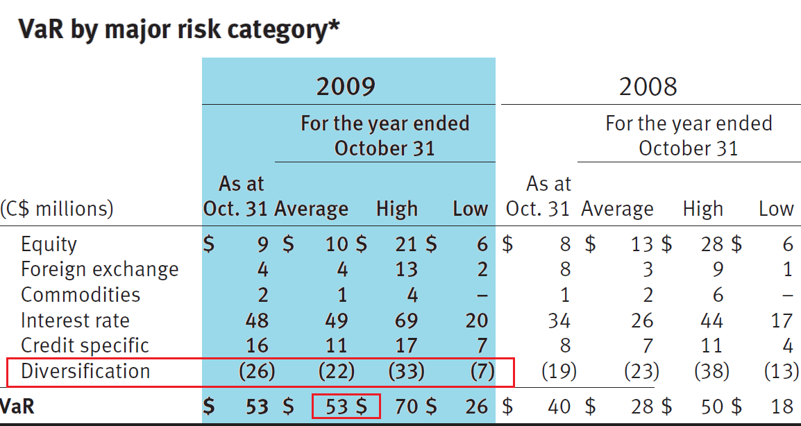
Market Risk-Trading

Slide 70
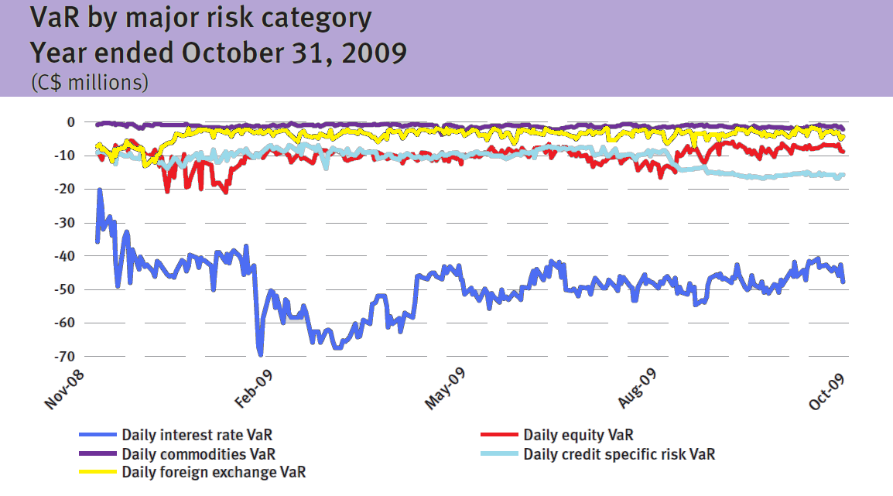
Market Risk-Trading

Slide 71
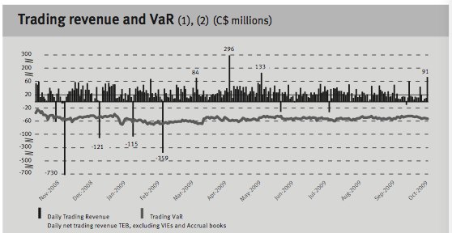
Market Risk-Trading Revenue
Notes:
RBC experienced 13 days of net trading losses in 2009 compared 44 days in 2008

Slide 72
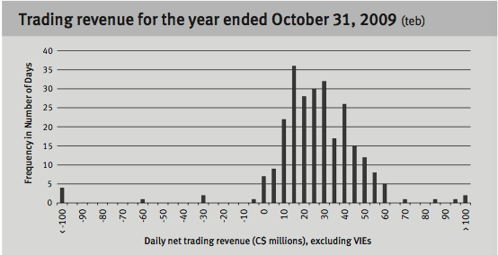
Market Risk-Trading Revenue

Slide 73
Market Risk-Non-Trading
Exposed non-trading market risk by traditional non-trading banking activities
  Deposit taking and lending
    Interest rate risk is the largest component
Goal
  Manage the interest rate risk of the non-trading balance sheet to a target level
  Modify the risk profile of the balance sheet through proactive hedging to achieve the target level

Slide 74
Market Risk-Non-Trading
Interest Risk
Basis Risk
Yield Curve Risk
Re-pricing Risk
Option Risk

Slide 75
Market Risk-Non-Trading
Key Sources of interest rate risk
  Exposure on the maturity and re-pricing structures of certain bank loans
  Investments
  Liabilities
  Derivative
  Off-balance sheet items
  Products with embedded options such as prepayment options
  Interest rate caps or floors

Slide 76
Market Risk-Non-Trading
Risk Measurement
  Risk position is measured daily, weekly or monthly based on the size and complexity of the portfolio
  Measurement of risk is based on rates charged to clients as well as fund transfer pricing rates.
  Key rate analysis is utilized as a primary tool
    Provides an assessment of the sensitivity of the exposure of the economic value of equity to instantaneous changes in individual points on the yield curve.

Slide 77
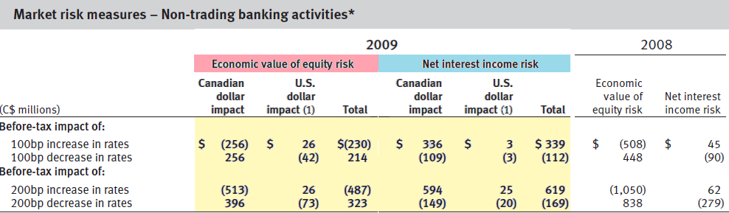
Market Risk-Non-Trading
Pg 49 Table 45
Notes:
This table represents the impact on the non-trading portfolios held in RBC U.S Banking operations.
This table provides the potential before-tax impact of an immediate and sustained 100 basis point and 200 basis point increase or decrease in interest rates on net interest income and economic value of equity of non-trading portfolio, assuming that
no further hedging is undertaken.
The economic value of equity is equal to the net present
value of their assets, liabilities and off-balance sheet instruments.
All interest rate risk measures are based upon interest rate exposures at a specific time and continuously change as a result of
business activities and their risk management initiatives.

Slide 78
Market Risk-Non-Trading
Validation
Dynamic scenarios simulate interest income in response to various combinations of business and market factors.
Business factors: includes assumptions about future pricing strategies and volume and mix of new business
Market factors: includes assumed changes in Interest rate levels and changes in the shape of the yield curve.
Static scenarios supplement dynamic scenarios and are employed for assessing the risks to the value of equity and net interest income

Slide 79
Market Risk-Non-Trading
Risk Control
  Policies and Limits
    The interest rate risk policies define the management standards and acceptable limits within which risks to net interest income over a 12-month horizon, and the economic value of equity, are to be contained.

Slide 80
Market Risk-Non-Trading
Foreign Exchange Rate Risk
  Potential adverse impact on earnings and economic value due to changes in foreign currency rates.
Commodity Price Risk
  Through their proprietary positions they are exposed to the spot and forward exchange market, derivatives markets and commodities markets

Slide 81
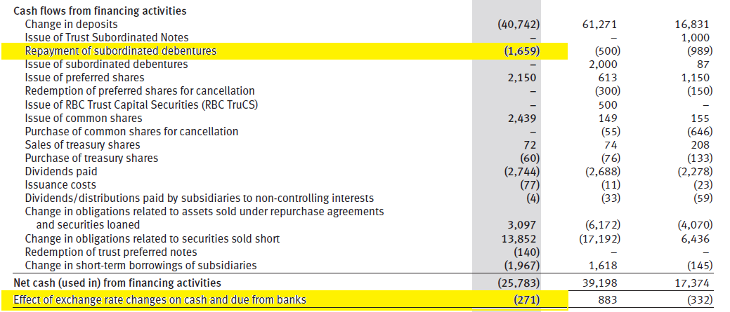
Market Risk-Non-Trading
Notes:
From the Cash flows from financing activities, we can see at the bottom column, RBC calculated the effect of exchange rate changes on cash and due from banks and it shows with negative number.

Slide 82
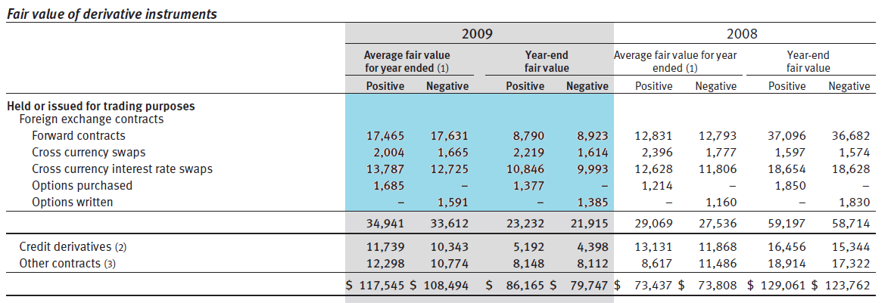
Market Risk-Non-Trading
Notes:
This table shows the foreign exchange contracts

Slide 83
Market Risk-Non-Trading
Equity Risk
  Risk of impact on earnings caused by movements in individual equity prices and in the level of the stockmarket
  Exposed through investment banking activities (buying and selling equities)

Slide 84
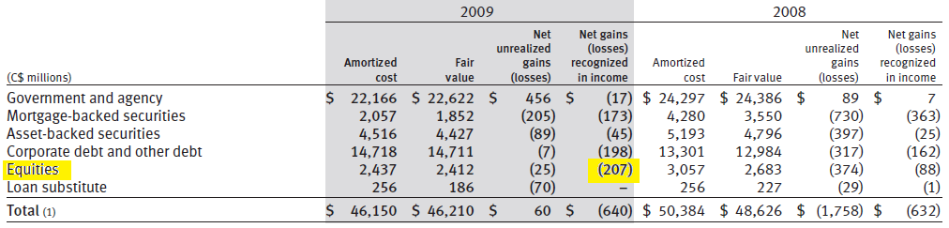
Market Risk-Non-Trading
Notes:
This table shows that the equities has a net losses recognized in income in 2009

Slide 85
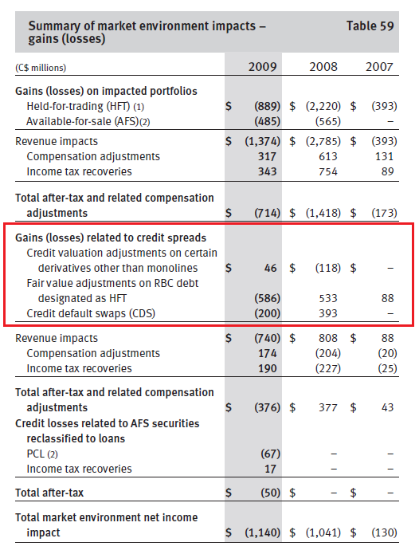
Market Risk-Non-Trading
Credit Spread Risk
  a credit spread is the yield spread, or difference in yield between different securities, due to different credit quality
  Risk exposure due to credit worthiness and credit rating of issuers of bonds and money market instruments, or the names underlying credit derivatives.

Slide 86
Market Risk Management Strategy
Interest rate Risk
Interest rate swap
Interest rate option
Foreign Exchange risk
Cross currency swap
Foreign currency option
Equity risk
Equity swap
Index option
Credit Spread Risk
Equity option
Credit default swap
Foreign exchange forward and future
Interest rate forward/future

Slide 87

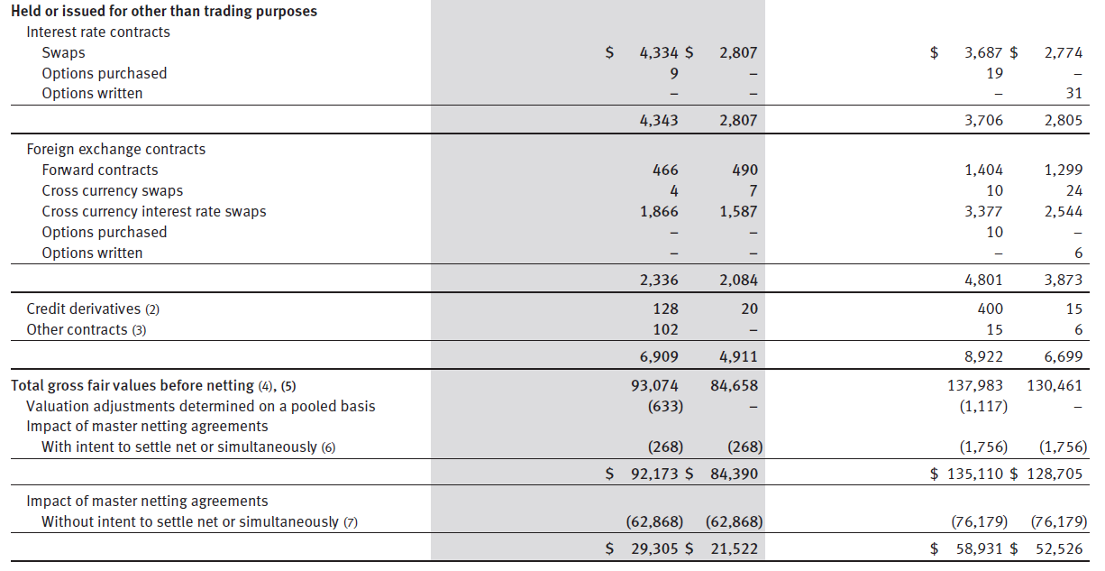
Derivatives held for hedging purpose
Notes:
Interest rate swaps are used to manage their exposure to interest
rate risk by modifying the repricing of assets and liabilities, including funding
and investment activities. Purchased interest rate options are used to
hedge redeemable deposits and option risk
They manage their exposure to foreign currency risk
with cross currency swaps and foreign exchange forward contracts.

Slide 88
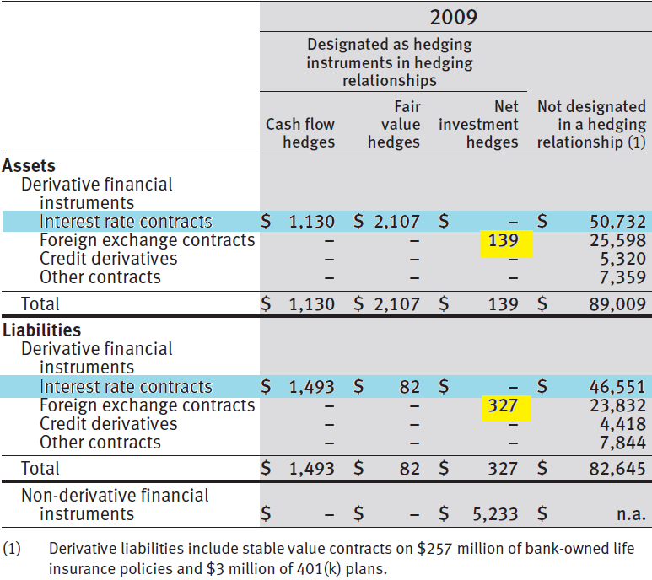
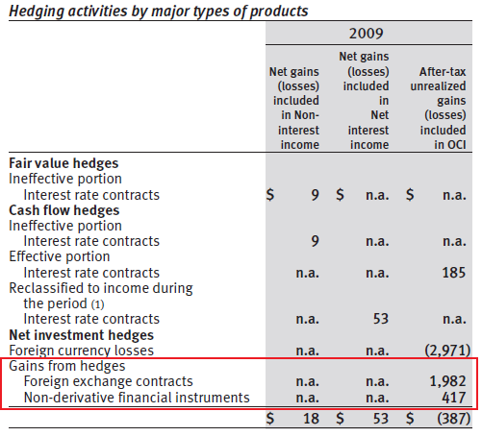
Hedging activities

Slide 89
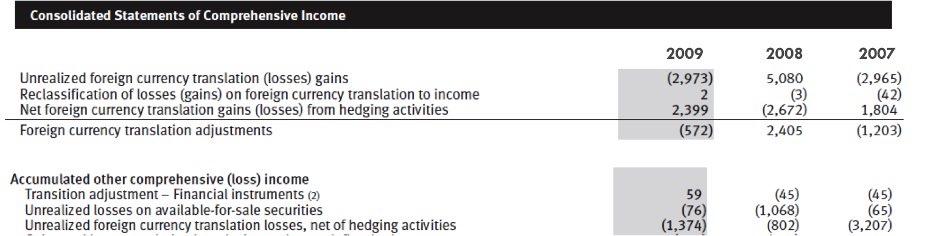
Hedging activities

Slide 90
Operational Risk
The risk of loss or harm resulting from inadequate or failed internal processes, people and systems or from external events.
Embedded in all our activities, including the practices and controls used to manage other risks.
Failure to manage operational risk can result in direct or indirect financial loss, reputational impact, regulatory censure, or failure in the management of other risks such as credit or market risk.

Slide 91
Operational Risk
Risk Measurement
  Advanced Measurement Approach (AMA) under Basel II
  Standardized Approach
  RBC corporate insurance program
    Transfer some of the operational risk exposure by purchasing insurance coverage
Notes:
Operational risk is difficult to measure in a complete and precise
manner, given that exposure to operational risk is often implicit,
bundled with other risks, or otherwise not taken on intentionally. In the
banking industry, measurement tools and methodologies continue to
evolve. The two options available to us under Basel II are the Advanced
Measurement Approach (AMA) and the Standardized Approach. We
continued to adopt the Standardized Approach for operational risk.

Slide 92
Operational Risk Control
Risk and Control Assessment
  Ensure consistent identification and assessment of operational risks and the controls used to manage them
Industry Loss Analysis
  Review and analyze information on operational losses that occurred at other financial institutions
  Monitor emerging developments and trends that affect the financial industry as a whole
Key Risk Indicators
  Business segments use a broad range of risk indicators to manage their day-to-day activities

Slide 93
Operational Risk Control
Operational event data collection and analysis
  Operational risk events are reported in a central database
  Comprehensive information about these events is collected
  Analysis of operational risk event data have a better understanding where and how our risks are manifesting themselves

Slide 94
Liquidity and Funding Risk
Risk that the bank may be unable to generate or obtain sufficient cash or its equivalent in a timely can cost-effective manner to meet its commitments as they come due.
Goal
  Satisfy current and prospective commitments
  In conjunction with capital position
  To a safety and soundness in times of stress

Slide 95
Liquidity and Funding Risk
Key liquidity risk mitigation strategies:
  An appropriate balance between the level of risk to undertake and the cost of its mitigation that takes into account the potential impact of extreme but plausible event
  Broad funding access
  A comprehensive enterprise-wide liquidity contingency plan
  Appropriate and transparent liquidity transfer pricing and cost allocation

Slide 96
Liquidity and Funding Risk
Risk Measurement
  Structural(longer-term) liquidity risk
    Cash capital and survival horizon methodologies
  Tactical(shorter-term) liquidity risk
    Net cash outflow limits in Canadian dollar and foreign currencies for key short-term time horizons and assign a risk-adjusted limit to aggregate pledging exposure and individual limits by types of pledging activities to measure shorter-term liquidity exposures
  Contingent liquidity risk
    Assess the impact of and the intended responses to sudden stressful events

Slide 97
Liquidity and Funding Risk
Risk Control
  Policies
    Principal liquidity and funding policies define risk tolerance parameter
  Authorities and limits
    Limits for the structural liquidity risk positions are approved at lease annually

Slide 98
Liquidity and Funding Risk
Funding Strategy
  Foundation of the structural liquidity position:
    Core funding
    Comprising capital
    Longer-term liabilities and a diversifies pool of personal
    To a lesser extent
    Commercial and institutional deposits
  Wholesale funding activities are well diversified by geographic origin, investor segment, instrument, currency, structure and maturity.
  Maintain competitive credit ratings

Slide 99
Liquidity and Funding Risk
Credit Ratings
  Access unsecure3d funding markets and to engage in certain collateralized business activities on a cost-effective basis
  Determined by the quality of RBC earnings, the adequacy of our capital and the effectiveness of RBC risk management programs

Slide 100
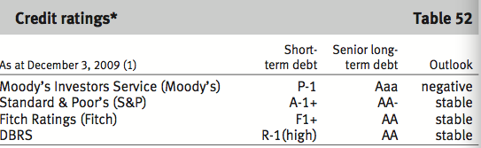
Liquidity and Funding Risk
Notes:
This table presents RBC major credit ratings as at December 3, 2009. Their collective ratings continues to be the highest categories assigned by the respective agencies to a Canadian bank and these strong credit ratings support RBC ability to competitively access unsecured funding markets.

Slide 101
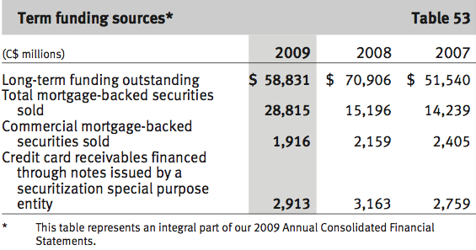
Liquidity and Funding Risk
Deposit Profile
  Constitutes the principal source of reliable

Slide 102
Other Risks
Reputation Risk
  A risk that an activity undertaken by an organization or its representative will impair its image in the community or lower public confidence in it
Regulatory and legal risk
  The risk of negative impact to business activities, earnings or capital, regulatory relationships or reputation
Environmental Risk
  The risk of loss to financial, operational or reputation value resulting from the impact of environmental issues

Slide 103
Other Risks
Insurance Risk
  Exposure to potential financial loss arising from payments that are different than anticipated under an insurance policy or reinsurance treaty.
  Risk Control
    Authorities and limits
    Risk oversight and approval
    Risk mitigation
    Actuarial provisions

Slide 104
Thank You

