Slide 1

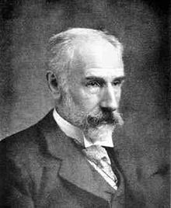
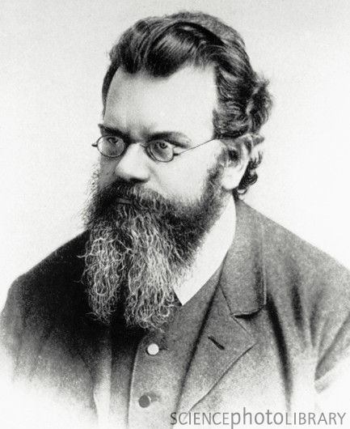
The History of Economics and the Pre-History of Econophysics:
Boltzmann versus the Marginalists
Geoffrey Poitras,
Simon Fraser University

Slide 2
Economics vs. Econophysics
Is the emergence of the ‘new’ subject of Econophysics incongruent with the adoption of mathematical, theoretical and empirical methods from physics in neoclassical and modern economics?
  What is Econophysics?
  Is this a separate subject or a sub-discipline of Economics or a sub-discipline of Physics?
Intellectual history can provide insights needed to answer such questions
  Mathematical Marginalists, such as Edgeworth, responsible for adopting methods from classical physics
  The prehistory of Econophysics commences with the contemporaneous beginning of statistical mechanics by Ludwig Boltzmann

Slide 3
What is ‘Econophysics’?
Term initially coined by Eugene Stanley (1995)
  Econophysics is “a pure subject in statistical mechanics”
  Jovanovic and Schinckus (2013, p.465): “econophysicists have positioned themselves in theoretical niches that mathematicians and economists have barely investigated, or not investigated at all, because of the constraints of the theoretical framework.”
Roehner (2002, p.3): “the term econophysics designates the investigation of economic problems by physicists”.
  Consistent with the usage of ‘astrophysics’, ‘geophysics’, ‘neurophysics’ and ‘biophysics’ and with the appearance of econophysics articles in physics journals
  Is this too narrow as it restricts the econophysics community only to physicists and physics journals?

Slide 4
Essentials of Econophysics
Schinckus (2010, p.3816) accurately recognizes that econophysics depends fundamentally on empirical observation: “The empiricist dimension is probably the first positivist feature of econophysics”
  Phenomenology characterizes the conventional experimental methodology and philosophical basis of econophysics
Roehner (2002, p.21): “experimental research is an essential part of physics”
  Economics is characterized by the prevalence of non-experimental data
  Many studies in econophysics examine financial variables where large data sets are available, though the data is still non-experimental

Slide 5
The Prehistory of Econophysics
The history of econophysics begins in 1995 when physicists and physics journals, such as Physica A, began systematically considering economic problems →
  The prehistory of econophysics is concerned with the development of theoretical and empirical methods used in statistical mechanics
  The origins of statistical mechanics can be traced to the 2nd half of the 19th century
  Not all key contributions to statistical mechanics are used in econophysics → Ising models
  Quantum mechanics, fractal geometry and chaos theory get almost no attention

Slide 6
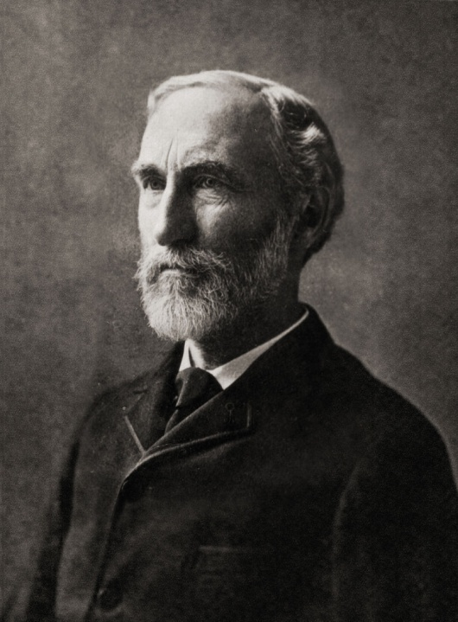
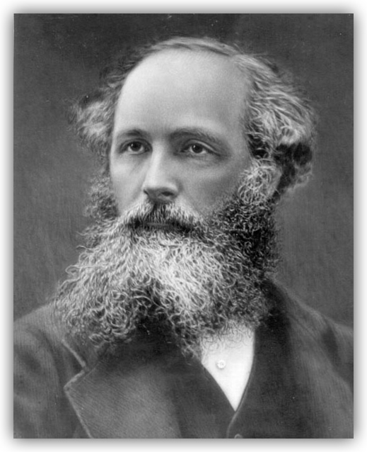
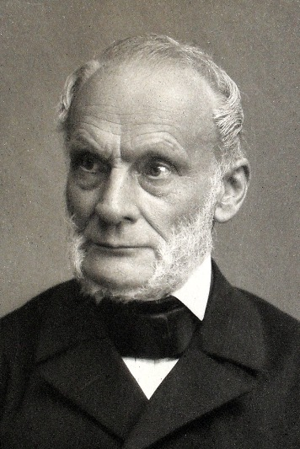
Early Statistical Physicists
Rudolf Clausius Josiah Gibbs James Maxwell
(1822-1888) (1839-1903) (1831-1879)
The second law of ‘Gibbs ensembles’ ‘Maxwell Distribution’
thermodynamics

Slide 7
Ludwig E. Boltzmann (1844-1906)
Founding father of the Second Scientific Revolution and intellectual giant in the kinetic theory of gases
Important influence on Einstein (Brownian motion) and Planck (theory of black matter)
First to demonstrate that time irreversible processes explain second law of thermodynamics
Originator of the ‘ergodicity hypothesis’

Slide 8
Origins of Ergodicity
  The etymology for “ergodic” begins with an 1884 paper by Boltzmann
  The ergodic property was initially associated with the kinetic theory of gases where the unobservable properties of the velocity of gas molecules can be ‘macroscopically’ measured, esp. using temperature
    Other macroscopic measures include density, pressure, viscosity, stresses and heat flow.
  The ergodic hypothesis maintains that a dynamical system samples all points in the dynamical space
  Ergodicity is a long run property

Slide 9
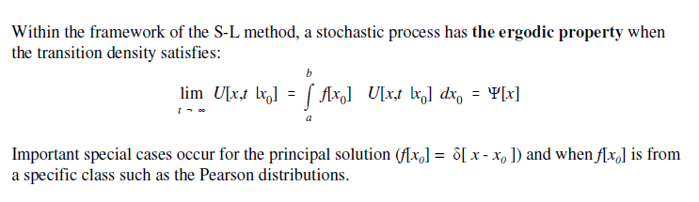
The Ergodic Property
Boltzmann was concerned with demonstrating the dynamic properties of the Maxwell distribution (the velocity distribution of gas molecules in thermal equilibrium)→ that the distribution would emerge whatever the initial condition of the system

Slide 10
Irreversibility, Entropy and Cosmology
“Heat can never pass from a colder to a warmer body without some other change occurring at the same time” (Clausius)
For Boltzmann, time was irreversible, i.e., could only move in one direction
  Coffee cup example
  This observation was a direct result of the second law of thermodynamics, the universal law of increasing entropy – a measure of the randomness of molecular motion and the loss of energy to do work.
    First recognized by Clausius in the early 19th century, the second law maintains that the entropy of an isolated system, not in equilibrium, will necessarily tend to increase over time. Entropy approaches a maximum value at thermal equilibrium.
The second law is of central importance to the ‘big bang’ theory in cosmology

Slide 11
The History for Economics:
Was there a Marginal Revolution?
Around the time Boltzmann introduced the ergodicity hypothesis, the history of economics is undergoing the ‘Marginal Revolution’ marking the transition from classical political economy to neoclassical economics
It is the use of mathematics, and the associated connection to the developed mathematical theories of classical physics, that is the defining characteristic of the ‘new theories of economics’ introduced by those the marginalists that adopted the “mathematical” approach to study economic phenomena, e.g., Fisher (1892).

Slide 12
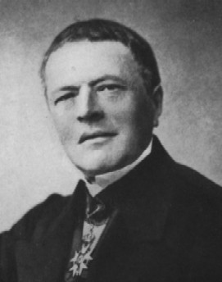
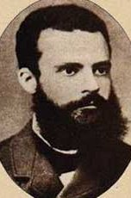
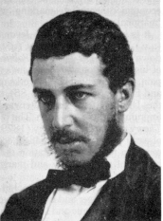
Early Mathematical Economists
Augustin Cournot Vilfredo Pareto Stanley Jevons
(1801-1877) (1848-1923) (1835-1882)
‘Cournot Equilibrium’ ‘Pareto wealth distribution’ ‘Sunspot theory’

Slide 13
Classical Physics and the Marginalists
‘Mirowski’s thesis’ recognizes that important theoretical elements of neoclassical economics were adapted by the mathematical marginalists from concepts developed in 19th century classical physics
“Just as the gravitating force of a material body depends not alone upon the mass of that body, but upon the masses and relative positions and distances of the surrounding material bodies, so utility is an attraction between a wanting being and what is wanted.”
Jevons, “Mathematical Theory of Political Economy” (1874, p.482)

Slide 14
Cournot and the Marginalists
Irving Fisher, a student of Gibbs, observed (1898, p.119):
  “Sixty years ago the mathematical treatise of Cournot was passed over in silence, if not contempt. To-day the equally mathematical work of Pareto is received with almost universal praise. In Cournot's time ‘mathematical economists’ could be counted on one's fingers, or even thumbs.”
Subsequent influence on the early mathematical marginalists:
  Cournot was closely studied by both Jevons and Walras;
  Marshall makes reference to Cournot’s “genius” and exploits the marginal cost analysis developed by Cournot in extending the marginalist contribution beyond utility.
  Edgeworth makes abundant references to Cournot in Mathematical Psychics.

Slide 15
Edgeworth and Mathematical Psychics (1881)
Chap. II of the Principes Mathématiques makes an explicit reference to Newton’s Principia and the use of relative vs. absolute space in pricing commodities
  Cournot did not consider utility, but did have a demand function
The unifying concept of the ‘marginal revolution’ is the use of (unobservable) utility function:
  “An analogy is suggested between the Principles of Greatest Happiness, Utilitarian or Egoistic, which constitute the first principles of Ethics and Economics, and those Principles of Maximum Energy which are among the highest generalisations of Physics, and in virtue of which mathematical reasoning is applicable to physical phenomena quite as complex as human life.” (p.v, Mathematical Psychics)

Slide 16
Pareto and Rational Mechanics
“Rational mechanics gives us a first approximation to theory of the equilibrium and of the movements of bodies. In the same way the theories of Jevons, Walras, Marshall, Irving Fisher, and others present us with a first approximation to the full theory of economic phenomena. It must be clearly understood that it is only an approximation; it is similar to that just made in the case of the heavy body supposed to fall in a vacuum. Pure economics has no better way of expressing the concrete economic phenomenon than rational mechanics has for representing the concrete mechanical one. It is at this point that there is a place for mathematics.”
Pareto (1897, p.499)

Slide 17
Rational versus Statistical Mechanics
Brush (1979) sees the evolution from rational to statistical mechanics as part of a “Second Scientific Revolution”
  “[The Second] Scientific Revolution, associated with the theories of Darwin, Maxwell, Planck, Einstein, Heisenberg and Schrödinger, substituted a world of process and chance whose ultimate philosophical meaning still remains obscure” (Brush 1983, p.79).
This Second Revolution superceded the: “First Scientific Revolution, dominated by the physical astronomy of Copernicus, Kepler, Galileo, and Newton, ... in which all changes are cyclic and all motions are in principle determined by causal laws.” The irreversibility and indeterminism of the Second Scientific Revolution replaces the reversibility and determinism of the First.
Mirowski’s thesis places the rational mechanics underlying neo-classical economic theory with the ‘First Scientific Revolution’

Slide 18
Jevons and Laplacian Determinism
Jevons (1877, p.738-9) reflects the Laplacian determinism of the marginalists:
“We may safely accept as a satisfactory scientific hypothesis the doctrine so grandly put forth by Laplace, who asserted that a perfect knowledge of the universe, as it existed at any given moment, would give a perfect knowledge of what was to happen thenceforth and for ever after. Scientific inference is impossible, unless we may regard the present as the outcome of what is past, and the cause of what is to come. To the view of perfect intelligence nothing is uncertain.”
With Boltzmann, the philosophical view that ‘for perfect intelligence nothing is uncertain’ is replaced by the view that ‘perfect intelligence has created order from infinite uncertainty’

Slide 19
Frank Knight on the Marginalists
“The utility theory should be seen as the culmination, historically and logically, of the rationalistic and individualistic intellectual movement of which the competitive economic system itself is one aspect and modern science and technology are others. To its admirers it comes near to being the fulfilment of the eighteenth-century craving for a principle which would do for human conduct and society what Newtonian mechanics had done for the solar system.” (Knight 1931)
→ Neoclassical economics is the culmination of a “Darwinian” transition from classical political economy to neoclassical economics

Slide 20
From the Marginalism to Neoclassical Economics
Following Colander (2000) and many others, there is considerable confusion and debate about the time line and historical content of ‘neoclassical economics’.
Aspromourgos (1986) traces the etymology of the term to Veblen (1900) where it is used “to characterize the Marshallian version of marginalism”.
  Veblen employed a “Darwinian” interpretation for the emergence of “neo-classical political economy”, this etymology is consistent with neoclassical economics having: “a positive, basic relationship to the earlier classical theory and some development beyond it” because “Marshall, more than any of the other marginalist founders, sought to present his theory as having a substantial continuity with classical economics”.

Slide 21
What is Neoclassical Economics?
Stigler (1941) popularized the extension of neoclassical economics to include “all the marginalist founders”.
Colander (2000, p.133):
  “In many ways, the two books that tied up the loose ends and captured the essence of neoclassical economics, Hicks’s Value and Capital (1939) and Samuelson’s Foundations (1947), were culminating works — they put all the pieces of marginalism together. Important work thereafter was modern.”
This approach permits the emergence of “modern economics” from ‘neoclassical economics’ being connected to the transition from deterministic to stochastic models.

Slide 22
From Neoclassical to Modern Economics
Samuelson (1947) extended the static neoclassical approach to include both static and dynamic theories.
  Static analysis “described equilibrium as resulting from economic agents solving maximization problems taking prices as parameters ... Samuelson’s analysis of dynamics rested on the concept of stationary equilibrium, which holds that equilibrium constitutes a state of rest” (De Vroey and Duarte 2013, p.979).
Lucas (1980, p.278) provides further elaboration of this point:
  The underlying idea seems to be taken from physics, as referring to a system ‘at rest’. In economics, I suppose such a static equilibrium corresponds to a prediction as to how an economy would behave should external shocks remain fixed over a long period, so that households and firms would adjust to facing the same set of prices over and over again and attune their behavior accordingly.
→ How to translate deterministic neoclassical theories into empirically testable stochastic models?

Slide 23
Ergodicity and Econometrics
For Economics, ‘Ergodicity’ is the property that permits a single ex post time series sample path to be used to estimate the parameters for the distribution of the ex ante ensemble of future time paths
  In the limit for time, an ergodic process will possess a steady state distribution that is independent of initial conditions.
  Ergodic processes can have non-linearity in the mean providing a wider class of theoretical processes for modeling economic variables than the reversible stationary unimodal processes which are conventional in econometric work
  Stationary processes are also ‘reversible’, only the distance between observations matter, not where in the process the observation occurs (no impact from initial or boundary conditions)

Slide 24
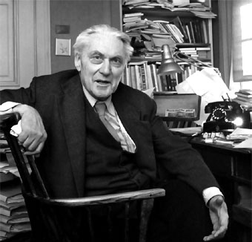
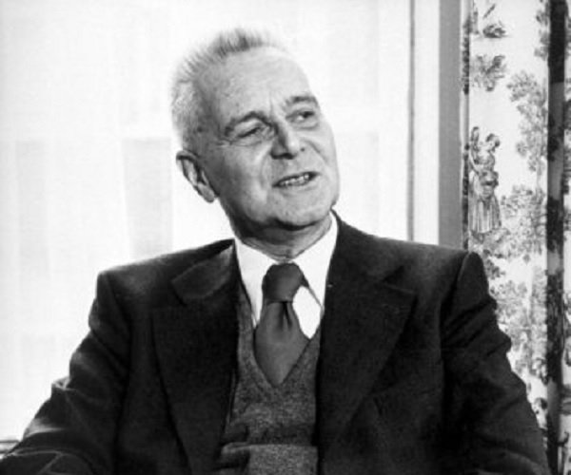
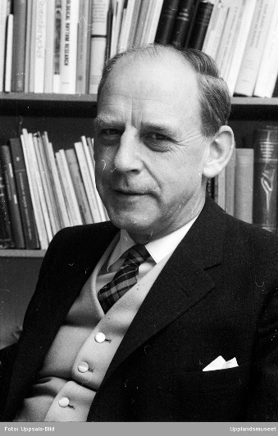
Founders of Econometrics
Ragnar Frisch Jan Tinbergen Herman Wold
(1895-1973) (1903-1994) (1908-1992)
1st Nobel Mem.Pr. 1969 1st Nobel Mem.Pr. 1969 ‘Wold Decomposition
(with Tinbergen) (with Frisch) Theorem’

Slide 25
Estimating empirical relationships for non-experimental data
R.G.D. Allen (1934):
  “The future progress of economic science depends largely upon the work of investigators, like Professor Frisch, who realise the importance of subjecting the concepts and conclusions of abstract economic theory to the test of statistical determination and verification”.
Wold (1969) recognized that:
  “experimental versus nonexperimental model building is a dualism that goes to the core of the scientific method.”
  “Recognition is due -- and perhaps overdue -- for nonexperimental analysis as an active partner to the method of controlled experiments, and for the integration of both experimental and non-experimental approaches in the scientific method.”

Slide 26
Developments in Statistical Mechanics: 1920’s
Around the time that the transition from deterministic neoclassical economic theories to the stochastic empirically testable models of modern economics, Physics, in general, and statistical mechanics, in particular, was undergoing dramatic changes
  Quantum mechanics developed by the likes of Max Born, Wolfgang Pauli, Werner Heisenberg and Erwin Schrödinger in a remarkable period from 1924-8
  Ernst Ising introduced the one dimensional Ising model of ferromagnetism in 1925, a model ultimately solved in the important two-dimensional phase transition case by Lars Onsager in 1944
  Empirical limitations of ergodic processes in physics identified at the same time such notions were entering economics

Slide 27
Whither Goes Modern Economics?
Modern Economics is a many-headed monster that now encompasses distinctly different epistemological and methodological approaches → ergodicity is essential to both the traditional ‘Lucas’ approach and the inductive Granger causality, ARCH/GARCH approach
Robert Lucas attacked “the idea that an economic system is in any sense ‘at rest’ [as] simply an anachronism”
Lucas represents a continuation in the evolution of economics stretching back to the marginalists advancing a ‘modern’ system that relies on “the equilibrium discipline, rational expectations and Walrasian microfoundations”

Slide 28
Modern Economics and Epistemology
The epistemology of an alternative camp is set out by Keynes (1939, p.559):
  Prof. Tinbergen is obviously anxious not to claim too much. If only he is allowed to carry on, he is quite ready and happy at the end of it to go a long way towards admitting, with an engaging modesty, that the results probably have no value. The worst of him is that he is much more interested in getting on with the job than in spending time in deciding whether the job is worth getting on with. He so clearly prefers the mazes of arithmetic to the mazes of logic, that I must ask him to forgive the criticisms of one whose tastes in statistical theory have been, beginning many years ago, the other way round.
Striking at fundamental assumptions underpinning the use of time reversible (stationary) ergodic processes, Keynes questioned the validity of “passing from statistical description to inductive generalisation”

Slide 29
Induction and Causality
Using combinations of stationary, i.e., independently, identically distributed (iid), error term distributions ensured the early econometric models implicitly assumed a restricted form of ergodicity.
The generalization of this discrete time estimation approach to the class of ARCH and GARCH error term models by Engle and Granger, e.g., Engle and Granger (1987), was of such significance that a Nobel memorial prize in economics was awarded for this contribution in 2003.
  By modeling the evolution of stationary error term volatility, this approach permitted a limited degree of non-linearity to be modeled providing a typically better ex ante fit to observed economic time series.
ARCH, GARCH and related time series models are systemically dependent on the assumption of Ergodicity

Slide 30
Phenomenology in Physics
An excellent example of phenomenology in physics is provided by the close collaboration between the theoretician Max Born and the experimentalist James Franck at Göttingen, starting in 1921, that led to important breakthroughs in quantum mechanics.
Im (1996) observes:
  “Born's close collaboration with Franck was well suited to his research style: a formal and mathematical description of nature based upon plentiful observational data”.
  Can non-experimental data provide a foundation for a phenomenological approach to economic phenomena?

Slide 31
Irreversibility and Economic Phenomena
Reversible processes originate when equilibrium states are compared → irreversibility arises from the presence of initial conditions and the associated path to equilibrium
  Suggests important stochastic differences between properties of static equilibria and the dynamic paths taken to achieve equilibrium from some initial starting point
Unlike Boltzmann where irreversibility is a consequence of the second law, in economics statistical processes are reversible as a consequence of employing stationary distributions to test theories of static equilibrium.
  Irreversibility can be obtained as a consequence of the non-linear dynamics associated with using diffusion processes with non-linear drift terms
    Consider the case of the quartic density examined Poitras and Heaney (2015)

Slide 32
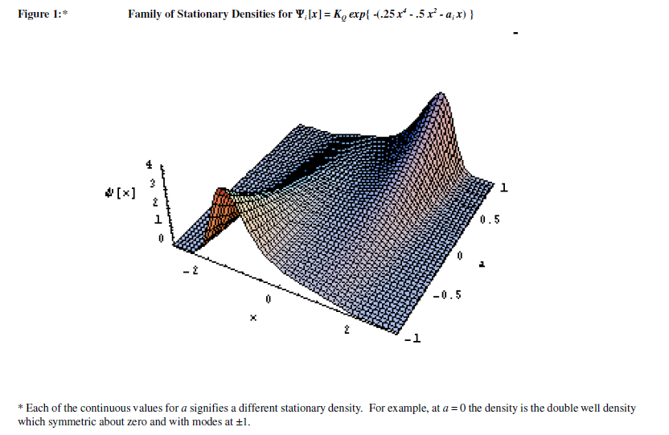
The Quartic Ex Ante Forecasting Distribution

Slide 33
Implications of the Quartic for Economic Models
Bimodal ex ante forecasting distributions are inconsistent with the use of ‘risk and return’ as measures of security performance
  The use of a single observed ex post sample path will not provide necessarily produce informative forecast estimates
Bimodal ex ante densities requires both modes to be identified leading to the use of ‘range’ estimates where the spread between modes is combined with information about distance between modes and location of the modes relative to the current price as risk ‘measures’
  The empirical basis for range estimates could be ‘complex’ or intuitive

Slide 34
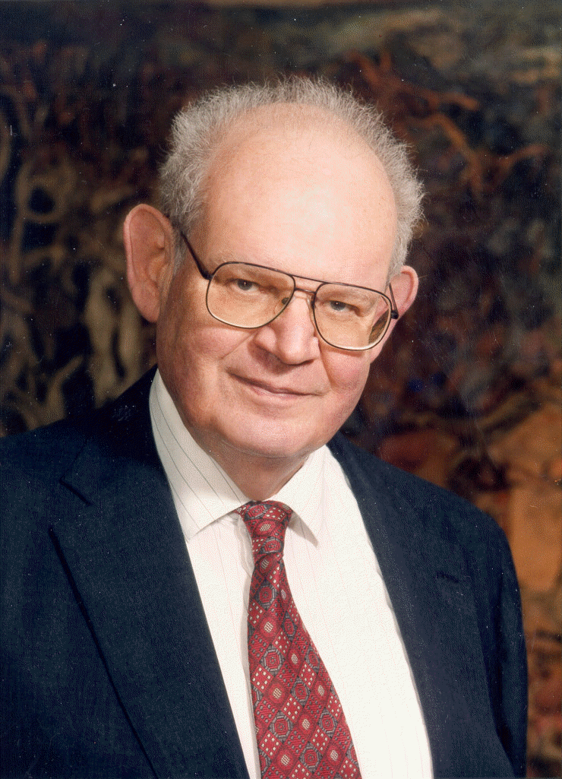
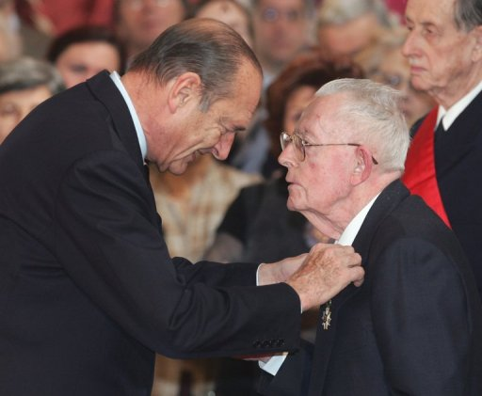
Modern Econophysicists?
Benoit Mandelbrot Maurice Allais
(1924-2010) (1911-2010)
(many contributions prior to mid-1990’s ) Economist with physics training

