Slide 1
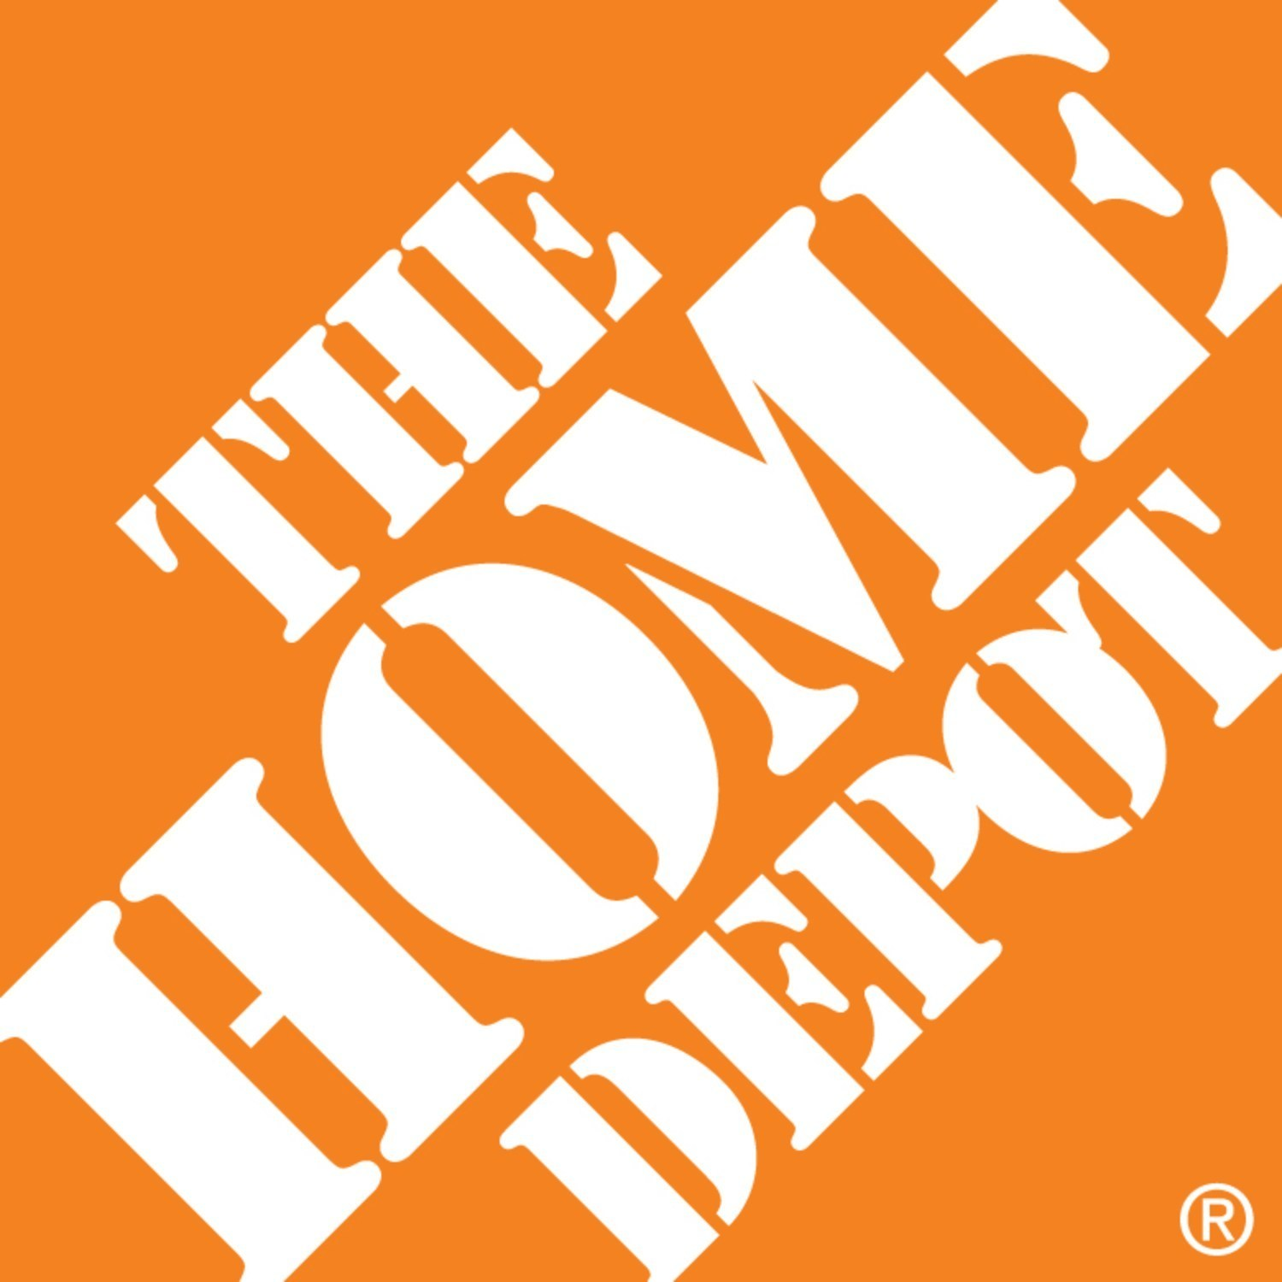

Slide 2
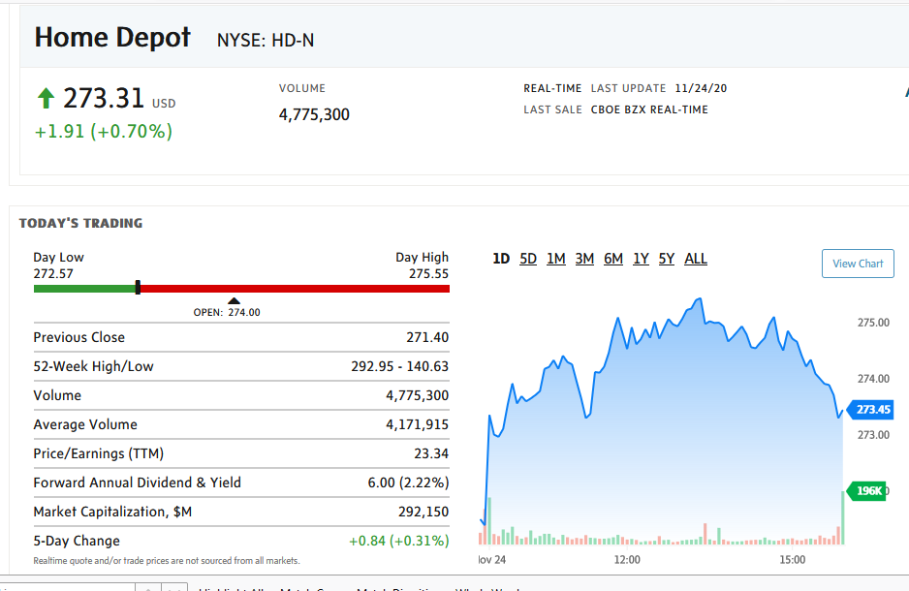

Slide 3
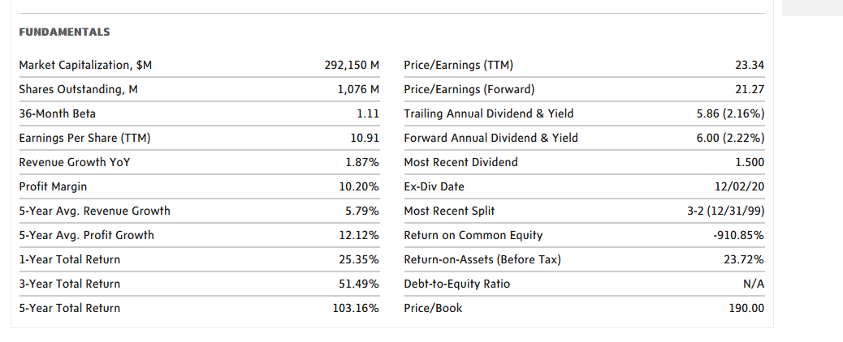

Slide 4
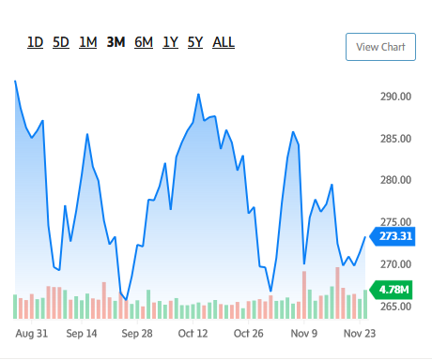

Slide 5
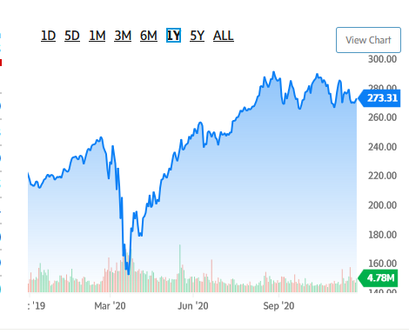

Slide 6
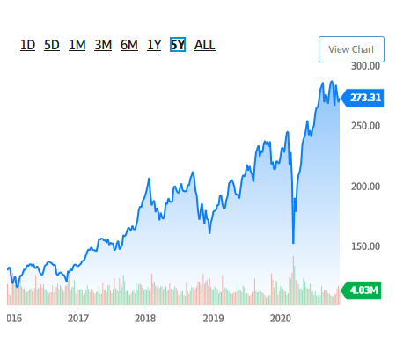

Slide 7
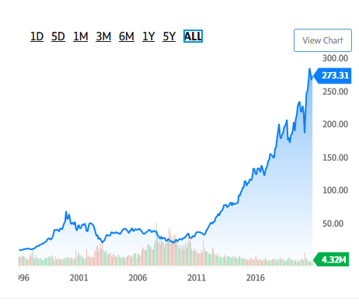

Slide 8
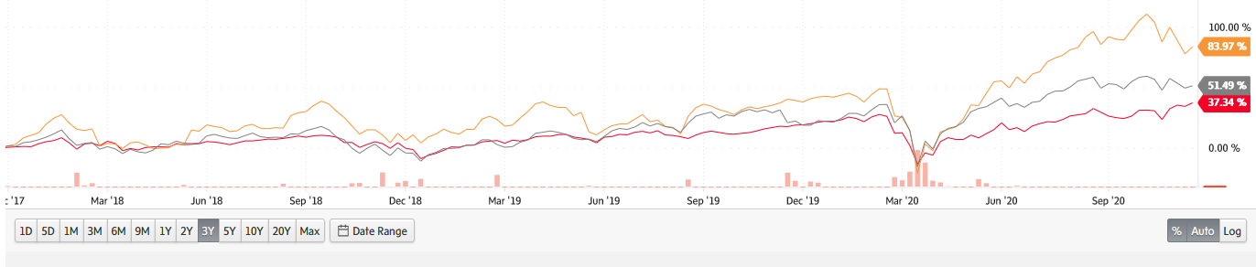
Home Depot vs. Lowes vs. S&P 500 3 YR

Slide 10
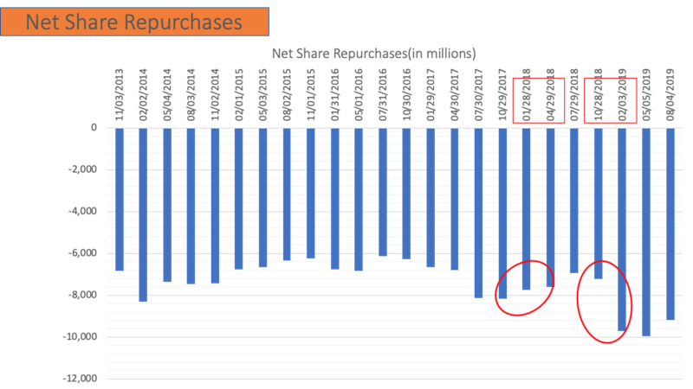

Slide 11

Total sales of home improvement in the United States from 2008 to 2023 (in billion U.S. dollars)
Total sales of home improvement in the U.S. 2008-2023
Note: United States; 2008 to 2019
Further information regarding this statistic can be found on page 37.
Source(s): NRHA; ID 239753
2
Home Improvement Market Overview

Slide 12
Total sales of home centers in the United States from 2013 to 2023 (in billion U.S. dollars)*
Total sales of home centers in the U.S. 2013-2023
Note: United States; 2013 to 2019
Further information regarding this statistic can be found on page 38.
Source(s): NRHA; ID 239795
3
Home Improvement Market Overview

Slide 13
Total sales of do-it-yourself lumberyards in the United States from 2013 to 2023 (in billion U.S. dollars)*
Total sales of DIY lumberyards in the U.S. 2013-2023
Note: United States; 2013 to 2019
Further information regarding this statistic can be found on page 39.
Source(s): NRHA; ID 239792
4
Home Improvement Market Overview

Slide 14
Total sales of hardware stores in the United States from 2013 to 2023 (in billion U.S. dollars)*
Total sales of hardware stores in the U.S. 2013-2023
Note: United States; 2013 to 2019
Further information regarding this statistic can be found on page 40.
Source(s): NRHA; ID 239794
5
Home Improvement Market Overview

Slide 15
Growth of the home improvement products market in the United States from 2017 to 2019
Growth of the home improvement products market in the U.S. 2017-2019
Note: United States; 2018 to 2019
Further information regarding this statistic can be found on page 41.
Source(s): HIRI; ID 241200
6
Home Improvement Market Overview

Slide 16
Sales of the leading home improvement chains in the United States in 2018 (in billion U.S. dollars)*
Sales of the leading home improvement chains in the U.S. 2018
Sales in billion U.S. dollars
Note: United States; 2019
Further information regarding this statistic can be found on page 42.
Source(s): NRHA; Forbes; ID 239783
8
Key Figures of Home Improvement Retail

Slide 17
Leading hardware and home improvement retailers in the United States in 2018, based on retail sales per store (in million U.S. dollars)*
Leading home improvement retailers in the U.S. in 2018, based on sales per store
Note: United States; 2019
Further information regarding this statistic can be found on page 49.
Source(s): Stores; Kantar; ID 316841
16
Leading Home Improvement & Hardware Retailers

Slide 18
Average amount spent by consumers at the Home Depot and Lowe's from 2011 to 2019 (in U.S. dollars)
Average amount spent by consumers at the Home Depot and Lowe's 2011-2019
Note: Worldwide; 2011 to 2019
Further information regarding this statistic can be found on page 55.
Source(s): Home Depot; Lowe's; ID 240861
22
Leading Home Improvement & Hardware Retailers

Slide 19
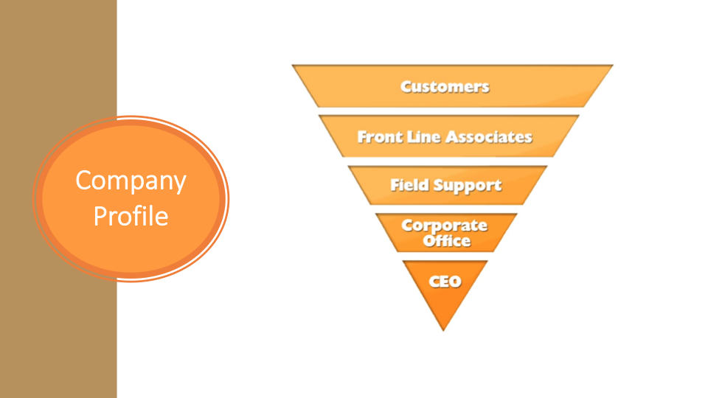

Slide 20
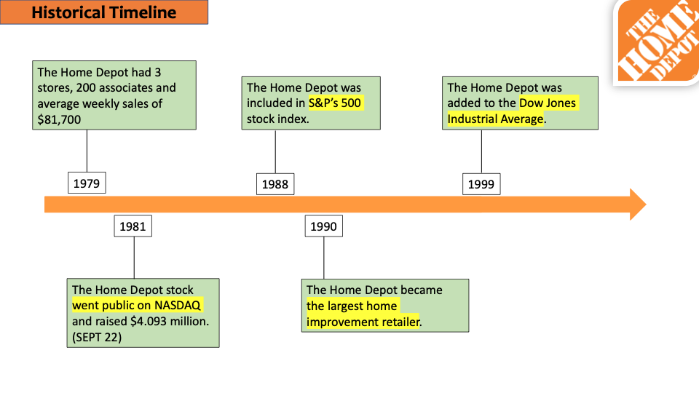

Slide 21

Discontinued on growing revenues through new store construction, closing 15 U.S. big box stores and canceling approximately 50 future store openings.
Established e-commerce site with test market in Las Vegas, NV.
The acquisition of Compact Power Equipment, Inc and The Company Store
2000
2008
2017
2005
2015
2019
The 2,000th store opened and acquired 21 companies for its Home Depot Supply and Home Services businesses.
The acquisition of Interline Brands, Inc.
#rank 21, FORTUNE THE WORLD”S MOST ADMIRED COMPANIES.

Slide 23


Slide 24
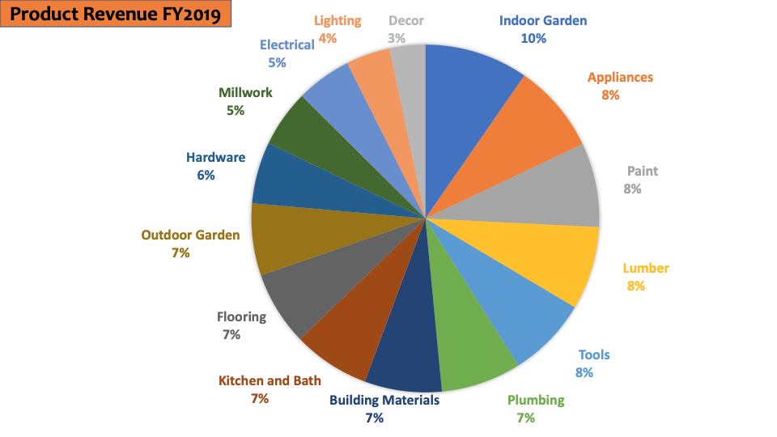

Slide 25
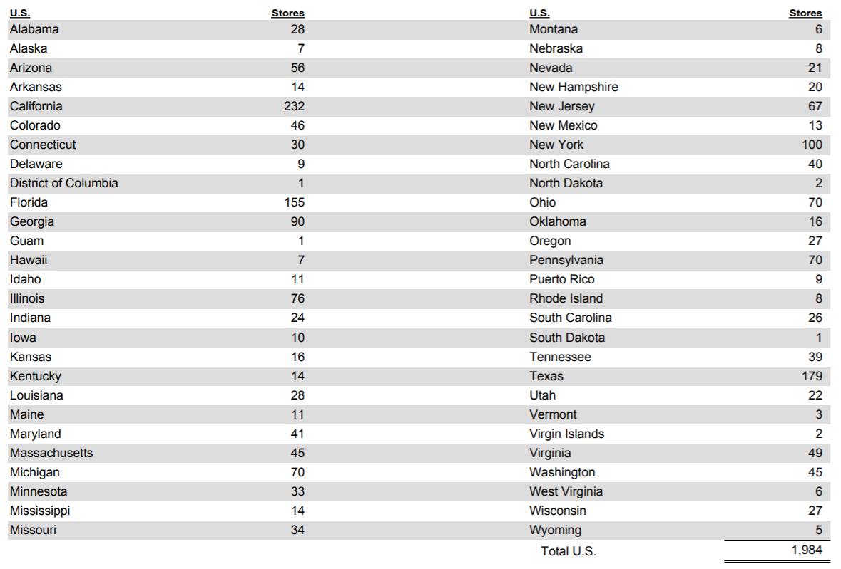
US Store Locations

Slide 28
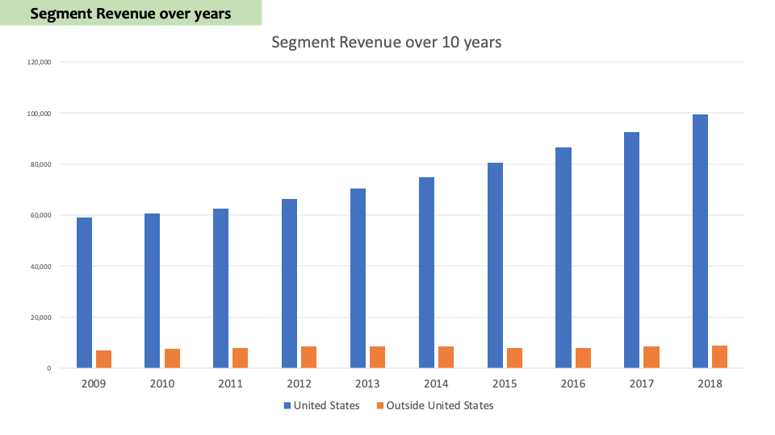
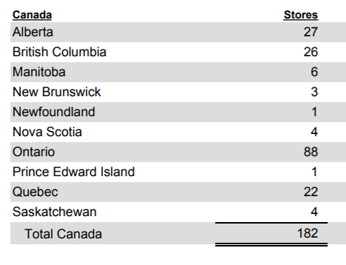
Home Depot stores in Canada

Slide 29
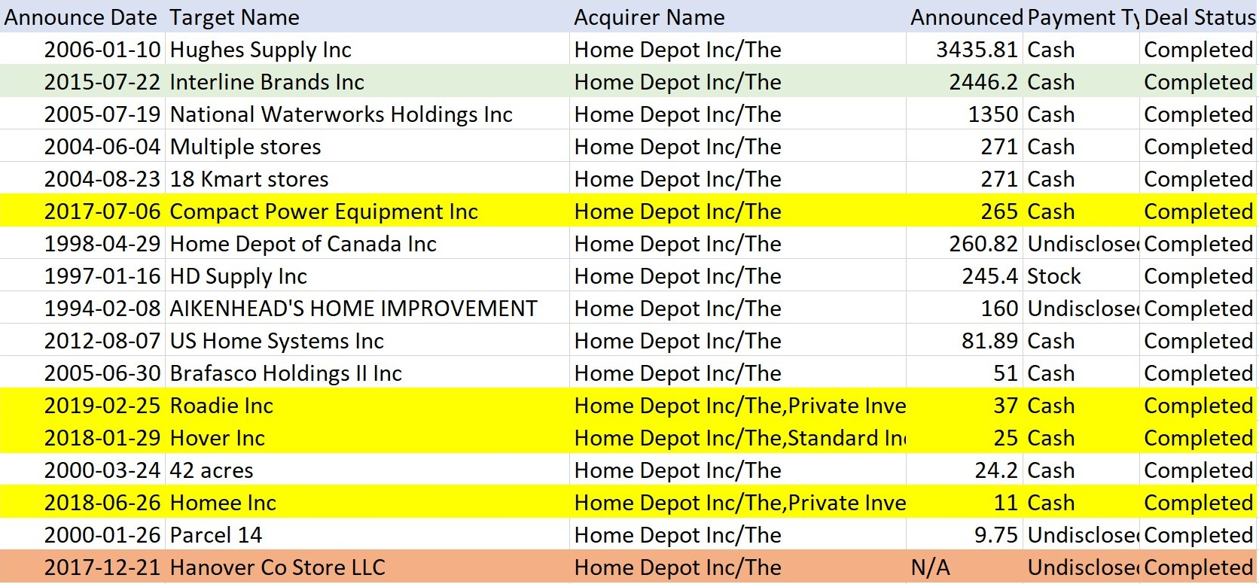
M&A (sort from largest)
Notes:
in millions

Slide 30
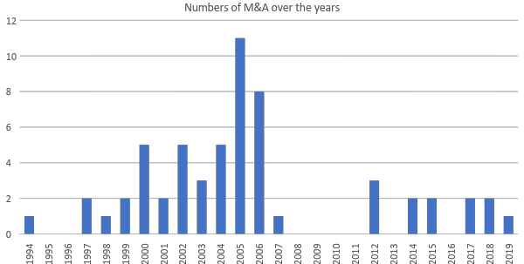
Numbers of M&A

Slide 31
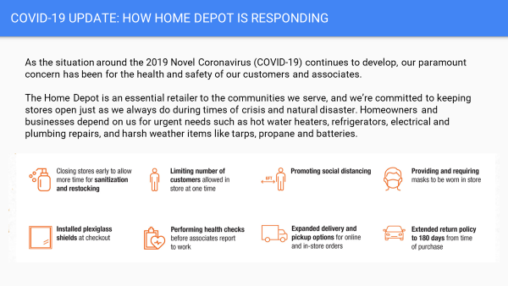

Slide 32


Slide 33
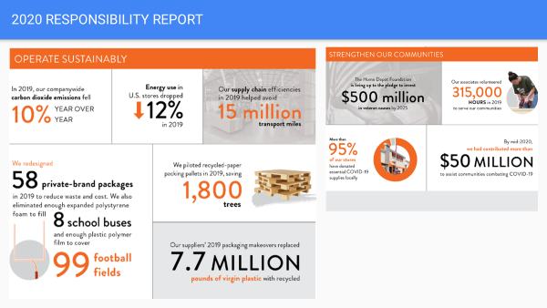

Slide 34
Management Overview

Slide 35
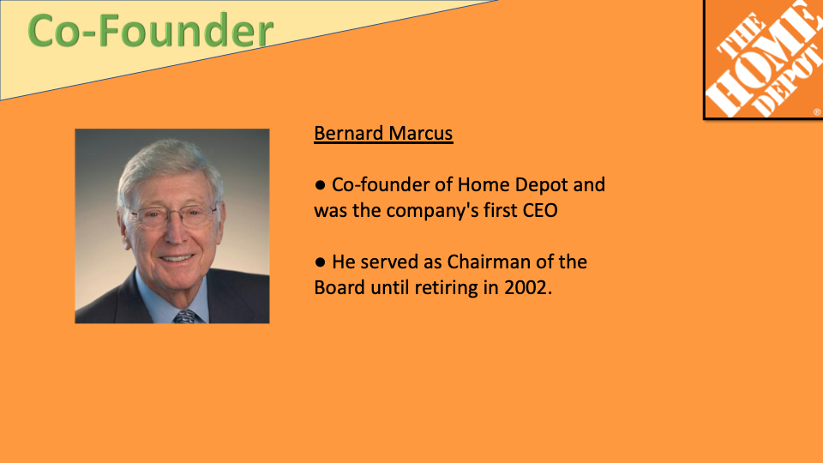

Slide 36


Slide 37


Slide 38

Notes:
Just recently assigned this title, however, have been with HD since 2005
Carol is main insiders of HD

Slide 39
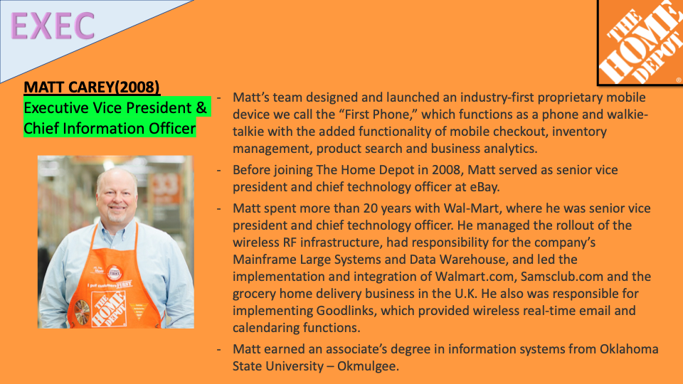

Slide 40
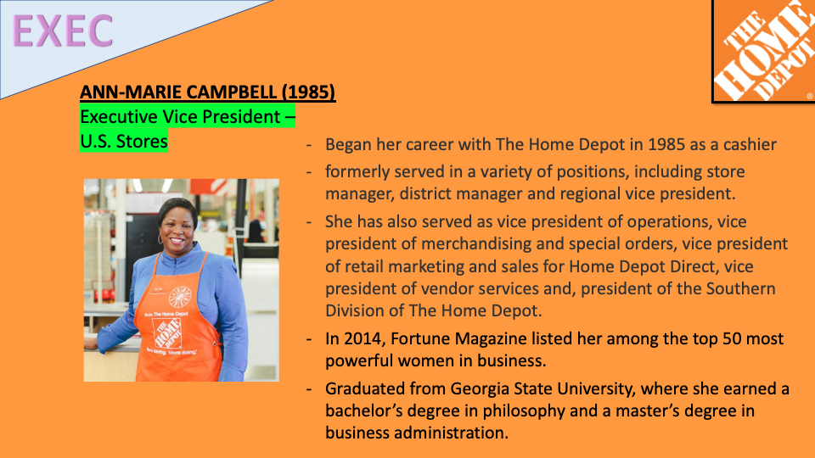
Notes:
Cashier - VP

Slide 41

Notes:
hold certain amount of shares

Slide 42


Slide 43


Slide 44
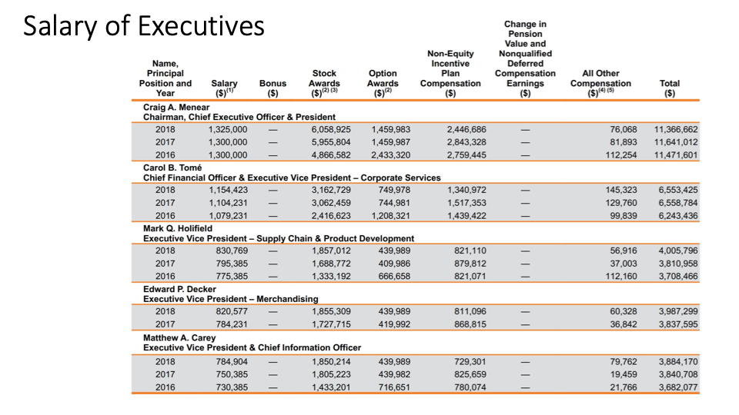


Slide 55


