Slide 1

GLOBAL AIRLINES
Duygu BAŞ
Chiara BRAMBILLA
Laila KACHBOUL
Monica SALVETTI

Slide 2



AIRLINE INDUSTRY
General Information
SOUTHWEST AIRLINES
Company overview
Risks
Hedging Derivatives
SINGAPORE AIRLINES
Company owerview
Risks
Hedging Derivatives

Slide 3
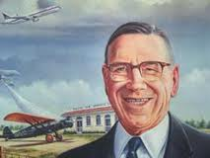
AIRLINES INDUSTRY
“Running an airline is like having a baby :
fun to conceive , but hell to deliver.”
C.E. Woolman
Principal founder Delta Air Lines
principal founder Delta Air Lines

Slide 4
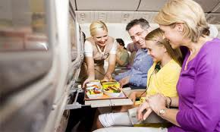
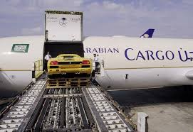
AIRLINES INDUSTRY
Global Airline Industry provides :
Services to virtually every corner of the globe
has been an integral part of the creation of a global economy
Air transportation of passengers and cargo

Slide 5
AIRLINES INDUSTRY
The airline industry is characterized by:
high competition arising from low barriers to entry and excess industry capacity;
cyclicality that is generally in line with the overall economy with occasional economic shocks, such as 9/11 or energy crises;
high costs, particularly for the legacy ﬁrms, including ﬁxed costs, such as capital and labour, as well as variable costs, such as fuel;
regulation focused on safety, maintenance, hours of operation per month for personnel and restrictions on routes, landing rights and slots.

Slide 6
Business Model
- Flag carriers
- Maintain hub and spoke networks
-Consolidate traffic at key hub airports
-Low unit costs
-Target holiday travelers
-Vertically integrated organizations
- Undercut the ticket prices of the full cost carriers
-Administration structures slim
- Operate shorter sectors
- Usually aircrafter less than 100 seats
Network carriers
Charter carriers
Low cost carriers
Regional airlines

Slide 7
AirlineS Alliances
An airline alliance is an agreement between multiple independent partners to collaborate in various activities to streamline costs while expanding global reach and market penetration.
Advantages:
  Increase of Network Coverage
  Increase of Traffic Volume
  Reduction in Costs
  Avoid Competition with Partner Airlines
Disadvantages:
  Multiple Listing on CRS Displays
  Passenger Confusion and Inconvenience
  Less competition can cause higher prices
  Less frequent flights

Slide 8
Star alliance
Sky Team
One World
PASSENGER AIRLINE ALLIANCE
CARGO AIRLINE ALLIANCE
WOW
Alliance
SkyTeam Cargo
ANA/UPS Alliance

Slide 9

AIRLINES Terminology
APK: Available Passenger Kilometres
ASK: Available Seat Kilometer
RPK: Revenue Passenger Kilometer
FTK: Freight Tonne Kilometer
YIELD: Revenue/RPK
LF: Load Factor, RPK/ASK
BREAK EVEN LF: Unit cost/Yield

Slide 10
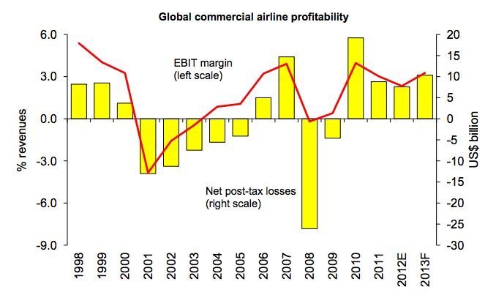
Commercial airlines profitability

Slide 11
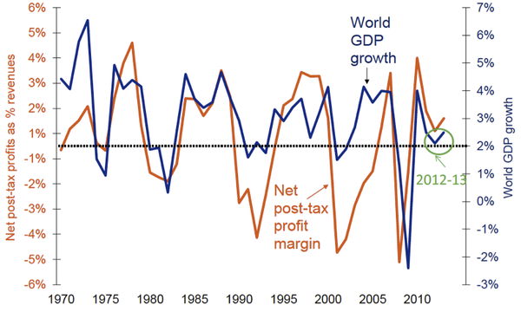
airlines Profitability

Slide 12
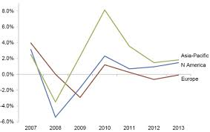
EBITDA as a % of Revenues by Region, 2007-2013

Slide 13
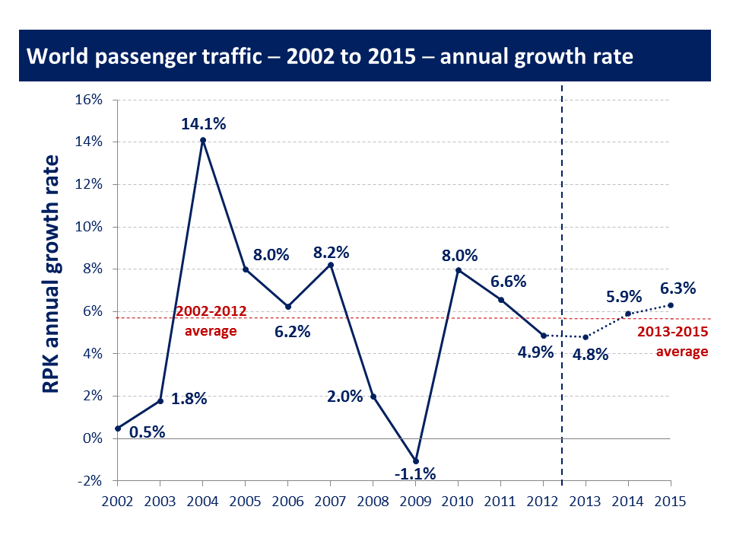
global passenger traffic

Slide 14
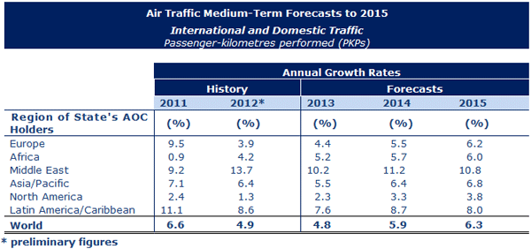
AIR TRAFFIC

Slide 15
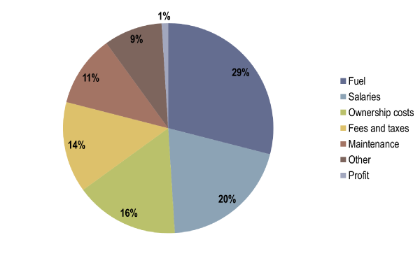
AirlineS COST STRUCTURE

Slide 16
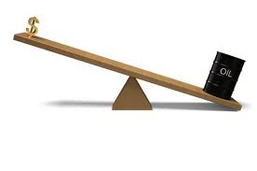
Fuel hedging
It is used to reduce or eliminate a company's exposure to fluctuating fuel costs
The use of derivatives does not guarantee profitability or reduction in risks

Slide 17
“Does hedging add value to corporations?”
Hedging stabilize fuel prices and therefore overall costs, cash flows, and profits.
Advantage of investment opportunities arises when fuel prices are high and airline operating cash flows and values are down.
The value premium associated with hedging increases with the level of the firm’s capital investment.

Slide 18
Smaller vs largest airlines
Larger airlines
more active hedgers of fuel costs
Smaller airlines
highest costs of financial distress
lacked sufficient resources
lacked strategic foresight

Slide 19
Hedging CONTRACTS
Fuel price risk can be managed in a number of ways:
Forward contracts
Futures contracts
Options, collars, swaps

Slide 20
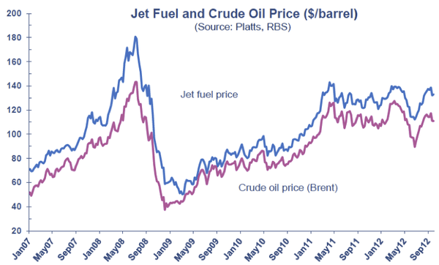
Jet Fuel AND CRUDE OIL Price

Slide 21
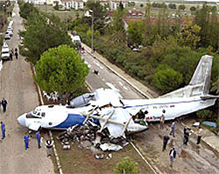
Risks

Slide 22

Types of Risk
Basis Risk
Exchange rate Risk
Counterparty Risk
Market Price Risk &Liquidity Risk
Credit Risk
Interest Rate Risk
Economic Risk
Fuel Risk

Slide 23
BASIS RISK
Basis Risk describes the relation (correlation factor) between the value of the commodity being hedged and the value of the derivative contract used to hedge the price risk.
Basis risks can be divided into 3 for airline companies:
Product basis risk
Time basis risk
Locational basis risk

Slide 24
EXCHANGE RATE RISK
Largest exposures are from $, €,£,CHF, AUD, NZD, ¥, ₹ , HKD, CNY, ₩ and MYR.
Companies usually generates a surplus in all of these currencies, with the exception of $.
The deficit in $ is attributable to capital expenditure, fuel costs and aircraft leasing costs – all conventionally denominated and payable in $

Slide 25
COUNTERPART RISK
In order to hedge the risk that exposure by airlines, some contracts are done but these contracts bear counterparty risks, such as the danger of bankruptcy of the airline or the trading partner.

Slide 26
MARKET PRICE & LIQUIDITY RISK
Liquidity risk is realted to the generated cash flows of the airline companies if we examine the financial instruments we can see company is a sufficient to pay off the next fiscal year’s expense.
Market Price determine the competitiveness of company.

Slide 27
CREDIT RISK
Limit exposure to individual counterparties and sometimes create provisions that require counterparties to provide security if their credit falls.

Slide 28
INTEREST RATE RISK
Interest rate risk is relevant in many investment funds where longer term investment may be bought with the risk that interest rates may increase during the term of the investment purchase.
If interest rates rise the portfolio will face a drop in overall value.

Slide 29

ECONOMIC RISK
  Airline industry is particularly sensitive to changes in economic conditions
  Affects customer travel patterns and related revenues. In harsh economic times customers will cut back on both leisure and business travel
  Hampers the ability of airlines to raise fares to counteract increased fuel, labor, and other costs

Slide 30
FUEL RISK
Jet Fuel has been one of the largest expense categories for domestic airlines
Airlines are inherently dependent upon jet fuel to operate
Unpredictable price movements
Cannot easily compensate for these increases with increases in fare prices due to competitive nature of airline industry
Fuel usually makes up at least 1/3 of operating expenses

Slide 31

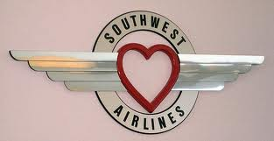
Southwest
Airlines
Notes:
Tan

Slide 32
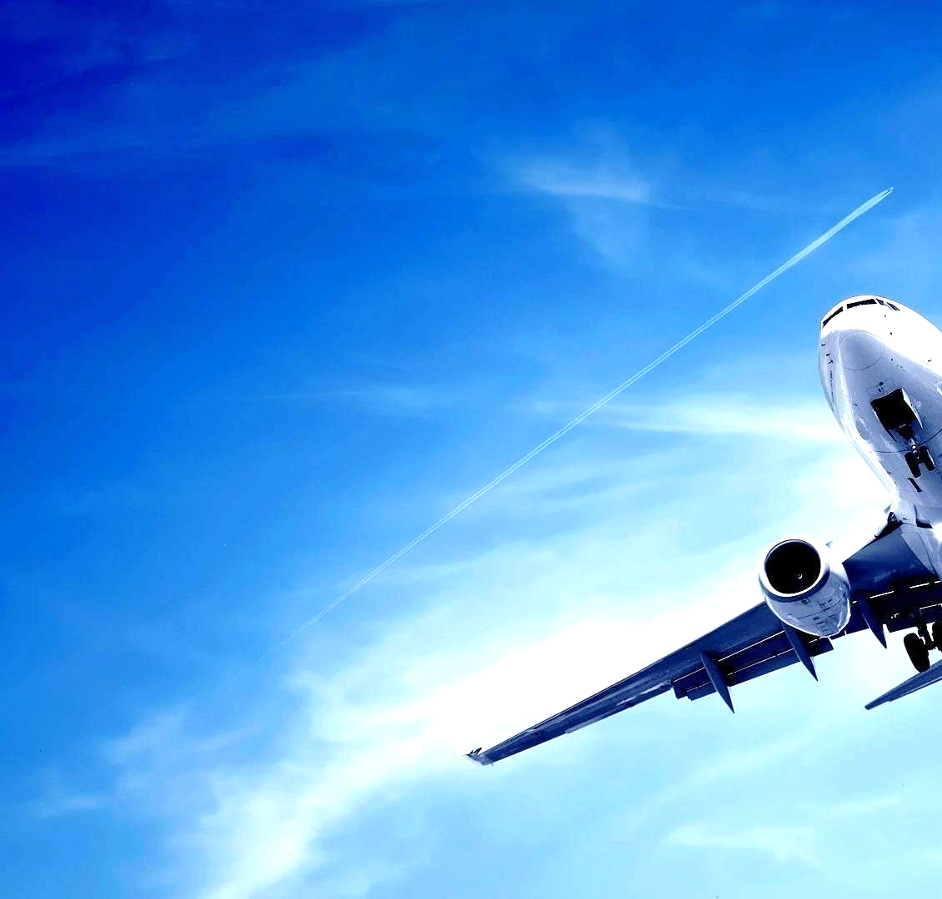
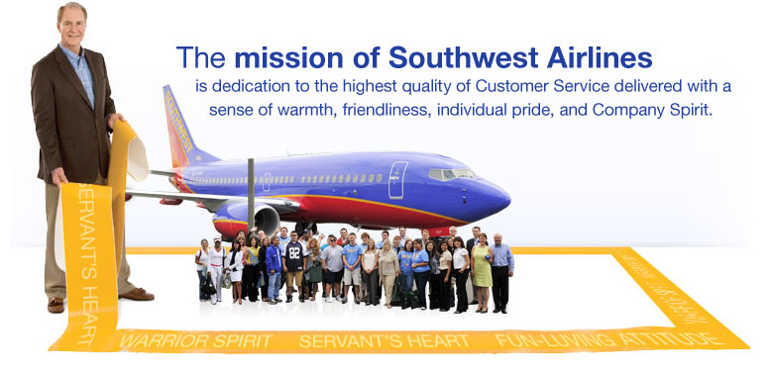

Slide 33

About
Southwest
The world’s largest low-cost carrier
Currently operates primarily in the United States
  10 million passengers annually
  Nearly 46,000 Employees
  serves 96 destinations in 41 states in the world
40 consecutive years of profitability
Attributes success to socially complex relationships with its employees
Operates an all-Boeing 737 fleet
Southwest does not use the traditional "hub and spoke" flight routing system ; preferring instead the "Point to Point" system
Notes:
Tan

Slide 34
HISTORY
1971 – Launched the company
In 3 cities :Dallas, Houston and San Antonio
1973 – First profitable year
1977 – Listed on NYSE
1978 – First services outside of Texas
1990 – First time annual revenue exceeds $1B
2013 – 40th consecutive year of profits

Slide 35
Corporate structure
Herb Kelleher
  Co-founder
Rollin King
  Co-founder
Gary C. Kelly
  Chairman of the Board, President, & Chief Executive Officer

Slide 36
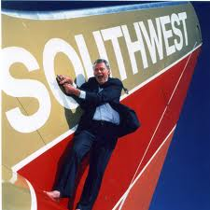

Slide 37

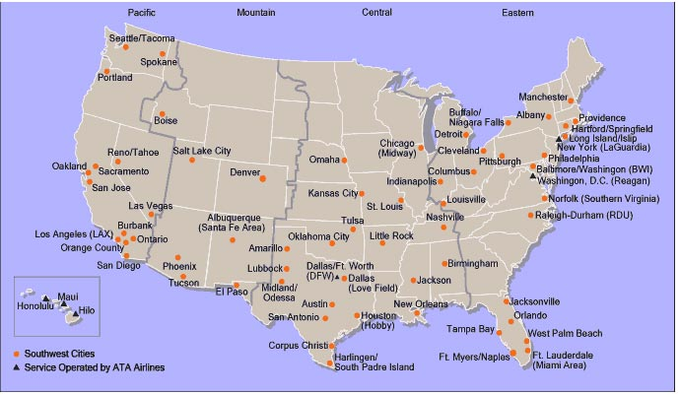
Destinations
Notes:
Trinh

Slide 38
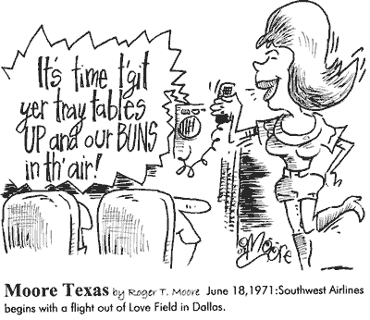
Southwest Internal analysis
STRENGTHS
Best low-fare carrier by standardization of their fleet of Boeing 737s
Flexible even though unionized - can still negotiate flexible work hours
Maximizes use of Internet for booking
Socially complex relationships with employees
Top class service
WEAKNESSES
Conservative growth tactics – generally uses the “go it alone” approach
Unionized work force
Being copied by other airlines
Limited to mostly U.S. cities
Possesses only one codeshare agreement (AirTran)
Notes:
Trinh
http://www.rapid-business-intelligence-success.com/southwest-airlines-swot-analysis.html

Slide 39
Southwest External analysis
OPPORTUNITIES
Expansion to other cities
International flights
Further improve customer satisfaction and value
Code sharing agreements with other airlines
Air travel is beginning to grow faster now that the recession is behind us – however there are no guarantees
THREATS
Recession - decrease in air travel
Fuel and Oil prices
Terrorist attacks
Competitors JetBlue, WestJet, formerly AirTran – Southwest is being copied.
Major airline alliances providing better value than Southwest
Notes:
Trinh

Slide 40
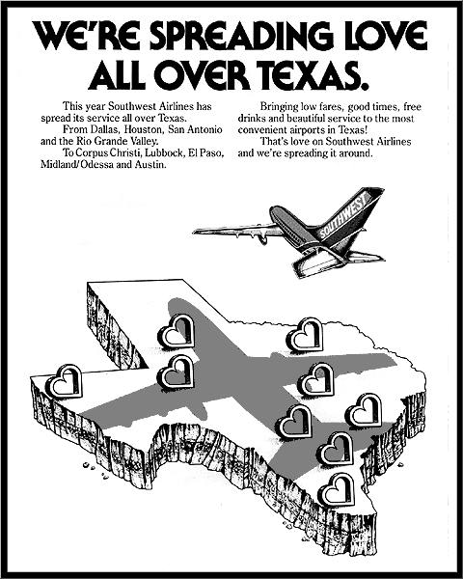
Southwest’s RECENT STRATEGIC MOVES
In 2008, announced the intent to begin a codeshare agreement with WestJet Airlines.
In May 2011, Southwest acquired AirTran Airways with the integration of the carriers expected to be completed in 2014
In April 2012, Southwest partnered with Amadeus IT Group to implement the Altea reservations system that would support the carrier’s international service

Slide 41

Southwest News 2013
Southwest Airlines Ceases Operations In 3 Cities: Branson Airport (BKG), Key West International Airport (EYW), and Jackson-Evers International Airport (JAN).
Announced new service between Chicago and both Dominican Republic & Jamaica.
Provides more than $10 Million in free travel through Medical Transportation
Southwest Airlines Cargo Awarded highest honors for Excellence In Air Cargo
Cargo Expands Service To AirTran Network

Slide 42
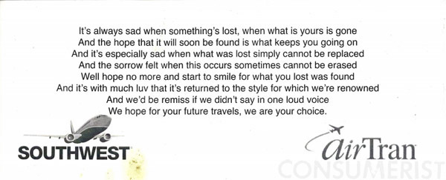
Southwest’s Acquisition of AirTran
Transaction valued at $3.2 billion with one time costs to integrate the two airlines of $500 million, with cost synergies of approximately $400 million annually
Elimination of a direct low-cost competitor and access to new markets
Adds 25 additional destinations
By April 2013, shared itineraries will be available in all Southwest and AirTran cities.
Southwest anticipates that the integration will be complete in late 2014.
Notes:
John

Slide 43
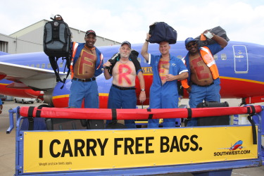
competitors
‘Southwest Airlines has the reputation of being able to force a competitor into bankruptcy!’
  Cost competitive
  “Bags fly free”
  Fewer fees
  MAIN COMPETITORS:
  American Airlines
  Delta Airlines
  Jetblue Airlines
  Spirit Airlines
Notes:
John
I want to show you this map for a second. This is an interactive map of all Southwest and AirTran destinations. The orange circles are Southwest locations, the blue circles are AirTran locations, and the blue diamonds are both companies combined. If you look toward Mexico and the Caribbean, you can see all the locations from the acquisition of AirTran that are now available to Southwest. But its not very much is it? But look up here in Canada, there is nothing going on in Canada. For a company that’s organizing to implement an international expansion, they have a pretty weak international presence. That leads us to our strategic recommendation.

Slide 44
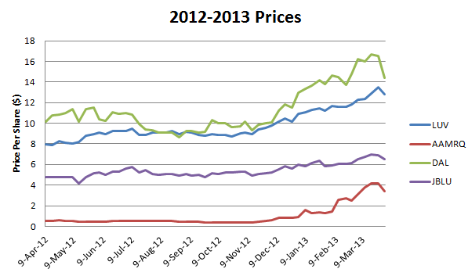
Southwest Airlines' performance over the last year in comparison to competitors.
performance 2013
*http://seekingalpha.com/article/1380301-southwest-airlines-2013-valuation

Slide 45
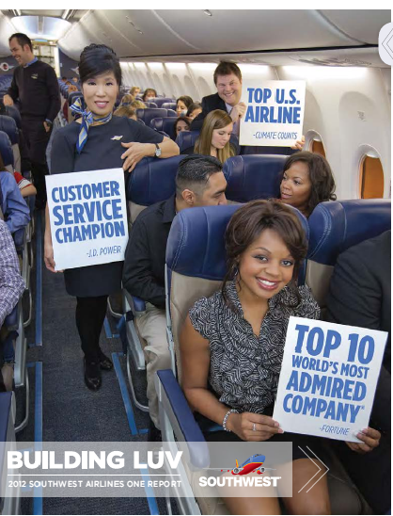

Slide 46

Size / fleet
September 30, 2013: Southwest and AirTran operated 683 Boeing jets
Type | Number | Seats
717-200 | 76 | 117
737-500 | 15 | 122
737-700 | 425 | 137/143
737-800 | 44 | 175
737-300 | 123 | 137/143
Notes:
Tan
Read slide

Slide 47

Scheduled passenger carried
Rank | Airline | Millions
1 | United Airlines | 288,282
2 | Delta Air Lines | 271,567
3 | American Airlines | 203,336
4 | Emirates | 180,880
5 | Lufthansa | 142,512
6 | Southwest Airlines | 137,708
7 | Air France | 135,821
8 | China Southern Airlines | 135,021
9 | British Airways | 124,318
10 | Qantas Airways | 108,051
SOURCE: IATA
Notes:
Josh
Now I would like to discuss the implications of our strategy and why we think its viable. We expect it will take two years for Southwest to fully integrate WestJet. That number is based on how long it is taking them to integrate AirTran right now. For those two years, they will operate as separate entities, with Southwest being the parent company and WestJet being their subsidiary.
Integrating WestJet into Southwest will be relatively easier than if we were to choose a company that did not use a low-cost strategy. Because WestJet essentially copied Southwest’s strategy as a low-cost carrier, we will be able to take advantage of mutual core competencies and create cost synergies between our corporate functions
Southwest has created competitive advantages for itself by using a fleet of only Boeing 737s. This has helped Southwest to significantly reduce the costs of maintenance and repair.WestJet also uses a fleet of Boeing 737s, meaning we will not need to alter our current workforce in order to integrate their aircraft. In addition to this, their fleet’s average age is significantly less than our own, meaning that our fleet’s average age will decrease and overall costs per aircraft should decrease. This gives us flexibility in the future when deciding whether to order aircraft now or wait longer.

Slide 48
TOP SERVED CITIES
Cities | Daily Departures |  | Number of Gates |  | Nonstop Cities Served |  | Year Established
 |  |  |  |  |  |  | WN | FL
Chicago (Midway) | 244 |  | 37 |  | 67 |  | 1985 | 1994
Las Vegas | 219 |  | 19 |  | 55 |  | 1982 | 2003
Baltimore | 210 |  | 28 |  | 58 |  | 1993 | 2001
Denver | 170 |  | 19 |  | 58 |  | 2006 | 2003
Atlanta | 168 |  | 31 |  | 45 |  | 2012 | 1993
Phoenix | 166 |  | 24 |  | 46 |  | 1982 | 2007
Houston (Hobby) | 157 |  | 18 |  | 43 |  | 1971 | 1997
Dallas (Love Field) | 127 |  | 15 |  | 18 |  | 1971 | -
Los Angeles (LAX) | 110 |  | 12 |  | 23 |  | 1982 | 2003
Orlando | 101 |  | 20 |  | 42 |  | 1996 | 1998
SOURCE:swamedia.com
Notes:
Josh
Southwest will also gain WestJet’s code sharing agreements. Now we’ve used that word codeshare agreement before – let me tell you what it means and why its valuable for Southwest. A codeshare agreement is an aviation business arrangement where two or more airlines share the same flight. A seat can be purchased on one airline but is actually operated by a cooperating airline under a different flight number or code. It allows greater access to cities through a given airline's network without having to offer extra flights, and makes connections simpler by allowing single bookings across multiple planes. Most major airlines today have code sharing partnerships with other airlines and code sharing is a key feature of the major airline alliances. At the moment, the only codeshare agreement that Southwest possesses is with AirTran, and that’s because they acquired AirTran and operate it as a subsidiary. By acquiring WestJet, Southwest will not only gain those codeshare agreements, provided the other companies don’t back out of the agreement, but they will also gain the managerial expertise that WestJet has in negotiating with other airlines to create codeshare agreements. What’s more is that we know that in 2008, Southwest Airlines officially announced the intent to begin a codeshare agreement with WestJet. Even though it was cancelled, this tells us that Southwest is definitely interested in WestJet’s destinations and that’s one of the reasons we feel this strategy is so strong.

Slide 49
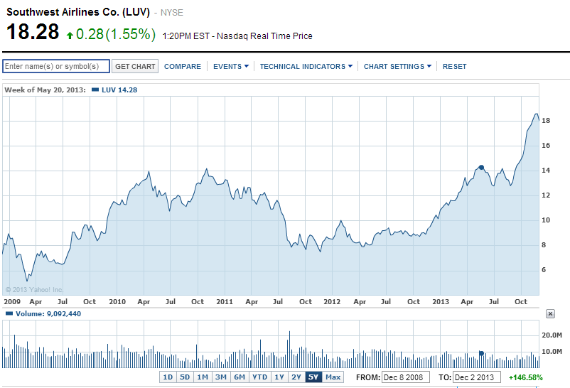
STOCK
Notes:
Josh
In our SWOT analysis, we talked about how Southwest has opportunities in international markets. Recall that interactive map we just showed you. Not a lot of international locations, right? Now here’s WestJet’s interactive map.
Acquiring WestJet opens Southwest to Canada, more U.S. cities, and more cities in Mexico, and the Caribbean. Here’s a rundown:
33 Locations in Canada
4 locations in Hawaii
4 locations in Mexico
22 other Caribbean locations
16 new destinations in the continental United States
For a total of 79 new destinations added to Southwest’s repertoire. Now we’re sure that they would eliminate some of these, but there’s no arguing that the acquisition of WestJet would be the best possible way to exploit international opportunities moving forward and the fastest way to catch up with other international airlines.

Slide 50

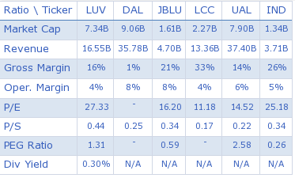
COMParATIVE SORT FOR stock over COMPETITORS
Notes:
At this point we want to move to our Excel sheets so that we can show you the impact of the acquisition on financial statements and budgets.

Slide 51

Southwest airlines FINANCIAL INDICATORS

Slide 52
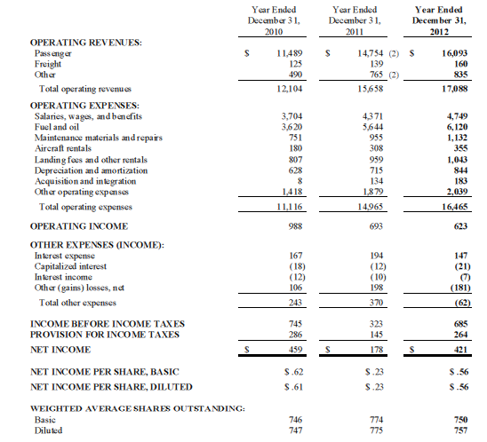
INCOME STATEMENT 2012

Slide 53
Operating revenues for 2012 increased by $1.4 billion compared to 2011. The other revenues for 2012 increased by $70 million of which approximately $69 million was due to the inclusion of the full year of AirTran results in 2012, while 2011 results only include AirTran Other revenues following the acquisition date.
Operating expenses for 2012 increased by $1.5 billion
Fuel and oil expense for 2012 increased by $476 million.

Slide 54
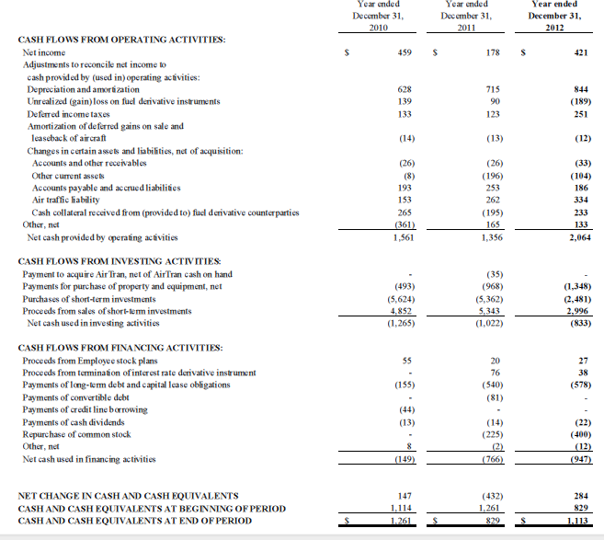
CASH FLOWS 2012

Slide 55
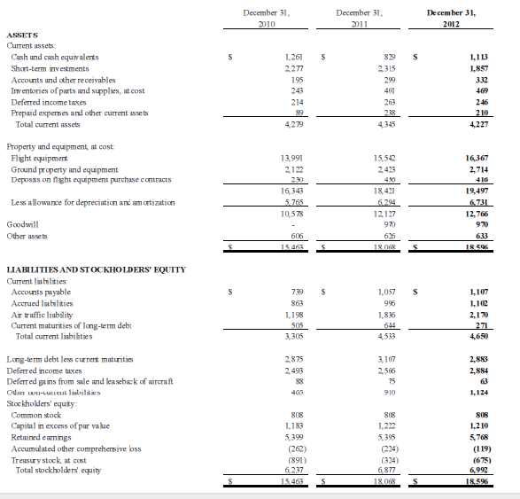
BALANCE SHEET 2012

Slide 56
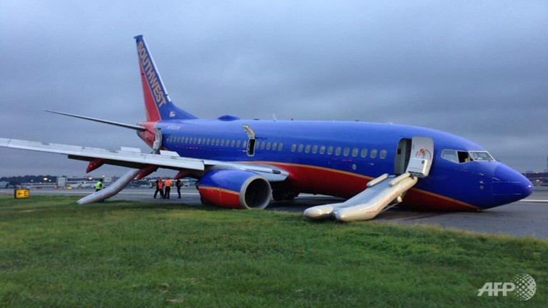
RISK MANAGEMENT
“If we don’t hedge jet fuel price risk, we are speculating. It is our fiduciary duty to try and
hedge this risk.”
Scott Topping, Director of Corporate Finance for Southwest Airlines

Slide 57
Types of Risk
Southwest Airline
Exchange rate Risk
Counterparty Risk
Market Price Risk &Liquidity Risk
Credit Risk
Interest Rate Risk
Economic Risk
Fuel Risk

Slide 58
EXCHANGE RATE RISK
Southwest generates a surplus in all of exposed currencies, with the exception of $. The deficit in $ is attributable to capital expenditure, fuel costs and aircraft leasing costs – all conventionally denominated and payable in $
FX is not an issue with LUV due to its small airport point-to-point strategy, which restricts luggage transfer and security clearance activities. As a consequence, LUV is almost exclusively a US domestic carrier and has no direct transactions exposure to other currencies.

Slide 59
Both are considered as low risk in 2012 Also ; Liquidity is not high risk as 2012’s generated cash flow if we examine the financial instruments we can see company is a sufficient to pay off the next fiscal year’s expense
Southwest’s strategy is to maintain their minimum credit ratings and fair values for outstanding debt agreements.Currently maintain a credit rating of BBB
MARKET PRICE&LIQUIDITY RISK

Slide 60
CREDIT RISK
To manage credit risk, Southwest periodically selects and reviews counterparties based on credit ratings

Slide 61
INTEREST RATE RISK
Southwest enters into interest rate swap contracts and interest rate cap contracts to manage interest rate costs on its financial assets and liabilities

Slide 62

ECONOMIC/POLITICAL RISK
  Airline industry is particularly sensitive to changes in economic and political condition.Company cannot hide from Political risk ( e.g. 9/11)

Slide 63
Jet Fuel has been one of the largest expense categories for domestic airlines.
FUEL RISK
Airlines are inherently dependent upon jet fuel to operate
Unpredictable price movements
Cannot easily compensate for these increases with increases in fare prices due to competitive nature of airline industry
Fuel usually makes up at least 1/3 of operating expenses

Slide 64
HEDGING STRATEGY
The Company utilizes financial derivative instruments primarily to manage its risk associated with changing jet fuel prices
The Company does not purchase or hold any derivative instruments for trading purposes.
The company has some alternatives:
Do nothing.
Hedge using a plain vanilla jet fuel or heating oil swap.
Hedging using options.
Hedge using a zero-cost collar strategy.
Hedge using a crude oil or heating oil futures contract.

Slide 65
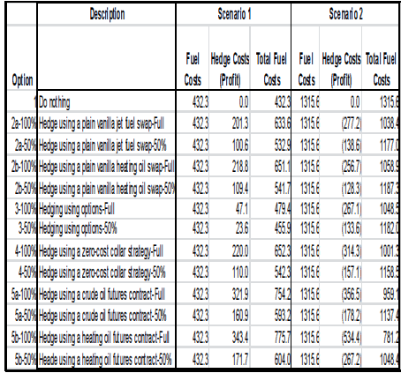
Instruments
Scenario 1: fuel price increase
Scenerio 2: fuel price decrease

Slide 66
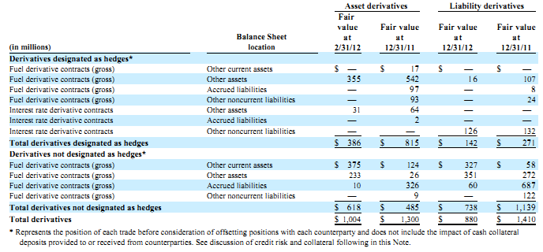
HEDGING BY DERIVATIVES (facts)
The table represents the location of all asset ad liabilities associated with the company’s hedging instrument within the consolidated balance sheet:

Slide 67
Ineffectiveness is inherent in hedging jet fuel with derivative based in other crude oil related commodities. Due to the volatility in market for crude oil and raletd products the company is enable to predict the amount of loss of hedge accounting.
Ineffectiveness and unrealized gains and losses on derivative contracts include fluctuation energy prices, number of derivative position and weather events

Slide 68
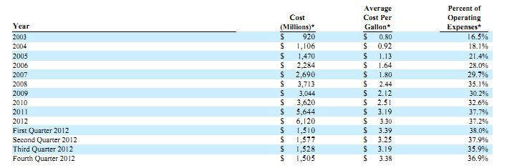
FUEL COST

Slide 69
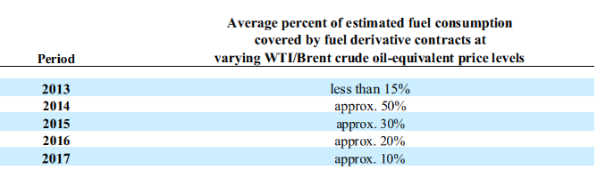
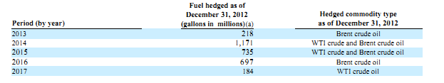
Hedging fuel assumptions and covered facts
The tables displays the Company’s estimated fair value of remaining fuel derivative contracts

Slide 70
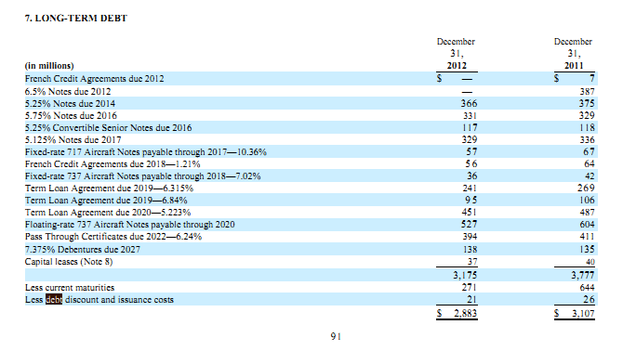
LONG-TERM DEBT
The table explains the after prepaying aircrafts secured term loan last quarter 2012, financed under floating rate and fixed rate.

Slide 71
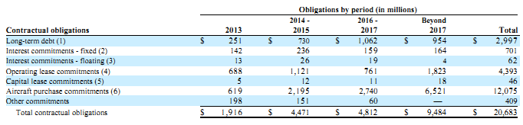
Contractual obligations
The table aggregates the companies material expected contractual obligation and commitments as december 2012;

Slide 72
(1)Includes principal only and includes $68 million in 2013 associated with the Company’s convertible senior notes due 2016.
(2) Related to fixed-rate debt only.
(3) Interest obligations associated with floating-rate debt
(4) Includes Love Field Modernization Program commitment amounts, and includes the impact of the Boeing 717 lease/sublease transaction entered into in 2012.
(5) Includes interest on capital leases.
(6) Firm orders from Boeing. The Company has flexibility as to the timing for certain of the firm orders in 2014 through 2017

Slide 73
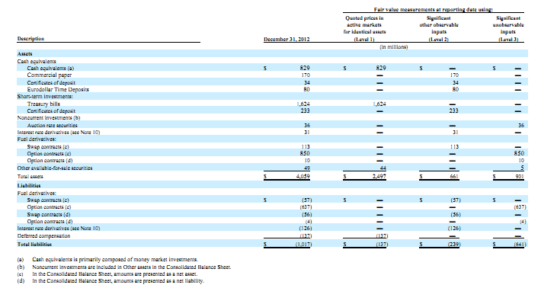
Fair Value Summary
The table represents the companies assets and liabiliteis that are measured at fair value at December 31, 2012

Slide 74

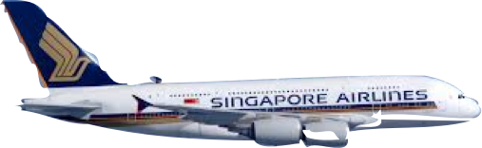


Slide 75

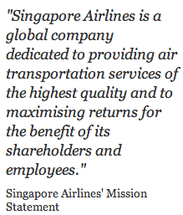

Slide 76

SINGAPORE AIRLINES OVERVIEW
Arguably the most successful airline company in the world
Flag carrier of Singapore
Second largest airline in the world by market capitalization
World's most awarded airline
In February 2004 Singapore Airlines inaugurated its first A340-500 by setting a record for the world’s longest non-stop commercial flight from Singapore to Los Angeles

Slide 77

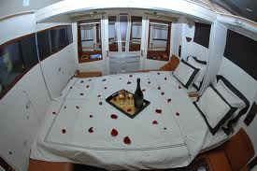

SINGAPORE AIRLINES OVERVIEW
Focus in the higher-end segment
Modern fleet of 99 aircraft
As of 1 December 2013 the average age of the fleet stands at six years and seven months
“one of the world's youngest and most fuel efficient”

Slide 78
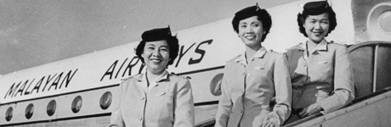
SINGAPORE AIRLINES’ HISTORY
Evolved from Malay Airline to one of the most respected travel brands around the world
In 1966 become Malaysia-Singapore Airlines
In 1972 Malaysia-Singapore Airlines divided into : Singapore Airlines and Malaysia Airlines

Slide 79

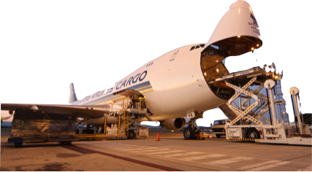
ABOUT SINGAPORE AIRLINES
Current employee:14,156
Subsidiaries : over 20 subsidiaries
(from cargo to engine overhaul)
SIA Cargo - SIA Engineering Company - SilkAir - Tradewinds Tours and Travel

Slide 80


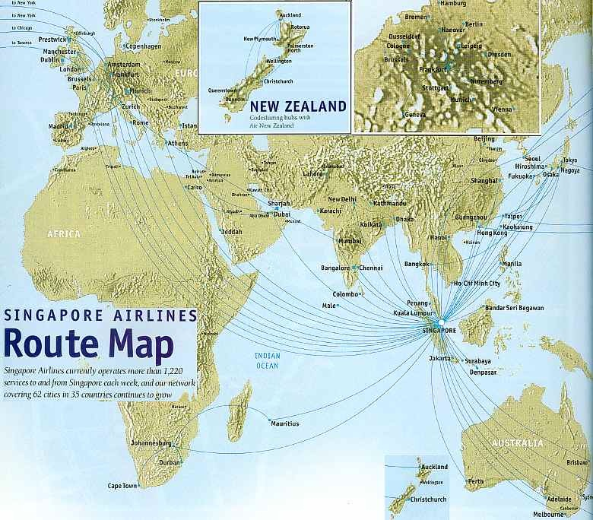

SINGAPORE AIRLINES ROUTE MAP

Slide 81
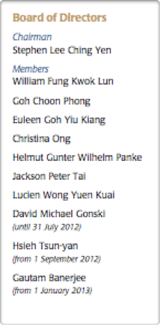
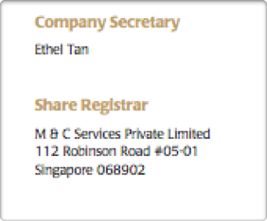

CORPORATE STRUCTURE

Slide 82
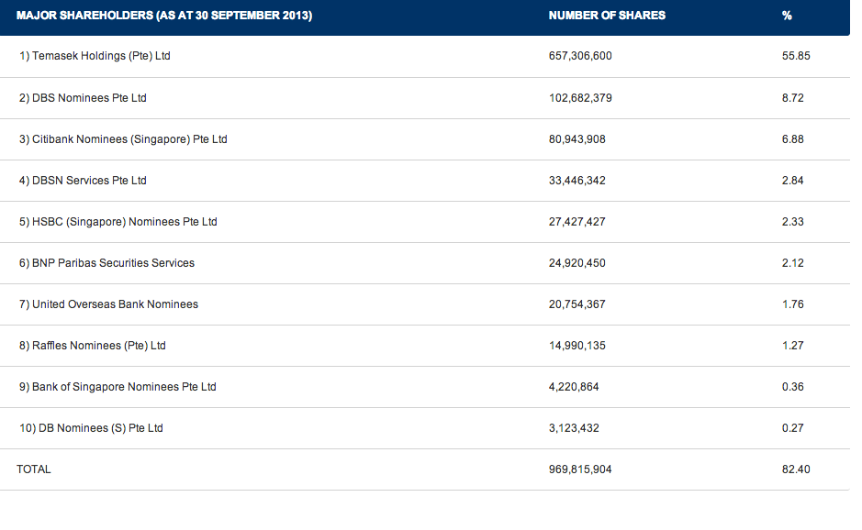
SHAREHOLDER COMPOSITION

Slide 83
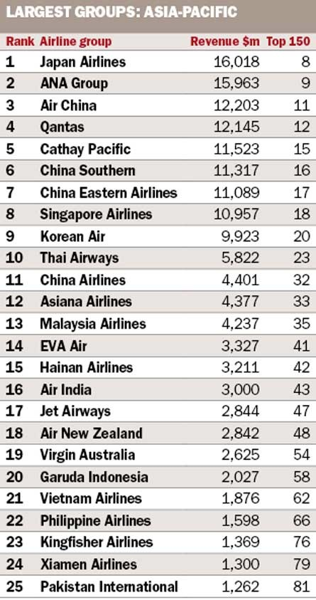
COMPETITORS
Notes:
John
I want to show you this map for a second. This is an interactive map of all Southwest and AirTran destinations. The orange circles are Southwest locations, the blue circles are AirTran locations, and the blue diamonds are both companies combined. If you look toward Mexico and the Caribbean, you can see all the locations from the acquisition of AirTran that are now available to Southwest. But its not very much is it? But look up here in Canada, there is nothing going on in Canada. For a company that’s organizing to implement an international expansion, they have a pretty weak international presence. That leads us to our strategic recommendation.

Slide 84

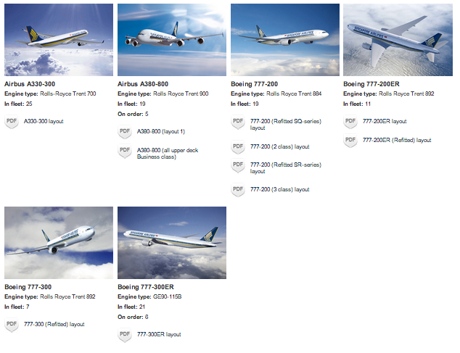
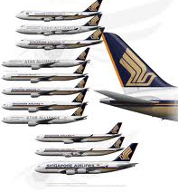
FLEET
Notes:
Tan
Read slide

Slide 85
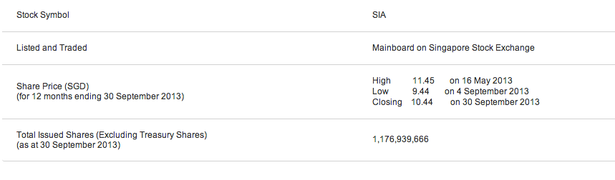

STOCK
Notes:
Josh
In our SWOT analysis, we talked about how Southwest has opportunities in international markets. Recall that interactive map we just showed you. Not a lot of international locations, right? Now here’s WestJet’s interactive map.
Acquiring WestJet opens Southwest to Canada, more U.S. cities, and more cities in Mexico, and the Caribbean. Here’s a rundown:
33 Locations in Canada
4 locations in Hawaii
4 locations in Mexico
22 other Caribbean locations
16 new destinations in the continental United States
For a total of 79 new destinations added to Southwest’s repertoire. Now we’re sure that they would eliminate some of these, but there’s no arguing that the acquisition of WestJet would be the best possible way to exploit international opportunities moving forward and the fastest way to catch up with other international airlines.

Slide 86

SINGAPORE AIRLINES
FINANCIAL INDICATORS

Slide 87


Slide 88


Slide 89

CASH FLOWS

Slide 90

GROUP’S PERFORMANCE

Slide 91

COST STRUCTURE

Slide 92

QUARTERLY TREND OF GROUP FUEL PRICE
AND FUEL COST (EXCLUDING HEDGING)

Slide 93

RISK MANAGEMENT ACTIVITIES

Slide 94

FINANCIAL RISK MANAGEMENT OBJECTIVES AND POLICIES

Slide 95

HIGHLIGHTS OF SIGNIFICANT RISK MANAGEMENT ACTIVITIES
Since 2002, a formalized Risk Management Framework has been implemented across the Group under which risks are identified, evaluated and controlled on a coordinated and integrated basis
Operational changes
New global risk
New legislation
Test/Simulation program for Ongoing Risk Responses
Reviews and Assurances of Risk Management Implementation
Risk Governance/Oversight

Slide 96

HEDGING STRATEGY
Use derivative financial instruments such as:
forward currency contracts
foreign currency option contracts
cross currency swap contracts
interest rate swap contracts
interest rate cap contracts
jet fuel option contracts
jet fuel swap contracts
jet fuel collar contracts
To hedge its risks associated with:
foreign currency
interest rate
jet fuel price fluctuations

Slide 97


FUEL PRODUCTIVITY AND SENSITIVITY ANALYSIS

Slide 98



JET FUEL PRICE RISK

Slide 99


JET FUEL PRICE SENSITIVITY ANALYSIS

Slide 100


Slide 101


SINGAPORE AIRLINES TO INCREASE FUEL SURCHARGES

Slide 102


FOREIGN CURRENCY RISK

Slide 103

FOREIGN CURRENCY RISK SENSITIVITY ANALYSIS

Slide 104


LIQUIDITY RISK

Slide 105

LIQUIDITY RISK

Slide 106


