Slide 1
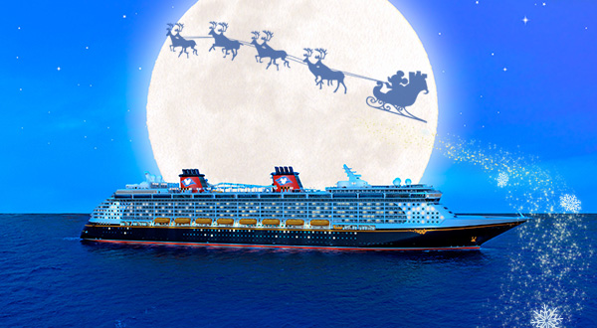
Cruise line industry
Andrea arrigoni, giorgio bertola, virginia martinelli, silvia scandella

Slide 2

agenda
Market overview
Carnival Corporation & Plc.
Royal Caribbean Cruises Ltd.
NCL Corporation Ltd.

Slide 3
CRUISE LINE SECTOR
It is a young sector → From 1980 191 million passengers have taken a cruise. (+ 2 days)
It is the most growth category in the leisure market --> plus 6,7% passengers every year
Cruise product are hugely diversified --> follow the vacation patterns of today’s market
It is organised by several entities --> the most important is C.L.I.A.
It is influenced by macro economic and human conditions

Slide 4

Risk factors
Enviromental risk
Regulation risk
Fuel price risk
Changes in costumers need
Political Risk
Human Risk
The “Black Swan Risk” (LFHI)

Slide 5
Major cruise companies (1/3)
Carnival Corporation | Ship | Berths | Market Share
Camival Cruise Lines | 23 | 57,876 | 19.5%
Costa Crociere | 15 | 32,362 | 7.2%
Princess Cruises | 16 | 36,51 | 7.0%
Holland America Line | 15 | 23,234 | 4.5%
AIDA Cruises | 8 | 14,164 | 3.0%
P&O Cruises UK | 7 | 14,38 | 2.1%
P&O Cruises Australia | 4 | 6,286 | 1.3%
Cunard Line | 3 | 6,712 | 1.2%
Iberocruceros | 4 | 4,938 | 1.2%
Seaboum Cruise Line | 6 | 1,962 | 0.3%
Total | 101 | 198,424 | 47.3%
Source: Cruise Line International Association 2012

Slide 6
Major cruise companies (2/3)
Royal Caribbean Cruises: | Ship | Berths | Market Share
Royal Caribbean International | 22 | 61,608 | 18.1%
Celebrity Cruises | 10 | 21,086 | 4.5%
Pullmantur | 5 | 7,984 | 1.7%
TUI | 2 | 3,7 | 0.7%
Azamara Club Cruises | 2 | 1,428 | 0.3%
CDF Crooisière de France | 1 | 750 | 0.1%
Total: | 42 | 95,556 | 25.4%
Source: Cruise Line International Association 2012

Slide 7
Major cruise companies (3/3)
Other comapanies | Ship | Berths | Market Share
NCL | 11 | 26,33 | 7.8%
MSC Cruise | 11 | 24,44 | 5.7%
Total | 22 | 50,77 | 13.5%
Source: Cruise Line International Association 2012
These companies control the market
Summary | Ship | Berth | Market Companies
Four Companies | 1654 | 344,751 | 86.2%
Source: Cruise Line International Association 2012

Slide 8
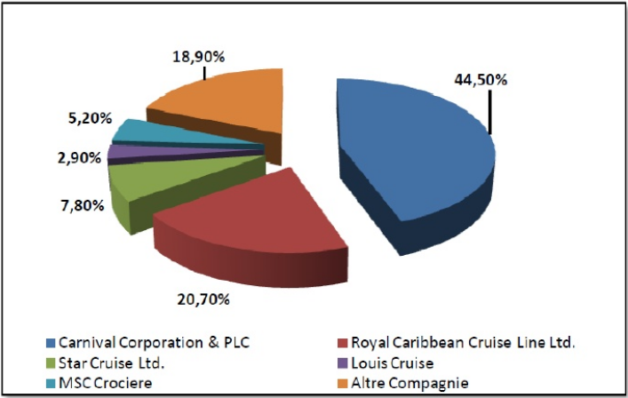
Market share of principal companies
Source: Marine Industries Global Market Analysis (2012)

Slide 9
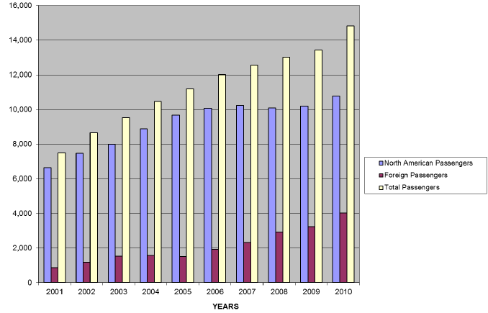
Overall passenger growth
Source: Cruise Line International Association 2011

Slide 10
Age profile of cruise ship passengeR
Age | Number of respondent | Percentage
Less than 30 | 10 | 0.8%
30-39 | 21 | 1.8%
40-49 | 79 | 6.7%
50-59 | 274 | 23.1%
60-69 | 539 | 45.5%
70-79 | 222 | 18.7%
80-89 | 39 | 3.3%
90 or older | 1 | 0.1%
Total | 1,185 | 100%
Study of an East Cost US port. The Total global average is around 50.

Slide 11
INCOME PROFILE
Annual Household Income | Number of respondent | Percentage
Less than $ 25,000 | 24 | 2.1%
$ 25,000 to $ 49,999 | 173 | 15.5%
$ 50,000 to $ 74,999 | 278 | 24.9%
$ 75,000 to $ 99,999 | 201 | 18.0%
$ 100,000 to $ 149,999 | 254 | 22.7%
$ 150,000 or more | 188 | 16.8%
Total | 1,118 | 100%
Study of an East Cost US port. The Total global average is around 50.

Slide 12
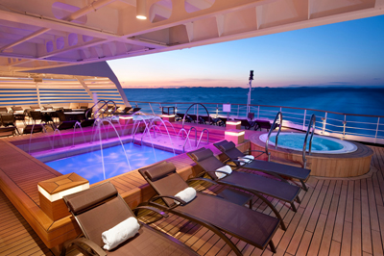
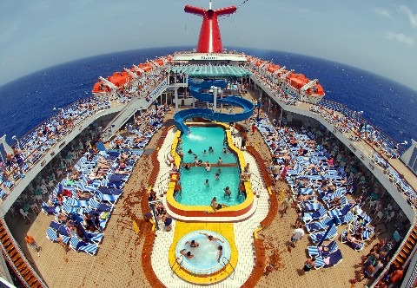
MARKET DIFFERENTIATION
Cruise lines are differentiated according to the market niche that they fill.
Four main sectors:
Luxury
Premium
Contemporary
Badget
For two main geographical areas:
North American cruise industry
European cruise industry

Slide 13
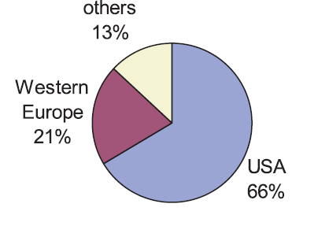
REGIONAL SEGMENTATION
Source: Rob H. Kamery, Nova Southeastern University (2011)

Slide 14
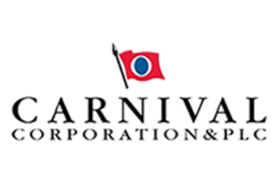
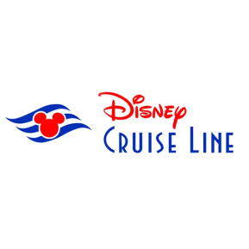
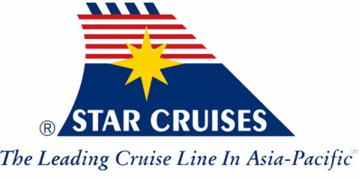
NORTH AMERICA MARKET
Few competitors
    Carnival
    Disney
    Star Cruises
Large market but only the 2% of the vacation industry
Large entry barriers
Importance of the Web
    Costa Cruise accepts reservation only by internet

Slide 15
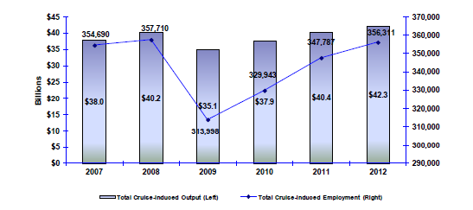
Economic contribution for North America
Source: Rob H. Kamery, Nova Southeastern University (2011)

Slide 16
Cruise line economic impact
$ 11 billion – Direct spending of the cruise line
267,762 – Total jobs create by these expenditures
$ 9.7 billion – Total wages paid to U.S. employees
 | Direct Impact | Multiplier Effects | Total impact
Sales | 5,247,201 | 2,719,231 | 7,966,432
Income | 2,348,079 | 890,973 | 3,239,052
Employment | 71 | 25 | 96
Source: Rob H. Kamery, Nova Southeastern University (2011)

Slide 17
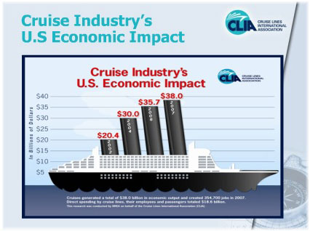
Economic contribution for North America
Source: Cruise Line International Association 2012

Slide 18

EUROPEAN Market
“The cruise industry in Europe is a dynamic source of economic activity providing economic benefits to virtually all industries
and countries throughout Europe”
“Europe, with its 250 ports, is the second most appealing market worldwide, despite the currently uncertain geopolitical conditions.”
- Brindisi Authority Port-

Slide 19
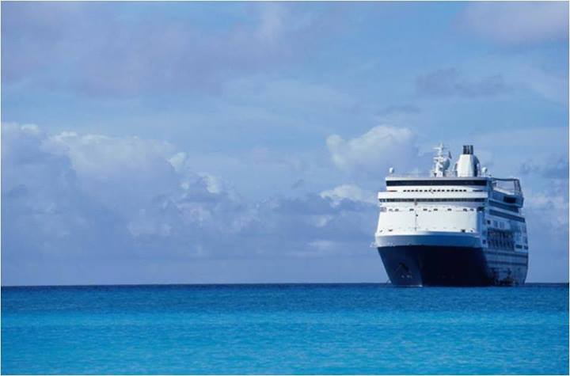
Market overview
The number of Europeans and non-Europeans who choose a cruise holiday has more than doubled to 5,5 million (*7.6%).
The Mediterranean is the first sailing region in Europe
Low market penetration: 1.3% in Europe Vs 3.2% in North America
High potential for developments
Europe is the number one cruise destination

Slide 20
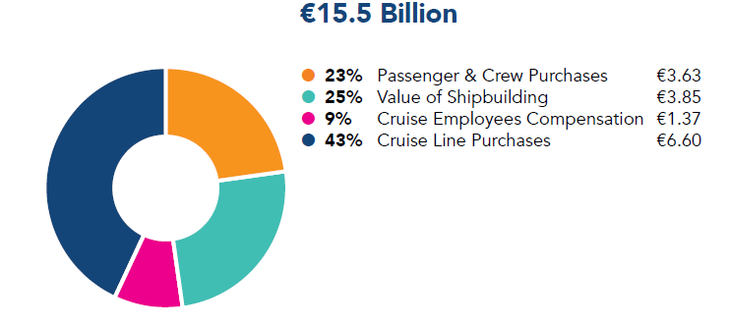
Cruise Line Total Expenditures
Source: Port-Net study 2010

Slide 21
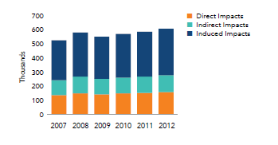
Economic Contribution to Europe
Source: Port-Net study 2010

Slide 22
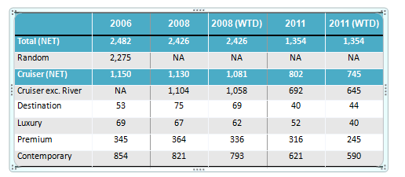
Offer differentiations – “Natural Hedging”
Source: CLIA Cruise Line Market Profile Study (2012)

Slide 23
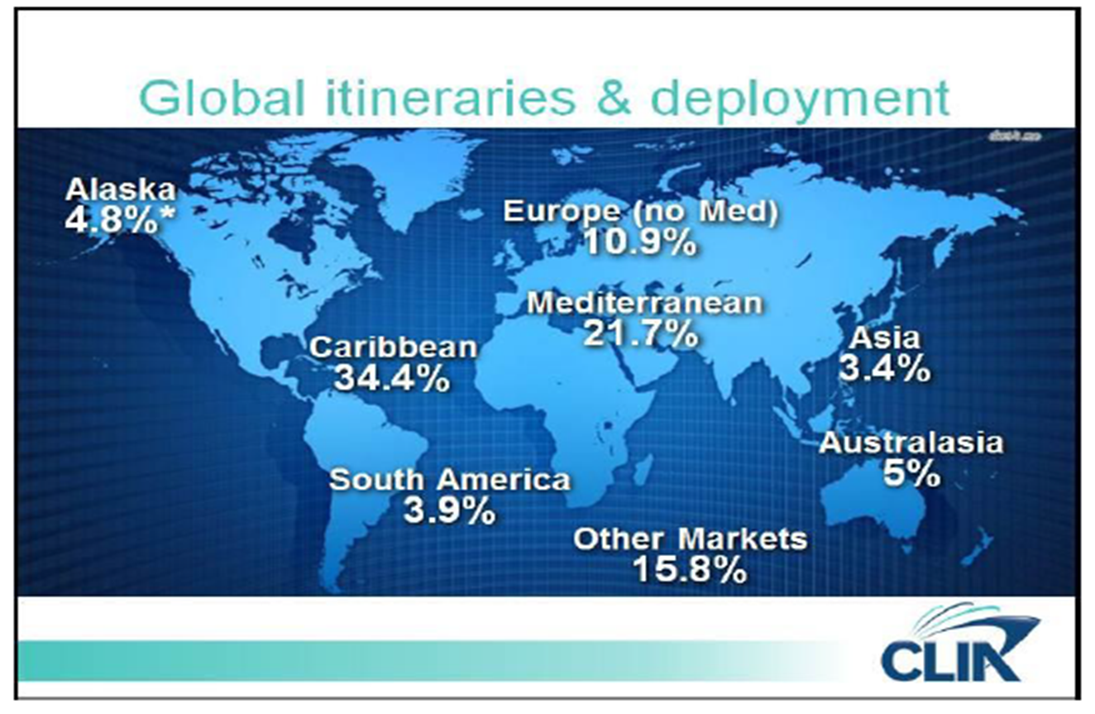
Market diversification
Source: CLIA Cruise Line Market Profile Study (2012)

Slide 24
Most appealing destination to cruise
Destination | %
Caribbean | 43
Alaska | 25
Bahamas | 25
Hawaii | 15
Mediterranean /Greek Island/ Turkey | 14
Bermuda | 11
Europe | 9
Panama Canal | 8
Mexico (West Coast) | 8
Source: CLIA Cruise Line Market Profile Study (2012)

Slide 25
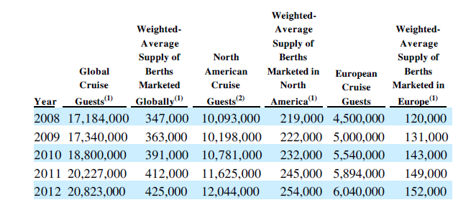
The numbers of cruises sector
Source: CLIA Cruise Line Market Profile Study (2012)

Slide 26
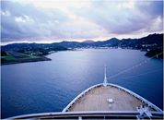
Market projection (1/3)
“The cruise industry has enjoyed dynamic growth over a period of 30 years, driven initially by demand from North America and more recently by growing demand from Europe and the rest of the world”.
-European Cruise Council-

Slide 27
Market projection (2/3)
The increase derives from:
  Population (+3%)
  Total past cruisers (+4% overall; +10% in core market)
  Future interest in cruising (+3%, Best Case; +1% Most Likely Case)
  Huge base to exploit:
  Of the current total US population (304,130,000), not quite half (44% or 132,947,000) are prime cruise candidates (age 25+; income $40,000+)
  Of the target population, 73,121,000 (55%) people have ever taken a cruise, and somewhat fewer than half of those (32,838,000) have done so in the past three years.

Slide 28
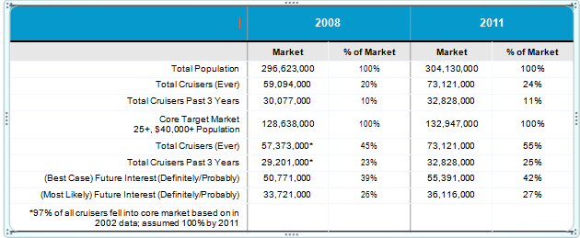
Market projection (3/3)
Source: CLIA Cruise Line Market Profile Study (2012)

Slide 29
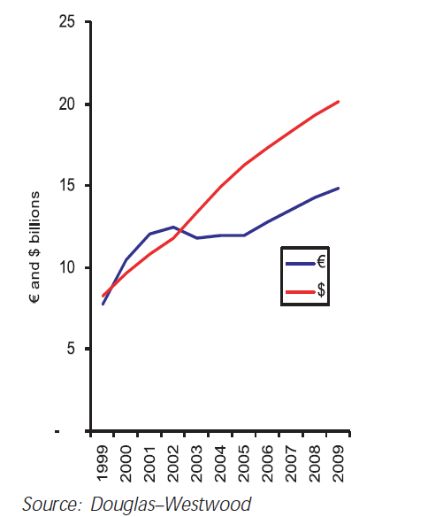
Market Projection [€ Vs $]

Slide 30
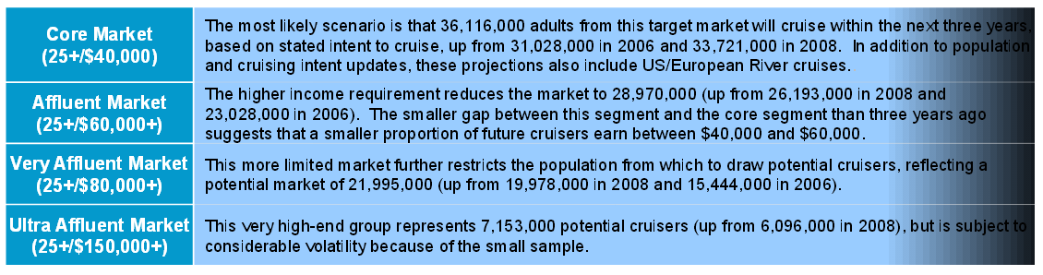
Possible scenarios

Slide 31
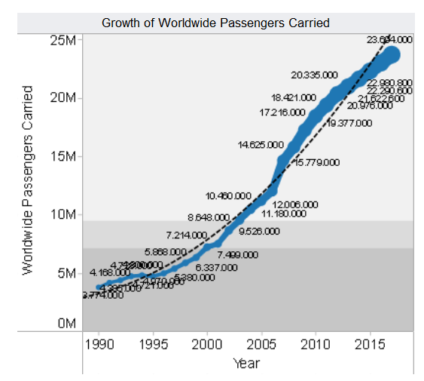
Source: CLIA Cruise Line Market Profile Study (2012)

Slide 32
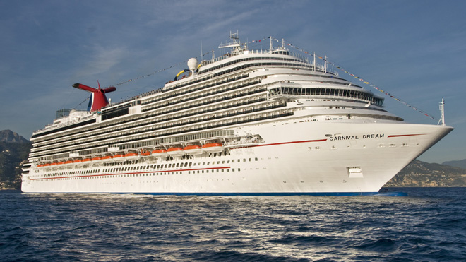
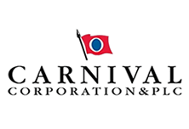
Carnival Corporation & Plc.

Slide 33
history
1972: Carnival Cruise Lines is founded by entrepreneur Ted Arison. The company’s first cruise ship, the TSS Mardi Gras, is a single secondhand ship with just enough fuel to make a one-way trip from Miami to San Juan.
1974: purchase of full ownership of the ailing Carnival for $1 in cash and the assumption of $5 million in debt.
1987: Carnival completes an initial public offering of 20% of its common stock, generating approximately $400 million. → expansion of the company.
1993: Change of the name into Carnival Corporation
2003: P&O Princess Cruises plc merges with Carnival Corporation and is re-registered as Carnival plc,
2003: on April 22, the first day of trading of Carnival Corporation and Carnival Plc shares (symbol: CCL) on the New York and London stock exchanges.

Slide 34
DLC arrangement
Carnival Corporation
Traded on NYSE
Carnival Plc
Traded on LSE
S&P 500
+
FTSE100
Company organization

Slide 35
In 2011 the combined brands of Carnival Corporation controlled a 49.2% share of the total worldwide cruise market.
Brands: Carnival Cruise Lines, Princess Cruises (“Princess”) ,Holland America Line, Seabourn, Costa Cruises (“Costa”), AIDA Cruises, P&O Cruises (UK), Cunard, P&O Cruises (Australia),Ibero Cruises (“Ibero”)
A fleet of 102 ships, with another seven ships scheduled for delivery between now and March 2016
10 million guests annually
77,000 shipboard employees
The Company

Slide 36
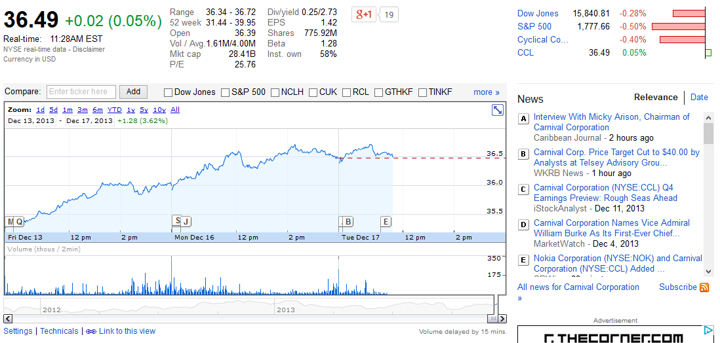
Source: Google finance
Share price

Slide 37
Land-based vacation alternatives throughout the world.
Our principal cruise competitors are:
      RCCL, which owns Royal Caribbean International, Celebrity Cruises, Azamara Club Cruises, CDF Croisieres de France and Pullmantur. RCCL and TUI AG jointly own TUI Cruises, a German cruise competitor.
      Other principal cruise competitors include Norwegian Cruise Line and MSC.
competitors

Slide 38
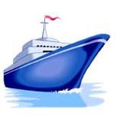
Dominant market share
Operational excellence and experience
Tailored products and services to specific geographic markets and lifestyles, which allows to penetrate each market more effectively.
Competitive strength

Slide 39
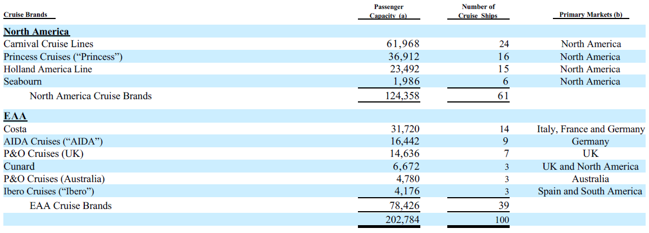
cruise brands

Slide 40
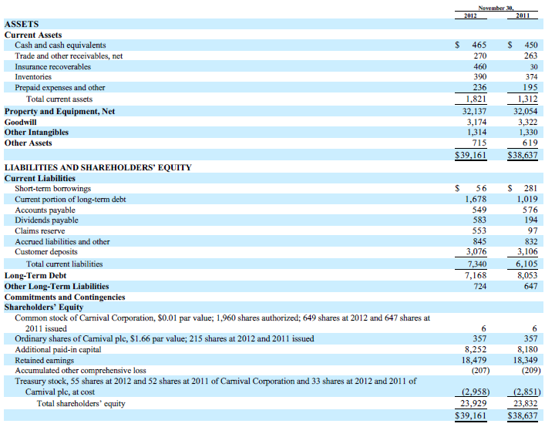
Consolidated balance sheet
(IN MILLIONS, EXCEPT PAR VALUES)

Slide 41
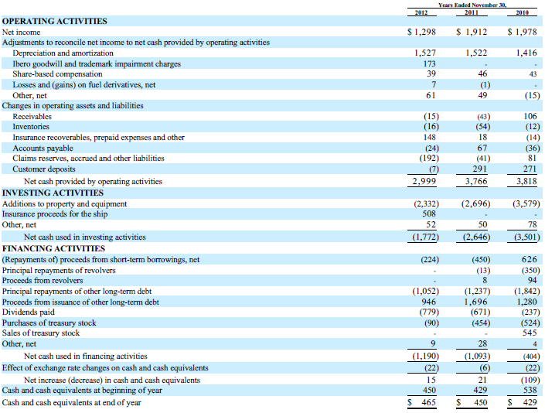

Consolidated statement of cashflowS
(IN MILLIONS)

Slide 42
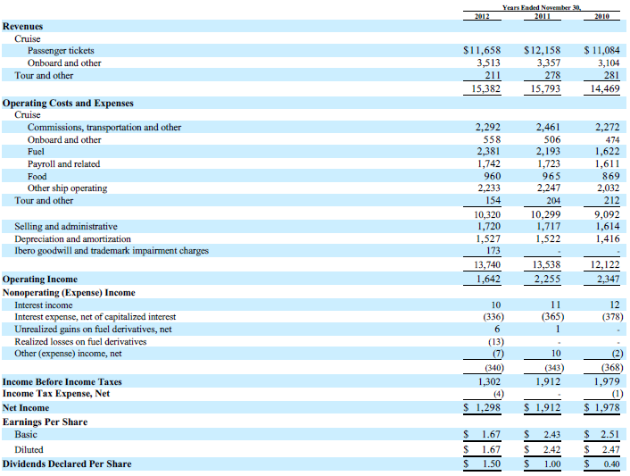
Consolidated statement of income
(IN MILLIONS, EXCEPT PAR VALUES)

Slide 43
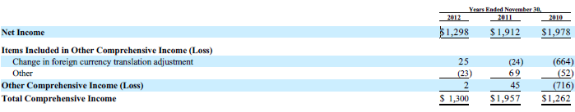
Consolidated statement of comprehensive income
(IN MILLIONS)

Slide 44
Sales of passenger cruise tickets (76%) + collection of governmental fees and taxes from guests
Sales of goods and services primarily onboard (24%)
Revenues
Results of operations (1/2)

Slide 45

Expenses
Travel agent commissions, transportation related costs, governmental fees and taxes
Onboard costs, directly associated with onboard revenues
Fuel costs, which include fuel delivery costs
Costs related to our shipboard personnel
Food costs, which include both our guest and crew food costs
Ship operating costs
Results of operations (2/2)

Slide 46
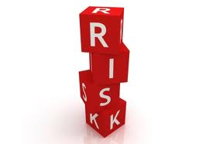
General economic and business conditions
Increases in fuel prices
The international political climate, terrorist and pirate attacks
Negative publicity.
Litigation, enforcement actions, fines or penalties.
Economic, market and political factors that are beyond our control.
Changes in and compliance with environmental laws and regulations.
Changes in laws and regulations relating to the protection of people with disabilities, employment, health, safety, security.
Risk factors

Slide 47
Changes in and compliance with income tax laws and regulations and income tax treaties.
Competitors throughout the vacation industry
The impact of disruptions in the global financial markets
Decisions to self-insure against various risks or the inability to obtain insurance for certain risks at reasonable rates.
Fluctuations in foreign currency exchange rates.
Ability to fund future obligations and to obtain financing.
Risk related to the DLC arrangement of the company
Uncertainties of a foreign legal system in protecting their interests.
Risk factors

Slide 48
Foreign Currency Exchange Rate Risks:
      Operational and Investment Currency Risks (Euro, Sterling and Australian, Canadian and U.S. dollars)
      New-build Currency Risks (shipbuilding contracts are typically denominated in euro)
Interest Rate Risks
Fuel Price Risks
CREDIT RISK associated with financial and other institutions with which significant business are conducted.
Market Risks

Slide 49
Use of derivative and non-derivative financial instruments
Implementation of a fuel derivatives program to mitigate a portion of the risk to future cash flows attributable to potential fuel price increases (economic risk).
The policy is NOT to use any financial instruments for trading or other speculative purposes.
All derivatives are recorded at fair value
The cash flows from derivatives treated as hedges are classified in our Consolidated Statement of Cash Flows in the same category as the item being hedged
DERIVATIVES

Slide 50
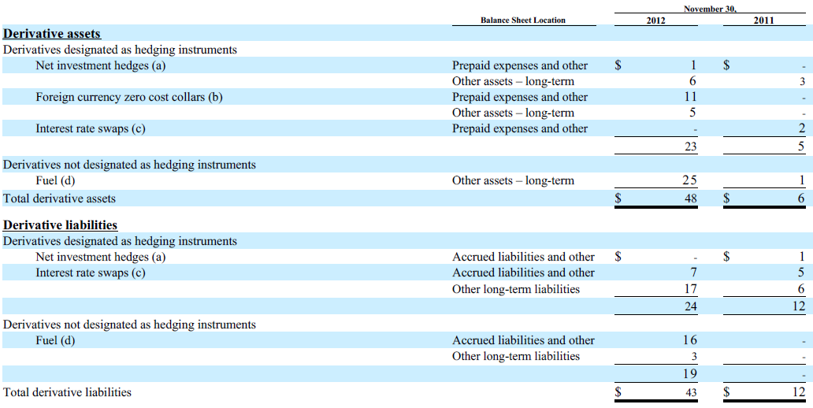
The estimated fair values of derivative financial instruments and their location on the Consolidated Balance Sheets were as follows (in million):
DERIVATIVES

Slide 51
Overall Strategy
Management of the exposure through operating and financing activities (netting certain exposures to take advantage of any natural offsets or through the use of derivative and non-derivative financial instruments).
Primary focus: to manage the economic foreign currency exchange risks.
The financial impacts of the hedging instruments employed generally offset the changes in the underlying exposures being hedged.
DERIVATIVES - exchange rate risk

Slide 52
Operational and Investment Currency Risks
Exchange rate fluctuations against the U.S. dollar will affect the reported financial:
      Any strengthening of the U.S. dollar against foreign currencies has the financial statement effect of decreasing the U.S. dollar values reported for cruise revenues and expenses.
      Any weakening of the U.S. dollar has the opposite effect.
Non-functional currency risk related to their international sales operations
All of the brands have non functional currency expenses for a portion of their operating expenses that create some degree of natural offset for recognized transactional currency gains and losses due to currency exchange movements.
Investments in foreign operations to be denominated in relatively stable currencies and of a long-term nature.
Partial mitigation of net investment currency exposures by denominating a portion of the foreign currency third-party debt and foreign currency intercompany payables in the foreign operations’ functional currencies (£ and €)
DERIVATIVES – exchange rate risk

Slide 53
New-build Currency Risks
Our shipbuilding contracts are typically denominated in euros.
Decisions regarding whether or not to hedge a non-functional currency ship commitment are made on a case-by-case basis.
Use of foreign currency derivative contracts and non-derivative financial instruments to manage foreign currency exchange rate risk for some ship construction payments.
The cost of shipbuilding orders in the future that is denominated in a different currency than the cruise brands’ or the shipyards’ functional currency is expected to be affected by foreign currency exchange rate fluctuations → this affect the willingness to order new cruise ships.
DERIVATIVES – exchange rate risk

Slide 54
  Management of exposure through investment and debt portfolio management strategies. These strategies include:
purchasing high quality short-term investments with floating interest rates,
evaluating the debt portfolio as to whether to make periodic adjustments to the mix of fixed floating rate debt through the use of interest rate swaps and the issuance of new debt or the early retirement of existing debt.
DERIVATIVES – interest rate risk

Slide 55

Substantially related to the consumption of fuel on our ships.
Fuel derivatives program to mitigate a portion of our economic risk attributable to potential fuel price increases + to maximize operational flexibility by utilizing derivative markets with significant trading liquidity.
The program currently consists of zero cost collars on Brent whereas the actual fuel used on ships is marine fuel.
Changes in the Brent prices may not show a high degree of correlation with changes in the underlying marine
fuel prices.
DERIVATIVES –fuel risk

Slide 56
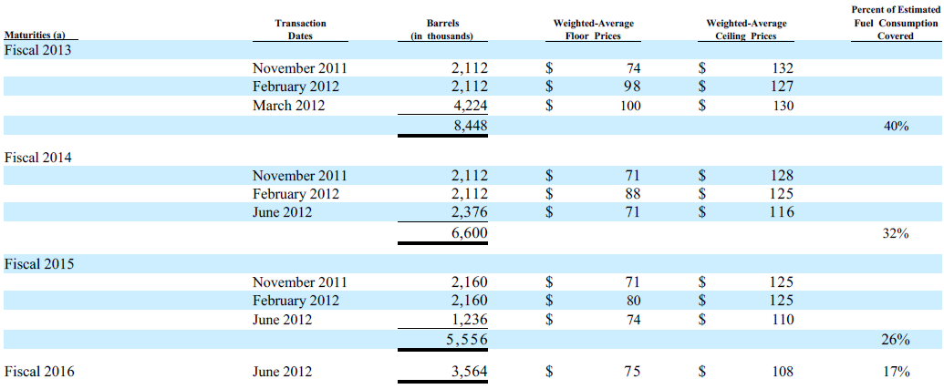

DERIVATIVES (fuel derivatives-zero cost collars)

Slide 57
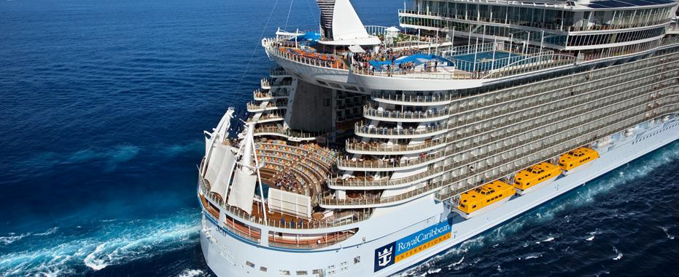

Royal Caribbean Cruises Ltd.
Anchored in excellence

Slide 58
«We always provide service with a friendly greeting and a smile.
We anticipate the needs of our customers.
We make all effort to exceed our customers' expectations.
We take ownership of any problem that is brought to our attention.
We engage in conduct that enhances our corporate reputation and employee morale.
We are committed to act in the highest ethical manner
and respect the rights and dignity of others.»
Company vision

Slide 59
1968: Royal Caribbean was founded as a partnership in Norway
1985: the current parent corporation, Royal Caribbean Cruises Ltd., was incorporated in the Republic of Liberia under the Business Corporation Act of Liberia
1993: NYSE
Oslo Stock Exchange
Video : http://www.royalcaribbean.com/ourCompany/ourHistory.do
HISTORY

Slide 60
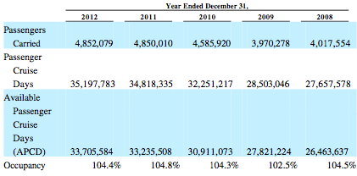
Second largest cruise company
41 ships → 98,650 berths
455 destinations in 7 continents
Headquarters in Miami, Florida but offices and international representatives around the world→ focus on global guest sourcing
Listed on NYSE + OSE
62,000 employees
The company

Slide 61
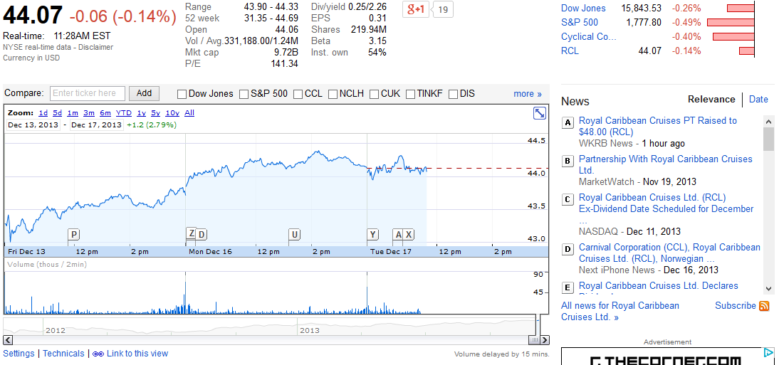
Source: Google finance
Share price

Slide 62
Exceptional service provided by the crew;
innovaton and quality of the ships;
variety of itineraries and destinations;
variety of prices;
investments in revitalization and maintenance of the fleet.
Competitive strengths

Slide 63
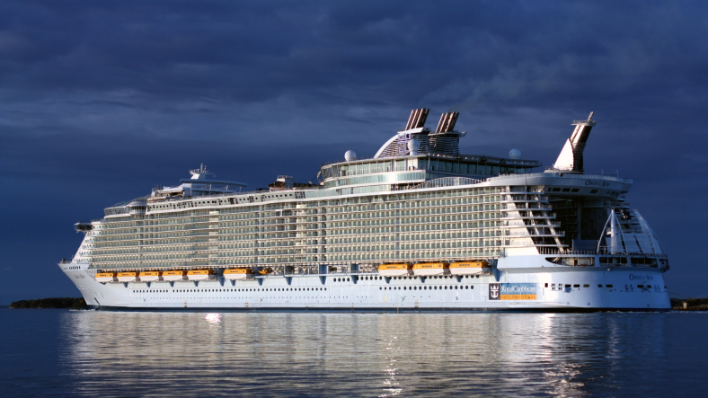
22 ships + 3 on order (62,000 berths);
upper-end segment of the contemporary segment of the cruise vacation industry (7 nights or shorter, casual ambiance, variety of activities and entertainment venues)
ability to attract guests from the premium segment (7-14 nights, more experienced guest)
STRATEGY:
attract guests by providing a wide variety of
itineraries, cruise length, entertainment,
shore excursions
→VARIETY
the BRANDS: Royal Caribbean International

Slide 64
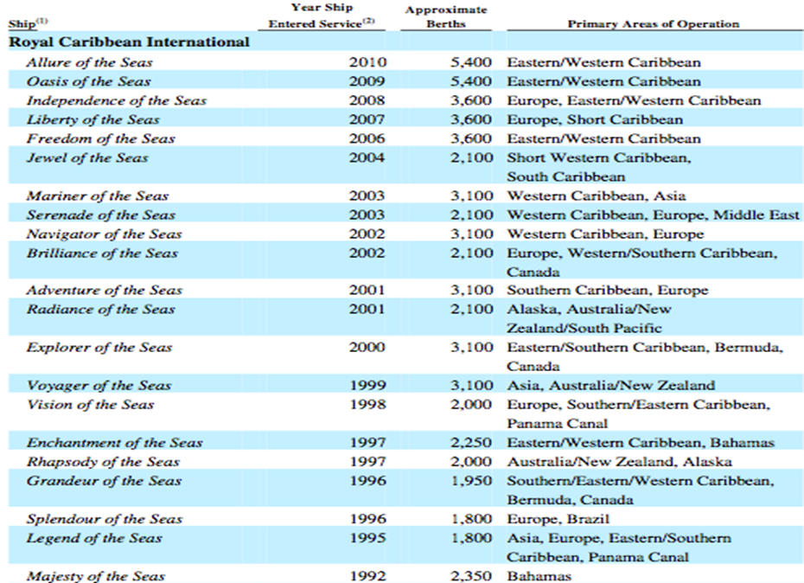
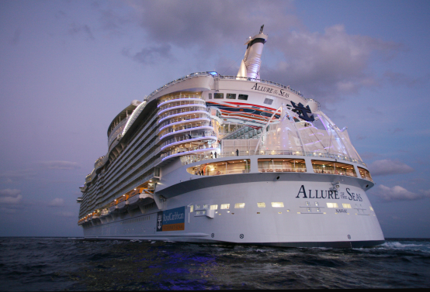
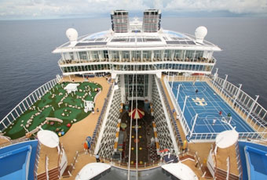
The Fleet

Slide 65
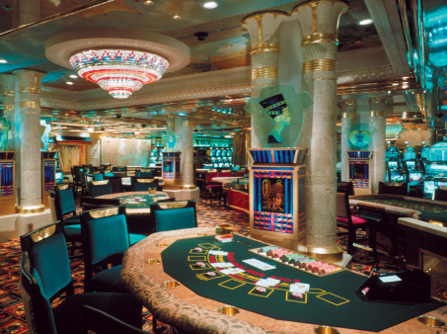
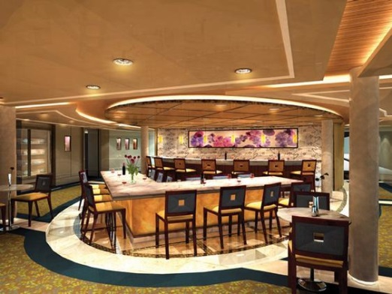
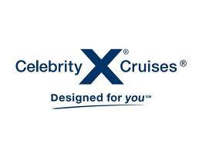
11 ships (24,800 berths);
first to operate a ship in the Galapagos Islands;
premium segment
STRATEGY:
modern luxury cruise for experienced
and loyal cruisers ; luxurious accomodation;
high staff-to-guest ratio; fine dining and personalized service
→ LUXURY
THE brands: Celebrity Cruises

Slide 66
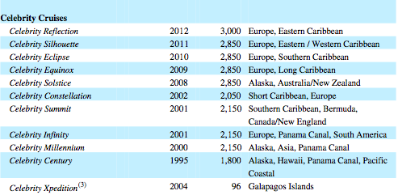
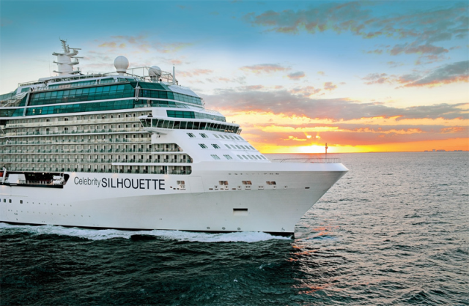
The Fleet

Slide 67
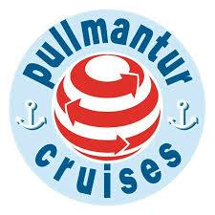


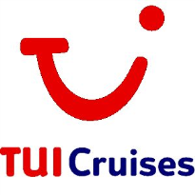
«Pullmantur»:
tailored to serve cruise markets in Spain, Portugal and Latin America;
3 ships (5,300 berths);
contemporary segment;
owns 49% on an air business.
«Azamara Club Cruises»
2 ships (1,400 berths);
up-segment (smaller ships, high standard accomodation and services, higer prices and exotic locations)of the North American, UK and Australian markets.
«CDF Croisières de France»:
French market;
contemporary segment.
“TUI Cruises” (50% joint venture with TUI AG, a German tourism and shippping company): German market
others brands

Slide 68
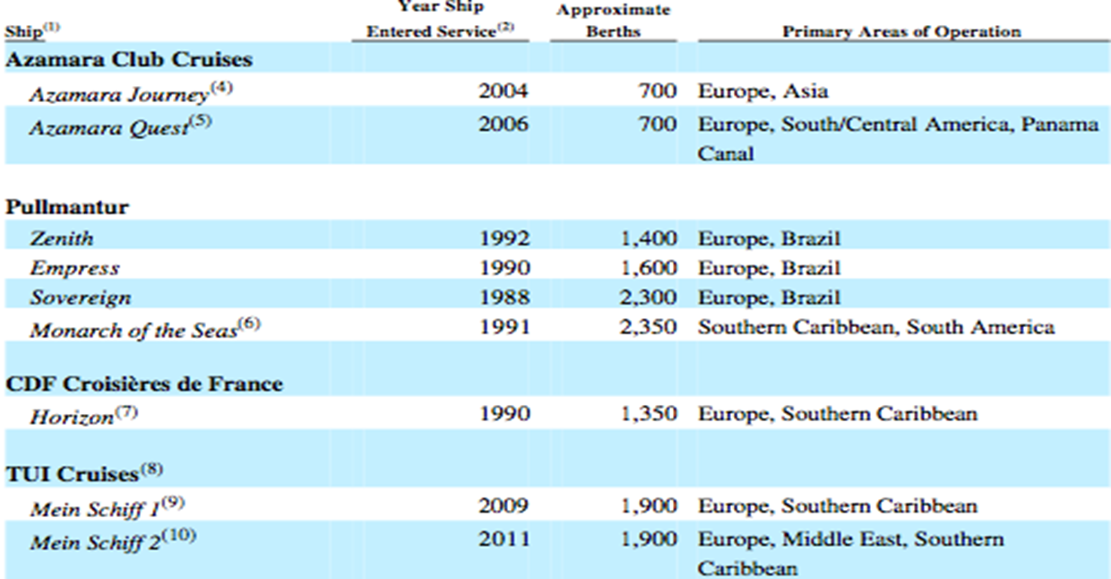
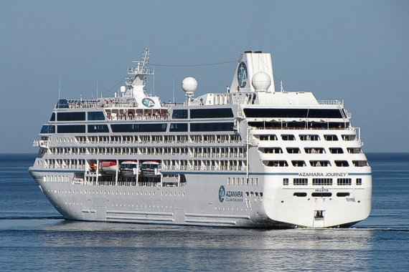

The fleet

Slide 69

Consolidated balance sheet

Slide 70

Consolidated Statement of comprehensive income

Slide 71

Consolidated statement of CASH FLOWS

Slide 72
International, national and local economic and geopolitical conditions.
Inability of obtaining sufficient financing or capital for the company needs or to do so in acceptable terms.
Inability to satisfy covenants by the company credit facilities
→ liquidity
Disruptions in the global financial markets
Competition
Risk Factors (1/2)

Slide 73
Weather/natural disasters
Increase in prices of commercial airline services
Environmental, labor, H&S, maritime regulations
Attempts to expand the business in new market may be not successful
Terrorism, pirate attacks
Incidents and bad reputation
Risk factors (2/2)

Slide 74

MARKET RISKS
Changes in interest rates
Changes in foreign exchange rates
Changes in fuel prices

Slide 75
USE:
→manage interest rate exposure
→limit the exposure to fluctuations in foreign currency exchange rates
→ fuel prices.
trading or speculative purposes
TYPES: foreign currency contracts and collars, interest rate, cross-currency and fuel swaps and options with third party institutions in OTC market.
Derivatives (1/3)

Slide 76
derivATIVES (2/3)

Slide 77
derivATIVES (3/3)

Slide 78
Fixed to floating
→potential increase in fair value resulting from a decrease in interest rates
Floating to fixed
→potential increase in interest rates expenses from an increase in interest rates
Operating leasing
→potential increase in rent expenses from an increase in LIBOR rates
TOT. Notional amount of IRS in 2012: $2.4 billion
DERIVATIVES – INTEREST RATE swaps

Slide 79
Ship construction contracts denominated in euro;
Growing international business operations
Mitigation of exposure related to investments denominated in foreign currencies
Minimize volatility resulting from remeasurement of net monetary assets and liabilities denominated in foreign currencies
TYPEs:
foreign currency forward contracts
collar options
cross currency swap agreements
DERIVATIVES – FOREIGN CURRENCY EXCHANGE RATE RISK

Slide 80

Consumption of fuel on the ships
TYPES:
Fuel swap agreements
Fuel call options
DERIVATIVES – FUEL PRICE RISK

Slide 81


NCL Corporation Ltd.
Norwegians have more fun at work!

Slide 82
history
1966: NCL started its operations in Miami
1979: introduction of onboard entertainment and several destinations and ships added
2000: Genting HK became the owner of NCL
2008: Apollo fund acquired 50% of outstanding share capital
2008: TPG Viking Funds acquired 12.5% of outstanding share capital
1 Ship for low-cost Caribbean cruises

Slide 83
Genting HK (50%): leading cruise line in the Asia-Pacific, headquartered in Hong Kong, offers several cruise itineraries in Asia-Pacific region.
Apollo Funds (37.5%): leading global alternative investment manager for a total of 113 billion $
TPG Viking Funds (12.5%): leading global private investment with more than 54.4 billion $
sponsor

Slide 84
February 2011: NCL Holding created issuing 10,000 shares at 0.001$ per share
January 2013: NCLH completed the IPO and the NCLC’s shares were exchanged with NCLH ones
NCLH became the parent of NCLC
New ownership percentage: - Genting HK 43.4%
- Apollo Funds 32.5%
- TPG Viking Funds 10.8%
- Public Shareholders 13.3%
Corporate reorganization

Slide 85
Leading global cruise line operator
Innovative and differentiated cruise vacation
Aim: generate highest customer’s loyalty and greatest number of repeat guests
Freestyle Cruising: freedom and flexibility associated with a resort style atmosphere
Sole cruise line to offer an entirely inter-island itinerary in Hawaii
the company

Slide 86

Share price
Source: Google finance

Slide 87

the competitors

Slide 88
Modern fleet: weighted average of 8.1 years allows to offer high-quality service
Rich stateroom mix: 48% with private balcony, 5 suites with 570 sf with exclusive services
High quality services: Norwegian Platinum Standards program
Diverse selection of Premium itineraries
Freestyle Cruising
Competitive strength (1/2)

Slide 89
Established brand recognition
Strong cash flow
Highly experienced management team
Strong sponsors with extensive industry expertise
Competitive strength (2/2)

Slide 90

The fleet

Slide 91

Consolidated balance sheet

Slide 92

Consolidated cash flow

Slide 93

Consolidated statement of operations

Slide 94

Results of operations

Slide 95
General economic downturn
Intense competition
Substantial indebtedness that affect the ability to raise funds
Increases in fuel price (19% of operating costs)
International business may increase political, tax and currency risks
Risk factors (1/2)

Slide 96
Volatility in credit and financial market may affect the ability to borrow money
Acts of piracy
Increasing airlines’ price could undermine the customer base
Viral outbreaks
Uncertain political environment
Unavailability of port of call
Risk factors (2/2)

Slide 97
Changes in interest rates
Changes in exchange rates
Changes in fuel prices
Market risks

Slide 98
Forward, swap, option and three-way collar contracts, to reduce our exposure to fluctuations in foreign currency exchange, interest rates and fuel prices
Changes in fair value of derivative instruments that are designated as cash flow hedges are recorded as a component of accumulated other comprehensive income (loss) until the underlying hedged transactions are recognized in earnings.
Derivatives used

Slide 99

Derivatives positions

Slide 100


Swaps
Collars and Options
Fuel swaps, collars and options

Slide 101


Options
Forwards
Collars
Foreign Currency Options, Forwards and Collars

Slide 102

Thank you for listening! any questions?
DO YOU FEEL SAFE ENOUGH TO GET ON BOARD?

