Slide 1


Company Overview and Risk Management Analysis
Simone Ansaldi
Rebecca Frassini
Laura Goglio
Mattias Pizzagalli
Jonida Resuli
Università degli Studi di Bergamo, December 2013
Risk Management and Derivatives

Slide 2
Agenda
Company overview
The Basel capital Accord
Company analysis
Risk factors
Financial statement and Notes

Slide 3
Definition
Leading global investment banking securities and investment management firm
Provides a wide range of financial services
Offices in over 30 countries
49 % of the staff based outside America
41 % of the revenues generated outside America

Slide 4
Investments banking
Serves corporate and government clients around the world
Provides financial advisory services
Helps companies raise capital
Try to develop and maintain long term relationships
Goal: deliver to the clients the entire resources of the firm

Slide 5

Investment banking: financial advisory
Strategic advisory assignments
Help clients execute large, complex transactions
Revenues from derivative transactions
Assist the clients in managing their asset and liability exposure and their capital
Provide lending commitments and bank loan
Bridge loan facilities

Slide 6
Investment banking: underwriting
Helping companies raise capital to fund their businesses
Match the capital of the investing clients with the needs of the clients
Public offerings and private placements
Revenues from derivative transactions

Slide 7
Investment banking: equity underwriting
Leading position in
Worldwide public common stock offerings
Worldwide initial public offerings

Slide 8
Investment banking: debt underwriting
Investment-grade
High yield debt
Bank loans
Bridge loans
Emerging and growth-market debt
Structured securities (mortgage-related securities)

Slide 9
Institutional client services
Helps clients to buy and sell financial products, raise funding and manage risk
Acts as a market maker
Offers market expertise
Makes markets and facilitates client transactions in:
Fixed income
Equity
Currency
Commodity products

Slide 10
Institutional client services (2)
Clear client transactions
Provides liquidity
Play a critical role in price discovery (efficiency of the capital markets)
Willingness to make markets is crucial
Relationships with clients are maintained
Prices to clients globally are provided

Slide 11
Institutional client services (3)
4 ways to generate revenues:
In large, highly liquid markets: high volume of transactions for modest spread and fees
In less liquid markets: transactions for spread and fees somewhat larger
Customized or tailor-made products that address the client's risk exposures
Financing to the clients is provided

Slide 12
Institutional client services (4)
The activities are organized by asset class including:
Cash instruments: trading the underlying instrument
Derivative: instruments that derive their value

Slide 13
Ics: fixed income, currency and commodities client execution
Interest rate products: government bonds, money market instruments, IRS, options
Credit products: investment-grade corporate securities, credit derivatives, bank and bridge loans
Mortgages: commercial mortgage-related securities, loans and derivatives
Currencies: including growth-market currencies
Commodities: oil and natural gas, base, precious and other metals

Slide 14
Fixed income, currency and commodities client execution
Equities: equity client execution, commissions and fees, securities services

Slide 15
Fixed income, currency and commodities client execution
Equities client execution:
Facilitates client transactions by providing liquidity with large blocks of stocks or options
Engagement in insurance activities
Structure and execute derivatives on indices, industry groups, financial measures and individual company stocks
Developing of strategies and portfolio hedging and restructuring
Asset allocation transactions
Creation of tailored instruments to establish or undertake hedging strategies

Slide 16
Fixed income, currency and commodities client execution
Commissions and fees:
Generated from executing and clearing institutional client transactions on major stock, options and futures
Access to electronic “low touch” equity trading platforms
Most of the revenues continued to be derived from the “high-touch” handling

Slide 17
Fixed income, currency and commodities client execution
Securities services:
Financial services: through margin loans collateralized by securities and cash or collateral
Securities lending services: borrowing and lending securities
Other prime brokerage services: technology platform is provided, custody services

Slide 18
Investing and lending
Long-term activities
Investing directly in publicly and privately traded securities and loans
Managing diversified global portfolio of investments in equity securities and debt
Investment in the ordinary shares of ICBC
Equity-related investments

Slide 19
Investing and lending (2)
Corporate, infrastructure debt investments
Credit to corporate clients through loan facilities
Investment entities with a defined exit strategy not related to the principal businesses
Invest in distressed assets

Slide 20
Investment management
Provides investment and wealth advisory services to help clients preserve and grow their financial assets
Managing client assets
Income and liability management
Trust and estate planning
Philanthropic giving and tax planning
Use of global securities to address the clients' needs

Slide 21
Management and other fees
Fees vary by asset class and affected by investment performance, asset inflows and redemptions
Assets under management
Incentive fees (when a return exceeds a specific benchmark)

Slide 22
Business continuity program
Business continuity and information security are high priorities
Key elements of the program:
Crisis planning and management
People recovery
Business recovery
System and data recovery
Process improvement

Slide 23
Employees and competition
Quality, commitment, professionalism, excellence, diversity, cooperation are the keys of success
Competitors are other entities that provide investment banking, securities and investment management services (brokers, dealers, investment advisors)
Advantages are taken from competing successfully with larger financial institutions (which have more capital and stronger local presence)

Slide 24
Competition and regulation
Price competition
Competition in attracting and retaining qualified employees
Dodd-frank act: enacted in July 2010 which provides extension on the rules adopted by the fed board
Supervision and examination by the fed board

Slide 25
Regulation
BHC act restricts bank holding companies from engaging in business activities
Fed board has the authority to limit the ability to conduct activities and it is necessary its approval before engaging in financial activities
The Volker rule prohibits “proprietary trading” sponsorship and investment in hedge funds

Slide 26
The Volker rule
Is expected to limit certain kind of transactions with the sponsored funds
Many aspects remain unclear and very complex
In October 2011 the rules to implement the Volker rule were issued
The Volker rule limitation on investments in hedge funds and private equity funds required to reduce investments to 3% or less

Slide 27
Capital and liquidity requirements
As a bank holding company, Goldman Sachs is subject to consolidated regulatory capital requirements by fed board

Slide 28
Changes in capital requirements
Changes to the market risk capital rules became effective on January 1, 2013 and these require the addition of new model based capital requirements
Basel 2 revises the regulatory capital framework for credit risk and equity investments and will be adopted once the regulators will approve GS to do so

Slide 29
Changes in capital requirements (2)
“The Collins amendment” of the Dodd-frank act requires advanced approach banking organization to continue upon adoption of Basel 2 to calculate risk-based capital ratios under both Basel 2 and the fed reserve board's risk-based capital requirements

Slide 30
Changes in capital requirements (4)
More stringent capital standards:
New Basel 3 requirements
In December 2011 the fed board proposed rules to implement the enhanced prudential standards contemplate by the Dodd-frank act which may affect if finalized, the ability of GS to transact or hedge

Slide 31
Payment of dividends and stock repurchases
Subject to the oversight of the fed board based on capital plans and stress tests to judge the capital planning processes
GS not object to its capital actions through the first quarter of 2013

Slide 32
Compensation practices
Oversight by the fed board
Risk must be taken in account
Incentives that balance risk and financial results
Review of the incentive compensation policies
Enforcement actions taken against the risk of the organization's safety caused by related risk management
If the regulations are adopted the flexibility will be restricted

Slide 33
Regulation of GS bank USA
Undertake stress test is required, according to Dodd-frank act and submit them to the fed board
“Derivative push-out” will prevent GS from conducting certain swaps-related activities
Transactions between GS bank USA and its subsidiaries are regulated by the fed board

Slide 34
Prompt corrective actions and capital ratios
The us federal deposit insurance corporation improvement act of 1991 (FDCIA) establishes 5 capital categories:
Well-capitalized depositary institution: if it has a tier 1 capital ratio of at least 6%, a total capital ratio of at least 10% and a tier 1 leverage ratio of at least 5%
Adequately capitalized
Undercapitalized
Significantly undercapitalized
Critically undercapitalized

Slide 35
Prompt corrective action and capital ratios
Capital ratios of GS bank USA are computed according to Basel 1 and will adopt Basel 2 only if it is approved by regulators
An institution may be downgraded if it is determined to be in a not safe position or as a result of bad rating

Slide 36
Insolvency of an insured depository institution
Transfer the depository institution's assets and liabilities to a new obligor
Enforce the terms of the depository institution's contracts
Repudiation of any contracts to which the institution is a party
Resolution plan: submitted to the regulators on June 29, 2012, which established GS bank USA is protected from risks

Slide 37
Broker-dealer and securities regulation
It is required to maintain orderly markets in the securities assigned
According to Dodd-frank act any person who organizes an asset-backed security transaction to retain a portion of any credit risk that the person conveys with a third party

Slide 38
Swap, derivatives and commodities regulations
Subject to regulation of us commodity exchange act
The Dodd-frank act provides increased regulation, imposing the following requirements:
Real time public and regulatory reporting of trade information for swaps
Registration of swap dealers
Position limits the cap exposure to derivatives on certain physical commodities
Mandated clearing through central counterparties for certain swaps
New business conduct standards for swap dealers
Margin requirements for trades that are not cleared
Entity level capital requirements for swap dealers

Slide 39
Other regulations
Some examples...
Insurance subsidiaries: subject to state insurance regulation in the states in which they are domiciled
Investment management: subject to significant regulation in numerous jurisdictions around the world

Slide 40
The Basel Capital Accord

Slide 41
The Basel Committee
The Basel Committee on Banking Supervision, established at the Bank for International Settlements, is a forum whose objective is to enhance the understanding of key supervisory issues and improve the quality of banking supervision worldwide

Slide 42
The Basel Capital Accord
The Basel Capital Accord is a Framework set at the Basel Committee in 1988 and subsequently revised.
The primary objectives are to promote the soundness of the international banking system and to provide an equitable basis for international cooperation among banks

Slide 43
The Basel Capital Accord’s Timeline
1988
Basel I
Not adapt for big banks in concentrated markets
Not in line with RM Evolutions
2003
Basel II
Didn’t avoid the financial crisis to happen
Procyclical
No Standard for Liquidity
2010
Basel III
Currently Implementing

Slide 44
Basel II - Main Failures
It Allowed the Financial Crisis to Happen: Basel II failed in capturing major on- and off-balance sheet risks, as well as derivative exposures. It also didn’t take into consideration potential losses due to Credit Evaluation Adjustments (CVA) due to M2M.
Procyclicality: During the Financial Crisis banks were forced to deleverage, sell problematic assets and dramatically decrease the credit issuance. All these actions had a pro cyclical effect and facilitated the spread of the financial crisis to the Real Economy.

Slide 45
Basel II - Main Failures (cont’d)
No Standard for Liquidity: During the early “liquidity phase” of the financial crisis, many banks that were in line with the capital requirements still experienced difficulties because they didn’t manage their liquidity in a prudent way, due to lapses in Liquidity Risk Management

Slide 46


Basel III - The Three Pillars
In 2010 the new Basel Framework has been issued, focusing on
Basel III Framework
Pillar 1
Pillar 2
Supervisory Oversight
Pillar 3
Market Disclosure
Credit Risk
Market Risk
Operational Risk
Liquidity Risk
Capital & Liquidity Requirements

Slide 47
Pillar 1 - Credit Risk
Based on 3 main Capital Ratios:
Common Equity Tier 1 Ratio =
Tier 1 Ratio =
Tier 2 Ratio =
Tier 3 Ratio, required in Basel II, has been eliminated in Basel III
Common Equity Tier 1
Risk Weighted Assets
Tier 1 Capital
Risk Weighted Assets
Total Capital
Risk Weighted Assets

Slide 48
Capital Ratios Timeline
 | 2013 | 2014 | 2015
Common Equity Tier 1 Ratio | 3.5% | 4% | 4.5%
Tier 1 Ratio | 4.5% | 5.5% | 6%
Tier 2 Ratio | 8% | 8% | 8%

Slide 49
Classes of Capital (1/3)
Common Equity Tier 1:
Common shares issued by the bank that meet the criteria for classification as common shares for regulatory purposes (or the equivalent for non-joint stock companies)
Stock surplus (share premium) resulting from the issue of instruments included in Common Equity Tier 1
Retained Earnings
Accumulated other comprehensive income and other disclosed reserves
Regulatory adjustments applied in the calculation of Common Equity Tier 1

Slide 50
Classes of Capital (2/3)
Additional Tier 1 Capital:
Instruments issued by the bank that meet the criteria for inclusion in Additional Tier 1 Capital (not included in Common Equity Tier 1)
Stock Surplus (share premium) resulting from the issue of instruments included in Additional Tier 1 capital
Instruments issued by consolidated subsidiaries of the bank and held by third parties that meet the criteria for inclusion in Additional Tier 1 capital and are not included in Common Equity Tier 1
Regulatory Adjustments applied in the calculation of Additional Tier 1 capital
Tier 1 Capital = Common Equity Tier 1 Capital + Additional Tier 1 Capital

Slide 51
Classes of Capital (3/3)
Tier 2 Capital:
Instruments issued by the bank that meet the criteria for inclusion in Tier 2 capital (not included in Tier 1 capital)
Stock surplus (share premium) resulting from the issue of instruments included in Tier 2 capital
Instruments issued by consolidated subsidiaries of the bank and held by third parties that meet the criteria for inclusion in Tier 2 capital and are not included in Tier 1 capital
Certain loan loss provisions
Regulatory adjustments applied in the calculation of Tier 2 capital
Total Capital = Tier 1 Capital + Tier 2 Capital

Slide 52
Risk Weighted Assets
RWAs may be calculated using three different kind of models:
SIMPLIFIED MODEL: Based on External Ratings and Standard Risk Weights according to the risk class
STANDARD INTERNAL RATING BASED MODEL: The bank implements its own internal rating model based on its own calculations about the Probabilities of Default, while LGD, EAD and Maturities are given by the Authorities

Slide 53
Risk Weighted Assets (cont’d)
ADVANCED INTERNAL RATING BASED MODEL: The bank calculates all the inputs of the model for the calculation of internal ratings (PD, LGD, EAD, M)
The Internal Models need to be approved by the Authorities and to be frequently updated

Slide 54
Capital Conservation Buffer
Outside periods of stress, banks shall hold a capital buffer above the regulatory minimum in order to be able to draw it down as losses are incurred
The Capital Conservation Buffer, who needs to be composed of Common Equity Tier 1 Capital, is set at 2.5% above the regulatory requirement
In order to build the buffer banks should reduce discretionary distributions of earnings (dividends, share-backs, staff bonus payments)

Slide 55
Countercyclical Buffer
During periods of credit growth, banks shall set apart a Countercyclical buffer, in order to use it when the credit market deteriorates
The Countercyclical Buffer is decided from the Authorities on National basis, and it can be in a range from 0 to 2.5% of the Risk Weighted Assets

Slide 56
Leverage Ratio
During the financial crisis, even well capitalized banks experienced problems, due to their Leverage
The Leverage Ratio has been introduced in order to avoid leverage-related problems
Leverage Ratio =
Capital Measure is very similar to Common Equity Tier 1
Total Exposure: On-Balance Sheet Items, Repurchase Agreements, Securities Finance, Derivatives, Off-Balance Sheet Items
Capital Measure
Total Exposure

Slide 57
Pillar I - Market Risk
Introduction of the concept of Credit Valuation Adjustments (CVA), which leads to the risk of change in values of the positions held (mark-to-market) due to changes in the counterpart’s situation.
The changes do not consider defaults, which are part of credit risk
Specific Capital Charges are applied in order to hedge the risk

Slide 58
Pillar I - Market Risk (cont’d)
Risk Measures:
VaR: Potential Loss in value of inventory positions due to adverse market movements over a defined time horizon with a specified confidence level (95%)
Stress Tests: Examine the risk of specific portfolios as well as the potential impact of significant risk exposures across the firm
Stressed VaR: Var using stressed parameters

Slide 59

Pillar I - Operational Risk (1/3)
Three Possible Approaches:
Basic Indicator Approach: Capital Requirements are a function of the overall Gross Income of the last 3 years and of a parameter alfa (15%)

Slide 60
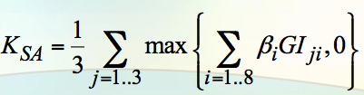
Pillar I - Operational Risk (2/3)
Standardized Approach: Based on the Gross Income of the last three year of 8 Business Lines and on a BL-specific beta factor

Slide 61
Pillar I - Operational Risk (3/3)
Advanced Measurement Approach: The biggest banks may choose on a range of more advanced models, using also other kind of internal data. The Advanced Models need to be approved by the supervisory Authority.
The most famous model classes are:
The Scorecard Approach
The Internal Measurement Approach
The Loss Distribution Approach

Slide 62
Pillar I - Liquidity Risk
In order to avoid that banks, although well capitalized, may experience liquidity shortages in periods of stressed markets, the Basel Framework developed the following two Ratios:
The Liquidity Coverage Ratio
The Net Stable Founding Ratio

Slide 63
Liquidity Coverage Ratio (1/4)
The Liquidity Coverage Ratio aims to ensure that a bank has an adequate stock of unencumbered High Quality Liquid Assets (HQLA) to meet its liquidity needs for a 30 calendar days liquidity stress scenario
After 30 days it is assumed that corrective actions can be taken by management and supervisors, or that the bank can be resolved in an orderly way

Slide 64
Liquidity Coverage Ratio (2/4)
Stock of HQLA
Liquidity Coverage Ratio:
Timeline
Total Net Cash Flows Over the Next 30 Calendar Days
 | 2015 | 2016 | 2017 | 2018 | 2019
Minimum LCR | 60% | 70% | 80% | 90% | 100%

Slide 65
Liquidity Coverage Ratio (3/4)
HQLA’s Features:
Low Risk
Ease and Certainty of Valuation
Low Correlation with Risky Assets
Listed on a Developed and Recognized Exchange

Slide 66
Liquidity Coverage Ratio (4/4)
HQLA Categories:
Level 1 Assets: Can be included without limit
Coins and Banknotes, Central Bank Reserves, Other securities with 0% risk weight under the Basel II Standardized Approach
2. Level 2 Assets: Can only comprise up to the 40% of the stock
Securities with 20% risk weight under Basel II Standardized Approach, Corporate Debt Securities and Covered Bonds not issued by the bank itself and with a minimum rating of AA-
3. Level 2B Assets: Included according to Supervisors’ choices, they can be maximum the 15% of the total HQLA and they are taken into account in calculating the 40% limit for Level 2 Assets
Residential Mortgage Backed Securities (25% haircut) with a minimum rating of AA, Corporate Debt Securities (50% haircut) not issued by the bank itself with a Rating between A+ and BBB-, some Common Equity Shares (50% haircut) not issued by the bank itself and centrally cleared

Slide 67
Net Stable Founding Ratio
The Net Stable Founding Ratio aims to promote the resilience over a longer time horizon by creating additional incentives for banks to fund their activities with more stable sources of founding on an ongoing basis
Still to be fully regulated

Slide 68
Pillar II - Supervisory Review Process
Every Bank needs to develop an Internal Capital Assessment Process and set targets for capital that are in line with the bank’s particular Risk Profile and Control Environment
Supervisors are responsible for evaluating how well banks are assessing their Capital Adequacy Needs relative to their Risks

Slide 69
Pillar III - Market Discipline
Banks need to provide disclosure in order to ensure that market participants can better understand their risk profiles and the Adequacy of Capital Positions
Disclosure Requirements and Recommendations are set in several areas
More detailed requirements for banks who use Internal Models for Evaluating Risks

Slide 70
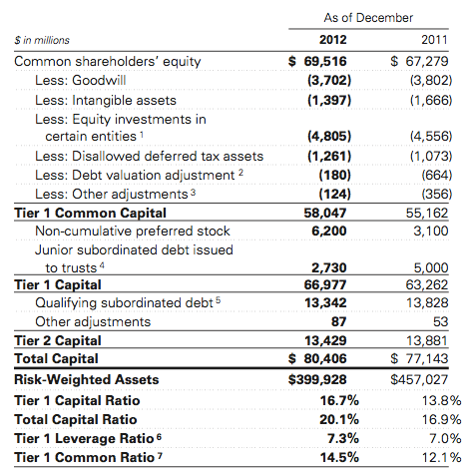
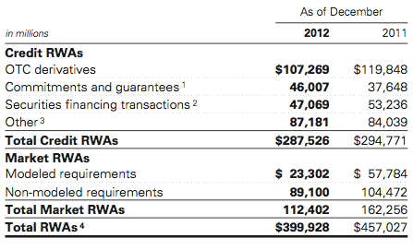
Goldman Sachs and Basel
Capital Requirements
Risk Weighted Assets

Slide 71
Company analysis

Slide 72
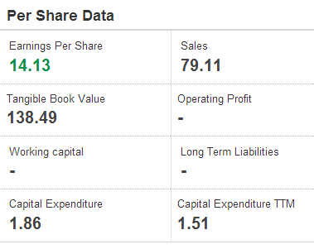
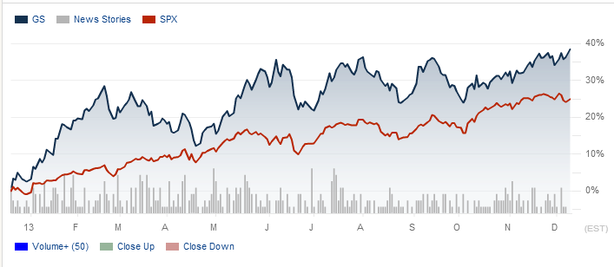
Stock chart
Source: Wall street Journal – 17/12/2013

Slide 73
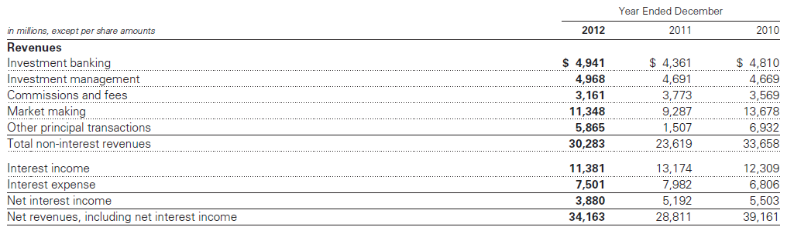
Income statement

Slide 74
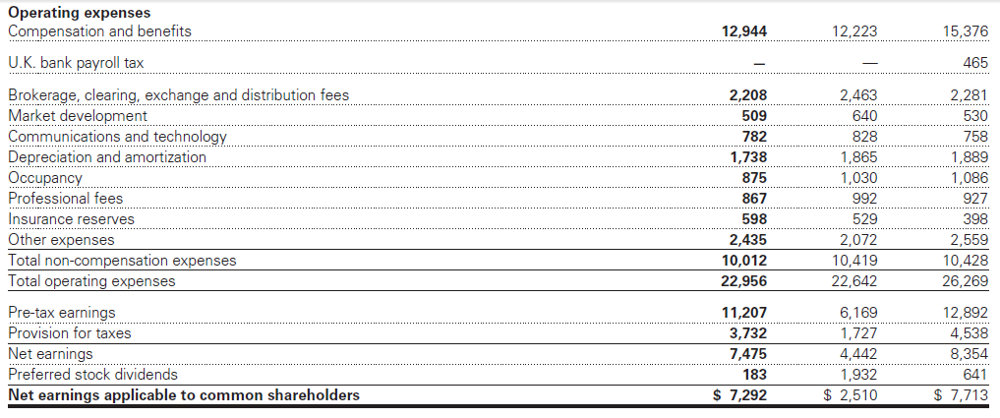
Income statement

Slide 75
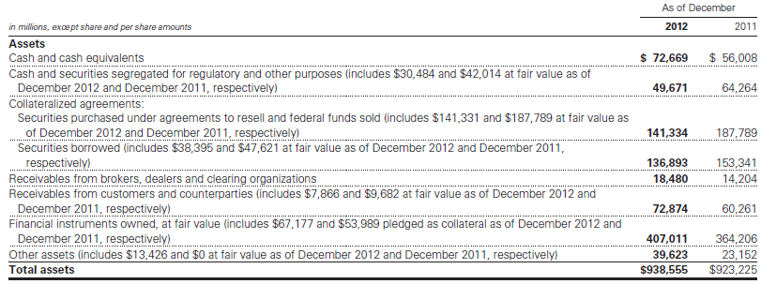
Financial statement

Slide 76
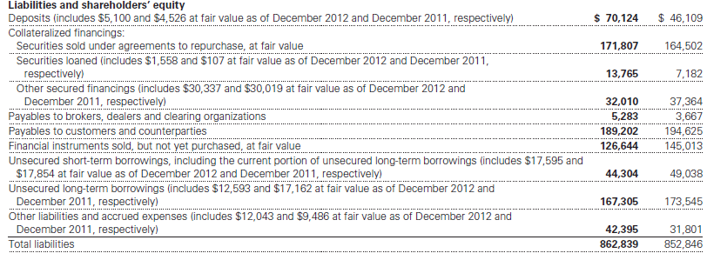
Financial statement

Slide 77
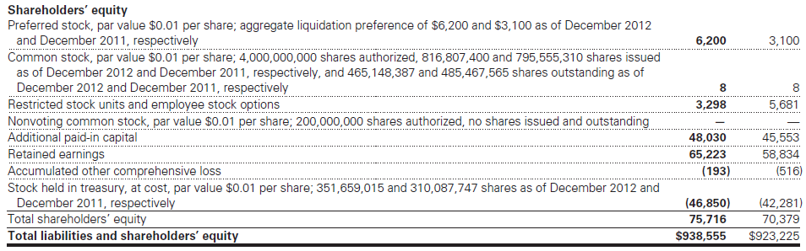
Financial statement

Slide 78
Business environment
Global economic conditions generally weakened in 2012
Improvement by central banks, resulted in tighter credit spreads, higher global equity prices and lower levels of volatility
General political instability lead to higher risk aversion
GDP declined in most countries and unemployment rate grew
Notes:
Global economic conditions generally weakened in 2012,
as real gross domestic product (GDP) growth slowed in
most major economies.
Various improvement by central banks, resulted in tighter credit
spreads, higher global equity prices and lower levels of
Volatility.
General political instability lead to higher risk aversion by clients all over the
world, and lower activity levels.
Real GDP growth declined in most adv economies and emerging markets

Slide 79
Critical accounting policies
.
The fair value of a financial instrument is the amount that would be received to sell an asset or paid to transfer a liability in an orderly transaction between market participants at the measurement date. Financial assets are marked to bid prices and financial liabilities are marked to offer prices. Fair value measurements do not include transaction costs.
Use of fair value fundamental for risk management practices
Notes:
The fair value of a financial instrument is the amount that would be received to sell an asset or paid to transfer a liability in an orderly transaction between market participants at the measurement date.
The fair values for substantially all of our financial assets and financial liabilities are based on observable prices and
inputs and are classified in levels 1 and 2 of the fair value hierarchy.

Slide 80
Fair value evaluation US GAAP
3rd Inputs that
cannot be observed
in market activity
1st Highest priority to unadjusted quoted prices in active markets for identical assets and liabilities
2nd Inputs other than level 1 inputs that are observable, either directly or indirectly
Notes:
The fair value of a financial instrument is the amount that would be received to sell an asset or paid to transfer a liability in an orderly transaction between market participants at the measurement date.
Hierarchy
Assets and liabilities are classified in their entirety based on the lowest level of input that is significant to their fair value
measurement.
The fair values for substantially all of our financial assets and financial liabilities are based on observable prices and
inputs and are classified in levels 1 and 2 of the fair value hierarchy.

Slide 81
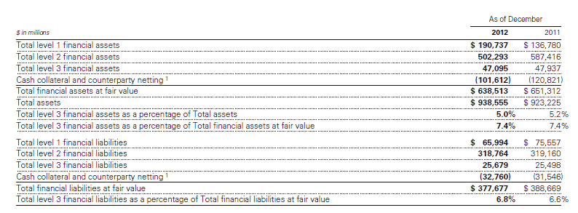
Assets and liabilities at Fair Value
Notes:
Financial assets and financial liabilities accounted for at fair
value under the fair value option or in accordance with
other U.S. GAAP

Slide 82
Result of operations - Revenues
Net revenues
We see a 19% increase in 2012 partially offset by lower commissions an fees
Non-interest revenues
13% increase is explained by higher revenues in debt underwriting
Investment management
The increase is linked to a general improvement in asset prices
Low market volumes due to lower volatility levels and concern about the outlook result in a 16% drop in 2012
Commissions and fees
Market making revenues
22% increase in this area is linked to the operating environment characterized by broad market uncertainty and positive developments (central banks actions and government policies) that helped to improve market conditions

Slide 83
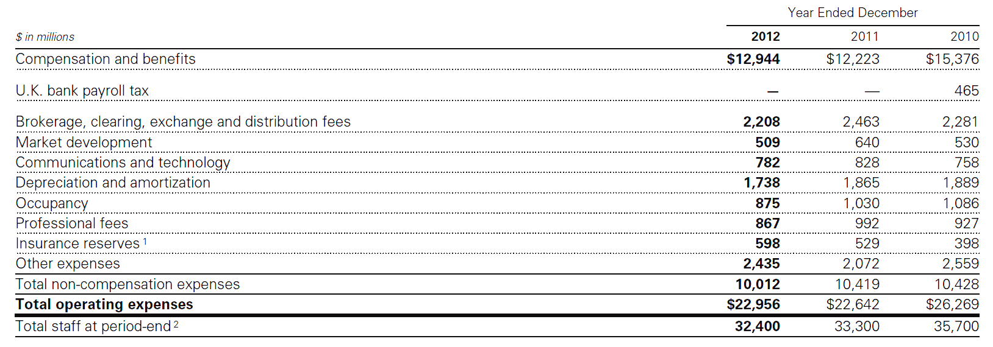
Result of operations - Costs
Operating expenses
They are influenced by compensation, headcount and level of business activity. They remain unchanged compared with 2011, this is due to the actions the company started in order to be more efficient
Provision for taxes
The increase in this area is primarily due to earning mix and decrease in the impact of permanent benefits

Slide 84
Segment operating result
Investment banking
It includes financial advisory and underwriting. Sector revenues increased by 13% since there has been a strong activity in debt underwriting
Institutional client services
This segment includes: fixed income, currency and commodities client execution and equities. 5% increase in the area is mainly due to strong net revenues on mortgages and securities services (hedge fund administration business)
Investing & Lending
The activity is mainly oriented in the origination of loans to provide financing to clients. Revenues has been positively impacted by tighter credit spreads and an increase in global equity prices.
The segment provides investment products across all major classes to assets to institutional and individual clients. The positive increase in the area is linked to higher incentive fees received due to the general appreciation of client’s assets
Investment management
Notes:
66

Slide 85
Regulatory developments
Principal areas of impact from regulatory reforms:
Dodd-Frank prohibition on “proprietary trading” and the limitation on the sponsorship of, and investment in, hedge funds and private equity funds by banking entities, including bank holding companies, referred to as the “Volcker Rule”
increased regulation of and restrictions on over-the-counter (OTC) derivatives markets and transactions
increased regulatory capital requirements

Slide 86
Balance Sheet and Funding Sources
One of GS most important management disciplines is the ability to manage the size and composition of its balance sheet.
Size and composition of balance sheet reflect:
overall risk tolerance
ability to access stable funding sources
amount of equity capital it holds

Slide 87
Balance Sheet Analysis and Metrics
GS seeks to maintain a liquid balance sheet and have processes in place
to dynamically manage assets and liabilities which include:
Quarterly planning
They combine projected total assets and composition of assets with expected funding sources and capital levels for the next quarter. It is important to allow risk managers to objectively evaluate balance sheet limit requests from business managers in the context of the firm’s overall balance sheet constraints
Business-specific limits
Monitoring of key metrics
GS monitor key balance sheet metrics daily both by business and on a consolidated basis, including asset and liability size and composition, aged inventory, limit utilization, risk measures and capital usage.
Scenario analyses
GS conduct scenario analyses to determine how it would manage the size and composition of its balance sheet and maintain appropriate funding, liquidity and capital positions in a variety of situations
The Firmwide Finance Committee sets asset and liability limits for each business and aged inventory limits for certain financial instruments as a disincentive to hold inventory over longer periods of time.

Slide 88
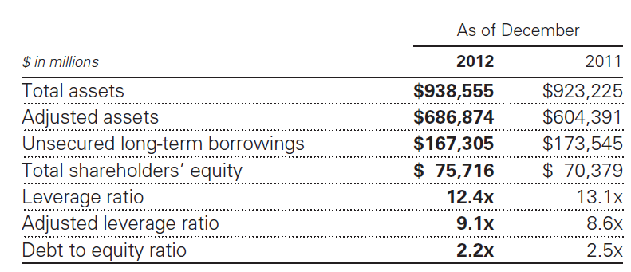
Balance Sheet Analysis and Metrics
Adjusted assets equals total assets less low-risk collateralized assets generally associated with secured client financing transactions, federal funds sold and excess liquidity and cash and securities segregated for regulatory and other purposes.
It equals adjusted assets divided by total shareholders’ equity. According to GS it is a more meaningful measure of capital adequacy than the leverage ratio.
Debt to equity ratio
Leverage ratio
Adjusted assets
Adjusted leveraged ratio
The leverage ratio equals total assets divided by total shareholders’ equity and measures the proportion of equity and debt the firm is using to finance assets.
The debt to equity ratio equals unsecured long-term borrowings divided by total shareholders’ equity.

Slide 89
Balance Sheet Analysis and Metrics
Risk-Weighted Assets
RWAs under the Federal Reserve Board’s risk-based capital requirements are calculated based on the amount of credit risk and market risk.
RWAs for credit risk reflect amounts for on-balance sheet and off–balance sheet exposures. Credit risk requirements for on-balance sheet assets, such as receivables and cash, are generally based on the balance sheet value. Credit risk requirements for securities financing transactions are determined based upon the positive net exposure for each trade, and include the effect of counterparty netting and collateral, as applicable.
Market risk
RWAs for market risk are comprised of modelled and non-modelled risk requirements. Modelled risk requirements are determined by reference to the firm’s Value-at-Risk (VaR) model. For certain portfolios of debt and equity positions, the modelled RWAs also reflect requirements for specific risk, which is the risk of loss on a position that could result from changes in risk factors unique to that position.
Credit risk
Notes:
RWAs for credit risk reflect amounts for on-balance sheet and off–balance sheet exposures. Credit risk requirements for on-balance sheet assets, such as receivables and cash, are generally based on the balance sheet value. Credit risk requirements for securities financing transactions are determined based upon the positive net exposure for each trade, and include the effect of counterparty netting and collateral, as applicabl
RWAs for market risk are comprised of modeled and non-modeled risk requirements. Modeled risk requirements are determined by reference to the firm’s Value-at-Risk (VaR) model. For certain portfolios of debt and equity positions, the modeled RWAs also reflect requirements for specific risk, which is the risk of loss on a position that could result from changes in risk factors unique to that position.

Slide 90
Funding sources
GS primary sources of funding are secured financings, unsecured
long-term and short-term borrowings, and deposits.
Collateralized financing (i.e. securities loaned)
Long term unsecured debt (i.e. 144A medium-term note programs)
Saving and demand deposit through deposit sweep programs and time deposit
Short term unsecured debt through commercial papers and promissory notes

Slide 91
Funding sources
Secured funding
Secured funding is less sensitive to changes in credit quality than unsecured funding, due to GS posting of collateral to its lenders.
Nonetheless, the company continually analyse the refinancing risk of its secured funding activities, taking into account trade tenors, maturity profiles, counterparty concentrations, collateral eligibility and counterparty rollover probabilities.
It seeks to mitigate refinancing risk by executing term trades with staggered maturities, diversifying counterparties and raising excess secured funding.

Slide 92
Funding sources
Equity capital
Capital adequacy is of critical importance to GS. Its objective is to be conservatively capitalized in terms of the amount and composition of its equity base. Accordingly, GS has in place a comprehensive capital management policy that serves as a guide to determine the amount and composition of equity capital it maintains.

Slide 93
Risk Management
GS gives a high level of importance to risk management, it has a comprehensive risk management processes through which it monitors, evaluates and manages the risks it assumes in conducting activities.
These include:
Market risk
Credit risk
Liquidity risk
Operational risk
Legal risk
Regulatory risk
Reputational risk

Slide 94
Risk Management
GS risk management framework is built around three core components:
People
Effective risk management requires people to interpret risk data on an ongoing and timely basis and adjust risk positions accordingly.
Structure
Processes
Fair value
Credit and market risk limits
Development of a comprehensive, reliable and timely risk management technology
Ultimate oversight of risk is the responsibility of the firm’s Board. The Board oversees risk both directly and through its Risk Committee. Within the firm, a series of committees with specific risk management mandates have oversight or decision-making responsibilities for risk management activities.

Slide 95
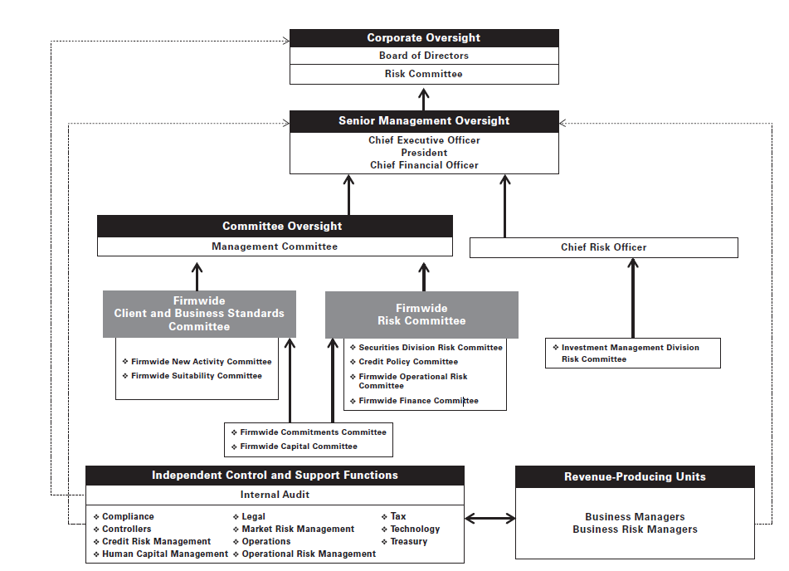
Risk Management
The governance structure:

Slide 96
Risk Management
Liquidity risk management
Liquidity is of critical importance to financial institutions. Most of the recent failures of financial institutions have occurred in large part due to insufficient liquidity. Accordingly, the firm has in place a comprehensive and conservative set of liquidity and funding policies to address both firm-specific and broader industry or market liquidity events.

Slide 97
Risk Management
Liquidity risk management
GS manages liquidity risk according to the following principles:
Excess liquidity
Maintaining substantial excess liquidity allows to meet a broad range of potential cash outflows and collateral needs in a stressed environment.
Asset-Liability Management.
Assessing anticipated holding periods for its assets and their expected liquidity in a stressed environment.
Contingency Funding Plan
It provides a framework for analysing and responding to a liquidity crisis situation or periods of market stress.

Slide 98
Risk Management
Liquidity risk management – Model liquidity outflow
The model is based on a scenario that includes both a market-wide stress and a firm-specific stress, characterized by several market environments and firm-specific crisis potentially triggered by material losses, litigation, rating downgrade, etc.
Critical parameters are:
Liquidity needs over a 30 day scenario
2-notch downgrade of the firm’s long-term senior unsecured credit ratings
Combinations of contractual outflows
No issuance of equity or unsecured debt
No support from government funding facilities

Slide 99
Risk Management
Liquidity risk management – ALM
GS ALM approach includes:
Manage the features of funding book with a focus on long-term diversified sources of funding in excess of current requirements
Active manage and monitor of the asset base with particular focus on liquidity
Raise secured and unsecured financing that has a long tenor relative to the liquidity profile of company’s assets.
Final goal is to ensure that the firm maintains sufficient liquidity to fund its assets and meet its contractual contingent obligations in normal times as well as during periods of market stress.

Slide 100
Risk Management
Liquidity risk management – Contingency Funding Plan
The plan sets out the action GS would use to fund business activity in crisis situations and periods of market stress.
It outlines a list of potential risk factors, key reports and metrics that are reviewed on an ongoing basis to assist in assessing the severity of, and managing through, a liquidity crisis and/or market dislocation.
It also identifies key groups of individuals to foster effective coordination, control and distribution of information, all of which are critical in the management of a crisis or period of market stress.

Slide 101
Risk Management
Liquidity risk management – Proposed Liquidity Framework
The Basel Committee on Banking Supervision’s international framework for liquidity risk measurement, standards and monitoring calls for imposition of a liquidity coverage ratio, designed to ensure that the banking entity maintains an adequate level of unencumbered high-quality liquid assets based on expected cash outflows under an acute liquidity stress scenario, and a net stable funding ratio, designed to promote more medium- and long-term funding of the assets and activities of banking entities over a one-year time horizon.

Slide 102
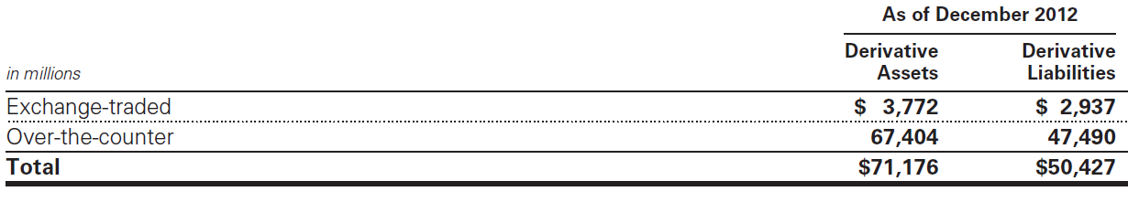
Derivatives and hedging activities
Derivatives are accounted for at fair value, net of cash collateral received or posted under credit support agreements. They are reported on a net-by-counterparty basis when a legal right of setoff exists. Derivative assets and liabilities are included in “Financial instruments owned, at fair value” and “Financial instruments sold, but not yet purchased, at fair value,” respectively.

Slide 103
Derivatives and hedging activities
Firm’s level 2 and level 3 derivatives are valued using derivative pricing models (e.g., models that incorporate option pricing methodologies, Monte Carlo simulations and discounted cash flows). Price transparency of derivatives can generally be characterized by product type:
Generally prices are observable and transparent even for long-dated contracts.
The primary difference between the price transparency of developed and emerging market currency derivatives is that emerging markets tend to be observable for contracts with shorter tenors.
Interest rates
Currency
Credit
Equity
In general prices are transparent. Credit default swaps that reference loans, asset-backed securities and emerging market debt instruments tend to have less price transparency than those that reference corporate bonds.
Commodity
In general price transparency for commodity derivatives is greater for contracts with shorter tenors and contracts that are more closely aligned with major and/or benchmark commodity indices.
Equity derivatives generally have observable market prices, except for contracts with long tenors or reference prices that differ significantly from current market prices.

Slide 104
Securitization activities
>
The firm securitizes residential and commercial mortgages, corporate bonds, loans and other types of financial assets by selling these assets to securitization vehicles (e.g., trusts, corporate entities and limited liability companies) and acts as underwriter of the beneficial interests that are sold to investors.
The primary risks included in beneficial interests and other interests from the firm’s continuing involvement with securitization vehicles are:
The performance of the underlying collateral
The position of the firm’s investment in the capital structure of the securitization vehicle
The market yield for the security.

Slide 105
Market risk
Possible adverse impact by condition in the global financial market and economic condition generally
Negative general condition
General uncertainty
Lower public confidence
Negative impact on client activities
Losses
Notes:
By definition it’s the risk arising from the changes in the market value of trading and investment position
Market uncertainty volatility and adverse economic conditions may cause clients to transfer asset to products that generate less fee income -> less revenues

Slide 106
Market risk
Performance highly linked to the environment
Main factors:
Global GDP
Efficiently of capital market
Level of investor confidence
Stability of geopolitical conditions
Regulatory certainty
Level of inflation
Notes:
With efficienty we mean also the level of transparency and liquidity, and availability to capital market otherwise -> higher cost of capital -> negative impact
Declining asset value -> negative impact, especially for net long position (receive fees based on value of asset managed) UNLESS HEDGING

Slide 107
Market risk
Risk of loss in the value of our inventory due to changes in market prices.
Inventory changes based on client demands and investment opportunities
Inventory accounted at fair value, fluctuations on a daily basis
INTEREST RATE RISK
EQUITY PRICE RISK
CURRENCY RATE RISK
COMMODITY RISK

Slide 108
Market risk – Asset Management
Declining of asset value -> negative impact especially for..
Net long position
Collateral management
Notes:
For net long position because GS receive fees related to value of asset managed.
For collateral because if GS provides collateral ->if value declines need of additional collateral, so more costs
And if GS receives collateral -> less profitability, less business.

Slide 109
Market risk - Volatility
More volatility -> more trading and arbitrage opportunities, a volatile market can increase trading revenues
BUT
more risk and Goldman Sachs may be obliged to limiting the size to market making position
-> less profitability
Notes:
+ volatility + difficult to value asset

Slide 110
Market risk – How to manage
Diversify exposure
Control position sizes
Economic hedge in related securities or derivatives
Notes:
E.g. hedging a portfolio of common stocks by taking an offsetting position in an equity index

Slide 111
Market risk – Effective management
accurate and timely information
dynamic limit setting framework
high level of communication

Slide 112
Market risk – Risk measures
For shorter-term period
Var
Sensitivity metrics
For longer-term period
Stress tests

Slide 113
Market risk – Value at Risk
Potential loss in value of inventory positions due to adverse market movements
one-day time horizon with a 95% confidence level

Slide 114
Market risk – Value at Risk
BENEFITS
Consideration of risks including interest rates, equity prices, currency rates and commodity prices
Easy comparison
Estimation of aggregate risk
Consideration of risk reduction due to diversification
LIMITS
Previous moves may not produce accurate predictions of all future market moves
No consideration of relative liquidity of different risk positions
Trading gains/losses due to market movements may differ from the model
Notes:
LIMITS -> model subject to critical review and validation, daily backtesting

Slide 115
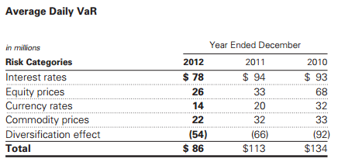
Market risk – Daily VaR
From 2011 to 2012 the decrease reflects a decrease in the interest rates category, commodity prices and currency rates categories due to lower levels of volatility and to reduced exposures. These decreases were partially offset by a decrease in the diversification benefit across risk categories.

Slide 116
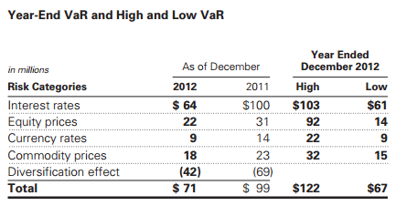
Market risk – Daily Var

Slide 117
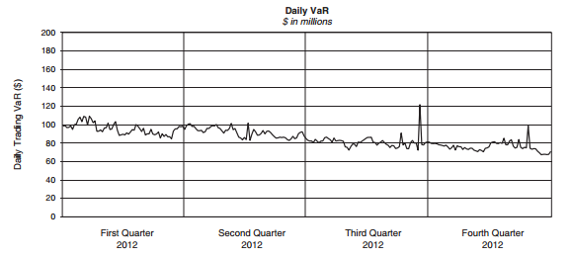
Market risk – Daily VaR

Slide 118
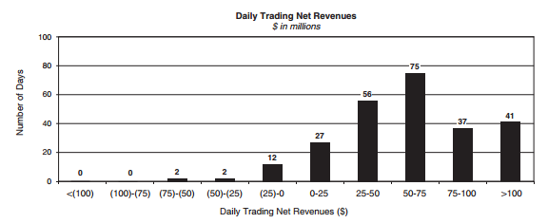
Market risk – Daily Trading Net Revenues
Daily trading net revenues are compared with VaR calculated as of the end of the prior business day. Trading losses incurred on a single day did not exceed 95% one-day VaR during 2012.

Slide 119
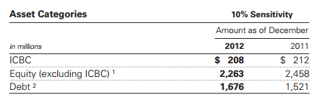
Market risk - Sensitivity measure
For position not included in VaR, estimation of the potential reduction in net revenues of a 10% decline in the underlying asset value.
Notes:
These measures do not reflect diversification benefits across asset categories and therefore have not been aggregated.

Slide 120
Market risk - Stress testing
Sensitivity analysis
Used to quantify the impact of a market move in a single risk factor across all position or the impact of the default of a single corporate entity
Scenario analysis
Used to quantify the impact of a specified event, including how the event impacts multiple risk factors simultaneously
Firmwide stress tests
Combination of market, credit, operational and liquidity risks into a single combined scenario, used to assess capital adequacy

Slide 121
Credit risk
Potential loss due to default or deterioration in credit quality of third parties who owe money, securities or other assets, or of issuers of securities or other instruments
Notes:
Deterioration in credit quality of 3° parties can generate higher risk of losses because third parties may not perform their obligation
Default rates, downgrades and disputes with counterparties (as to the valuation of collateral) increase significantly in times of market stress and illiquidity.

Slide 122
Credit risk
Goldman Sachs could incur in loss if
Counterparty in a security of other financial instrument defaults on GS
Value of securities GS holds decrease due to decrease in credit quality / ratings
Notes:
Deterioration in credit quality of 3° parties can generate higher risk of losses because third parties may not be able to perform their obligations
Default rates, downgrades and disputes with counterparties (as to the valuation of collateral) increase significantly in times of market stress and illiquidity.
Securities includes OTC derivatives

Slide 123
Credit risk
Credit risk can be generated by:
OTC derivatives
Loans and lending commitments
Securities financing transactions (i.e., resale and repurchase agreements and securities borrowing and lending activities)

Slide 124
Credit risk – Management process
Approving transactions and setting credit exposure limits;
monitoring compliance with established limits;
measuring potential losses resulting from counterparty default;
reporting of credit exposure to senior management, the Board and regulators;
use of credit risk mitigants;
communication and collaboration with other independent control and support functions such as operations, legal and compliance.
Notes:
Risk mitigants = collateral and hedging

Slide 125
Credit risk – Credit review
Initial and ongoing analyses of counterparties
Independent judgement on the ability of the counterparty to perform obligations
Determination of the internal credit rating according to the determined profile
Approval of credit review and rating by senior personnel within credit risk management
Notes:
They consider also future business performance, the nature and outlook for the counterparty’s industry, and the economic environment

Slide 126
Credit risk – Measurement of exposure
Risk measure and limits
Measure of credit risk based on the potential loss in an event of non-payment by a counterparty and limits are fixed to control the size of exposure
Stress tests/scenario analysis, applying shock to counterparties credit rating or credit risk factors
Notes:
GS measures credit risk based on the potential loss in an event of non-payment by a counterparty. For derivatives and securities financing transactions, the primary measure is potential exposure, which is the estimate of the future exposure that could arise over the life of a transaction based on market movements within a specified confidence level. Potential exposure takes into account netting and collateral arrangements. For loans and lending commitments, the primary measure is a function of the notional amount of the position. To monitor credit risk in terms of current exposure, which is the amount presently owed to the firm after taking into account applicable netting and collateral.

Slide 127
Credit risk – Reduction of exposure
According to the credit quality of the counterparty risk mitigants are employed like collateral provisions, guarantees, covenants, structural seniority of the bank loan claims and provisions in the legal documentation that allow the firm to adjust loan as market conditions change
Third parties garantees
Credit derivatives or participation agreements
Notes:
Adjust loan amounts, pricing, structure and other terms

Slide 128
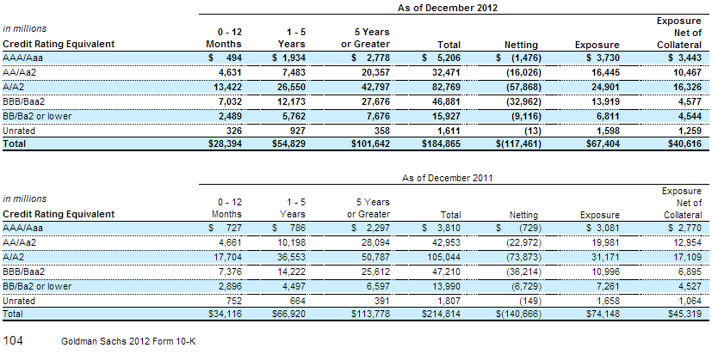
Credit risk – Credit exposure
Notes:
Cash and cash equivalents include both interest-bearing and non-interest-bearing deposits.
Derivatives are reported on a net-by-counterparty basis (i.e., the net payable or receivable for derivative assets and liabilities for a given counterparty).
Derivatives are accounted for at fair value, net of cash collateral received or posted under credit support agreements.
As credit risk is an essential component of fair value, the firm includes a credit valuation adjustment (CVA) in the fair value of derivatives to reflect counterparty credit risk.

Slide 129
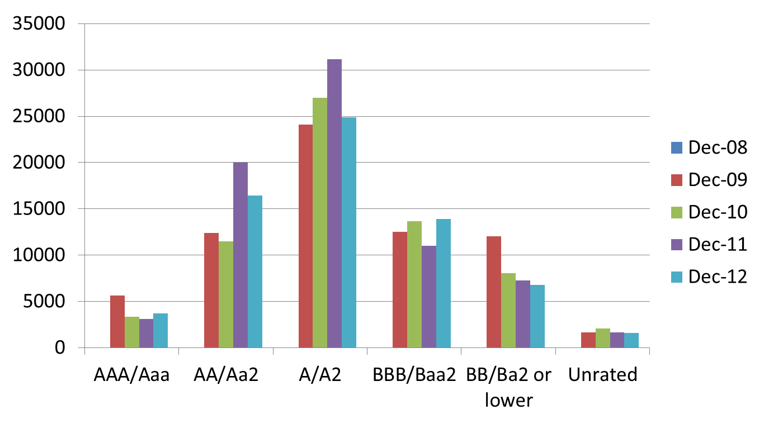
Credit risk – Exposure by credit rating

Slide 130
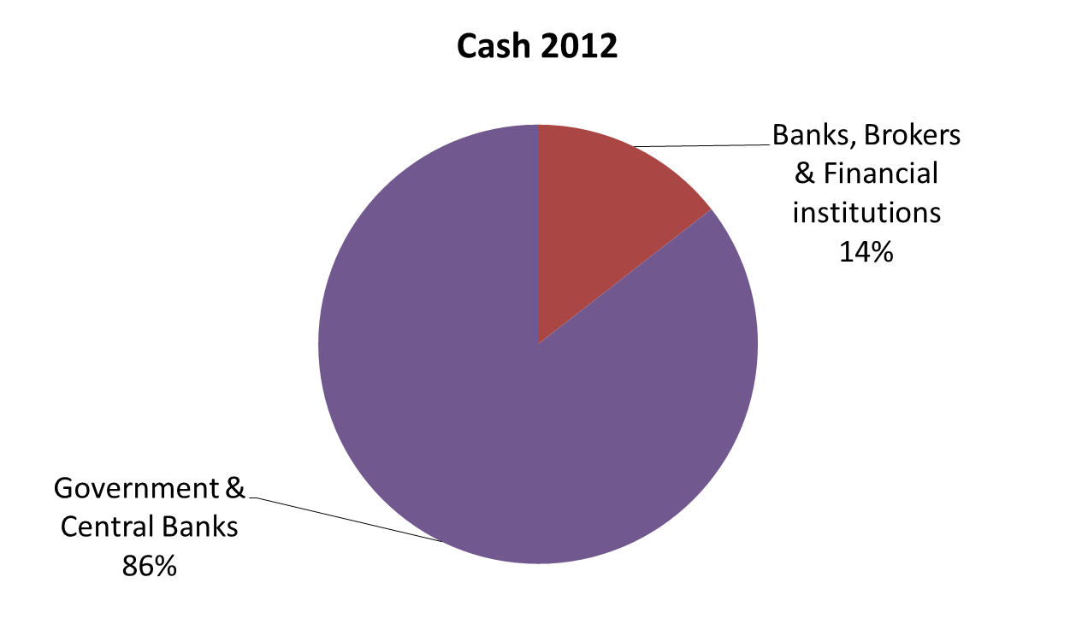
Credit risk – Exposure by industry (1)

Slide 131
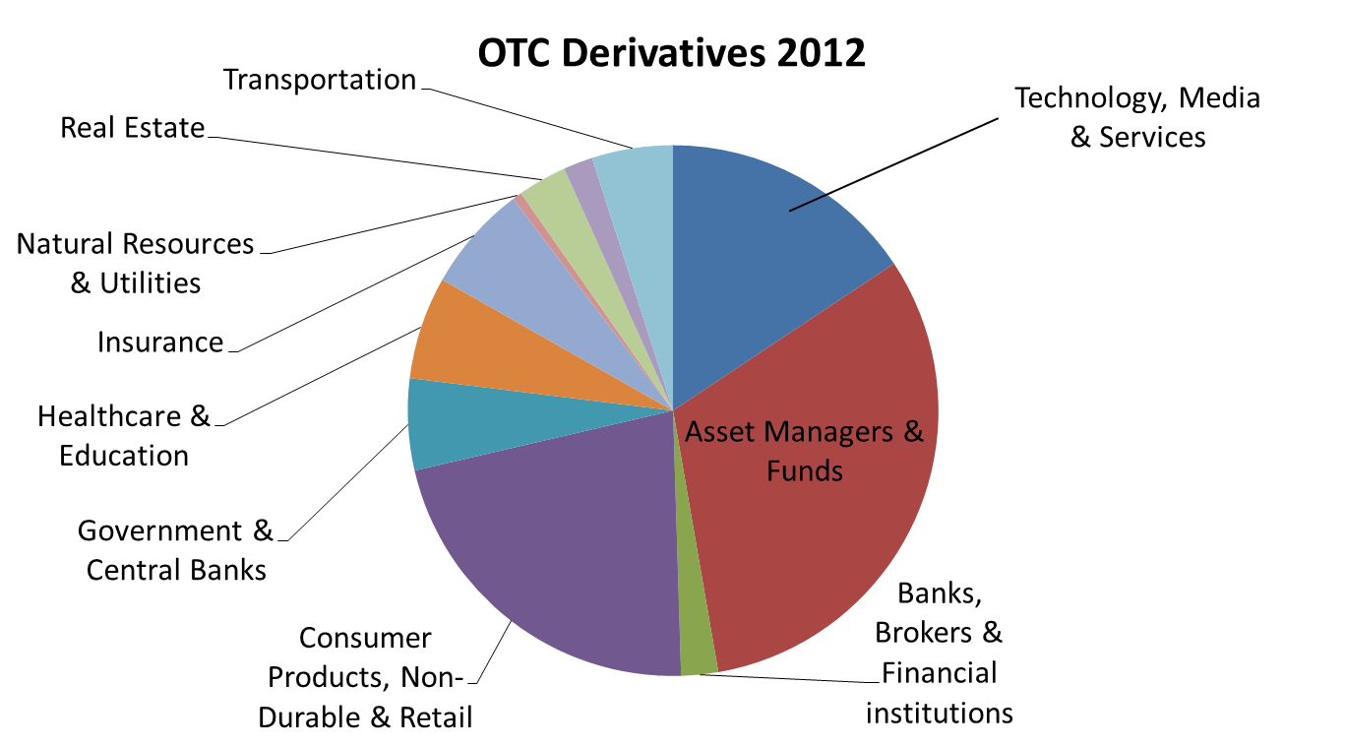
Credit risk – Exposure by industry (2)

Slide 132
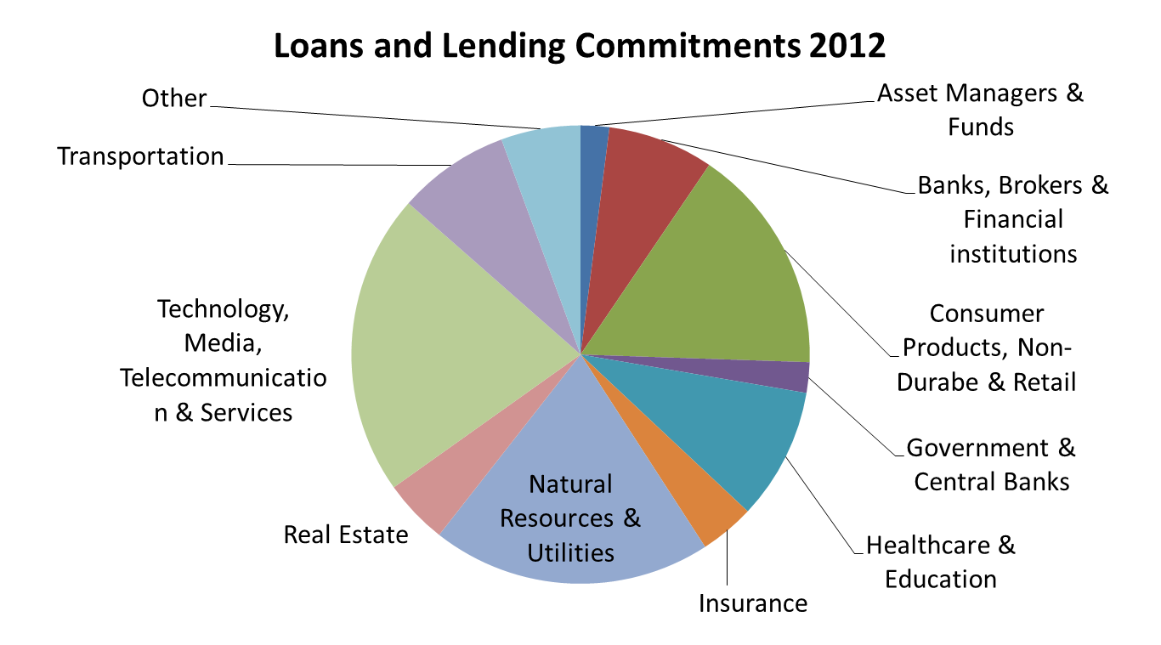
Credit risk – Exposure by industry (3)

Slide 133
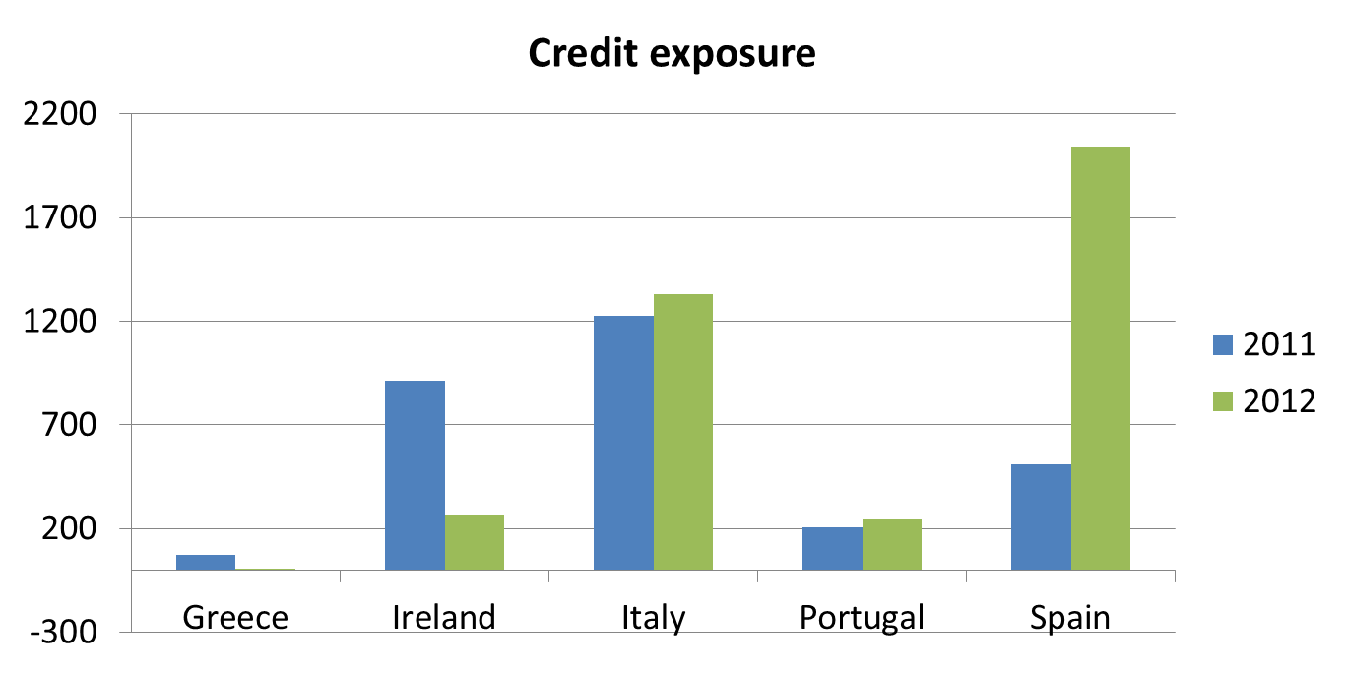
Credit risk – European countries
During 2011 and through 2012 many European banking system and member states have been experiencing significant credit deterioration

Slide 134
Operational risk
Risk of loss resulting from inadequate or failed internal processes, people and systems or from external events. It includes operational risk arises from routine processing errors as well as extraordinary incidents.

Slide 135

Operational risk – Management process
TRAINING
COMMUNICATION
MANAGEMENT PROCESS
SUPERVISION
ACTIVE PARTICIPATION

Slide 136
Operational risk – Management process
It was designed to comply with the operational risk measurement rules under Basel 2 and has evolved based on the changing needs of our businesses and regulatory guidance.
Risk identification and reporting
Risk
Measurement
Risk
Monitoring

Slide 137
Notes to Consolidated Financial Statements Note 3.Significant Accounting Policies
Significant accounting policies of a firm?
when and how to measure the fair value of assets and liabilities
when to consolidate an entity
Entity as voting/variable interest
controlling financial interest
Consolidation
Notes:
The firm’s significant accounting policies include when and how to measure the fair value of assets and liabilities and when to consolidate an entity
The firm consolidates entities in which the firm has a controlling financial interest. The firm determines whether it has a controlling financial interest in an entity by first evaluating.
The usual condition for a controlling financial interest in a voting interest entity is ownership of a majority voting interest. If the firm has a majority voting interest in a voting interest entity, the entity is consolidated.

Slide 138
Investment funds
Numerous investment funds with third-party investors BUT not hold a majority of the economic interests
Estimation
Management make certain estimates to the fair value accounting for intangible assets, provision for losses. These estimation are based on the best available information but actual results could be materially different.
Notes:
The firm has formed numerous investment funds with third-party investors. These funds are typically organized as limited partnerships or limited liability companies for which the firm acts as general partner or manager. Generally, the firm does not hold a majority of the economic interests in these funds.

Slide 139
What is a fair value of a financial instrument?
the amount that would be received to sell an asset or paid to transfer a liability in an orderly transaction between market participants at the measurement date. Financial assets are marked to bid prices and financial liabilities are marked to offer prices.
Notes:
Financial instruments owned, at fair value and Financial instruments sold, but not yet purchased, at fair value are recorded at fair value either under the fair value option .
The fair value of a financial instrument is the amount that would be received to sell an asset or paid to transfer a liability in an orderly transaction between market participants at the measurement date. Financial assets are marked to bid prices and financial liabilities are marked to offer prices

Slide 140
Investment Banking
Expenses
With underlying transactions
deferred until the related revenue is recognized
with financial advisory assignments
recorded as non-compensation expenses, net of client reimbursements.
Notes:
Fees from financial advisory assignments and underwriting revenues are recognized in earnings when the services related to the underlying transaction are completed under the terms of the assignment.
Expenses associated with such transactions are deferred until the related revenue is recognized or the assignment is otherwise concluded. Expenses associated with financial advisory assignments are recorded as non-compensation expenses, net of client reimbursements

Slide 141
Investment Management
The firm earns management and incentive fees for investment management services
Management fees: as % of net asset value,
invested capital
or commitments
recognized over the period that the related service is provided.
Incentive fees: as a % of a fund’s or
separately managed account’s return,
or excess return above a specified benchmark
incentive fees are generally based on investment performance over a 12-month period
Management and incentive fee revenues are included in “Investment management” revenues
Notes:
Management fees are calculated as a percentage of net asset value, invested capital or commitments, and are recognized over the period that the related service is provided.
Incentive fees are calculated as a percentage of a fund’s or separately managed account’s return, or excess return above a specified benchmark or other performance target.
Incentive fees are generally based on investment performance over a 12-month period or over the life of a fund this fees are subject to adjustment prior to the end of the measurement period

Slide 142
Transfers of Assets
Transfers of assets are accounted for as sales when the firm has relinquished control over the assets transferred.
Firm’s continuing involvement with transferred assets: measured at fair value.
the assets remain in “Financial instruments owned, at fair value” for transfers of assets not accounted for as sales
Notes:
Transfers of assets are accounted for as sales when the firm has relinquished control over the assets transferred. Assets or liabilities that arise from the firm’s continuing involvement with transferred assets are measured at fair value. For transfers of assets that are not accounted for as sales, the assets remain in “Financial instruments owned, at fair value” and the transfer is accounted for as a collateralized financing, with the related interest expense recognized over the life of the transaction.

Slide 143
Cash and Cash Equivalents
The firm defines cash equivalents as highly liquid overnight deposits held in the ordinary course of business
December 2011
December 2012
interest-bearing deposits with banks $48.05
Cash and cash equivalents” $6.75
Cash and cash equivalents” $7.95
interest-bearing deposits with banks $65.92
Notes:
Cash and Cash Equivalents The firm defines cash equivalents as highly liquid overnight deposits held in the ordinary course of business. As of December 2012 and December 2011, “Cash and cash equivalents” included $6.75 billion and $7.95 billion, respectively, of cash and due from banks, and $65.92 billion and $48.05 billion, respectively, of interest-bearing deposits with banks.

Slide 144
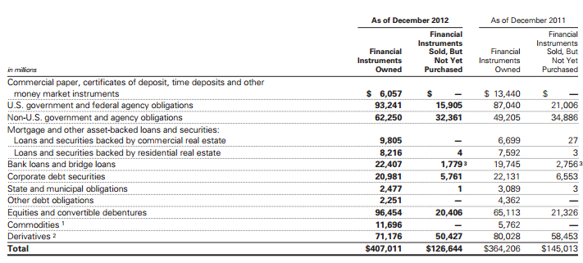
Note 4. Financial Instruments Owned/Sold, But Not yet Purchased, at Fair Value
Notes:
Note 4.
Financial Instruments Owned, at Fair Value and Financial Instruments Sold, But Not yet Purchased, at Fair Value
This table presents the firm’s financial instruments owned, at fair value, including those pledged as collateral, and financial instruments sold, but not yet purchased, at fair value. The firm held $9.07 billion and $4.86 billion as of December 2012 and December 2011, respectively, of securities accounted for as available-for-sale related to the firm’s reinsurance business

Slide 145
Fair Value Measurements
The amount that would be received to sell an asset (paid to transfer a liability) in a transaction between market participants at the measurement date.
Financial assets: marked to bid prices
financial liabilities: marked to offer prices.
portfolio
financial assets
financial liabilities
Notes:
The fair value of a financial instrument is the amount that would be received to sell an asset or paid to transfer a liability in an orderly transaction between market participants at the measurement date. Financial assets are marked to bid prices and financial liabilities are marked to offer prices. Fair value measurements do not include transaction costs. The firm measures certain financial assets and financial liabilities as a portfolio

Slide 146
Evidence
Best choice
quoted price in an active market
Available
Not available
fair value is determined by reference to prices for similar instruments
Notes:
The best evidence of fair value is a quoted price in an active market. If quoted prices in active markets are not available, fair value is determined by reference to prices for similar instruments, quoted prices or recent transactions in less active markets, or internally developed models that primarily use market-based or independently sourced parameters as inputs including, but not limited to, interest rates, volatilities, equity or debt prices, foreign exchange rates, commodity prices, credit spreads and funding spreads

Slide 147
The fair value hierarchy
unadjusted quoted prices in active markets
Observable valuation techniques
Significant and unobservable valuation techniques
Notes:
The fair value hierarchy is as follows:
Level 1. Inputs are unadjusted quoted prices in active markets to which the firm had access at the measurement date for identical, unrestricted assets or liabilities.
Level 2. Inputs to valuation techniques are observable, either directly or indirectly.
Level 3. One or more inputs to valuation techniques are significant and unobservable.
Valuation adjustments are generally based on market evidence.

Slide 148
3 Levels of Cash Instruments
bank loans and bridge loans
non-U.S. government and agency obligations
Cash instruments
U.S. government and federal agency obligations
corporate debt
securities
equities and convertible debentures
other
Non-derivative financial instruments
Notes:
Cash instruments include U.S. government and federal agency obligations, non-U.S. government and agency
obligations, bank loans and bridge loans, corporate debt securities, equities and convertible debentures, and other non-derivative financial instruments owned and financial instruments sold, but not yet purchased.

Slide 149
Level 1
Include:
U.S. government obligations
most non-U.S. government obligations
traded listed equities
certain government agency
obligations and money market instruments.
These instruments are valued using quoted prices for identical unrestricted instruments in active markets.
The firm defines active markets:
for equity instruments based on the average daily trading volume both in absolute terms and relative to the market capitalization for the instrument.
for debt instruments based on both the average daily trading volume and the number of days with trading activity.
Notes:
cash instruments include U.S. government obligations and most non-U.S. government obligations, actively traded listed equities, certain government agency obligations and money market instruments. These instruments are valued using quoted prices for identical unrestricted instruments in active markets.
The firm defines active markets for equity instruments based on the average daily trading volume both in absolute terms and relative to the market capitalization for the instrument. The firm defines active markets for debt instruments based on both the average daily trading volume and the number of days with trading activity.

Slide 150
Level 2
In this level cash instruments include:
commercial paper,
certificates of deposit
time deposits,
most government agency obligations
certain non-U.S. government obligations
most corporate debt securities
commodities
certain mortgage-backed loans and securities
certain bank
loans and bridge loans,
restricted or less liquid listed equities
most state and municipal obligations and certain lending commitments.

Slide 151
Level 3
Level 3 cash instruments are initially valued at transaction price, which is considered to be the best initial estimate of fair value.
Valuation inputs and assumptions are changed when corroborated by substantive observable evidence, including values realized on sales of financial assets.

Slide 152
Investments in Funds That Calculate Net Asset value Per Share
The firm uses NAV as its measure of fair value for fund investments when the fund investment does not have a readily determinable fair value
NAV of the investment fund is calculated in a manner consistent with the measurement principles of investment company accounting, including measurement of the underlying investments at fair value.

Slide 153
Investments in Funds That Calculate Net Asset Value Per Share
The firm’s investments in funds that calculate NAV primarily consist of investments in firm-sponsored funds where the firm co-invests with third-party investors
The firm’s investments in hedge funds are generally redeemable on a quarterly basis with 91 days’ notice, subject to a maximum redemption level of 25% of the firm’s initial investments at any quarter-end

Slide 154
Fair value option
The firm has elected to account for certain of its other financial assets and financial liabilities at fair value under the fair value option
Primary reasons for electing the fair value option:
reflect economic events in earnings on a timely basis;
mitigate volatility in earnings from using different measurement attributes
address simplification and cost-benefit considerations

Slide 155
Hybrid financial instruments
Instruments which contain bifurcatable embedded derivatives and do not require settlement by physical delivery of non-financial assets
If the firm elects to bifurcate the embedded derivative from the associated debt:
the derivative is accounted for at fair value
the host contract is accounted for at amortized cost
adjusted for the effective portion of any fair value hedges.
If the firm does not elect to bifurcate:
the entire hybrid financial instrument is accounted for at fair value under the fair value option.
Notes:
These financial assets and financial liabilities at fair value are generally valued based on discounted cash flow techniques, which incorporate inputs with reasonable levels of price transparency, and are generally classified as level 2 because the inputs are observable. Valuation adjustments may be made for liquidity and for counterparty and the firm’s credit quality.

Slide 156
Resale and Repurchase Agreements and Securities Borrowed and Loaned.
collateral funding spreads
the amount and timing of expected future cash flows an
interest rates
Are the significant inputs to the valuation of resale repurchase agreements and securities borrowed/loaned
Notes:
The significant inputs to the
valuation of resale and repurchase agreements and
securities borrowed and loaned are collateral funding
spreads, the amount and timing of expected future cash
flows and interest rates

Slide 157
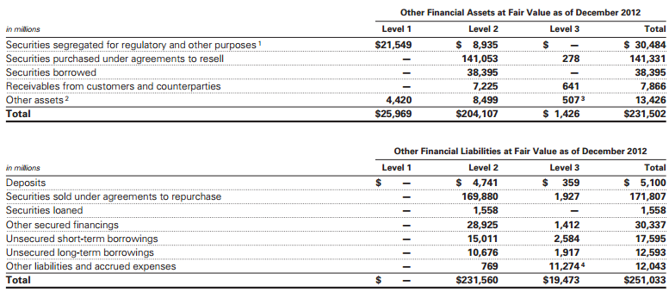
Fair Value of Other Financial Assets and Financial Liabilities by Level
This 2 tables shows other financial assets and financial liabilities within the fair value hierarchy, accounted for at fair value primarily under the fair value option.

Slide 158
Transfers Between Levels of the Fair Value Hierarchy
Transfers between levels of the fair value hierarchy are reported at the beginning of the reporting period in which they occur.
! No transfers of other financial assets and financial liabilities between level 1 and level 2 during the year ended December 2012.
!Yes transfer between level 2 and level 3.
Notes:
Transfers between levels of the fair value hierarchy are reported at the beginning of the reporting period in which
they occur. There were no transfers of other financial assets and financial liabilities between level 1 and level 2 during
the year ended December 2012.

Slide 159
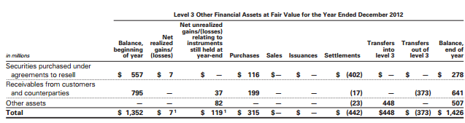
Level 3 Rollforward
If a financial asset or financial liability was transferred to level 3 during a reporting year, its entire gain or loss for the year is included in level 3
Notes:
The tables below present changes in fair value for other financial assets and financial liabilities accounted for at fair
value categorized as level 3 as of the end of the year. Level 3 other financial assets and liabilities are frequently
economically hedged with cash instruments and derivatives.
As a result, gains or
losses included in the level 3 rollforward below do not necessarily represent the overall impact on the firm’s results of operations, liquidity or capital resources.

Slide 160
THANK YOU FOR LISTENING! ANY QUESTIONS???

Slide 161
References
Ferguson R.W.Jr. (2003), “Capital Standards for Banks: The Evolving Basel Accord”, Federal Reserve Working Paper.
Giacometti R; Paterlini S. (2013), Presentation on Operational Risk, Università degli Studi di Bergamo, December 2013.
Goldman Sachs (2013), 10-K 2012
The Basel Committee on Banking Supervision (2011), “Basel III: A global regulatory framework for more resilient banks and banking systems”, Bank for International Settlements Publications.
The Basel Committee on Banking Supervision (2013), “Basel III: The Liquidity Coverage Ratio and liquidity risk monitoring tools”, Bank for International Settlements Publications.
The Basel Committee on Banking Supervision (2001), “The New Basel Capital Accord: an explanatory note”, Bank for International Settlements Publications.

