Slide 1
Trade 1
Following is an example of where to get the information for the first trades
The pages needed are the Settlements page; the Contract Specs.; and the Margin Page
In the following only the information about the Mexican peso is provided. The first trade involves taking positions in 3 commodities.
Only the settlements page (with prices circled) and the trade sheet need to be submitted.

Slide 2
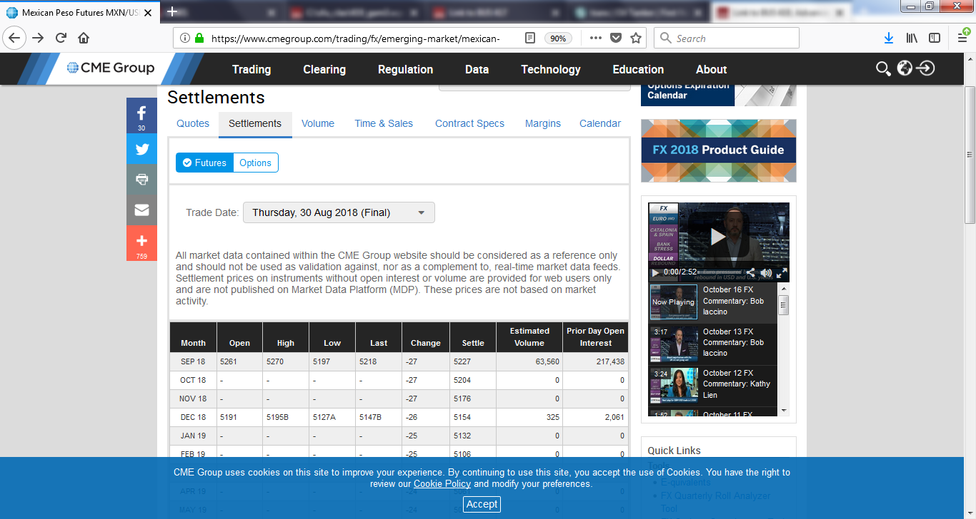
Finding the Futures Price and Delivery Date; Mexican Peso

Slide 3
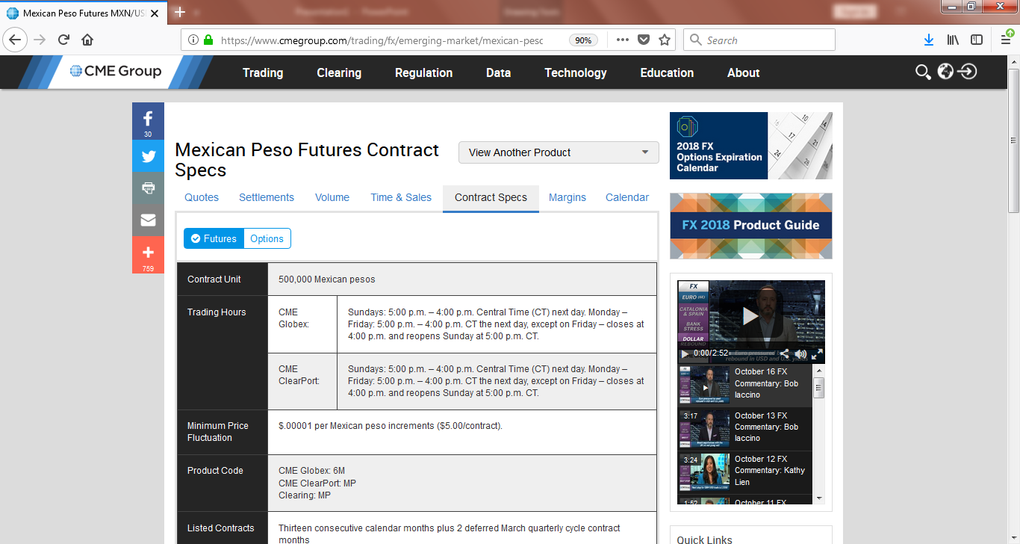
Contract Specs. for position size; Note the minimum price relationship to the price quote page!

Slide 4
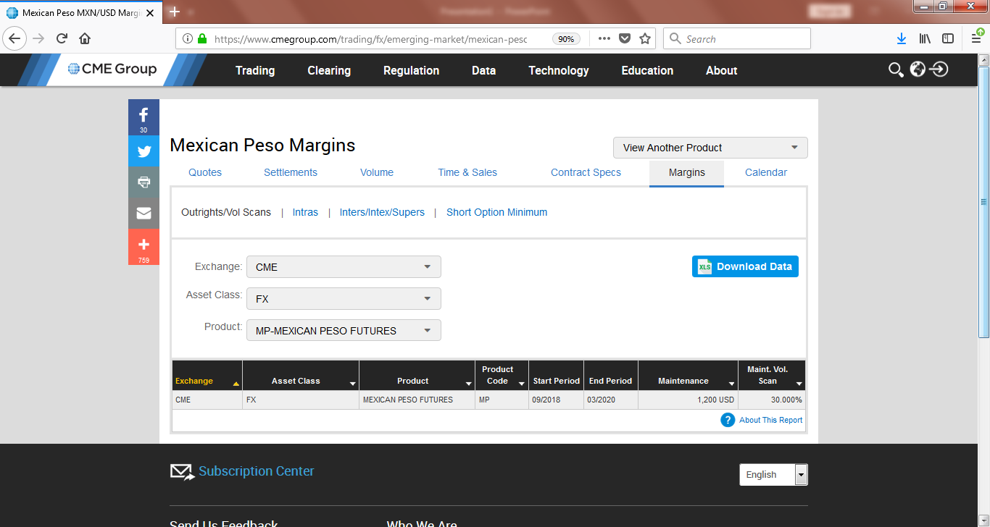
The game will only use maintenance margin info. (x # contracts); Note that the margin amounts can change over time due to changes in volatility and contract value; Note also that there is a search box

