Slide 1

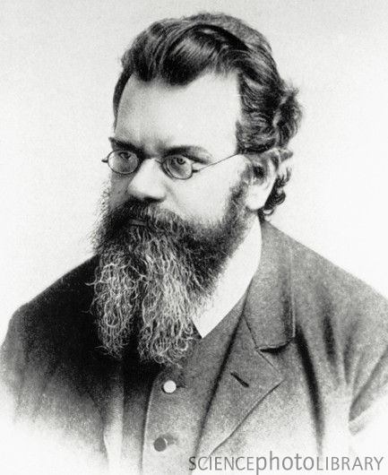
Ergodicity, Econophysics and the History of Economic Theory
Geoffrey Poitras,
Simon Fraser University

Slide 2
Mirowski’s Thesis: Confusion in HET?
At least since Mirowski (1984), it has been recognized that important theoretical elements of neoclassical economics were adapted from mathematical concepts developed in 19th century physics.
Is the rise of the ‘new’ subject of Econophysics incongruent with ‘Mirowski’s Thesis’?
What is Econophysics? Is this a separate subject or a sub-discipline of Economics or a sub-discipline of Physics?
Is it possible to have a ‘history of thought’ for a subject which is still emerging? How to write such a history?

Slide 3
What is ‘Econophysics’?
Term initially coined by Eugene Stanley (1994?, 1996)
Roehner (2002, p.3): “the term econophysics designates the investigation of economic problems by physicists”.
Consistent with the usage of ‘neurophysics’ and ‘biophysics’ and with the appearance of econophysics articles in physics journals
Following Jovanovic and Schinckus (2012) this ignores the trans-disciplinary aspects of econophysics
Wikipedia definition: “Econophysics is an interdisciplinary research field, applying theories and methods originally developed by physicists in order to solve problems in economics, usually those including uncertainty or stochastic processes and nonlinear dynamics.
Too broad a definition as, under Mirowski’s thesis, econophysics would encompass neo-classical economics

Slide 4
Essentials of Econophysics
Schinckus (2010, p.3816) accurately recognizes that econophysics depends fundamentally on empirical observation: “The empiricist dimension is probably the first positivist feature of econophysics”
Roehner (2002, p.21): “experimental research is an essential part of physics”
Economics is characterized by the prevalence of non-experimental data
Many early studies in econophysics examined financial economics where large data sets are available (yet still replaces experimental with non-experimental data).

Slide 5
Rational versus Statistical Mechanics
Brush (1979) sees the evolution from rational to statistical mechanics as part of a “Second Scientific Revolution”
“[The Second] Scientific Revolution, associated with the theories of Darwin, Maxwell, Planck, Einstein, Heisenberg and Schrödinger, substituted a world of process and chance whose ultimate philosophical meaning still remains obscure” (Brush 1983, p.79).
This Second Revolution superceded the: “First Scientific Revolution, dominated by the physical astronomy of Copernicus, Kepler, Galileo, and Newton, ... in which all changes are cyclic and all motions are in principle determined by causal laws.” The irreversibility and indeterminism of the Second Scientific Revolution replaces the reversibility and determinism of the First.
Mirowski’s thesis places the rational mechanics underlying neo-classical economic theory with the ‘First Scientific Revolution’

Slide 6
Physical Origins of Neoclassical Economics
Mirowski and others identify the close connection between neoclassical economic theory and the deterministic rational mechanics of early 19th century physics
Jevons (1877, p.738-9) reflects the Laplacian determinism of the marginalists: “We may safely accept as a satisfactory scientific hypothesis the doctrine so grandly put forth by Laplace, who asserted that a perfect knowledge of the universe, as it existed at any given moment, would give a perfect knowledge of what was to happen thenceforth and for ever after. Scientific inference is impossible, unless we may regard the present as the outcome of what is past, and the cause of what is to come. To the view of perfect intelligence nothing is uncertain.”

Slide 7
HET for Econophysics
Raymond de Roover associated HET with the ‘genesis of ideas and the evolution of methods’ → the methods of physics are grounded in solving physical problems
Because econophysics combines both physics and economics, is the original physical interpretation of the theoretical method being used to model the behavior of economic variables relevant to creating an HET for econophysics?
Are important individuals in the history of econophysics comprised of physicists that considered economic problems? Alternatively, are the originators of the physical theories and the associated physical problems which motivated the contributions of relevance?
For example, is Mandelbrot relevant to HET for econophysics because of the contributions to chaos theory proper or because of the application of chaos theory to studying the behavior of financial prices?

Slide 8
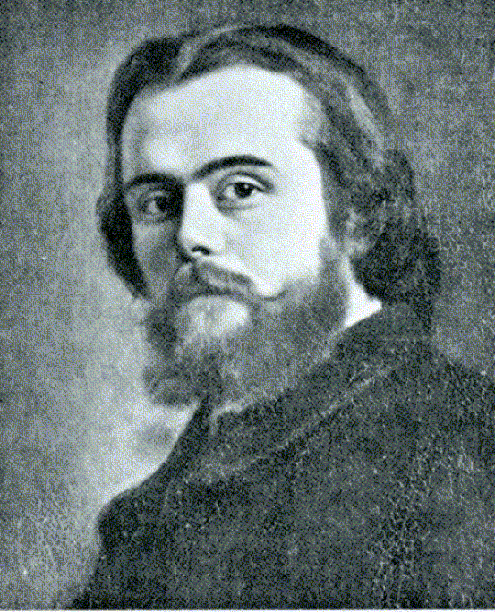
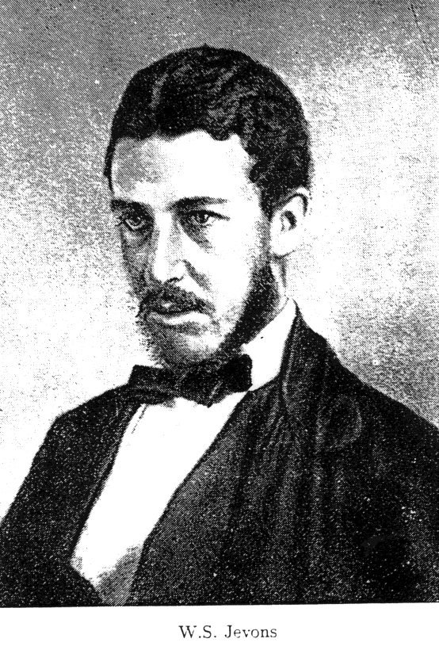
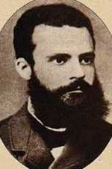
Pre-Econophysicists?
Leon Walras W. Stanley Jevons Vilfredo Pareto
(1834-1910) (1835-1882) (1848-1923)

Slide 9
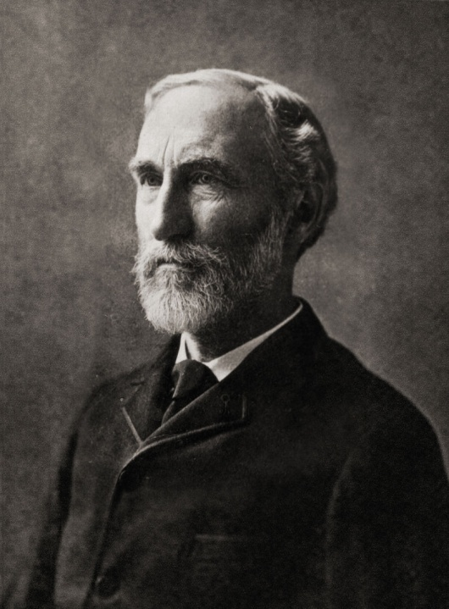
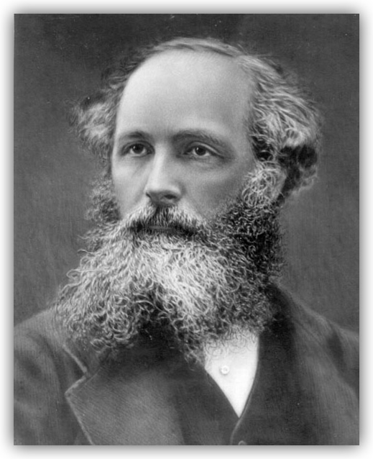
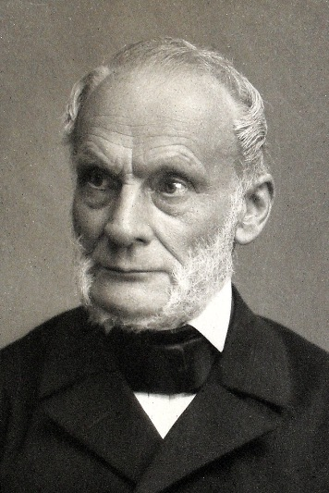
Early Econophysicists?
Rudolf Clausius Josiah Gibbs James Maxwell
(1822-1888) (1839-1903) (1831-1879)

Slide 10
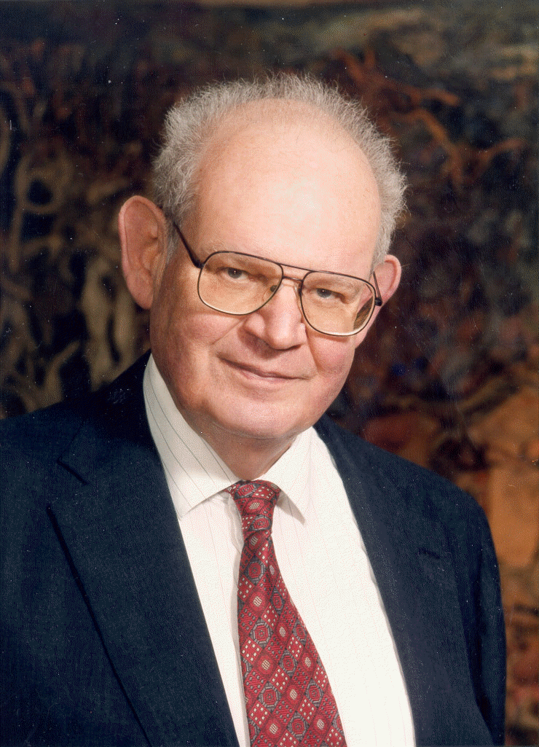
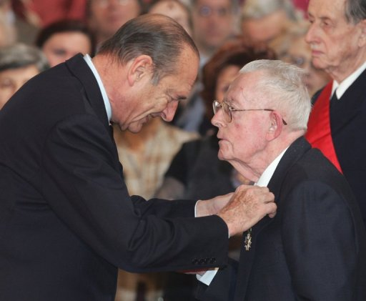
Modern Econophysicists?
Benoit Mandelbrot Maurice Allais
(1924-2010) (1911-2010)
(many contributions prior to mid-1990’s ) Economist with physics training

Slide 11
Ludwig E. Boltzmann (1844-1906)
Founding father of Second Scientific Revolution and intellectual giant in the kinetic theory of gases
Important influence on Einstein (Brownian motion) and Planck (theory of black matter)
First to demonstrate that time irreversible processes explain second law of thermodynamics
Originator of the ‘ergodicity hypothesis’

Slide 12
Origins of Ergodicity
The etymology for “ergodic” begins with an 1884 paper by Boltzmann
The ergodic property was initially associated with the kinetic theory of gases where the unobservable properties of the velocity of gas molecules can be ‘macroscopically’ measured, esp. using temperature
Other macroscopic measures include density, pressure, viscous stresses and heat flow.
The ergodic hypothesis maintains that a dynamical system samples all points in the dynamical space
‘Dynamical space’ is referred to as the ‘phase space’ in modern terminology
Ergodicity is a long run property

Slide 13
Ergodicity and Economics
For Economics, ‘Ergodicity’ is the property that permits a single ex post time series sample path to be used to estimate the parameters for the distribution of the ex ante ensemble of future time paths
In the limit for time, an ergodic process will possess a steady state distribution that is independent of initial conditions.
Ergodic processes can have non-linearity in the mean providing a wider class of theoretical processes for modeling economic variables than the reversible stationary unimodal processes which are conventional in econometric work
Stationary processes are also ‘reversible’, only the distance between observations matter, not where in the process the observation occurs (no impact from initial conditions)

Slide 14
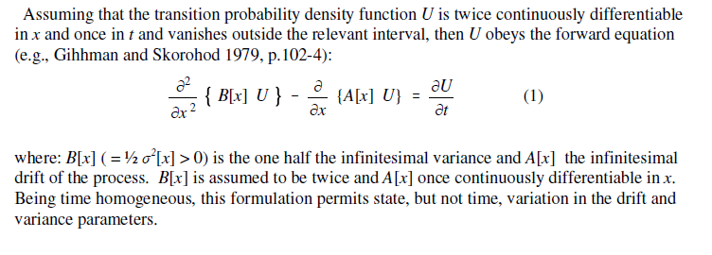
Ergodicity and Sturm-Liouville Theory
The modern formulation of the ergodic hypothesis can be formulated using Sturm-Liouville theory to solve the transition density from the forward equation for the problem
Nolte (2010) attributes the origins of S-L theory and the notion of phase space to Boltzmann

Slide 15
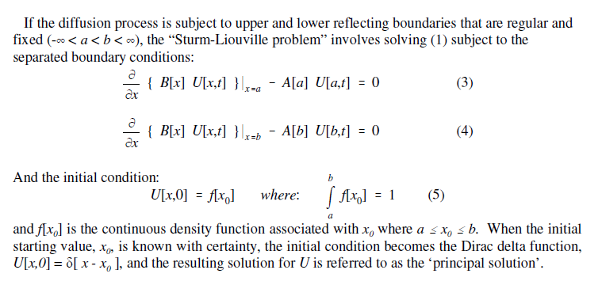
Initial and Boundary Conditions
A PDE is not properly formulated until the boundary and initial conditions are stated
Reflecting barriers act like the walls of a cylinder

Slide 16
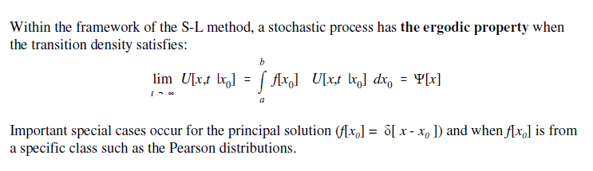
The Ergodic Property
Boltzmann was concerned with demonstrating the dynamic properties of the Maxwell distribution → that the distribution would emerge whatever the initial condition of the system

Slide 17
Irreversibility, Entropy and Cosmology
“Heat can never pass from a colder to a warmer body without some other change occurring at the same time” (Claussius)
For Boltzmann, time was irreversible, i.e., could only move in one direction
Coffee cup example
This observation was a direct result of the second law of thermodynamics, the universal law of increasing entropy – a measure of the randomness of molecular motion and the loss of energy to do work.
First recognized in the early 19th century, the second law maintains that the entropy of an isolated system, not in equilibrium, will necessarily tend to increase over time. Entropy approaches a maximum value at thermal equilibrium.
The second law is of central importance to the ‘big bang’ theory in cosmology

Slide 18
Irreversibility and Economic Theory
Reversible processes originate when equilibrium states are compared → irreversibility arises from the presence of initial conditions and the associated path to equilibrium
Suggests important stochastic differences between properties of static equilibria and the dynamic paths taken to achieve equilibrium from some initial starting point
Unlike Boltzmann where irreversibility is a consequence of the second law, in economics statistical processes are reversible as a consequence of employing stationary distributions to test theories of static equilibrium.
Irreversibility can be obtained as a consequence of the non-linear dynamics associated with using diffusion processes with non-linear drift terms
Consider the case of the quartic density examined in the paper

Slide 19
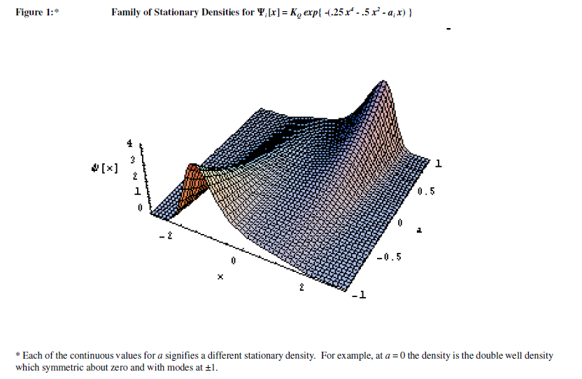
The Quartic Ex Ante Forecasting Distribution

