Slide 1

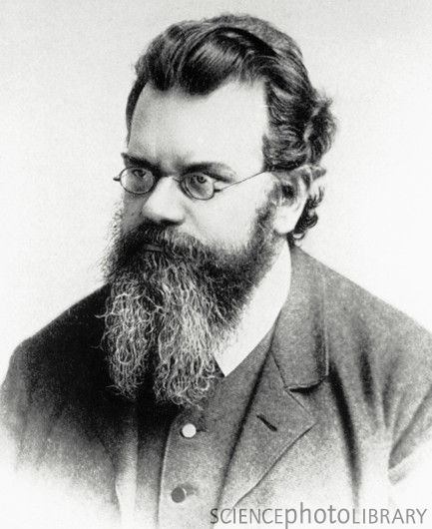
Ergodicity, Econophysics and
Financial Economics
Geoffrey Poitras,
Simon Fraser University

Slide 2
Physics and Financial Economics
Connections between methods of physics and financial economics stretch back to Irving Fisher and Markowitz
  Examples: Fama and Mandlebrot (stable Paretian distributions)
  Black Scholes (1973) (diffusion processes and the fundamental PDE)
  Irving Fisher was a student of Josiah Gibbs
Is the rise of the ‘new’ subject of Econophysics incongruent with the previous (and current) use of methods developed in physics to financial economics?
  What is Econophysics? Is this a separate subject or a sub-discipline of Economics or a sub-discipline of Physics?

Slide 3
What is ‘Econophysics’?
Term initially coined by Eugene Stanley (1994?, 1996)
Roehner (2002, p.3): “the term econophysics designates the investigation of economic problems by physicists”.
  Consistent with the usage of ‘neurophysics’ and ‘biophysics’ and with the appearance of econophysics articles in physics journals
  Too narrow as it restricts the econophysics community to only physicists
Wikipedia definition: “Econophysics is an interdisciplinary research field, applying theories and methods originally developed by physicists in order to solve problems in economics, usually those including uncertainty or stochastic processes and nonlinear dynamics.
  Too broad a definition as econophysics could encompass much of financial economics

Slide 4
Essentials of Econophysics
Schinckus (2010, p.3816) accurately recognizes that econophysics depends fundamentally on empirical observation: “The empiricist dimension is probably the first positivist feature of econophysics”
Roehner (2002, p.21): “experimental research is an essential part of physics”
  Economics is characterized by the prevalence of non-experimental data
  Many studies in econophysics examine financial variables where large data sets are available, though the data is still non-experimental

Slide 5
Essentials of Financial Economics
Financial economics is an evolving subject that has at least two distinct streams: modern portfolio theory and contingent claims valuation
  MPT employs static equilibrium methods adapted from neoclassical economics combined with basic concepts from probability theory
    Key results: CAPM; Two Fund Separation
  Contingent claims valuation employs stochastic methods, such as diffusion processes and numerical methods employed in a variety of subjects including physics, engineering and actuarial science
    Key results: Option Pricing Models; CIR

Slide 6
Physical Origins of Neoclassical Economics
Mirowski (1984) and others identify the close connection between neoclassical economic theory and the deterministic rational mechanics of early 19th century physics
Jevons (1877, p.738-9) reflects the Laplacian determinism of the marginalists:
“We may safely accept as a satisfactory scientific hypothesis the doctrine so grandly put forth by Laplace, who asserted that a perfect knowledge of the universe, as it existed at any given moment, would give a perfect knowledge of what was to happen thenceforth and for ever after. Scientific inference is impossible, unless we may regard the present as the outcome of what is past, and the cause of what is to come. To the view of perfect intelligence nothing is uncertain.”

Slide 7
Rational versus Statistical Mechanics
Brush (1979) sees the evolution from rational to statistical mechanics as part of a “Second Scientific Revolution”
  “[The Second] Scientific Revolution, associated with the theories of Darwin, Maxwell, Planck, Einstein, Heisenberg and Schrödinger, substituted a world of process and chance whose ultimate philosophical meaning still remains obscure” (Brush 1983, p.79).
This Second Revolution superceded the: “First Scientific Revolution, dominated by the physical astronomy of Copernicus, Kepler, Galileo, and Newton, ... in which all changes are cyclic and all motions are in principle determined by causal laws.” The irreversibility and indeterminism of the Second Scientific Revolution replaces the reversibility and determinism of the First.
Mirowski’s thesis places the rational mechanics underlying neo-classical economic theory with the ‘First Scientific Revolution’

Slide 8
Intellectual History for Econophysics
Raymond de Roover associated HET with the ‘genesis of ideas and the evolution of methods’ → the methods of physics are grounded in solving physical problems
  Because econophysics combines both physics and economics, is the original physical interpretation of the theoretical method being used to model the behavior of economic variables relevant to creating a HET for econophysics?
Are important individuals in the history of econophysics comprised of physicists that considered economic problems? Alternatively, are the originators of the physical theories and the associated physical problems which motivated the contributions of relevance?
  For example, is Mandelbrot relevant to HET for econophysics because of the contributions to chaos theory proper or because of the application of chaos theory to studying the behavior of financial prices?

Slide 9
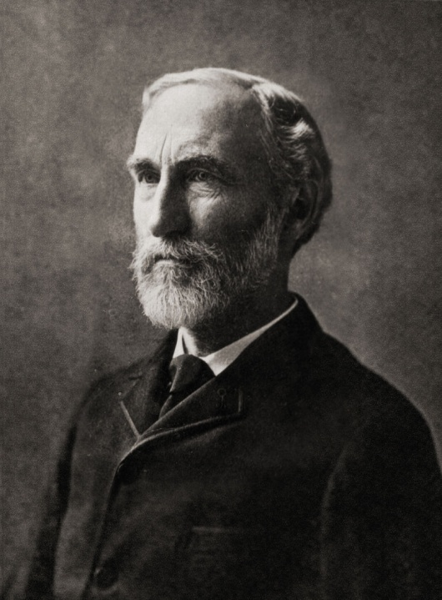
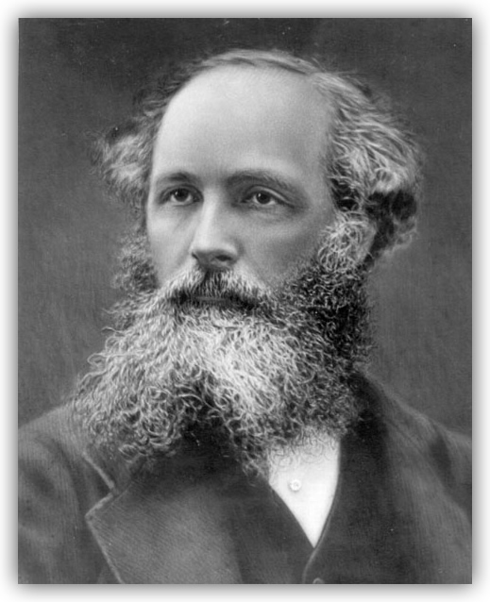
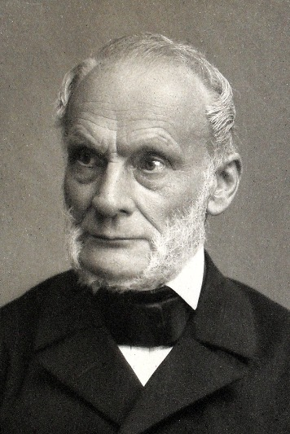
Early Econophysicists?
Rudolf Clausius Josiah Gibbs James Maxwell
(1822-1888) (1839-1903) (1831-1879)

Slide 10
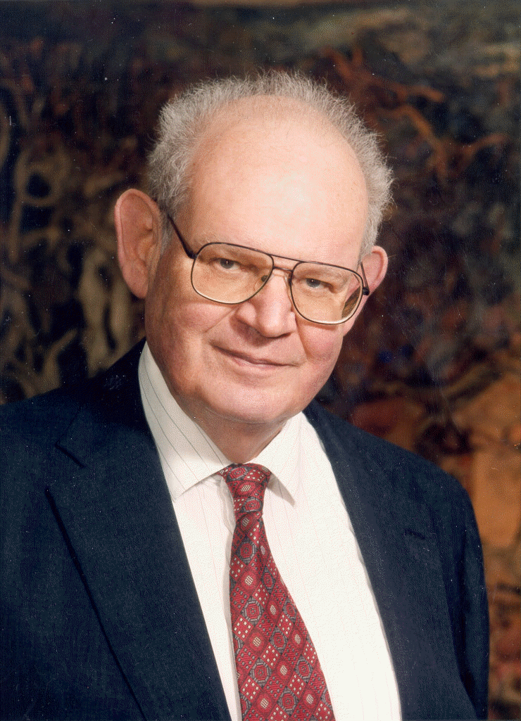

Modern Econophysicists?
Benoit Mandelbrot Maurice Allais
(1924-2010) (1911-2010)
(many contributions prior to mid-1990’s ) Economist with physics training

Slide 11
Ludwig E. Boltzmann (1844-1906)
Founding father of Second Scientific Revolution and intellectual giant in the kinetic theory of gases
Important influence on Einstein (Brownian motion) and Planck (theory of black matter)
First to demonstrate that time irreversible processes explain second law of thermodynamics
Originator of the ‘ergodicity hypothesis’

Slide 12
Origins of Ergodicity
  The etymology for “ergodic” begins with an 1884 paper by Boltzmann
  The ergodic property was initially associated with the kinetic theory of gases where the unobservable properties of the velocity of gas molecules can be ‘macroscopically’ measured, esp. using temperature
    Other macroscopic measures include density, pressure, viscous stresses and heat flow.
  The ergodic hypothesis maintains that a dynamical system samples all points in the dynamical space
    ‘Dynamical space’ is referred to as the ‘phase space’ in modern terminology
  Ergodicity is a long run property

Slide 13
Ergodicity and Financial Economics
For Economics, ‘Ergodicity’ is the property that permits a single ex post time series sample path to be used to estimate the parameters for the distribution of the ex ante ensemble of future time paths
  In the limit for time, an ergodic process will possess a steady state distribution that is independent of initial conditions.
  Ergodic processes can have non-linearity in the mean providing a wider class of theoretical processes for modeling economic variables than the reversible stationary unimodal processes which are conventional in econometric work
  Stationary processes are also ‘reversible’, only the distance between observations matter, not where in the process the observation occurs (no impact from initial conditions)

Slide 14
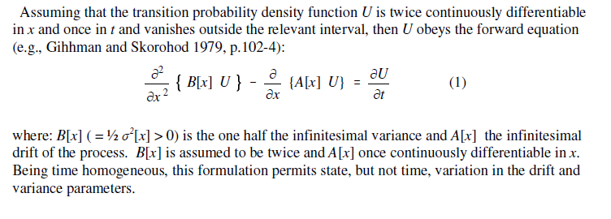
Ergodicity and Sturm-Liouville Theory
The modern formulation of the ergodic hypothesis can be formulated using Sturm-Liouville theory to solve the transition density from the forward equation for the problem
  Nolte (2010) attributes the origins of S-L theory and the notion of phase space to Boltzmann

Slide 15
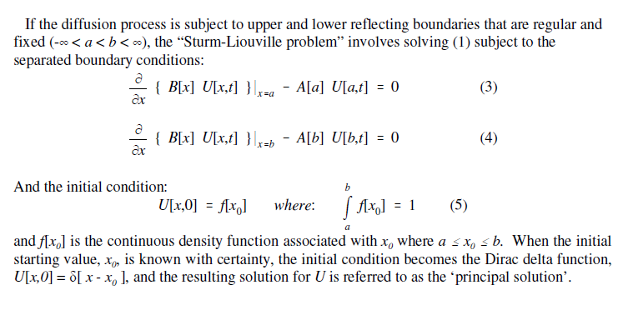
Initial and Boundary Conditions
A PDE is not properly formulated until the boundary and initial conditions are stated
  Reflecting barriers act like the walls of a cylinder

Slide 16
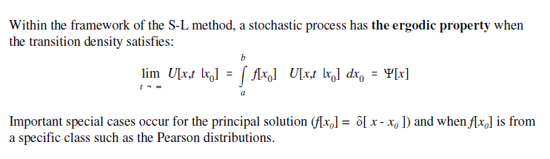
The Ergodic Property
Boltzmann was concerned with demonstrating the dynamic properties of the Maxwell distribution → that the distribution would emerge whatever the initial condition of the system

Slide 17
Irreversibility, Entropy and Cosmology
“Heat can never pass from a colder to a warmer body without some other change occurring at the same time” (Claussius)
For Boltzmann, time was irreversible, i.e., could only move in one direction
  Coffee cup example
  This observation was a direct result of the second law of thermodynamics, the universal law of increasing entropy – a measure of the randomness of molecular motion and the loss of energy to do work.
    First recognized in the early 19th century, the second law maintains that the entropy of an isolated system, not in equilibrium, will necessarily tend to increase over time. Entropy approaches a maximum value at thermal equilibrium.
The second law is of central importance to the ‘big bang’ theory in cosmology

Slide 18
Irreversibility and Financial Economics
Reversible processes originate when equilibrium states are compared → irreversibility arises from the presence of initial conditions and the associated path to equilibrium
  Suggests important stochastic differences between properties of static equilibria and the dynamic paths taken to achieve equilibrium from some initial starting point
Unlike Boltzmann where irreversibility is a consequence of the second law, in economics statistical processes are reversible as a consequence of employing stationary distributions to test theories of static equilibrium.
  Irreversibility can be obtained as a consequence of the non-linear dynamics associated with using diffusion processes with non-linear drift terms
    Consider the case of the quartic density examined in the paper

Slide 19
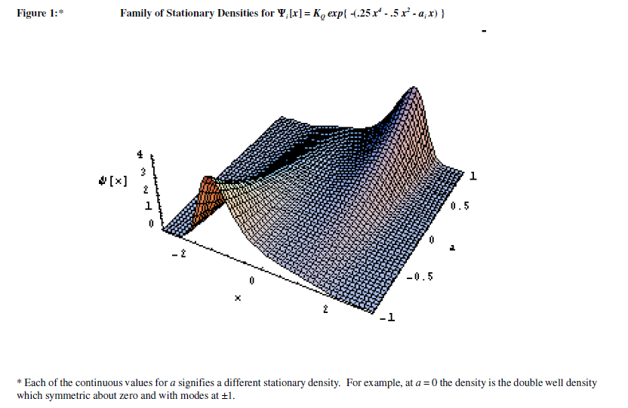
The Quartic Ex Ante Forecasting Distribution

Slide 20
Implications of the Quartic for Financial Economics
Bimodal ex ante forecasting distributions are inconsistent with the use of ‘risk and return’ as measures of security performance
  The use of a single observed ex post sample path will not provide necessarily produce informative estimates
Bimodal ex ante densities requires both modes to be identified leading to the use of ‘range’ estimateswhere the spread between modes is combined with information about distance between modes and location of the modes relative to the current price as risk ‘measures’
  The empirical basis for range estimates could be ‘complex’ or intuitive

Slide 21
Other S-L Implications for Financial Economics
The PDE setting of S-L theory highlights the importance of initial, terminal and boundary conditions
  The initial and boundary conditions relate to recurrence → how long the process takes to return to the ergodic state (recurrence)
  Financial economics pays little attention to the possibly significant implications of ‘initial conditions’, e.g., at what price a security is purchased, on financial decisions
  The quartic illustrates how the non-linear dynamics of the ergodic density can undermine conventional MPT (irreversibility)
    Use of ‘mean reverting’ processes does not avoid the irreversibility problem but can address recurrence

