Slide 1
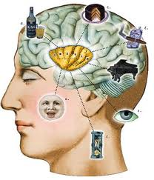

Behavioral Experiments on Biased Voting in Networks
Presented by Qian Zou

Slide 2
Content
The purpose of conducting the experiments.
The methodology for the experiments.
The Experimental Design :
Cohesion Experiments
-- two categories
Minority Power Experiments
Results
Individual Behaviors
Questionnaire
Conclusion

Slide 3
Purposes
To analyze the conflict on individual preferences with the desire for collective unity across that entire voting group.
A group of people come up with the same/one decision
Factors that influence each person’s choice or decision

Slide 4
Methodology
Utilizes 36 undergrad students from the University of Pennsylvania
Participating in 81 separate experiments
Each experiment lasts 1 minute
- 36 subjects each control a node (red or blue)
- able to update as often as desired during 1 minute
- can only view their immediate neighbors choices
- no global information on the current state of the
network
- each subject is given a financial incentive that varies
across the network
No payment if no global unanimity.

Slide 5
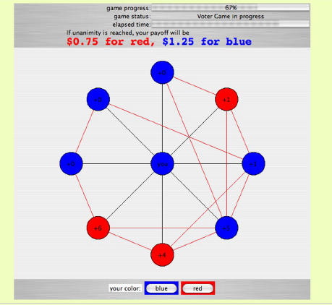

Slide 6
Experimental Design—Cohesion experiments
Conducted 54 times, each equally split the 36 subjects into 2 groups for each preferred color.
Subjects in blue group were given more incentives paying more for a blue global consensus, and vise versa.
18
18

Slide 7
Cohesion Con’t
Experiments Varied in:
a) the relative strengths of the incentives
b)the connectivity within and between the two groups
random or Erdos-Renyi process
--two process
preferential attachment process
Do you have more friends within the group or with the other group
Put people prefer the same color into the same group.

Slide 8
Purpose of Cohesion experiments
Meant to test individual and collective behaviors based on network diversities and varied interest.
Hypothesis:
--increased inter-group connectivity should
improve the collective performance.
-- the greater the financial incentive, the less likely
that participants would be willing to sacrifice their
higher payoff in order to achieve a group consensus

Slide 9
Experimental Design—Minority Power Experiments
All networks were generated with preferential attachment
A minority of the nodes with the highest degree were assigned incentives preferring red global consensus to blue, whereas the remaining majority were assigned incentives preferring blue global consensus.
The size of the chosen minority was varied(6, 9 or 14), as were the relative strengths of preferences.

Slide 10
Purpose of Minority Power experiments
Systematically investigated the influence that a small but well-connected set of individuals could have on collective decision-making
In particular, to investigate whether such a group could reliably cause their preferred outcome to hold globally and unanimously.

Slide 11
Other Incentive Structures
For each of the different network structures, the researchers also ran other incentive structures:
a) Symmetric: incentives of those players preferring
blue and those preferring red were
symmetrically opposed.
Weak Symmetric:
$0.75 /$1.25 for consensus to red /blue.
Strong Symmetric:
$1.5/$0.5 for consensus to red/blue

Slide 12
Other Incentive Structures Con’t
b) Asymmetric:
- the group preferring one color would be give
strong incentives
- groups preferring the other color would be given
weak incentives
$2 for blue
$0.75 for red
$1.25 for red
$0.75 for blue

Slide 13
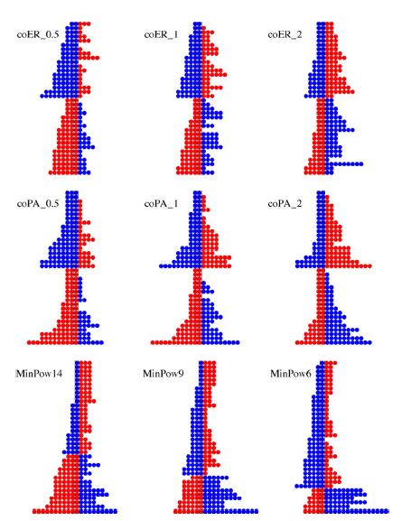
Diagram:

Slide 14
Results
Cohesion VS Minority Power:
--only 31/54 Cohesion Experiments reached consensus
--24/27 of Minority Experiments reached consensus
not only can an influentially positioned minority group
reliably override the majority preference, but that such a
group can in fact facilitate global unity
Preferential Attachment VS Erdos-Renyi:
--44/54 preferential attachment experiments
succeed, compared to only 11/27 Erdos-Renyi
experiments that have succeed
for this class of consensus problems, preferential attachment
connectivity may generally be easier for subjects than Erdos-Renyi
connectivity.

Slide 15
Results Con’t
Symmetric VS Asymmetric :
--22/27 of asymmetric structure reached consensus
--31/54 of symmetric structure reached consensus
most beneficial to have extremists present in a relatively indifferent population, and most harmful to have 2 opposing extremist groups
Other observations:
--In terms of the rate of approaching consensus
1) Cohesion with Erdos-Renyi tend to both begin
and end slowly; those with preferential attachment
connectivity begin slowly but end more rapidly
2) Minority Power dynamics ended relatively fast, but early
speed was heavily influenced by the size of their minorities.

Slide 16
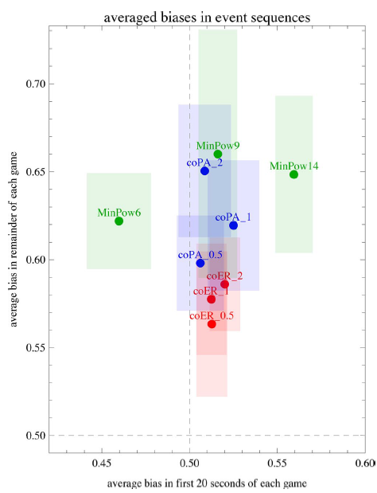

Slide 17
Individual Behaviors
To see how people make choices and how they are influenced by networks.
Use wealth as a measure of individual subject behaviors:
-- ranged from $46.5 to $58.75 in total earnings
with a mean of $52.76.
However, this finding in no way precludes the possibility that subjects still display distinct “personalities”, nor that these differences might strongly correlate with final wealth.

Slide 18
Example—Individual Stubbornness
Amount of time a subject is playing their preferred color, but is the minority color in their neighborhood
Stubbornness has 2 effect:
1) improve the chances of swaying the population
towards ones preferred color
2) risk preventing global consensus being reached in
time
However, no subject was infinitely stubborn, most of them were willing to change their preferred color in order to achieve a consensus. The wealthiest player had their preferred color 28/55 successful games, but change their vote and accepted the lower payoff 27 times. (Others:40/55)

Slide 19
Questionnaire
Questions were asked to understand why participants acted how they did in given situations and to understand their motivations.
24 participants stated that they always choose their preferred color initially because it offered higher payoff.
27 of them also stated that they saw participants trying to communicate with others in order to achieve a consensus.
Etc.

Slide 20
Conclusion
The researchers do propose that their study is only a beginning into how individual behavior is affected by the collective’s desire for uniformity. Future research should focus on the role of extremists and how their influence is carried over to the rest of the population, especially with varying network structures. It would also be interesting to test whether other individual traits beyond stubbornness are a factor in group cohesion.

