Slide 1

Public Goods In Networks
Ryan Dewar

Slide 2
What is a public good
Public goods have two distinct aspects:
  Non-excludable: The cost of keeping nonpayers from enjoying the benefits of the good or service is prohibitive.
  Non-rivalrous: Consumed by one consumer without preventing simultaneous consumption by others

Slide 3
Intro
Purpose of the Paper
  Examine the incentives to provide goods that are non-excludable along social geographic links
Importance of the study
  Information spread is often local and thus can depend on social networks and the geography of industry and trade

Slide 4
Intro
The Problem with Public Goods
  People desire a good which is costly to produce. This good is non-excludable among linked individuals. Individuals decide how much to contribute to this good, knowing the good is non-excludable.

Slide 5
Intro
3 Main Insights
    Networks can lead to Specialization
    Specialization can have welfare benefits
    New Links can reduce overall welfare

Slide 6
Intro
Equilibrium Outcome
  Agents who specialize cannot be linked to each other in equilibrium. Hence, they constitute an independent set.
  We show that equilibrium where some agents contribute and others free ride always exist and correspond to this structural property of a graph.
  Moreover these equilibrium are stable

Slide 7
The Model
n agents, and the set of agents is N={1,…,n}
Let ei ∈ [0,+∞) denote agent i’s level of effort.
MC is constant and equal to c
Let e = (e1, . . . , en) denote an effort profile of all agents.
Agents are arranged in a network, which we represent as a graph g, where gij = 1 if agent j benefits directly from the results of agent i’s effort, and gij =0 otherwise.

Slide 8
The Model
We assume that results flow both ways so that gij = gji. Since agent i knows the results of his own effort, we set gii = 1.
Let Ni denote the set of agents that benefit directly from agent i’s efforts, called i’s neighbors: Ni = {j ∈ N\i : gij = 1}. Let ki = |Ni|
  denote the number of agent i’s neighbors.
Agent i’s neighborhood is defined as himself and his set of neighbors; i.e., i ∪ Ni .

Slide 9
The Model
Assumptions
  An agents effort is a substitute of the efforts of her neighbors, but not of individuals further away in the graph
  A neighbors efforts is a perfect substitute with ones own. Agent I derives benefits from the total of his own and his neighbors efforts

Slide 10

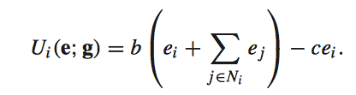
The Model
Benefit Function
  b(e)=0 when b(0) = 0
  b’ > 0 and b’’ <0
  Agent i’s payoff from profile e in graph g is then

Slide 11


Equilibrium Contributions
b’(e*)=c
e* is the optimal effort level
is the total effort level of agent i’s neighbors
Profile e is a NE if and only if agent i either:

Slide 12
Equilibrium Contribution
Agents want to exert effort as long as their total benefit are less than b(e*)
If they are less they exert effort up to the point where their benefit equal b(e*)
The more effort an agent’s neighbors exert, the less an agent exerts himself

Slide 13
Equilibrium Contribution
We say a profile e is Specialized when every agent either exerts the maximum amount of effort e* or exerts no effort so either ei=0 or ei=e*
  Agents who exert e* are specialists
We say a profile e is Distributed when every agent exerts some effort 0 < ei <e*

Slide 14
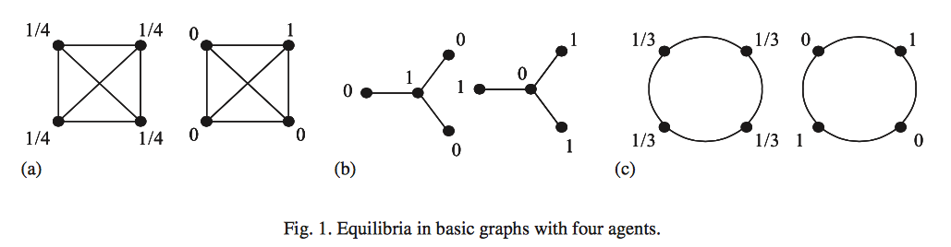
Equilibrium Contribution

Slide 15
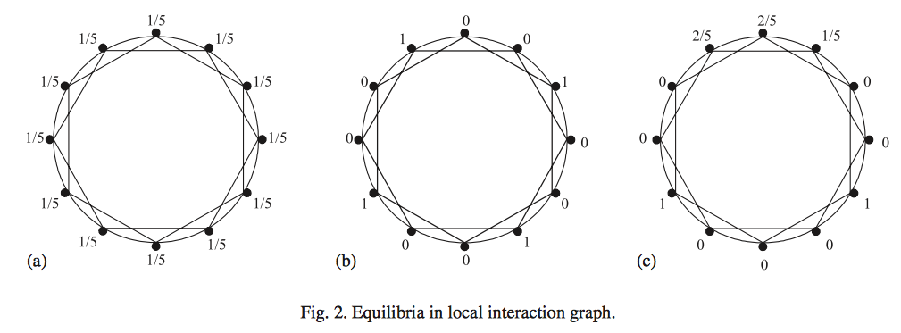
Equilibrium Contribution
In any equilibrium there must be at least an aggregate
effort of e* in the agents neighborhood

Slide 16
NE Specialized Profiles
Maximal Independent Sets
  An independent set I of a graph g is a set of agents that no two agents who belong to I are linked
  An independent set is maximal when it is not a proper subset of any other independent set

Slide 17
NE Specialized Profiles
Given a maximal independent set I, every agent either belongs to I or is connected to an agent who belongs to I.
From this we can divide the population into two disjoint sets of agents:
  Those who belong to maximal independent set I, and
  Those who are linked to an agent in I

Slide 18
Equilibrium Contribution
A specialized profile is a NE if and only if its set of specialists is a maximal independent set of the structure g
Since for every g there exists a maximal independent set, there always exists a specialized NE

Slide 19
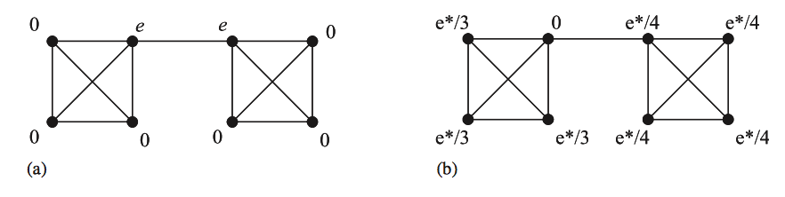
Equilibrium is Not Always Efficient

Slide 20
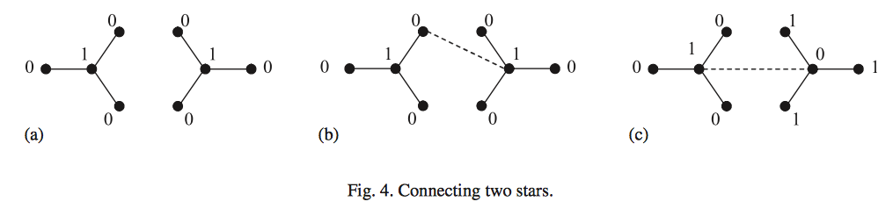
Positive / Negative effects of New Links

Slide 21
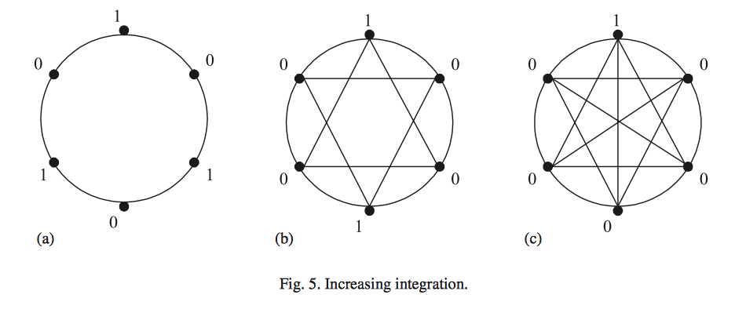
Positive / Negative effects of New Links

Slide 22
Conclusion
Our analysis suggests that individuals who have active social neighbors should have high benefits but exert little effort. We also expect individuals who have prominent social positions to bear less of the effort costs, and instead to rely on others’ efforts.

