Slide 1
Tie Strength, Embeddedness & Social Influence: Evidence from a Large Scale Networked Experiment
Sinan Aral , Dylan Walker
Presented by: Mengqi Qiu(Mendy)
301159832
March 16th

Slide 2
Introduction
Definitions and measurements of Tie Strength, Embeddedness & Social Influence;
Confounding factor of empirical research;
Model specification and data;
Result

Slide 3
Before beginning
If you are a consumer and deciding whether to buy a clothes, what will influence your decision?
If you are a marketing person of a new clothing brand, what will you do?

Slide 4
The prime question in understanding the role of social influence in the diffusion of new products, ideals, behaviors and outcomes is how heterogeneity in the relationships between individuals impacts the level of influence they exert on one another.

Slide 5
Science of social influence
Vital to marketing strategy and public policy.
E.g. estimating product demand and diffusion, creating effective viral marketing, and designing ‘network interventions’ to promote positive social change
This paper focuses on when and under what individual, social and structural conditions influence is stronger or weaker.
It reveals which relationships warrant viral incentives, social interventions, targeting or network-based marketing.

Slide 6
Social influence
An action or actions taken by an individual not actively engaged in selling the product or service that impacts others’ expected utility for that product or service”.
Theoretical dimensions of social influence:
Channel of social influence
Content of social influence
Impact of social influence

Slide 7
Dimensions of social influence
Channel of social influence
The medium through which influence is communicated or transmitted.
  The number of senders and recipients involved.
  One-to-one, one-to-many, many-to-many, many-to-one.
  How the recipients are selected, the credibility of the channel, and whether the channel is mediated by a third party .

Slide 8
Dimensions of social influence(cont.)
Content of social influence
The information that is transmitted over the channel.
  Subjectivity (fact vs. opinion) and whether the content is personalized to the intended recipients.
  For example:
    Individual decisions or outcomes relating to product features or product adoption
    Factual information about product features
    Subjective opinions about the product as in the case of peer recommendations or customer reviews .

Slide 9
Dimensions of social influence(cont.)
The impact of social influence
The overall effect social influence may have on the actions of others.
  Causal effect of an individual on their peers’ behavior.
  How the behaviors of one’s peers change the likelihood that (or extent to which) one engages in a behavior.

Slide 10
Embeddedness
The number of common friends shared by individuals and their peers.
Increases the level of trust
Engenders greater cooperation
Create opportunities for greater knowledge transfer between individuals and more fine-grained information flows.
We expect embedded relationships to convey greater influence.

Slide 11
Tie Strength
The significance or intensity of the relationships between individuals.
We expect greater social affiliation and interaction is predictive of greater influence conducted between friends.

Slide 12
Strength of Ties
The social context of the relationship - how individuals met, know one another or interact with each other
e.g. whether peers attended the same college, come from the same hometown, or share common institutional affiliations
The recency of the relationship
e.g. whether peers currently live in the same town
The overlap of common interests
e.g. being fans of the same Facebook pages, joining the same Facebook groups
The frequency of the interaction
e.g. co-presence in photos online

Slide 13
Confounding factor
Endogeneity and spurious correlation:
Inferring the impact of tie strength and social embeddedness on influence is difficult because influence-mediating communications are inherently endogenous.
In real-world networks, social embeddedness and tie strength are often correlated with each other and with homophily.
It is hard to explicitly control selection biases in communication patterns.
Solution:
Controlling the channel of influence (through randomized recipient selection) and holding message content constant .

Slide 14
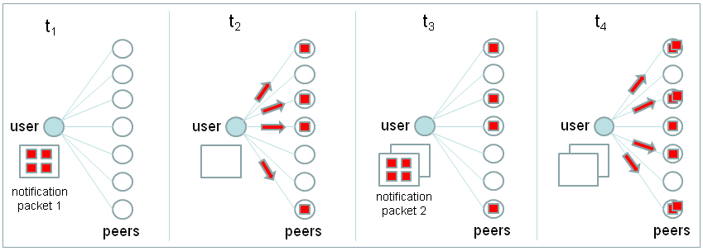
Empirical Methods
A diagram depicting the message target randomization employed in the experiment. Notification packets are generated when an application user takes a packet-generating action within the Facebook application. For each packet that is generated, the notifications in the packet are distributed to a randomly selected subset of the application user’s peers. Above displays two sequential packet distributions. Different recipient targets are randomly chosen at the time of distribution for each packet.

Slide 15
Data
44-day experimental period;
Collected individual level profile data from 7,730 application users and their 1.3M distinct peers;
41,686 automated notifications were delivered;
967 peer adoptions;
Collected user data included the social network of adopters and all mutual ties between their peers;
Individual level profile data included age, gender, relationship status, hometown, current town, college attendance, affiliations, Facebook pages, Facebook group membership, and tagged appearance in photos

Slide 16

Model
λj: the hazard for a peer j of a user i to adopt;
Nj(t): number of notifications received by a peer j;
Embedij: embeddedness of the relationship between user i and peer j;
SoTij: vector of the tie strength attributes characterizing the relationship between individual i and peer j.

Slide 17
Effects of social embeddedness and tie strength on influence
Tie measures that capture peers’ joint participation in common social or institutional contexts between individuals and their Facebook friends are associated with greater influence.
  Friends attending same college are more influential to friends attending different colleges.
  Coming from the same hometown is not significantly associated with influence
Tie strength measures associated with current or recent social contexts exhibit differing impacts on influence.
  Living in the same current town exhibits more influence.
  appearing in photos with peers, an indicator of offline interaction at significant events, is not significantly associated with influence.

Slide 18
Effects of social embeddedness and tie strength on influence(cont.)
Tie strength measures associated with common interests or preferences do not moderate influence.
  Individuals are no more or less influential on peers with whom they share common Facebook pages or are co-members of online groups.
Individuals are more influential on peers with whom they are more embedded.
  exhibiting a 0.6% increase in influence for each friend they share in common

Slide 19
Social Embeddedness and Tie Strength as Predictors of Spontaneous Adoption
Current friends influence us more, but that our preference-driven behaviors are more correlated with past, non-recent social contexts.
  we are more influenced by friends in the same current town; but our preferences are more correlated with friends from the same hometown and with friends that currently do not live in the same town.
Declared preferences and interests (not directly related to the product) capture preferences for the product.
Online social activities capture latent dimensions of preference for the product.

