Slide 1

Making a Crankshaft in SolidWorks
IAT 106
AMT Project
Click the “speaker” icons to hear audio annotation:

Slide 2
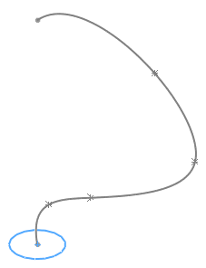
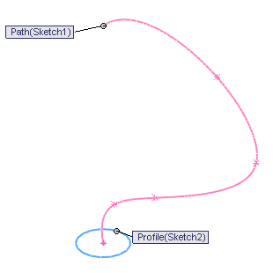
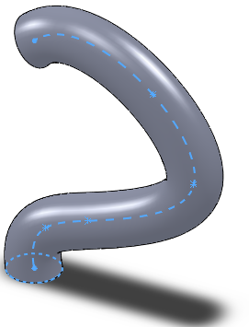
Sweep
Sweep feature – create by:
  Move 2D profile sketch (must be closed)
  along a path (defined in another sketch).

Slide 3
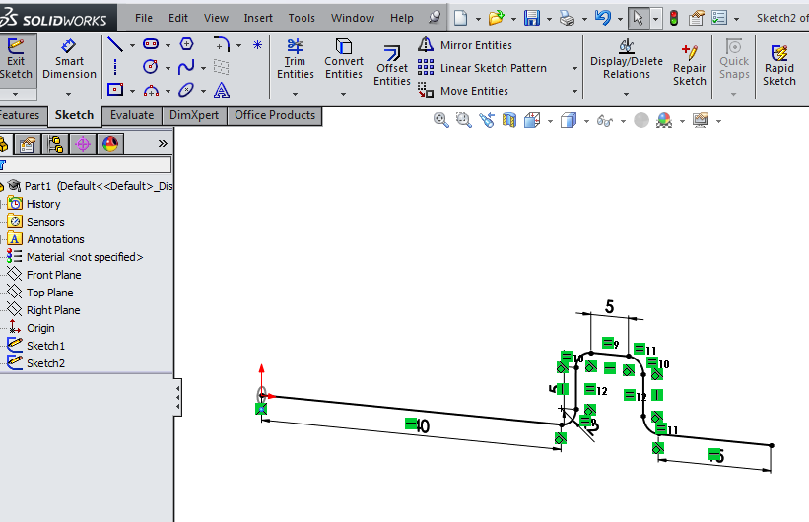
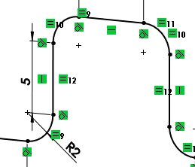
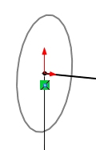
CrankShaft Profile & Path Sketches

Slide 4
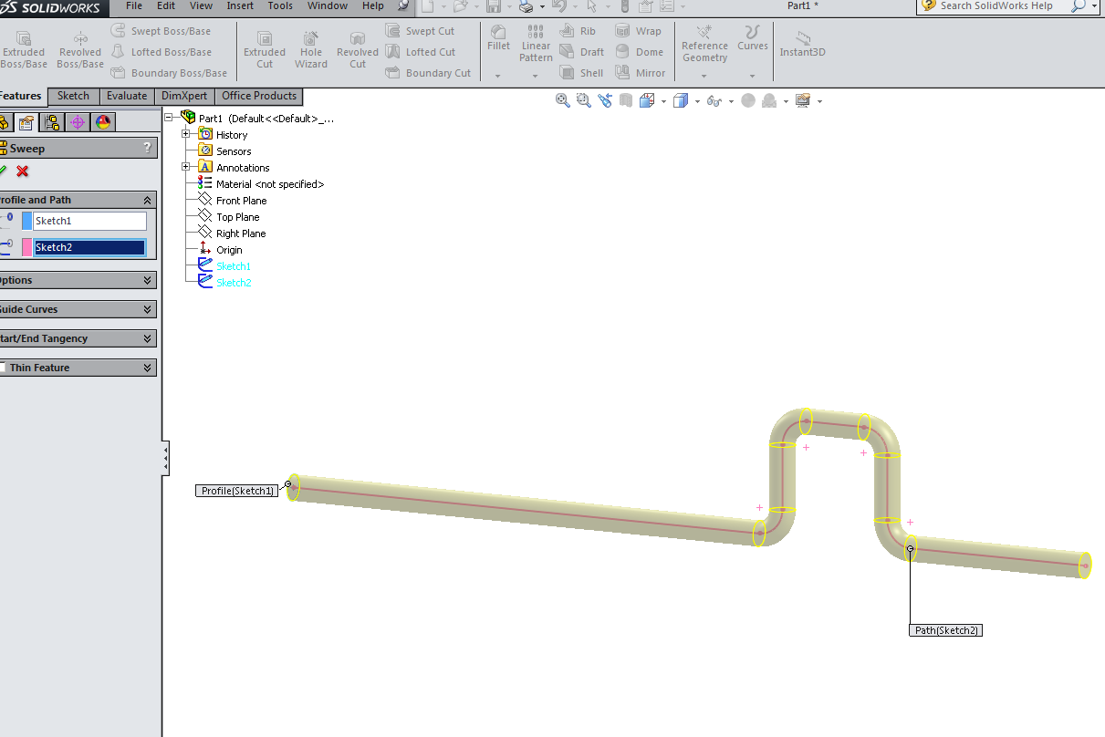
Sweep Property Manager & preview

Slide 5
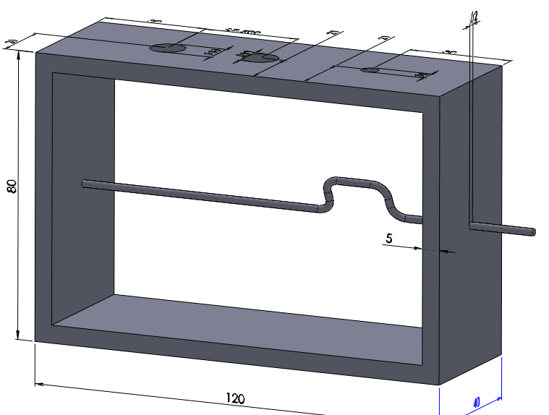
Crank inserted into assembly

Slide 6
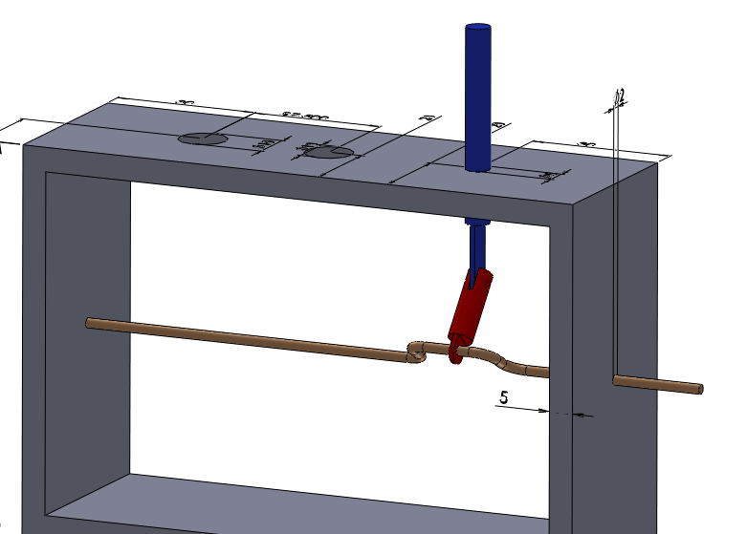
Conrod and Slider added

