Slide 1
AI and Chess
CMPT 310

Slide 2
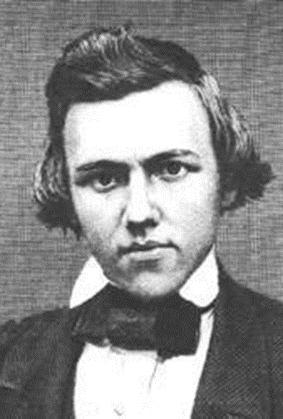
Introduction
In Western culture, chess is a special game that has been played for 100s of years
To be good at chess is to be intelligent and sophisticated
Great chess players are considered geniuses
So, surely, if a “machine” could play chess well, then it too would have to be intelligent …
Paul Morphy 1837- 1884

Slide 3
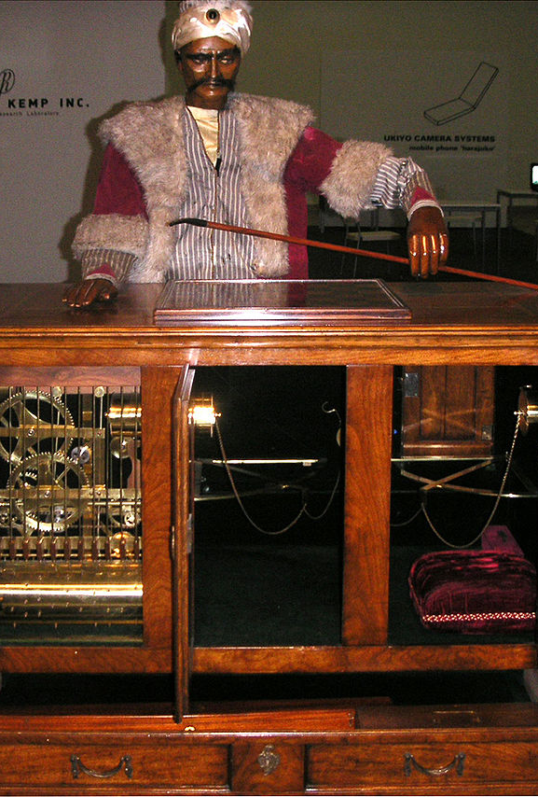
The Turk (1770 – 1854)
From about 1770 to 1854 (when it was destroyed in a fire), you could play chess against The Turk
It appeared to be an automaton, i.e. a machine that played chess on its own
And it could play pretty well
But it was a hoax!
A small human chess player hid inside the compartment on the right and made all the moves

Slide 4
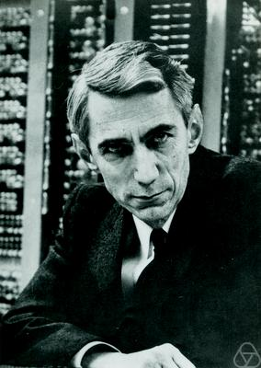
Claude Shannon (1949/50)
Best known as “the father of information theory”
Wrote a famous paper called “Programming a Computer for playing Chess” in 1949
Proposed the basic idea of “position evaluation” and min max search for looking ahead to find the best moves
Later this was refined to alpha-beta search, which does essentially the same thing but more efficiently
In 1950 he published another paper where he estimated that total number of different possible chess positions 10¹²⁰
There are “only” about 10⁸⁰ atoms in the universe
Such a huge number means that pure “brute force” probably can’t be used to play chess well

Slide 5
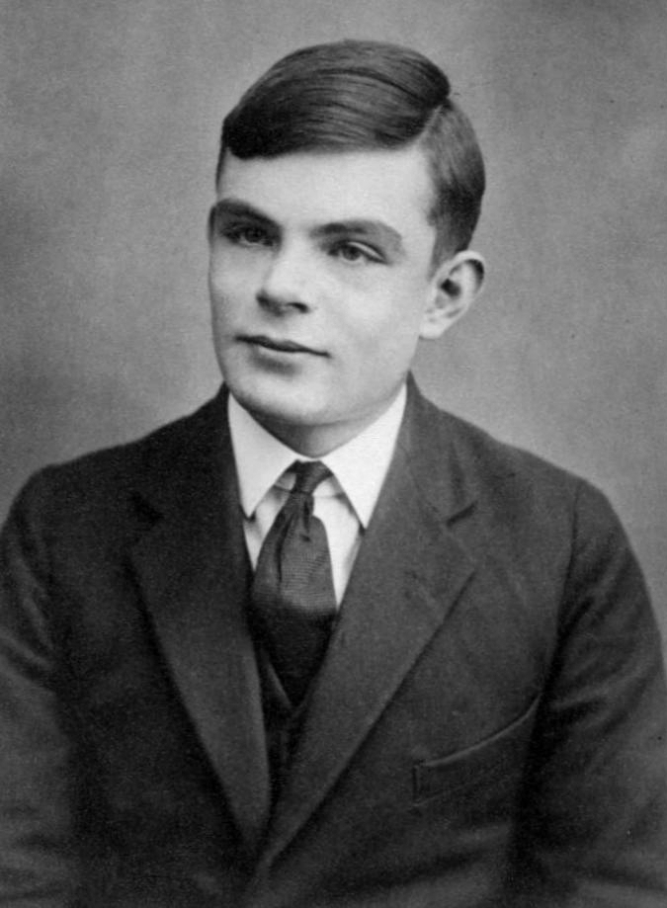
Alan Turing: Turochamp (1948)
Alan Turing is best known for the creation of Turing machines (to help prove that some problems cannot be solved by any computer)
He was also greatly interested in AI, and created the Turing Test
Turochamp was a complete chess-playing program written by Turing and David Champernowne
They didn’t actually get it running on a computer
But it could be run by tracing it by hand, and it could play chess (although not very well)

Slide 6
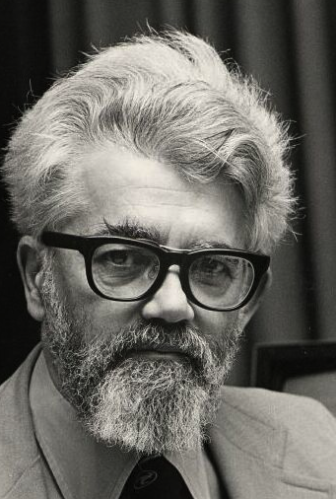
The Kotok-McCarthy Chess Program (1962)
John McCarthy is famous for creating the LISP programming language, and many other contributions to AI
He also coined the term “Artificial Intelligence”
Alan Kotok was an undergrad student who worked with McCarthy to create a chess playing programming
Generally considered to be the strongest chess playing program of the time
Took 5 to 25 minutes to make a move
Played full chess, but not great
Estimated to play about as well as an amateur who had played 100 games

Slide 7
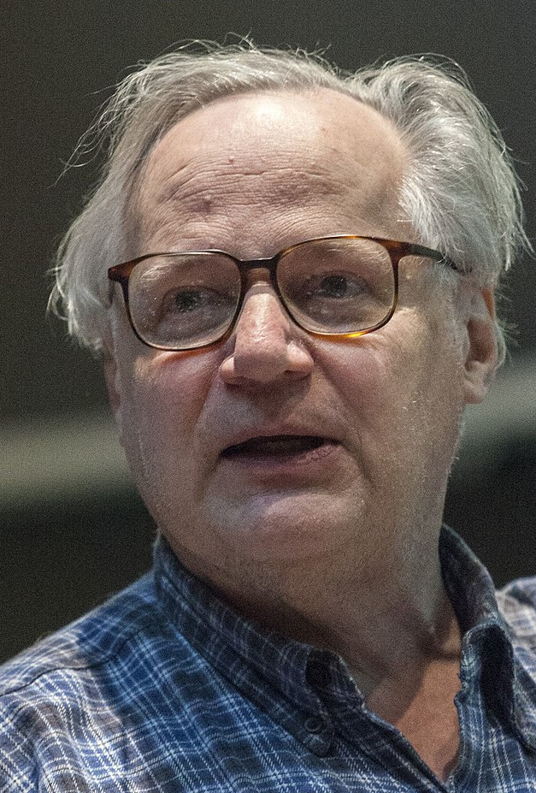
MacHack (1967)
Developed by famed “hacker” Richard Greenblatt
An influential program with a number of new ideas
First program to defeat a human in a tournament
Greenblatt himself was a pretty good amateur player, and hand-coded many chess heuristics into his program
MacHack is also famous for being involved in a famous game of chess against philosopher Hubert Dreyfuss in
Dreyfuss argued that the claims of AI where vastly overblown
The poor quality of chess programs was something he often pointed out
So he played a game against MacHack --- and lost

Slide 8
Computer Chess Grows
By the 1970s, there were enough computer chess programs that tournaments started to be held
1970: the first North American Computer Chess Tournament was held
6 participants
Won by a program called Chess 3.0
Successors of Chess 3.0 dominated this tournament in the its first decade (only lost the championship twice in the 1970s!)
1974: the first world computer chess championships
Won by the Russian program Kaisa
1977: first consumer chess programs that ordinary people could buy

Slide 9
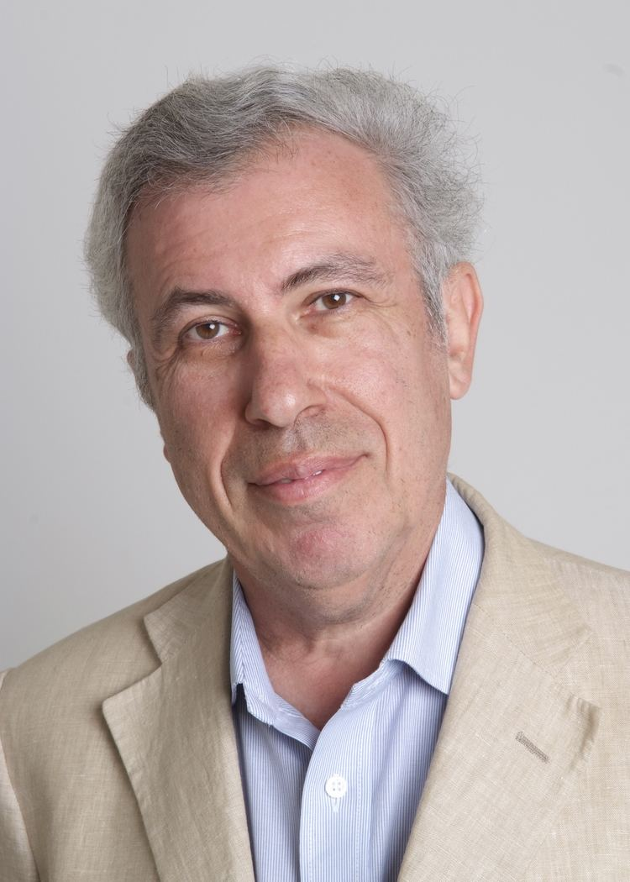
The Levy-McCarthy Bet (1969)
In 1969, chess master David Levy made a bet of $1000 with John McCarthy that Levy could defeat any chess playing program in the next 10 years
Levy won the bet --- in 1979 he defeated the best chess programs of the day
Levy extended his bet and offered $1000 to the first chess program that could beat him
He finally lost that bet to …

Slide 10
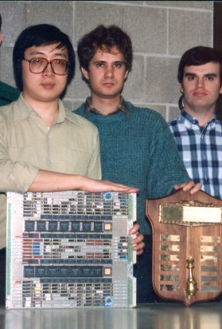
Deep Thought (1989)
Feng-hsiung Hsu developed a special purpose chess chip that was used to create the chess playing machine Deep Thought
First computer to beat chess master David Levy
First machine to beat a grandmaster in a tournament
Lost a 2-game match to then chess world champion Garry Kasparov
Deep Thought could search about 500 million positions per second
Enough to look ahead 10-11 moves completely
Although it also used so-called “extension searches” where it could sometimes look ahead many more moves
E.g. once found checkmate in 35 moves

Slide 11
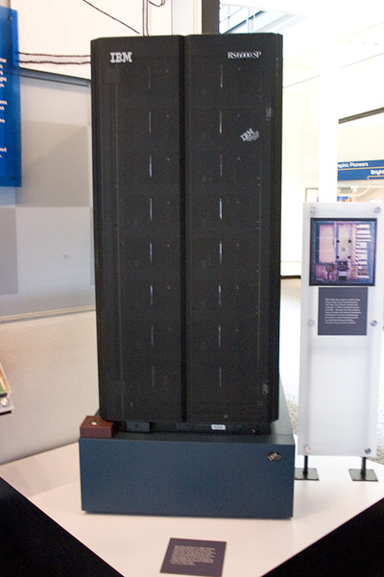
Deep Blue (1997)
The Deep Thought team moved to IBM, and renamed their project Deep Blue
IBM’s nickname is Big Blue
1996: world chess champion Garry Kasparov played a 6-game match against Deep Blue
Deep Blue won the 2nd game --- the first time a reigning human chess champion has ever lost a game to a computer in a match
Kasparov won the match overall, 4-2
1997: Kasparov and Deep Blue played a 6-game rematch
This time Deep Blue won the match 3.5 – 2.5
This was a major media event, and generally seen as marking the turning point when computers became better at chess than the best humans
Nowadays, a chess program running on your laptop could easily defeat Deep Blue (or the human world champion)

Slide 12
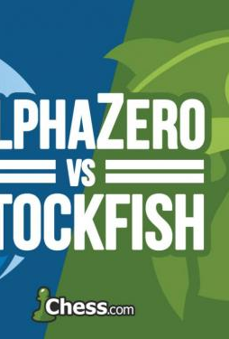
AlphaZero (2017)
AlphaZero is generally considered to be the next major breakthrough in computer chess
Previous elite-class programs used highly tuned and carefully crafted versions of alpha-beta search
But AlphaZero is different
It used reinforcement learning to play chess games against itself
It was given just the rules of chess, and no other knowledge
In a few hours of self-play (admittedly on high-performance hardware!), AlphaZero learned to play chess about as well as the best programs of the day
In 2019, a 1000-game match against the world champion calibre chess program StockFish, AlphaZero
Won 155 games
Lost 6 games
Drew 839 games

Slide 13
AlphaZero
Radically different approach to chess than previous best programs
Learned all its chess knowledge through self play
Stored as a neural network
Didn’t use alpha-beta search
instead, it uses a different technique called Monte-Carlo Tree search (MCTS)
the basic idea of MCTS is to pick random successor states, and keep going until the game is played out
this is repeated thousands (or more) times
the move that is actually selected is the one that leads to the most wins
AlphaZero uses a modified version of this: it uses its learned knowledge to decide what move to make when simulating the games
StockFish: searches about 60 million positions per second
AlphaZero: searches about 60,000 positions per second

Slide 14
AlphaZero
Another remarkable fact about AlphaZero is that it is not specific to chess
The AlphaZero algorithm was also used to create (probably) the best Go and Shogi programs
Alpha-beta search programs don’t play Go well because the branching factor of Go is so much bigger than chess
This dramatic success of AlphaZero has sparked the imagination of many people: if a computer can learn more about chess in ten hours than humans have learned in centuries, how long before computers start to similarly out-perform humans in other disciplines?
It is important to keep in mind that the AlphaZero approach does not work well with all games, and there are still many hard problems that remain unsolved

