Slide 1
Some Important Programming Languages
CMPT 383

Slide 2
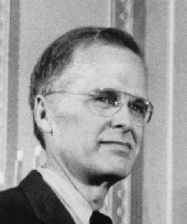
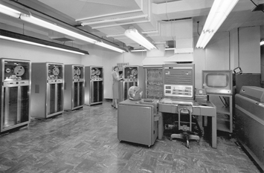
Fortran (1957)
Fortran = Formula Translator
Design by John Backus et al from IBM
Designed to be easier to use than machine language
1st version for the IBM 704
Extremely popular with scientists and engineers
Still in use today

Slide 3
C AREA OF A TRIANGLE WITH A STANDARD SQUARE ROOT FUNCTION
C INPUT - TAPE READER UNIT 5, INTEGER INPUT
C OUTPUT - LINE PRINTER UNIT 6, REAL OUTPUT
C INPUT ERROR DISPLAY ERROR OUTPUT CODE 1 IN JOB CONTROL LISTING
READ INPUT TAPE 5, 501, IA, IB, IC
501 FORMAT (3I5)
C IA, IB, AND IC MAY NOT BE NEGATIVE OR ZERO
C FURTHERMORE, THE SUM OF TWO SIDES OF A TRIANGLE
C MUST BE GREATER THAN THE THIRD SIDE, SO WE CHECK FOR THAT, TOO
IF (IA) 777, 777, 701
701 IF (IB) 777, 777, 702
702 IF (IC) 777, 777, 703
703 IF (IA+IB-IC) 777, 777, 704
704 IF (IA+IC-IB) 777, 777, 705
705 IF (IB+IC-IA) 777, 777, 799
777 STOP 1
C USING HERON'S FORMULA WE CALCULATE THE
C AREA OF THE TRIANGLE
799 S = FLOATF (IA + IB + IC) / 2.0
AREA = SQRTF( S * (S - FLOATF(IA)) * (S - FLOATF(IB)) *
+ (S - FLOATF(IC)))
WRITE OUTPUT TAPE 6, 601, IA, IB, IC, AREA
601 FORMAT (4H A= ,I5,5H B= ,I5,5H C= ,I5,8H AREA= ,F10.2,
+ 13H SQUARE UNITS)
STOP
END
More Modern Fortran
PROGRAM Fibonacci
IMPLICIT NONE
INTEGER :: FIRST, SECOND, TEMP, IX
FIRST = 0
SECOND = 1
WRITE (*,*) FIRST
WRITE (*,*) SECOND
DO IX = 1, 45, 1
TEMP = FIRST + SECOND
FIRST = SECOND
SECOND = TEMP
WRITE (*,*) TEMP
END DO
END PROGRAM Fibonacci

Slide 4
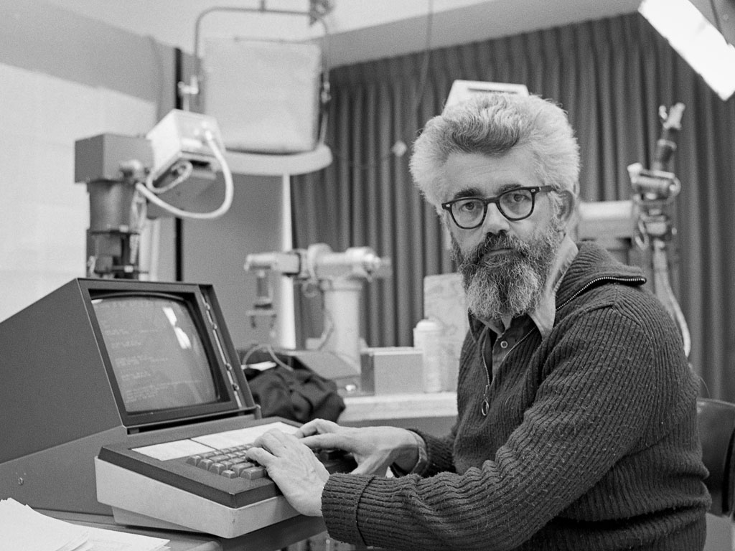
LISP (1958)
LISP = List Processing
Designed by John McCarthy and his students
Designed for symbolic processing (e.g. calculating symbolic derivatives) and AI
Extremely simple core language
Pioneered many programming ideas
Many dialects over the years
(defun factorial (n)
(if (= n 0) 1
(* n (factorial (- n 1)))))

Slide 5
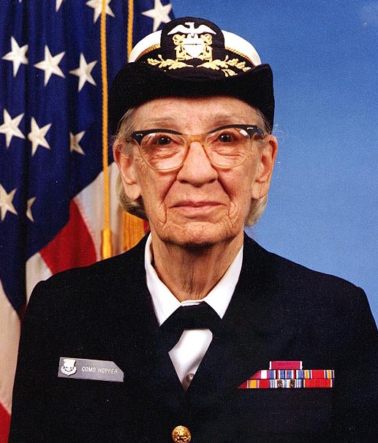
COBOL (1959)
COBOL = Common Business-Oriented Language
Associated with Rear Admiral Grace Hopper, who designed a predecessor called Flow-matic
Specifically for business
Extremely popular

Slide 6
IDENTIFICATION DIVISION.
PROGRAM-ID. "Fibonacci".
ENVIRONMENT DIVISION.
DATA DIVISION.
WORKING-STORAGE SECTION.
01 ix BINARY-C-LONG VALUE 0.
01 first-number BINARY-C-LONG VALUE 0.
01 second-number BINARY-C-LONG VALUE 1.
01 temp-number BINARY-C-LONG VALUE 1.
01 display-number PIC Z(19)9.
PROCEDURE DIVISION.
* This is the start of the program
START-PROGRAM.
MOVE first-number TO display-number.
DISPLAY display-number.
MOVE second-number TO display-number.
DISPLAY display-number.
PERFORM VARYING ix FROM 1 BY 1 UNTIL ix = 90
ADD first-number TO second-number GIVING temp-number
MOVE second-number TO first-number
MOVE temp-number TO second-number
MOVE temp-number TO display-number
DISPLAY display-number
END-PERFORM.
STOP RUN.

Slide 7
Algol Languages (1960s)
Algol 60 Example
Algol = Algorithmic Language
Influential set of languages designed by a group of computer scientists (including Backus and McCarthy)
Pioneered many now-standard language features (and more)
No longer popular in practice, but still very influential
procedure Absmax(a) Size:(n, m) Result:(y) Subscripts:(i, k);
value n, m; array a; integer n, m, i, k; real y;
comment The absolute greatest element of the matrix a, of size n by m is transferred to y, and the subscripts of this element to i and k;
begin
integer p, q;
y := 0; i := k := 1;
for p := 1 step 1 until n do
for q := 1 step 1 until m do
if abs(a[p, q]) > y then
begin y := abs(a[p, q]);
i := p; k := q
end
end Absmax

Slide 8
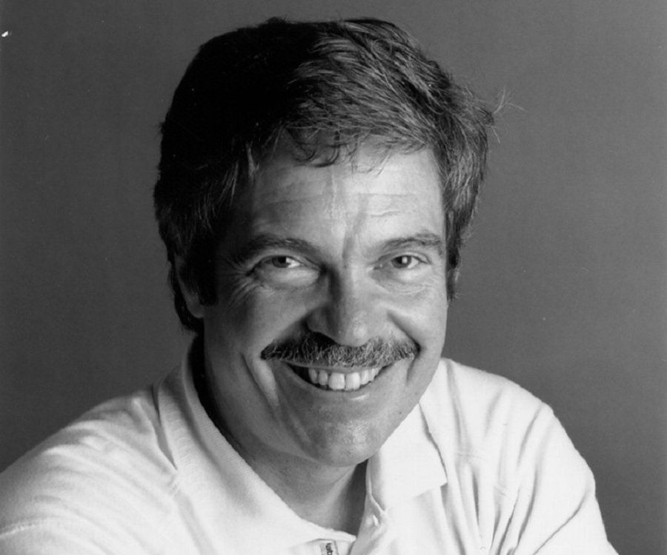
SmallTalk (1970s)
Developed by Alan Kay and his group at Xerox Parc
Helped popularize OOP, especially in North America
Not the first object-oriented programming (OOP) language (that was SIMULA, from the 1960s)
Squeak Code Example
factorial
"Answer the factorial of the receiver."
self = 0 ifTrue: [^ 1].
self > 0 ifTrue: [^ self * (self - 1) factorial].
self error: 'Not valid for negative integers'

Slide 9
Prolog (1972)
Quicksort in Prolog
Prolog = Programming Logic
Declarative, logic-based, constraint-oriented
Developed by Alain Colmerauer (although many others helped develop the underlying ideas)
Certain complex problems have beautifully simple Prolog solutions
Certain easy problems have ugly and complex Prolog solutions
partition([], _, [], []).
partition([X|Xs], Pivot, Smalls, Bigs) :-
( X @< Pivot ->
Smalls = [X|Rest],
partition(Xs, Pivot, Rest, Bigs)
; Bigs = [X|Rest],
partition(Xs, Pivot, Smalls, Rest)
).
quicksort([]) --> [].
quicksort([X|Xs]) -->
{ partition(Xs, X, Smaller, Bigger) },
quicksort(Smaller), [X], quicksort(Bigger).

